Slide 1
Colorado Secretary of State’s Office
Judd Choate, State Election Director
Trevor Timmons, Chief Information Officer
Bipartisan Election Advisory Commission
April 6, 2018

Slide 2
Russia’s 2016 Meddling in U.S. Elections
Two Methods:
Successful Social Media Campaign
Attempted Election Manipulation

Slide 3
Successful Social Media Campaign

Slide 4
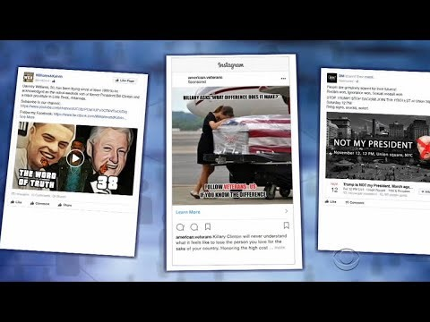

Slide 5
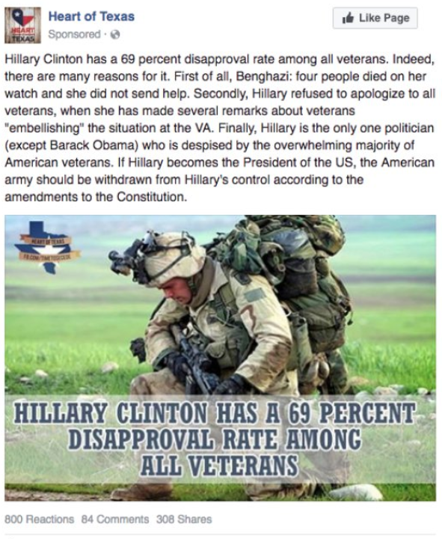

Slide 6


Slide 7
Indictments

Slide 8
Indictment Summary
13 people and two businesses were indicted for various violations of federal law that furthered a conspiracy to illegally influence the 2016 election.
The indictment states that the Russian conspiracy dates back to at least 2014.
The Russian plot was substantial and is ongoing.
US citizens were not co-conspirators. Instead, Americans were “unwitting members, volunteers and supporters of the Trump campaign.”
The Internet Research Agency created millions of impostor social media accounts largely to support Donald Trump and oppose Hillary Clinton.
Charges include violations of campaign finance laws forbidding foreign nationals from making expenditures in US elections.
Russians traveled to U.S. cities (including Denver) in which Russian agents “posed as US persons and and contacted US social and political activists.”
Russians posted on social media and adopted election-related hashtags including “#TrumpTrain” “#Trump2016” “MAGA” and “Hillary4Prison.”

Slide 9
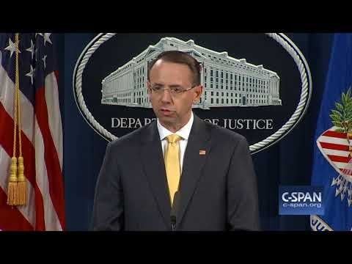

Slide 10
Attempted Election Manipulation

Slide 11
What is Known about Russian Election Attacks?
Attacks on 21 states
Two worrisome states
One intrusion – download of 77,000 voter files
No evidence of:
  File alterations, deletions, or additions
  Voting system targets
  ENR manipulation

Slide 12
21 States Targeted by the Russians
ME
WA
VT
MT
ND
NH
MA
OR
MN
NY
ID
SD
WI
MI
RI
WY
PA
MD
NJ
CT
IA
OH
DE
NE
IL
IN
WV
Washington D.C.
NV
VA
CA
UT
CO
KY
KS
MO
NC
TN
SC
AZ
NM
OK
AR
AL
GA
MS
AK
TX
LA
FL
HI
Notes:
12

Slide 13






Headlines from 22 September 2017
U.S. Tells 21 States That Hackers Targeted Their Voting Systems -
DHS tells states about Russian hacking during 2016 election -
Federal government notifies Illinois, 20 other states of election hacking -
Homeland Security notifies 21 states targeted by Russian election hacking -
Did Russia Hack the 2016 Vote Tally? -
10 Months After Election Day, Feds Tell States More About Russian Hacking -

Slide 15
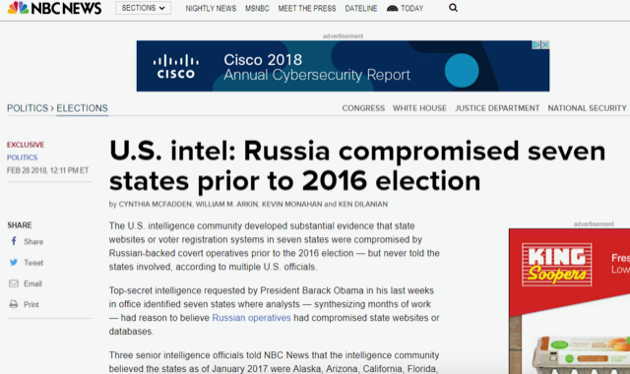

Slide 16
Critical Infrastructure Designation

Slide 17
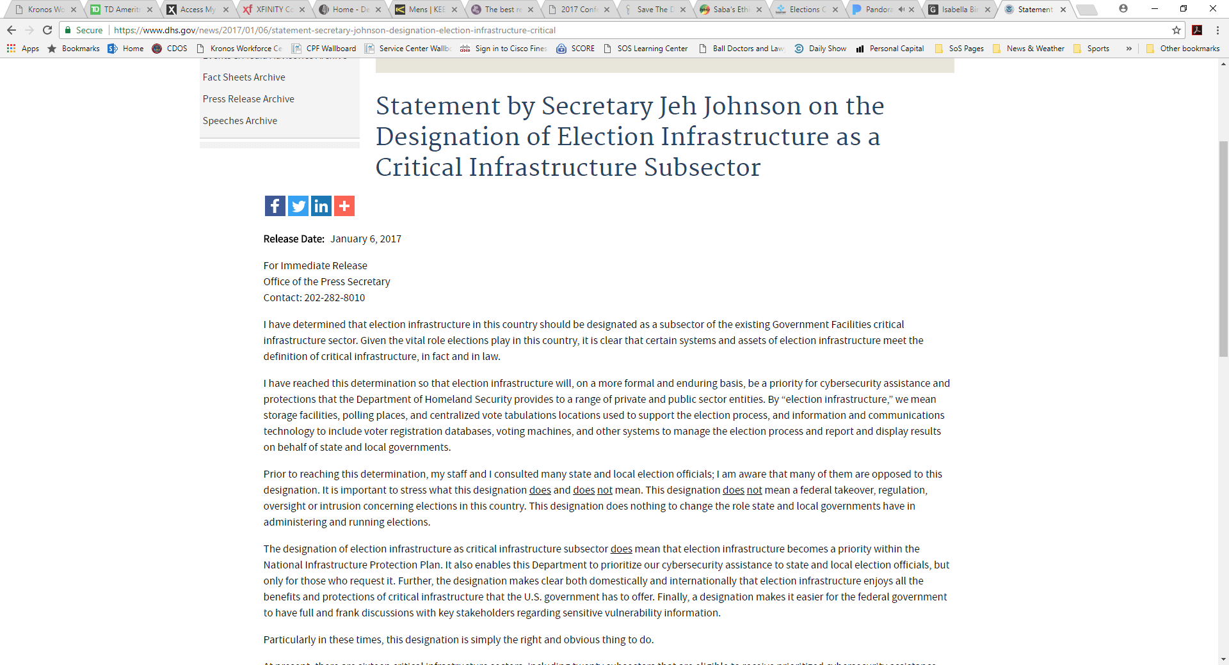

Slide 18
Critical Infrastructure Designation
What is Critical Infrastructure?
How does it work?
What is the state/county/NASS/NASED/EAC role?
What is DHS’s role?
Several conference calls led to the following steps:
a. Create Government Coordinating Council (GCC)
b. Adopt charter
c. Create Sector Coordinating Council (SCC)
d. Adopt a Sector Specific Plan
    e. Adopt a communication protocol

Slide 19
Critical Infrastructure Coordinating Council
Met July 24-25 in Albany, NY
a. Tour MS-ISAC
b. Agreed to consider MS-ISAC as Elections ISAC
c. Determine GCC membership

Slide 20
Governmental Coordinating Council
GCC Composition – 27 people, representing 9 organizations:
a. 8 Secretaries of State/Lt Governors – Determined by NASS
b. 4 State Election Directors – Determined by NASED
c. 6 Local Election Officials – Evenly from iGO/Election Center
d. 2 Board of Advisors – one NASED rep, one other
e. 2 Standards Board – one NASED rep, one other
f. 2 TGDC – one NASED rep, one other
g. 2 EAC – Determined by EAC
h. 1 DHS – Determined by DHS

Slide 21
Critical Infrastructure Executive Committee
Members:
  Tom Hicks (EAC) – EAC Commissioner, Chairman
  Noah Praetz (IGO/EC) – Cook County Election Director
  Connie Lawson (NASS) – Indiana Secretary of State
  Bob Giles (NASED) – New Jersey Election Director
  Bob Kolasky (DHS) – Acting Deputy Under Secretary for the National Protection & Programs Directorate at the Department of Homeland Security

Slide 22
GCC Progress
Critical Infrastructure Plan is in progress – awaiting GCC approval
Sector Coordinating Council has been created
  ExCom - Kathy Rogers, Kay Stimson, Ericka Haas, Brian Finney, and Ben Martin
Creating a Communication Plan – So every elections jurisdiction gets all the information it needs...but…
    Not be inundated with info
    Speak in a common language
    Provide correct information for size and nature of jurisdiction
    Information should go both ways
4. Evaluate MS-ISAC and get “Alberts” installed

Slide 23
Three Takeaways
The Election Assistance Commission has been FANTASTIC
The Department of Homeland Security has been FANTASTIC
The MS-ISAC has been FANTASTIC

Slide 24
(Sorta) New Services

Slide 25


 | National Cybersecurity and Communications Integration Center (NCCIC) | 24/7 cybersecurity operations centers that maintain close coordination among the private sector, government officials, the intelligence community, and law enforcement to provide situational awareness and incident response, as appropriate.
 | MS-ISAC Security Operations Center (SOC)
Contact Information
For access to the full range of DHS cyber resources, contact SLTTCyber@hq.dhs.gov To become an MS-ISAC member, visit https://www.cisecurity.org/ms-isac/

Slide 26


Summary of Services:
Cybersecurity Assessments
Needs | DHS Services | Summary
Identifying and Limiting Vulnerabilities | Cyber Hygiene Scanning | Automated, weekly recurring scans of internet facing systems that provide the perspective of the vulnerabilities and configuration errors that a potential adversary could see
 | Risk and Vulnerability Assessment (RVA) | Penetration testing Social engineering Wireless access discovery Database scanning Operating system scanning
 | Phishing Campaign Assessment | Measures susceptibility to email attack Delivers simulated phishing emails Quantifies click rate metrics over a 10 week period
Cyber Risk and IT Security Program Assessment | Cyber Resilience Review (CRR) | One day, onsite engagement, conducted on an enterprise-wide basis to provide insight on areas of strength and weakness, guidance on increasing organizational cybersecurity posture, preparedness, and ongoing investment strategies.
 | External Dependencies Management Assessment | To access the activities and practices utilized by an organization to manage risk arising from external dependencies that constitute the information and communication technology service supply chain.
 | Cyber Infrastructure Survey (CIS) | Assesses an organization’s implementation and compliance with over 80 cybersecurity controls.

Slide 27
Summary of Services:
Continuous Monitoring
Needs | MS-ISAC Services | Summary
Network Protection | Network Monitoring (Albert) * | Albert service consists of an IDS sensor placed on an organization’s network—typically inside the perimeter firewall monitoring an organization’s Internet connection—that collects network data and sends it to the ISAC for analysis. Based on the ISAC’s vast repository of indicators of compromise, analysts are able to identify malicious activity and alert the effected organization.
Vulnerability Monitoring & Notification | Vulnerability Management Program (VMP) * | The ISAC uses member-provided IP addresses and domains to identify an organization’s vulnerable/out-of-date systems. VMP notifies members on a monthly basis about any outdated software that could pose a threat to assets.
Breach Notification | Victim Notification (in partnership with Public and Private partners) | The ISAC receives notices from trusted partners, both public and private, where the partners share information regarding the potential compromise of an SLTT system. This information is analyzed and passed along to the affected SLTT organization.
* ISAC Services Requiring Fee

Slide 28
Summary of Services:
Incident Response
Needs | MS-ISAC Services | Summary
Exercises & Planning | Participation in National Level Cyber Exercises | The ISAC participates in multiple national level cyber exercises and provides members with a summary of activities, as well as the opportunity to participate in and/or observe the exercise play. The ISAC publishes a monthly tabletop cybersecurity exercise for members to use in their own organization’s risk management program.
 | Tabletop Exercises
Analysis of Malicious Code | Malicious Code Analysis Platform | ISAC members can submit suspicious files for analysis in a controlled and non-public fashion. Suspicious files can be submitted either via a website or programmatically via a direct API. Through this platform, users are able to obtain the analysis results, behavioral characteristics, and additional information that will help explain the nature of any infection and guide incident remediation in a timely manner.
Mitigation and Recovery | Incident Response and Digital Forensics | The ISAC provides incident response and digital forensics analysis services to SLTT members upon request. Depending on the level of data available for review, the forensic analysis can identify the source of the compromise, the activities performed by the attacker while inside the system or network, and if there were any signs of data exfiltration. A full report is provided at the end of each engagement which details the analysis, findings and recommended remediation steps.

Slide 29
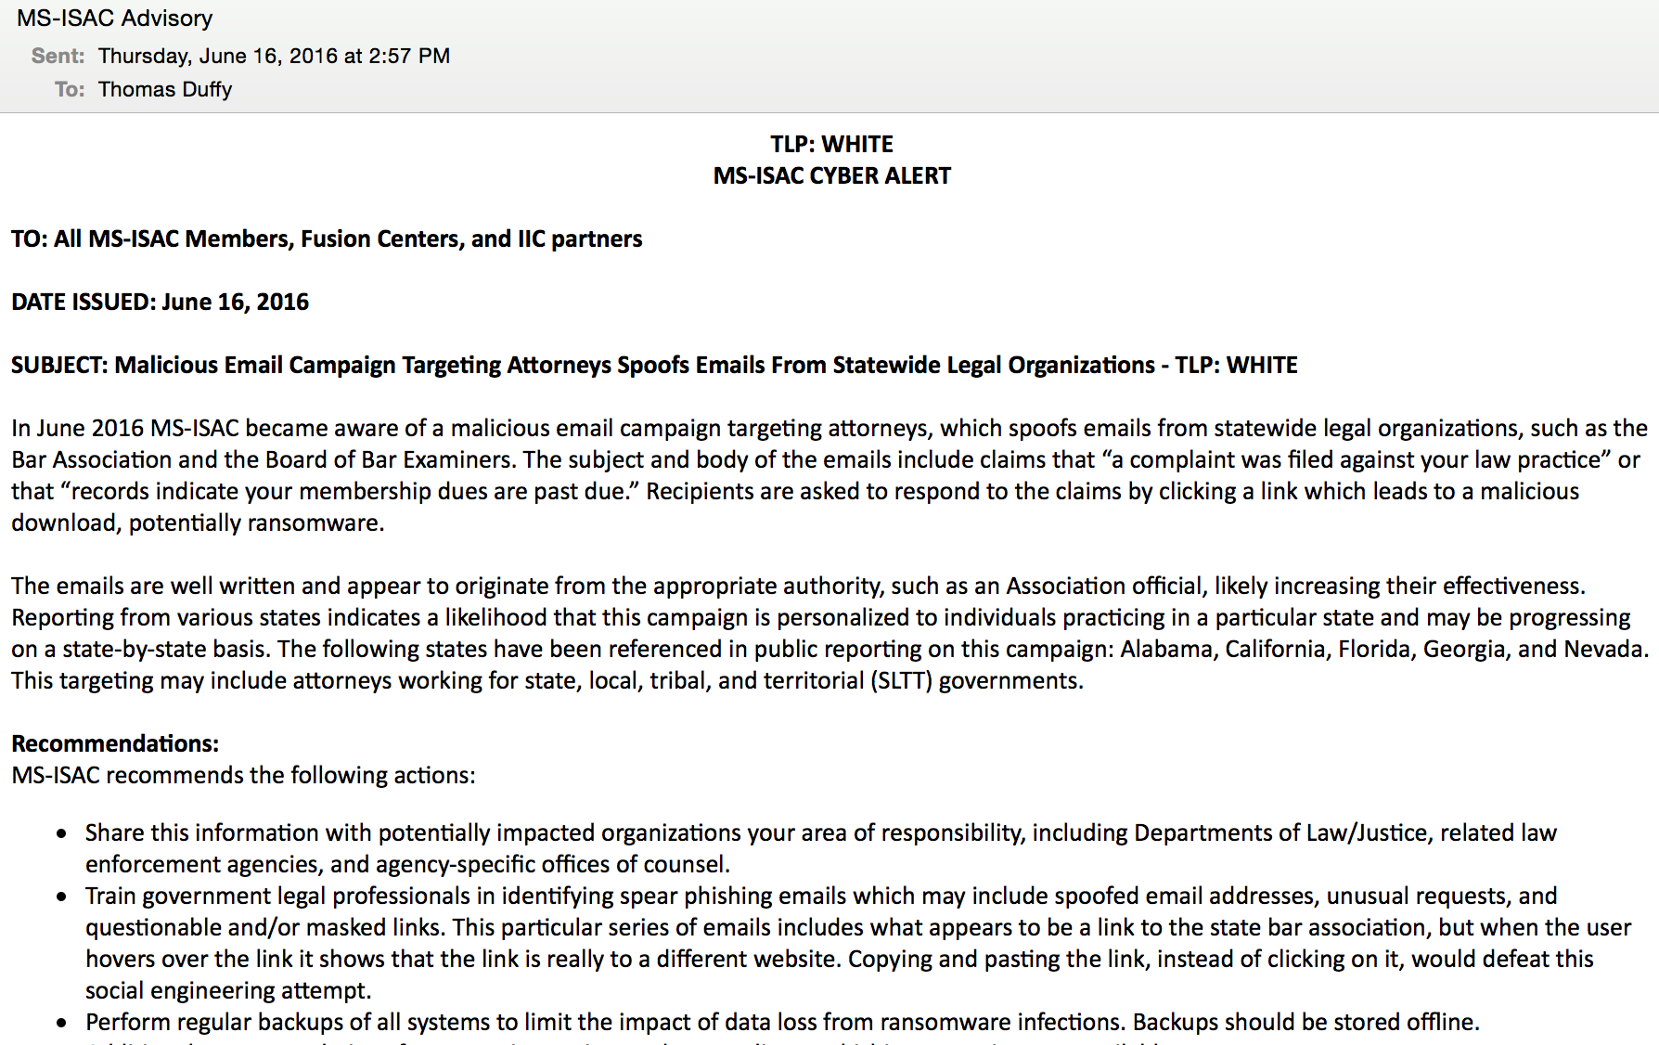
MS-ISAC Cyber Alerts

Slide 30
What have we done here in Colorado?
Multi-jurisdictional Election Day Operations Center in 2016 & 17
  Governor’s Office of Information Technology & Office of Information Security
  U.S. Department of Homeland Security
  Department of Public Safety
  MS-ISAC (now the EI-ISAC)
  Federal Bureau of Investigation
  Colorado National Guard
  City & County of Denver
  Jefferson County
  Others

Slide 31
What Have We Done In Colorado?
Upgraded perimeter firewalls
Upgraded endpoint protection systems for CDOS & Counties
Added threat intelligence sharing feeds
CTIS (Colorado Threat Intelligence Sharing) network
  Jefferson County, City of Aurora, City of Arvada, City & County of Denver, State of Colorado, U.S. Dept. of Homeland Security, C.I.A.C., CDOS, …
Penetration testing
DHS services
  Cyber Hygiene, Risk & Vulnerability Assessment, Phishing Campaign Assessment, Onsite Cyber Security Evaluation Assessment
MS-ISAC services
  Albert network monitoring, Vulnerability Management Program, Exercises and Training, ISAC membership

Slide 32
What Have We Done In Colorado?
DDoS Protection
Risk-limiting Audits
Cyber Storm VI – elections scenarios
Obtaining security clearances
And (old news)
  2-factor authentication
  Annual cybersecurity awareness training
  Mock elections
  On-site audits
  Endpoint malware protection
  Strong acceptable use policies
  Incident Response policies and guidelines

Slide 33
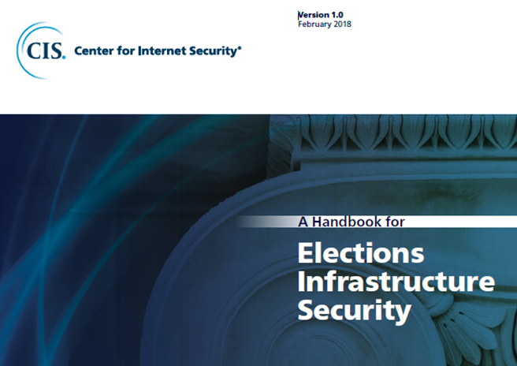
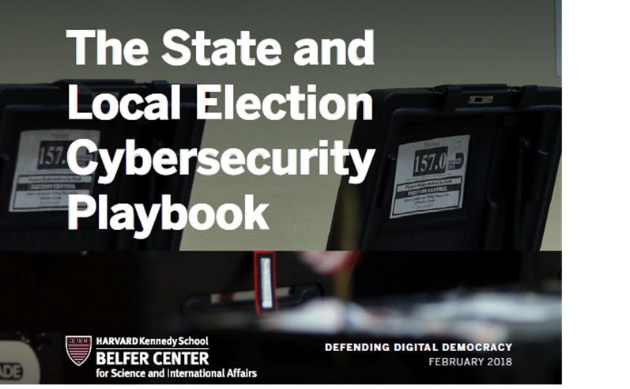
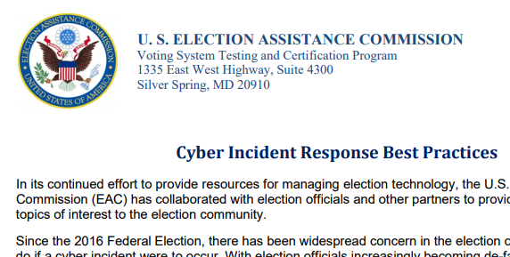
What Have We Done In Colorado?
Standards & Best Practices Development

Slide 34
What Is on the Horizon in Colorado?
Upgraded internal firewalls (moving toward “no-trust” networks)
Privileged Access Management
Endpoint detection
Improved DDoS protection
Database Access Monitoring tools
Tabletop Exercises
Improving Risk-limiting Audits
Improving quality and security of data exchanges
Improved USB controls

Slide 35
Future
Election system code review
Physical security
Human review

Slide 36
Questions?
judd.choate@sos.state.co.us
303-869-4927

