Slide 1
2018 Legislative Session Changes to Election Law
SB18-233: Elections Cleanup Bill (Marble-Fenberg/Foote-Neville)
Senate 35-0
House 65-0
Omnibus election bill making various technical changes, including:
Improves the accuracy of the state’s voter registration database by allowing for automatic updates to an elector’s registration address when they renew their driver’s license at a DMV
Saves money for Colorado’s county clerks by making the ballot secrecy sleeve optional under certain conditions.
Updates several timelines associated with canvassing, certifying the abstract of the vote, and requesting recounts; all in order to accommodate the new requirement to perform the state’s risk-limiting audits
Allows more time for the training of election judges and allows county clerks to appoint election judges who reside in another county, if necessary
Updates outmoded language throughout Title 1 referring to “precincts” and “polling locations”
HB18-1047: Campaign Finance Cleanup Bill (Lontine/Gardner)
House 50-11
Senate 35-0
Omnibus campaign finance bill making various technical changes, including:
Eliminates redundant donor reports
Fixes error in previous legislation that required major contributor reports during the year a candidate is not on the ballot
Modernizes language around paper-filing requirements and TRACER
Clarifies certain complaint and procedural issues and the distinction between different types of committees
Places additional safeguards in the law to prevent the political use of public funds

Slide 2
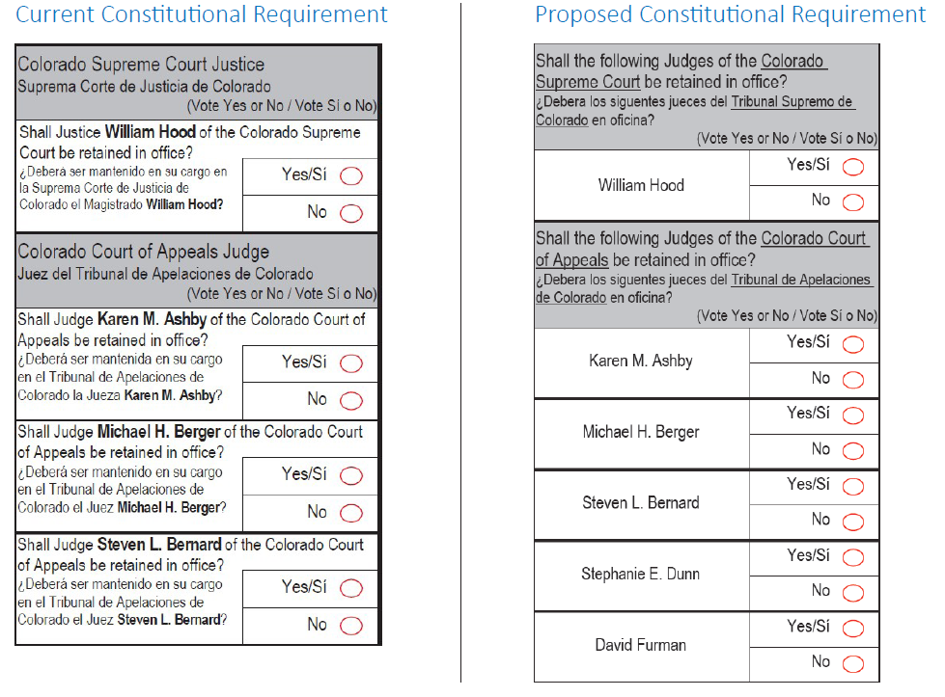
2018 Legislative Session Changes to Election Law
SB18-076: Ban Vote Trading (Lundberg/Melton)
Senate 33-0
House 35-29
Prohibits the facilitation of vote trading between electors in Colorado or between Colorado electors and electors in other states
Class 2 petty offense punishable by a $1,000 fine for each offense
HCR18-1001: Judicial Retention Ballot Format (Lee-Wist/Court-Gardner)
House 63-0
Senate 35-0
Referred constitutional amendment that will appear on November’s ballot
Changes the requirement for judicial retention elections so that the
retention question needs to be written only once for each court

Slide 3
2018 Legislative Session Changes to Election Law
SB18-150: Voter Reg Criminal Justice System (Fenberg-Lundberg/McKean-Lee)
Senate 24-11
House 37-26
Allows parolees who are released from incarceration to preregister to vote
The individual’s registration is activated upon successful completion of parole, as reported by Department of Corrections
Requires Division of Adult Parole to inform parolees on process for preregistration
HB18-1145: Enjoined Laws Petition Circulators (Hooton/Moreno)
House 64-0
Senate 35-0
Statutory Revision Committee bill
Strikes unconstitutional language from statue regarding residency requirement for initiative petition circulators, as well as unconstitutional language regarding limits on by-signature compensation

Slide 4
2018 Legislative Session Changes to Election Law
HB18-1039: Change Date Special District Elections (Ransom/Gardner)
House 64-0
Senate 34-0
Changes regular special district elections from May of even-numbered years to May of odd-numbered years beginning in 2023
HB18-1181: Nonresident Electors Special Districts (Liston/Tate)
House 46-17
Senate 19-16
Allows special districts, by resolution of the board of directors, to permit nonresident electors to vote in a special district election if they own property in the special district
A participating nonresident elector must submit a notarized oath or affirmation affirming their eligibility to vote in a special district election
The special district is responsible for maintaining an accurate list of nonresident electors

