Slide 1
2018 Unaffiliated Voter Campaign
BEAC Comments: Secretary Williams
May 23, 2018

Slide 2
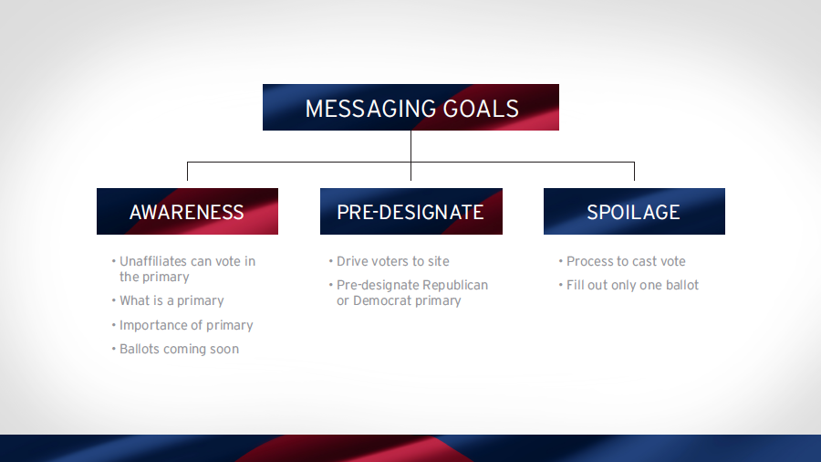
“Uchoose” Campaign

Slide 3

“Uchoose”began with Awareness, directed voters to Selection

Slide 4
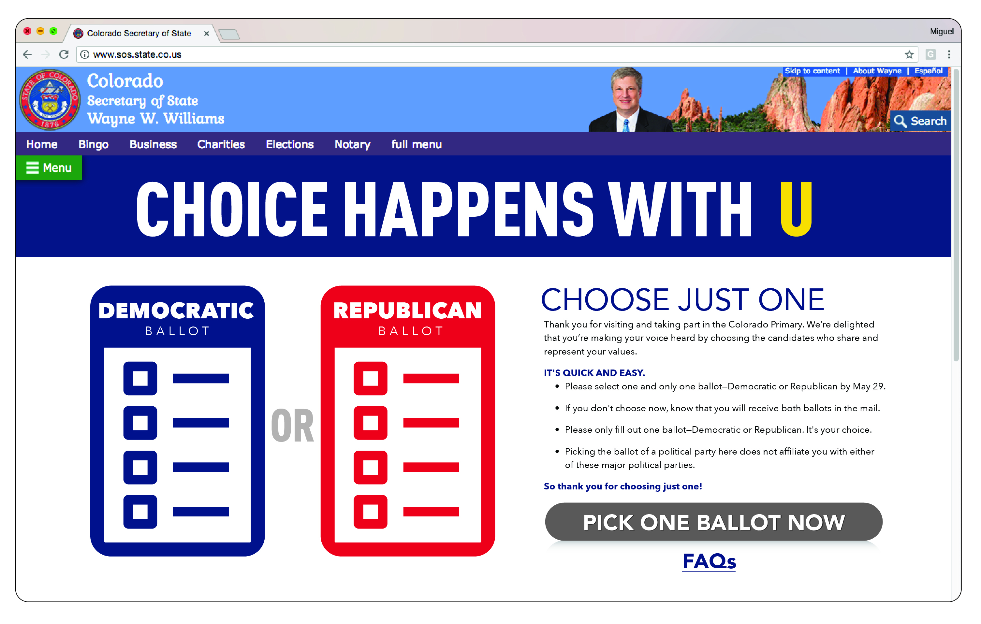
“Uchoose”Messaging: Selection

Slide 5
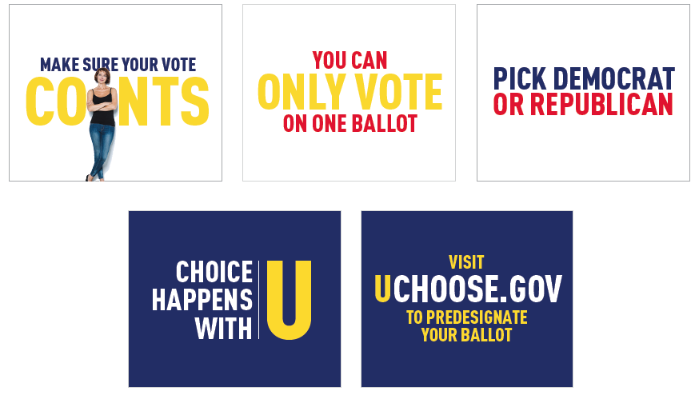
“Uchoose” Creative Campaign
Banner Ad: Spoilage

Slide 6

In-Market / PR Event Launch

Slide 7
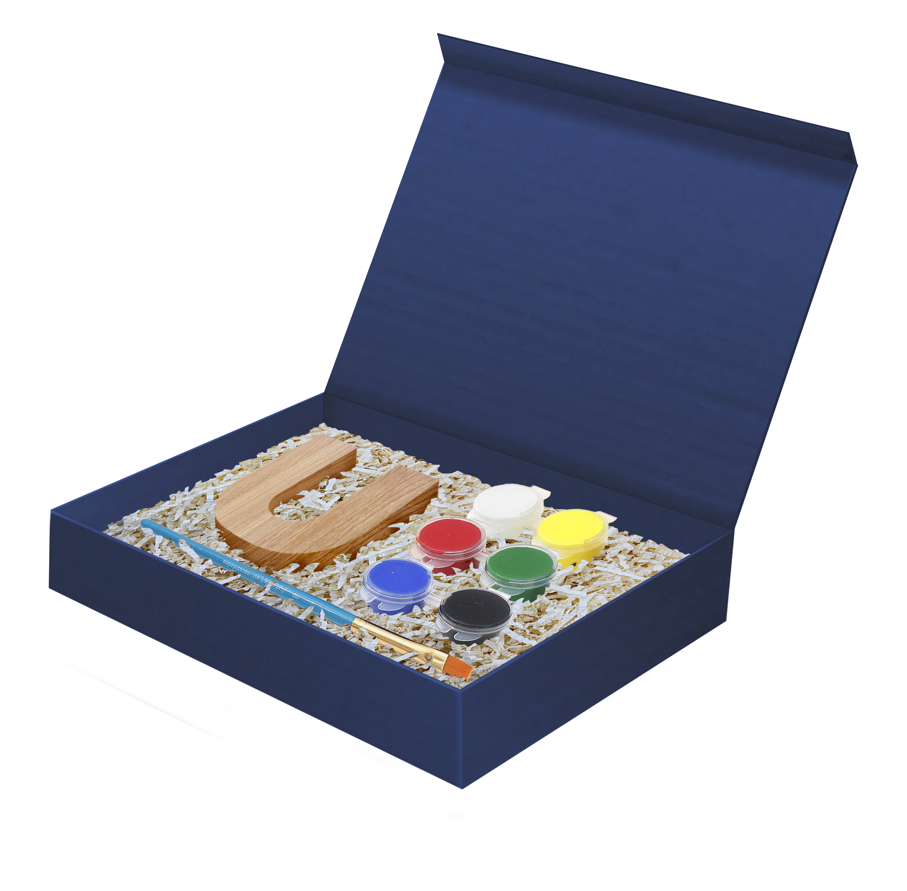
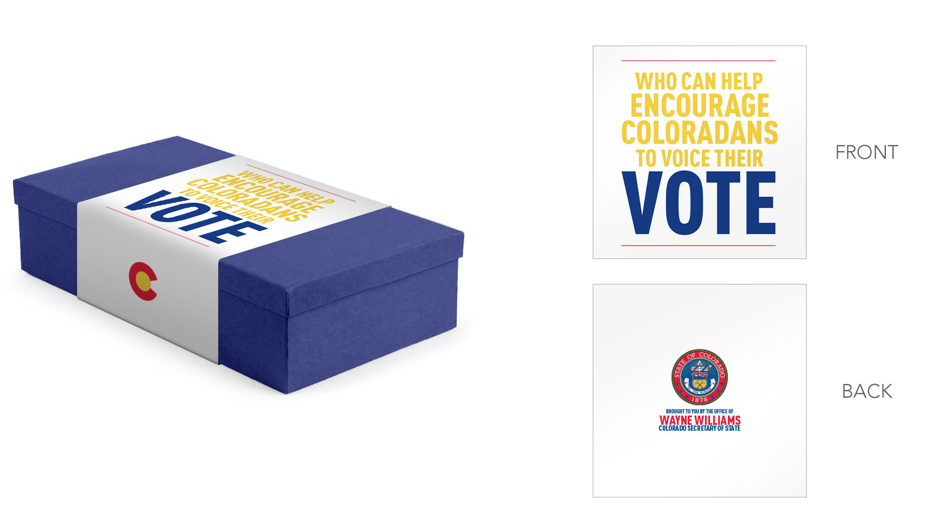


Influencer “Art U’s”

Slide 8
Questions

