Slide 1
Bipartisan Election Advisory Commission
Jena Griswold, Secretary of State

Slide 2
Welcome – Jena Griswold, Secretary of State
BEAC purpose:
  Open discussion about the administration and conduct of elections in Colorado is necessary to ensure that every eligible citizen has the opportunity to participate in fair, accessible, and impartial elections, and has the assurance that elections are conducted with integrity and his or her vote will count.
  The Commission will make recommendations to the Secretary of State regarding the development and implementation of best practices, administrative rules and suggestions for legislation.

Slide 3
2019 BEAC Members
Jennifer Flanagan, Deputy Secretary of State
Judd Choate, Elections Director
Amanda Gonzalez, Colorado Common Cause
Jennifer Levin, Disability Law Colorado
Martha Tierney, Colorado Democratic Party
Michael Valdez, Special District Association
Chris Murray, Colorado Republican Party
Pam Anderson, CCCA Executive Director
Janice Vos Caudill, Pitkin County Clerk
Tiffany Parker, La Plata County Clerk
Representative Susan Lontine
Representative Janice Rich
Senator Julie Gonzales
Senator Jack Tate
Patty Salazar, Governor’s office
Lizzy Stephan, New Era Colorado
Dusti Gurule, COLOR
Rosemary Lytle, NAACP
Kelly Byrne, America Votes
Karen Goldman, Colorado Municipal League

Slide 4
Policies and Procedures
23.1.2 Membership of the Commission
  The Secretary of State will appoint at least 13 members to the Commission. The Commission may include: (1) A Representative of an organization that advocates on behalf of people with disabilities; (2) A member of the executive branch and at least one legislator from each party; (3) Two County clerk and recorders representing the Colorado County Clerks Association presidential line of leadership; (4) If both clerks in (3) are from the same party or if not all counties are members of the CCCA, additional clerks may be appointed; (5) Two representatives of organizations that advocate on behalf of local governments, including counties, municipalities, and special districts; (6) Chair, party officer, or legal counsel for each major political party; and (7) Two members with expertise on voting rights and/or election integrity.
  The Secretary of State or his or her designee, will be a member and serve as chair of the Commission.
  The Secretary of State’s office will provide staff support to the Commission as may be directed by the Secretary of State.

Slide 5
Policies and Procedures
23.1.3 Meetings
  The Commission must meet no fewer than three times annually.
  The meetings will be held at the office of the Secretary of State or regional locations throughout the state as the Commission determines appropriate.
  Meetings must comply with Colorado Open Meetings Law and will permit an opportunity for public comment.
  Notices, records of meetings, written comments, and documents submitted to the commission will be published on the official website of the Secretary of State. Documents that are otherwise publicly available need not be posted. Any submission containing inflammatory or otherwise inappropriate content will not be posted, including any material that is defamatory, irrelevant, duplicative, or obscene.

Slide 6
Housekeeping items
Travel Reimbursement Policy
Call-in information
Website resources

Slide 7
2019 Legislation
Modifications to Uniform Election Code (HB19-1278 - Lontine, Fenberg):
  Increases access to Voter Service & Polling Centers (VSPCs) and ballot drop boxes across Colorado
  Gives county clerks the tools they need to run efficient elections in their communities.
  Improves access to voting for college students by guaranteeing ballot drop boxes on small public higher education institutions and VSPCs on large public higher education institutions.
  Expands access to voters living on Colorado's tribal lands.
  Includes needed technical modifications to ballot access and other election laws.

Slide 8
2019 Legislation
Automatic Voter Registration (SB19-235 - Fenberg, Danielson, Mullica, Esgar): Streamlines automatic voter registration at drivers' license offices and expands the program to eligible Coloradans applying for Medicaid.
Voting access for people with Disabilities (SB19-202 - Danielson, Zenzinger, Froelich): Requires the Secretary of State to develop policies to increase access to the ballot for voters with disabilities.
Parolee Voting (HB19-1266 - Herod, Fenberg): Restores the right to vote to people serving a sentence of parole for a felony.

Slide 9
Legislation Implementation
Administering grant program for voting equipment and drop boxes
  13 counties with additional VSPC locations on election day (33 total VSPCs)
  14 counties with additional drop box locations (69 total drop boxes)
SCORE User Panel - Working on SCORE and webSCORE development
Drafting Election Rules and other form and policy updates
Working with CDOR on automatic voter registration implementation for July, 2020
Contracting with vendor for online ballot delivery solution for disability voters

Slide 10
Preparing for 2019-2020
Reviewing Presidential Primary communications and planning
Preparing for the 2019 mock election in August
Certifying and installing the next version of the Dominion Voting System
Implementing RLA software updates

Slide 11
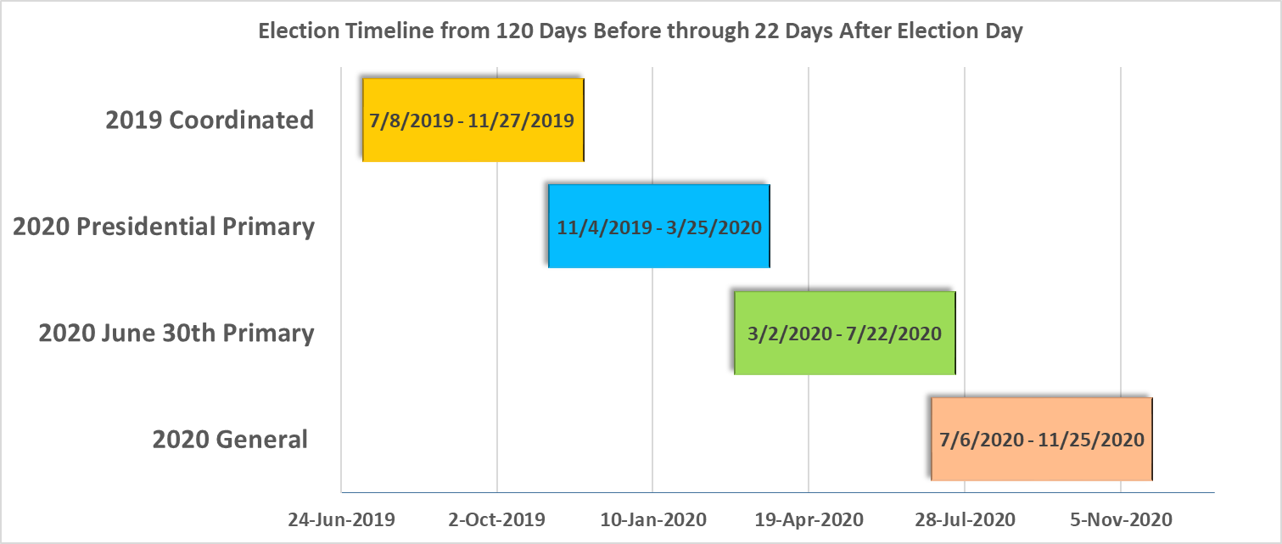
2019-2020 Timelines

Slide 12
Presidential Primary
March 3, 2020 (Super Tuesday)
Ballot Access
  All candidates certified by SOS
  Candidates will have a chance to withdraw until just prior to ballot certification
  Chance for write-in
  Parties may choose a “non-committed” delegate option
The Ballot
  No other races are allowed on the ballot
  Ballot order is determined by lot
  One ballot for each primary
  Voters affiliated with a major party will receive that party’s ballot. Unaffiliated voters can choose to vote in either primary.

Slide 13
Cybersecurity
Tabletop the Vote 2019 exercise (June 20, 2019)
DHS Region 8 staff engaging with counties to perform physical site assessments
Discussion on federal legislation at NASS & NASED
100% EI-ISAC membership in Colorado
Software development capacity increasing
Secure information exchange portal
Secure removable media rollout
Quarterly elections security outreach

Slide 14
Public Comment

Slide 15
Future Meetings & Agenda Items

