Slide 1
Bottom-Line
A large proportion of American voters have no confidence in the integrity of the 2020 election
American citizens will accept a bitter loss in a fair election, but even the perception of unaddressed fraud is corrosive, dangerous, and delegitimizes our government
Colorado elected officials’ oaths to our Constitutions and faithful duty performance obligate thorough investigation and either repudiation or validation of election fraud and security concerns
1. 47% of voters believe there was significant fraud which affected the outcome of this election : https://www.rasmussenreports.com/public_content/politics/elections/election_2020/61_think_trump_should_concede_to_biden

Slide 2
Outline
Facts
Questions
Recommendations

Slide 3
QUESTIONS

Slide 4
RECOMMENDATIONS

Slide 5
What IS an election
An election is the answer to a question or series of questions, posed by elected officials to the pool of eligible citizen voters in a jurisdiction
The components of the election are Questions, Voters, Voting Systems, and Answers
Questions = choices between candidates and options on issues
Voters = eligible citizens who interact w/Voting Systems in elections
Voting System = combinations of mechanisms and procedures which determine voter eligibility, pose the Questions to Voters, collect their responses, establish and retain an auditable record of votes by Voters
Answers = the compiled/tabulated, verified, auditable results of each and all voters’ will

Slide 6
Requirements for legitimacy
Questions: voters have the opportunity to select any eligible candidate in each contest, and indicate their will on all issues which have met state requirements for ballot inclusion
Voters: each eligible citizen has the opportunity to vote, once, and no ineligible person has the opportunity to vote
Voting system:
Questions = choices between candidates for office/options on issues
Voters = those eligible citizens who
Voting System = combinations of mechanisms and procedures which pose the Questions to Voters, collect

Slide 7
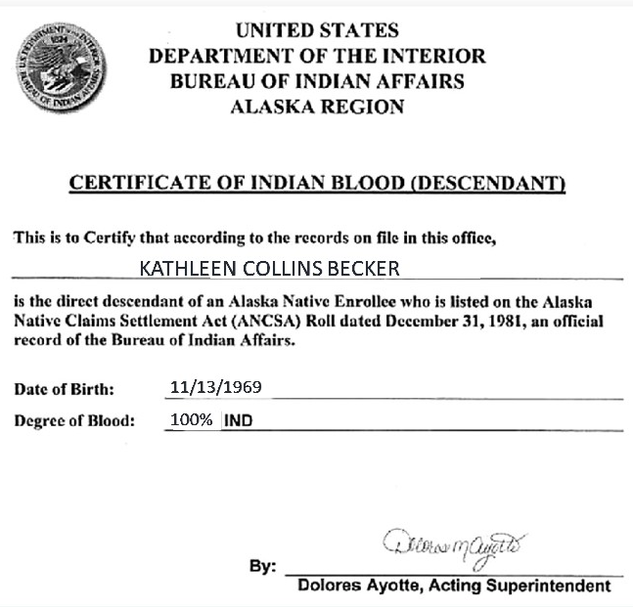
BUREAU
Facts
2019 study: 40/64 CO counties’ voter registration > 100% of eligible CVAP; % CO counties exceeding 100% highest in U.S. (https://www.judicialwatch.org/wp-content/uploads/2020/10/JW-v-Griswold-complaint-02992.pdf)
Acceptable forms of ID for same-day CO voting incl: “A copy of a current (within the last 60 days) utility bill, bank statement, government check, paycheck, or other government document that shows the name and address of the elector.” (https://www.sos.state.co.us/pubs/elections/vote/acceptableFormsOfID.html)

Slide 8
Facts
CO voting systems, certified by the CO SOS; marking: hand-marked paper ballots, ballot marking devices for accessibility; tabulation: hand count and optical scan (https://www.sos.state.co.us/pubs/elections/VotingSystems/CertifiedSystems.html), with Hand Marked:
Clear Ballot ClearVote 1.41 (Garfield & Douglas counties), consisting of
Dominion Democracy Suite 5.11 (all other CO counties)
Component Name | System Function | Version
ClearDesign | Election management software (for use with Linux operating system) | 1.4.3
ClearCount | Software Application (for use with Linux operating system) for Central Count Scanners which includes the following three scanners:Fujitsu fi-7180Fujitsu fi-6800Fujitsu fi-6400 | 1.4.2
ClearAccess | Ballot Marking Device: Dell OptiPlex AIO 5250, Dell 15 Inspiron (w/Win!0 Pro | 1.4.1
System Software (EMS) | Software Application which includes (for use w/Win10 or MS Windows Server 2016):Election Event Designer (EED),Results Tally and Reporting (RTR),File System Service (FSS, Audio Studio (AS), Data Center Manager (DCM,)Election Data Translator (EDT),Application Server (APPS),Adjudication Services, Adjudication Client, Smart Card Helper Service, ImageCast Voter Activation (ICVA) | 5.11
ImageCast Central (ICC) | Software Application for Central Count Scanners which includes the following three scanners (for usewith MS Windows 10):Canon DR-X10C Canon DR-G1130 Canon DR-M160II, HiPro 821dd | 5.11
ICX Platform ICX Client | Ballot Marking Device Samsung Galaxy Tab/Pro(Andriod 4.4.2), Samsung Galaxy Note/ Pro (Andriod 5.0.2), and Avalue SID-21VZ37 (Android 8.1 Oreo | 5.11

Slide 9
Facts
MI voting systems, certified by the CO SOS; marking: hand-marked paper ballots, ballot marking devices for accessibility; tabulation: hand count and optical scan (https://www.sos.state.co.us/pubs/elections/VotingSystems/CertifiedSystems.html), with Hand Marked:
Clear Ballot ClearVote 1.41 (Garfield & Douglas counties), consisting of
Dominion Democracy Suite 5.11 (all other CO counties)
Component Name | System Function | Version
ClearDesign | Election management software (for use with Linux operating system) | 1.4.3
ClearCount | Software Application (for use with Linux operating system) for Central Count Scanners which includes the following three scanners:Fujitsu fi-7180Fujitsu fi-6800Fujitsu fi-6400 | 1.4.2
ClearAccess | Ballot Marking Device: Dell OptiPlex AIO 5250, Dell 15 Inspiron (w/Win!0 Pro | 1.4.1
System Software (EMS) | Software Application which includes (for use w/Win10 or MS Windows Server 2016):Election Event Designer (EED),Results Tally and Reporting (RTR),File System Service (FSS, Audio Studio (AS), Data Center Manager (DCM,)Election Data Translator (EDT),Application Server (APPS),Adjudication Services, Adjudication Client, Smart Card Helper Service, ImageCast Voter Activation (ICVA) | 5.11
ImageCast Central (ICC) | Software Application for Central Count Scanners which includes the following three scanners (for usewith MS Windows 10):Canon DR-X10C Canon DR-G1130 Canon DR-M160II, HiPro 821dd | 5.11
ICX Platform ICX Client | Ballot Marking Device Samsung Galaxy Tab/Pro(Andriod 4.4.2), Samsung Galaxy Note/ Pro (Andriod 5.0.2), and Avalue SID-21VZ37 (Android 8.1 Oreo | 5.11

Slide 10
Facts
There are multiple kinds of security involved with and required in elections, including physical security of facilities, IT, and materials (e.g. ballots), cybersecurity for the IT, Privacy Act obligations, compliance, and auditing, etc
All require procedures, oversight, expert and knowledgeable personnel, auditing, and independent verification
No amount of experience running elections can make an individual adequately prepared to design, execute, audit, or verify security, particularly

Slide 11
Facts
In 2019, MI SOS Benson appointed a first-ever full-time elections security specialist, Ms. Ashiya Monice Brown, “to ensure the integrity of the 2020 election,” stating "The security of our elections in Michigan has always been of paramount importance to all of my predecessors, and you've not seen evidence of the types of potential threats that have impacted systems in other states," Benson, a Democrat, said in an interview.”
There are multiple kinds of security involved with and required in elections, including physical security of facilities, IT, and materials (e.g. ballots), cybersecurity for the IT, Privacy Act obligations, compliance, and auditing, etc; all require procedures
Ms. Brown’s CV
Education: BA, Public Relations; 3 semesters, Cooley Law School; MBA
Work experience: Scoring Supervisor, Pearson Global Education; Election Co-Chair, Ingham Cty, MI; Calculations Assistant; Medicaid Exceptions Team, Senior Systems and Operations Analyst dealing with contacts and State contractors for healthcare in MI; Departmental Specialist II in Healthcare Information Technology

Slide 12
Facts
The CV of an cybersecurity expert (coder)
Education: undisclosed
Work experience: Senior Cyber Intelligence Analyst, Aggressor Team Lead Analyst, Lead of Tactics Development
And another (~non-coder)
Education: Certified GIAC Systems and Network Auditor (SANS); Security+(CompTIA); Foundations of CyberSecurity (UMA) AD, Military Info Systems Technology; MA Cyber Security
Work Experience: Deputy task lead, cyber requirements; Program Manager, Oracle US Public Sector Continuous Monitoring Program; Senior Manager, Compliance Operations – US Public Sector Cloud; Principle Technical Program Manager, Information Security & Compliance; Senior Manager, IT Regulatory Compliance
And another (~non-coder)
Education: BE, Electrical/Computer Engineering; George C. Marshall European Center Program for Cybersecurity Studies
Work experience: Certified Info Systems Security Professional (CISSP); AXELOS ITIL Foundation Level; Directed cybersecurity plan for 146 worldwide USAF installations; Chief information Security Officer for 27k-person USAF base; Chief Information Security Officer/Team Leader Task Force Cyber at Supreme Headquarters Allied Powers Europe, SACEUR representative to NATO Cyber Defense Committee; Commander, USAF cybersecurity center of excellence; managing director cyMars advisors on cybersecurity/risk assessment/management to Fortune 500 companies; Cybersecurity Policy Fellow at New America; Director, National Security Research Center, Los Alamos National Laboratory
And Another (coder)
Education: Certified Offensive Security Certified Professional (OS), GIAC Certified Penetration Tester (GPEN)(SANS), GIAC Web Application Penetration Tester (GWAPT)(SANS), GIAC Incident Handler (GCIH)(SANS), GIAC Reverse Engineering Malware (GREM)(SANS), GIAC Security Essentials (GSEC)(SANS) BS, Computer Science; MS, Global Leadership
Work experience: Ops network Systems Analyst, Team Chief, USAF Red Team; Instructor, Offensive Cyber Operations; Malware Analyst, Incident Response, Cyber Intelligence Analyst, Senior Cyber Security Consultant & Red Team Lead; Director, offensive Cybersecurity Operations

Slide 13
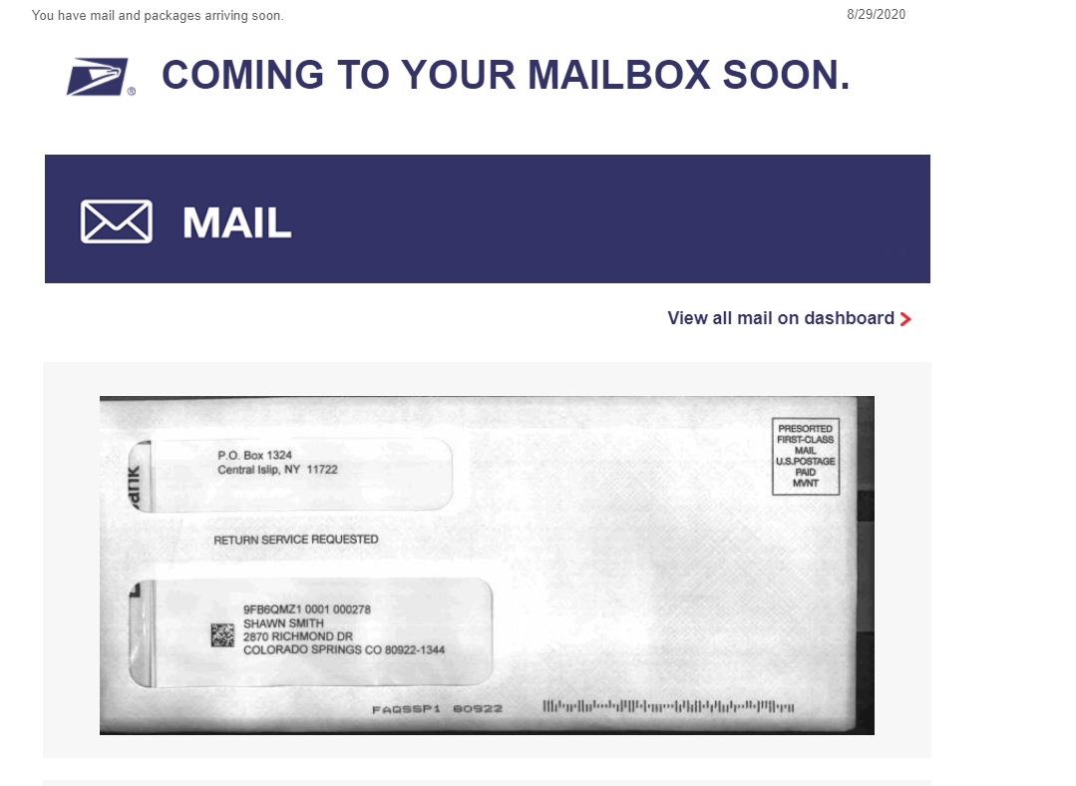

Slide 14
