Slide 1



Comparing Voting Methods with an Emphasis on Approval Voting
Presenter: Celeste Landry

Slide 2
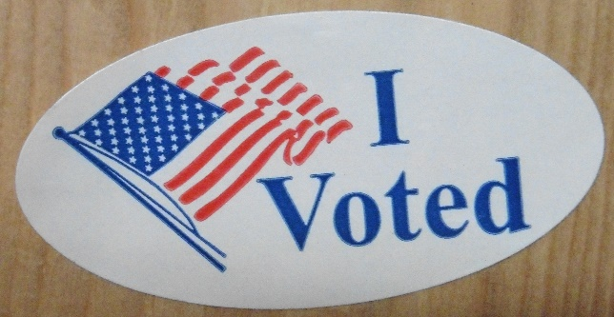
Voting is a process for making a collective decision

Slide 3
An Important Distinction
Single-Winner (SW): governor, ward member, member of Congress
Versus
Multi-Winner (MW): 2 or more seats filled in a single contest

Slide 4

VOTING METHODS Position
The League supports authorizing and implementing alternatives to plurality voting that allow people to express their preferences more effectively. The League supports gaining on-the-ground experience with alternative voting methods in order to ascertain whether a voting method results in outcomes that match voters’ preferences as recorded on their ballots. The League supports voting methods that can improve the election experience, that encourage honest* voting rather than tactical* voting, and that consider ease of implementation.
Considerations:
  • Some voting methods are intended for single-winner elections, others for multi-winner elections. It is important that the intended use of a voting method match its actual application. Multi-winner voting methods can promote proportional representation which fosters diversity of our elected officials.
  • Election officials should conduct post-election analysis to evaluate the voters’ usage of the voting method and the election’s reflection of voters’ stated preferences. There should be sufficient data transparency – for example, access to ballot records in anonymous form – for an independent analysis to be conducted by other interested groups.
*A voting method encourages "honest" voting when it allows voters to meaningfully support all their preferred candidates, rather than leading them to either not support their favorite or "tactically" indicate a higher preference for a candidate who is not their favorite.
Notes:
I don’t expect you to read this entire slide now, but I included it mostly for later reference.
The LWV of Colorado does not endorse any particular voting method, but does encourage alternatives to plurality voting that are more expressive and that improve the election experience. We are also aware that single-winner and multi-winner elections should be treated differently and have different properties. And we are proud of Colorado’s role in piloting risk-limiting audits and want the electorate to have faith that the reported election outcomes are valid.

Slide 5
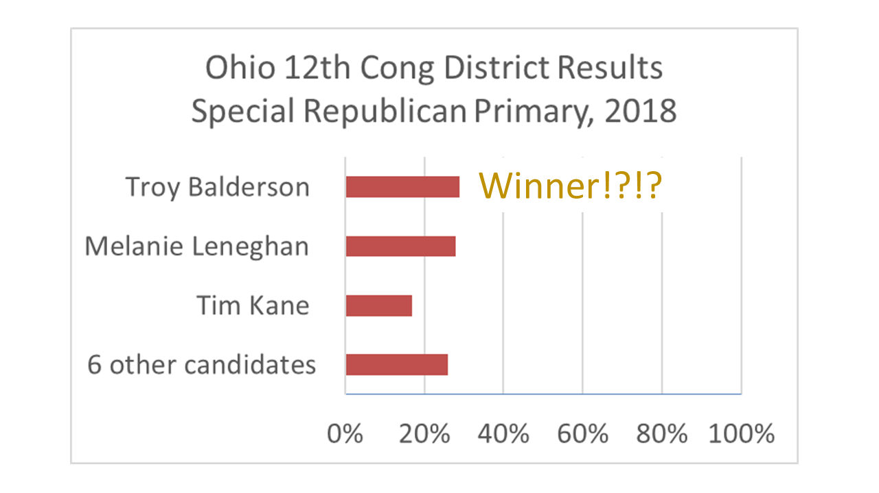
To Win a Plurality Election
-- Get more votes than anyone else --
Do more votes equal many votes?
Notes:
Plurality voting is the most common voting method in the US. You can see in this election that the winner got about 29% of the vote, the second-place candidate came up just short with about 28%. Meanwhile, they accounted for less than 60% of the vote between the two of them! We have a problem here.

Slide 6
Popular Ways to Vote
PLURALITY
RATING
RANKING
Limited Choice
Vote Y/N on All or Score All
1st choice, 2nd choice, etc.
Cumulative Voting
(Multi-Winner)
MMP (Multi-Winner) – other countries
Notes:
I don’t use the term RCV because RCV has multiple meanings – instant-runoff voting or IRV, single transferable vote, multi-winner repeated IRV, vote-for-W RCV.
If RCV is voter-centric, then let’s just say ranked voting, but that includes Bucklin and Borda Count too. Why not use the specific name, e.g., IRV or STV, to avoid confusion?

Slide 7
Adopting
Better Voting Methods
… is the best way to
Eliminate the spoiler effect
Defeat gerrymandering
Attract better candidates
Make every vote count
We want to vote for the greater good, instead of for the lesser evil.

Slide 8
There is
NO PERFECT
Voting Method
But there are
BETTER
Voting Methods!

Slide 9
Expressive Voting Methods
Pro vs Con - Not an Exhaustive List
Pros
Voters can provide more information about their preferences
May inspire more positive campaigning and prevent a frontrunner from taking up all the contest’s oxygen
Cons
Voters may feel that providing more information is too much work
Reaching out to more voters may increase campaign costs
Notes:
The pros are true of multiple voting methods, both rating and ranking methods

Slide 10
Plurality Ballot
Vote for ONE.
sugar cookie
brownie
lemon bar
chocolate chip cookie
Notes:
A candidate could win with just over 25% of all the votes. (Assume no write-in votes.)

Slide 11

Approval Voting Ballot
Vote for ONE or MORE. (One elected.)
sugar cookie
brownie
lemon bar
chocolate chip cookie
Notes:
Don’t have to choose between the two chocolate desserts.

Slide 12
Approval Voting Poll – July 2019
https://drive.google.com/file/d/0ByVu4fDHYJgVSHlRQWtlanA5MFFNdldVQnR6T2VPWlhFRmdr/view
8760 Registered Democrats in early caucus/primary states
Which of these current Democratic candidates are you considering supporting?
Elizabeth Warren | 55%
Kamala Harris | 53%
Joe Biden | 50%
Bernie Sanders | 40%
Pete Buttigieg | 32%
Cory Booker | 19%
Beto O'Rourke | 19%
Julián Castro | 17%
Amy Klobuchar | 12%
Kirsten Gillibrand | 7%
Andrew Yang | 7%
Tulsi Gabbard | 5%
Jay Inslee | 5%
Tom Steyer | 5%

Slide 13
SW Approval Voting
(Voters and Candidates)
More expressive than Plurality voting. The voter is not limited to choosing one candidate.
Every vote is counted equally. Better visibility of support for sincere preferences.
Candidate with the most votes wins
  Q: But what if the winner doesn’t get a majority?
  A: When there are more than two candidates in plurality or a ranking or rating method, no candidate is guaranteed a majority, but the approval winner has the broadest support of all the candidates.
Notes:
2nd bullet point -- IRV reverts to plurality when there is only one round of counting, as happened in Telluride. When IRV reverts to Plurality, there is no visibility of voters’ other preferences. Approval voting does not suffer from lack of visibility.

Slide 14
SW Approval Voting
(County/Town Clerks – Implement and Audit)
Simple to implement for election administrators: ballot format and tabulation
Voters cannot spoil a ballot by “overvoting”
More votes cast than ballots. Report percentages out of ballots cast, not out of votes cast
Should work well with Colorado’s risk-limiting audit process
Notes:
3rd bullet point – We earlier said that Approval voting does not guarantee a majority, but majorities are more likely than with Plurality.
Also, with Approval voting, more than one candidate may have support from a majority of the voters! What a nice world that is, when you like more than one candidate and can support more than one candidate.
The ranked voting methods considered here today only count one vote on your ballot toward a candidate. Instant-runoff voting reverts to Plurality voting if your lower-ranked choices never see the light of day.

Slide 15
SW Approval Voting
Pro vs Con - Not an Exhaustive List
Pros
Voter doesn’t have to choose between two favorites: “Sophie’s Choice”
Current effort to ask CO voters to adopt Approval voting. Home-rule cities may be able to adopt now.
Cons
Voter may not differentiate their support among candidates.
Currently no enabling legislation in CO statute.
Notes:
Differentiate
Not all rating methods are y/n, black or white. I’ll introduce you to another rating method.

Slide 16
Score Voting Ballot
Rate EACH candidate.
No support = 0 Maximum support = 5
sugar cookie
brownie
lemon bar
chocolate chip cookie
0
1
2
3
4
5
0
1
2
3
4
5
0
1
2
3
4
5
0
1
2
3
4
5
Notes:
Score voting is a rating method with more than the two ratings so score voting is more expressive than approval voting.
Two counties in Oregon are considering a variation of score voting, called score runoff voting, for their elections.
Score voting ballots are the most work for voters. There is an expectation but not a requirement that a voter will express an opinion on all the candidates. This can be hard when there are a dozen or more candidates. We don’t know any contests like that, do we?

Slide 17
Multi-Member Board Elections – 2 Types
Can Promote Proportional Representation
Single-Winner
(Ward) Contests
Multi-Winner
At Large Contests
VS
Bye-Bye, Gerrymandering!
Notes:
I’d like to speak for a moment about boards, councils, legislatures – elected bodies with multiple members. We have a lot of these types of elected bodies. There are two ways to elect these members.
Wards or single-winner elections, such as we do for Congress and Senate.
Multi-winner at-large elections. For instance, the city council of Boulder elects 5 council members every 2 years. All the candidates run against each other for one of the 5 seats. Boulder uses Plurality Block elections, but there is interest in moving to a proportional way to elect the city council.
When you have districts or wards, you have to draw district lines, which can be subject to gerrymandering If there are no lines, there is no gerrymandering.

Slide 18
Proportional Representation
For multi-member bodies
Elect candidates who represent voters’ interests – ethnicity, gender, profession, political leanings, neighborhood, etc. – in proportion to the electorate
Notes:
Another advantage of multi-winner contests is the option to use a proportional voting method.

Slide 19
19
Notes:
Just because a jurisdiction has a multi-winner contest doesn’t mean that the elections will result in proportional representation.
This graphic show two different results. Plurality Block voting allows a majority or even a plurality to determine the winners of all the seats. In contrast, a proportional voting method provides representation for all the sizable cohesive groups. The more seats to fill, the smaller the group that can achieve representation.
Let’s look at a MW Approval voting ballot.

Slide 20
Approval Voting Ballot
Vote for ONE or TWO or MORE. (Two elected.)
sugar cookie
brownie
lemon bar
chocolate chip cookie
Notes:
Voting on single-winner and multi-winner ballots is identical. (Likewise with ranked voting ballots.)

Slide 21
MW Approval Voting
(Voters and Candidates)
SW and MW have the same ballot format.
Somewhat more expressive than Plurality Block voting. For example, you can vote for 6 candidates in a 5-winner contest (and not spoil your ballot).
Some tabulation methods promote proportional representation.
  After one choice on ballot is elected, remaining votes on ballot are reweighted to achieve diverse representation.
  A sizable group can get representation. Prevents majority rule with no minority voice.
Notes:
A colleague and I have given a presentation on 4 different kinds of multi-winner approval voting, but we won’t go into most of those details today since this is an introductory presentation.
Suffice it to say….

Slide 22
Proportional Voting Methods in the US
Single transferable vote
  Cambridge city council, school board
  Some members of Minneapolis boards
Cumulative voting
  In more than 5 states
  Usually ordered by courts
Notes:
Also Eastpointe, MI

Slide 23
Non-Proportional Methods
Approval Block Voting
  More expressive than Plurality Block Voting (Fargo starting SW and MW in 2020)
Winner-Take-All RCV (aka MW Repeated Instant-Runoff Voting)
  Worse than Plurality Block Voting because some ballots’ votes get counted multiple times (Payson and Vineyard, UT city council – piloted in 2019)
Notes:
Also Eastpointe, MI

Slide 24
When Adopting a
Better Voting Method
Consider what the electorate wants
  ranking vs rating
  districts vs at-large (no gerrymandering)
  proportional representation?
Consider what election officials can
feasibly implement
  costs, post-election audits, statutory limits

Slide 25
More Information
Approval Voting Initiative
Mark Tejeda, Jackandji@gmail.com
720/448-9959
NathanClayForCongress.com/initiatives
Approval Voting Party
  Blake Huber, blake@ApprovalVotingParty.com
  720/439-6000
  ApprovalVotingParty.com
League of Women Voters (not for women only)
vmteam@lwvbc.org
lwvbc.org > Teams At Work > Voting Methods

