Slide 1

Ranked Choice: More Voice!
Presented at the office of the
Colorado Secretary of State
February 6, 2020
by
Linda S. Templin, MPA
Executive Director
Ranked Choice Voting for Colorado

Slide 2
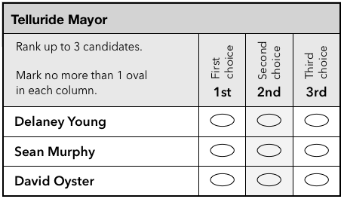
What is Ranked Choice Voting?
R
a
n
k
e
d
C
h
o
i
c
e
Ranked Choice Voting (RCV) empowers you to vote for the candidate of your choice - and feel secure about it. Simply rank your preferences.
https://drive.google.com/file/d/0B3K2g6lIQMWsYkEzSkgtWHBQVDg/view https://www.jstor.org/stable/20451834,

Slide 3
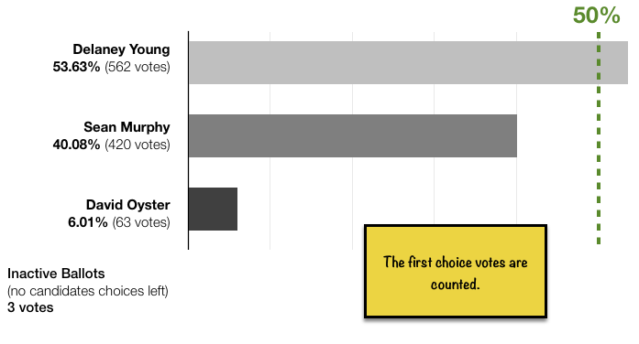
How is RCV tallied?
R
a
n
k
e
d
C
h
o
i
c
e
2019 Telluride Mayoral Race
https://telluride-co.civicweb.net/filepro/documents/53530?preview=53532

Slide 4
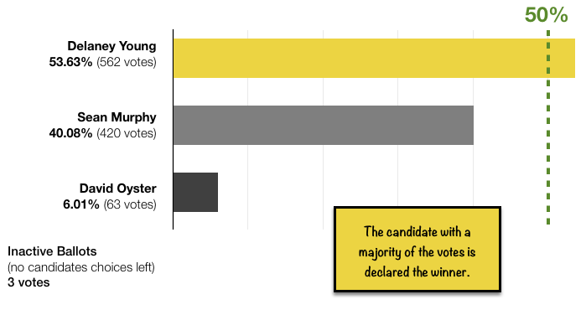
R
a
n
k
e
d
C
h
o
i
c
e
2019 Telluride Mayoral Race
https://telluride-co.civicweb.net/filepro/documents/53530?preview=53532

Slide 5
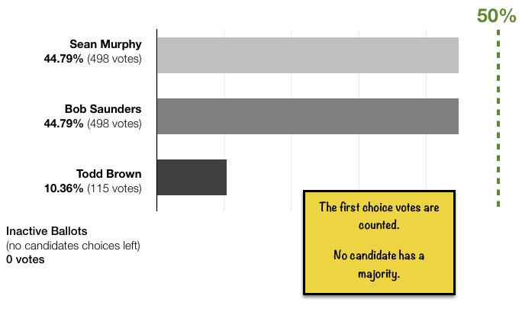
Let’s see one with an automatic runoff
R
a
n
k
e
d
C
h
o
i
c
e
2015 Telluride Mayoral Race
https://telluride-co.civicweb.net/filepro/documents/53530?preview=53532

Slide 6
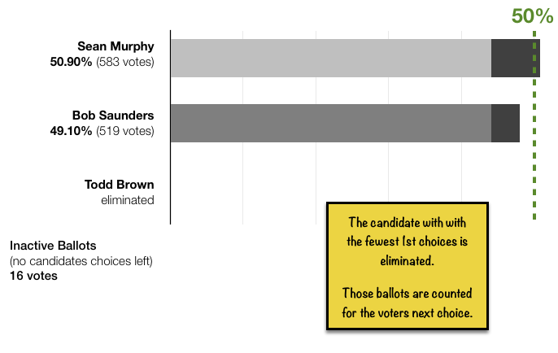
R
a
n
k
e
d
C
h
o
i
c
e
2015 Telluride Mayoral Race
https://telluride-co.civicweb.net/filepro/documents/53530?preview=53532

Slide 7
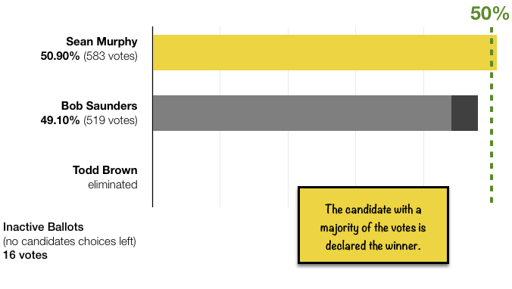
R
a
n
k
e
d
C
h
o
i
c
e
2015 Telluride Mayoral Race
https://telluride-co.civicweb.net/filepro/documents/53530?preview=53532

Slide 8
IRV & STV for Clerks
R
a
n
k
e
d
C
h
o
i
c
e
Instant-Runoff Voting (IRV) = single-winner RCV
Single Transferrable Vote (STV) = multiple-winner RCV
Ranked Choice Voting (RCV) is the voter-centered language for one voting method which can be applied to either type of race.
There are two important differences in how RCV gets applied if you are administering a tally.
The majority threshold formula yields a different result.
The formula is (1/(n+1)) + 1 vote where n=the number of seats to be filled.
1 seat threshold is ½ or 50% - this provides representation 50% + of voters
2 seat threshold is ⅓ or 33% - this provides proportional representation for 66% + of voters.
2. The tally process stops after the final winner is identified. The transfer of surplus votes from a candidate who already won is irrelevant to a race with only one winner.

Slide 9
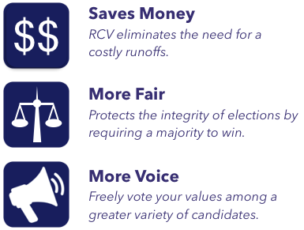
Why use RCV?
R
a
n
k
e
d
C
h
o
i
c
e
Source: https://drive.google.com/file/d/0B3K2g6lIQMWsYkEzSkgtWHBQVDg/view

Slide 10
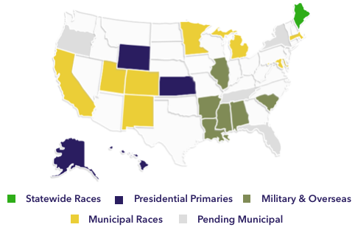
Where is RCV used?
R
a
n
k
e
d
C
h
o
i
c
e
https://www.rankedchoicevoting.org/where_used

Slide 11
Implemented RCV:
R
a
n
k
e
d
C
h
o
i
c
e
Single-winner seats
(like Mayor)
Berkeley, CA
Cambridge, MA
Las Cruces, NM
Maine - statewide races
Minneapolis, MN
Oakland, CA
Payson, UT
Portland, ME
San Francisco, CA
San Leandro, CA
Santa Fe, NM
St. Louis Park, MN
St. Paul, MN
Takoma Park, MD
Telluride, CO
Vinyard, UT
Multi-winner seats
(like at-large city council)
Berkeley, CA
Cambridge, MA
Eastepoint, MI
Las Cruces, NM
Minneapolis, MN
Oakland, CA
Payson, UT
Portland, ME
San Francisco, CA
St. Louis Park, MN
https://www.rankedchoicevoting.org/where_used

Slide 12
Pending RCV:
R
a
n
k
e
d
C
h
o
i
c
e
Local races
Amhurst, MA (2021)
Basalt, CO (2020)
Benton County, OR (2020)
Carbondale, CO
Davis, CA
Easthampton, MA (2021)
Ferndale, MI
Memphis, TN
New York City, NY (2021)
Santa Clara County, CA
Sarasota, FL
Palm Desert, CA(2020)
Vancouver, WA
Presidential primaries
Alaska (April 2020)
Hawaii (April 2020)
Kansas (May 2020)
Wyoming (April 2020)
https://www.rankedchoicevoting.org/where_used

Slide 13
RCV when & why?
R
a
n
k
e
d
C
h
o
i
c
e
Good idea:
When: Important decisions that need a majority consensus to be fair.
example: Electing a Government Representative
Why: - The more voters care about an election, the stronger of an opinion they about which candidates they like better.
- Proven to meet the one-person, one-vote legal standard.
Bad idea:
When: Quick, low-importance decision-making where a majority winner is not needed.
example: where to have lunch
Why: Sometimes speed is most important.

Slide 14
Comparison of Voting Methods
R
a
n
k
e
d
C
h
o
i
c
e
 | Plurality | AV | Ranked Choice
Majority winner with one election | No | No | Yes*
Voters like it | 33% | ? | 84%
Expressiveness | nominal | nominal | ordinal
Game-able? | lesser of two evils | bullet voting | Not effectively
Spoiled ballots | 1.5% | ? | 0.7%
Impact on turnout | baseline | ? | +10% on average
Legal complaince with one-vote per voter | Yes | Unlikely | Yes
*Oakland ballot design error in 2010. https://www.pewresearch.org/fact-tank/2016/09/12/already-low-voter-satisfaction-with-choice-of-candidates-falls-even-further/RCV Voter feedback 2019 Telluride Study - preliminary. Final will be posted at RCVforColorado.org turnout www.jstor.org/stable/1957082 RCV spoiled - https://www.santafenm.gov/election_-_march_6_2018_regular_municipal_election
Plurality spoiled https://gvpt.umd.edu/sites/gvpt.umd.edu/files/pubs/Herrnson%20Hanmer%20Niemi%20AJPS%20Ballot%20and%20Errors.pdf (p714)

Slide 15
Ready in Colorado?
R
a
n
k
e
d
C
h
o
i
c
e
Administrative Element | AV | Ranked Choice
Ballot Design Study | None | 2017
Election Rules | None | 2018 - second version
Best Practices body of knowledge | None | Over 100 years
RLA Audits | No standards Not done before Needs software | Have standards Done in another state Needs software
Counties with software module | 0 | 60 out of 64
Software Certification Standards | None | State stds needed New fed stds 2022?
2017 https://civicdesign.org/wp-content/uploads/2017/07/Introducing-RCV-Ballots-18-0803-FNAL.pdf
2018 (https://www.sos.state.co.us/pubs/rule_making/CurrentRules/8CCR1505-1/Rule26.pdf) & (https://rcvforcolorado.org/wp-content/uploads/2019/06/Blom-Stuckey-Teague-RLAs-for-IRV-Elections-20190322.pdf)
https://civicdesign.org/projects/rcv/ https://www.electioncenter.org/index.html https://www.rankedchoicevoting.org

Slide 16
Proven Legal Compliance
R
a
n
k
e
d
C
h
o
i
c
e
RCV meets legal standards. Since first implemented in 1912, RCV in both single- and multi-winner uses have met the legal standard of one-vote per-voter set forth in Brown v. Smallwood (1903). It is most recently reaffirmed in Baber v. Dunlap (2018).
Colorado local option. Statutory Municipalities and local districts may excercise local option to use single-winner RCV under the 2008 Ranked Voting Method Act. Election Rules [8CCR 1505-1].
https://www.sos.state.co.us/pubs/rule_making/CurrentRules/8CCR1505-1/Rule26.pdf
.

