Slide 1

Election 2020
Dominion Voting and others

Slide 2

Companies involved:
Dominion voting systems
Scytl
Smartmatic
Edison Research
Supermajority
Center for tech and civic life
Obama for America
Indivisible

Slide 3
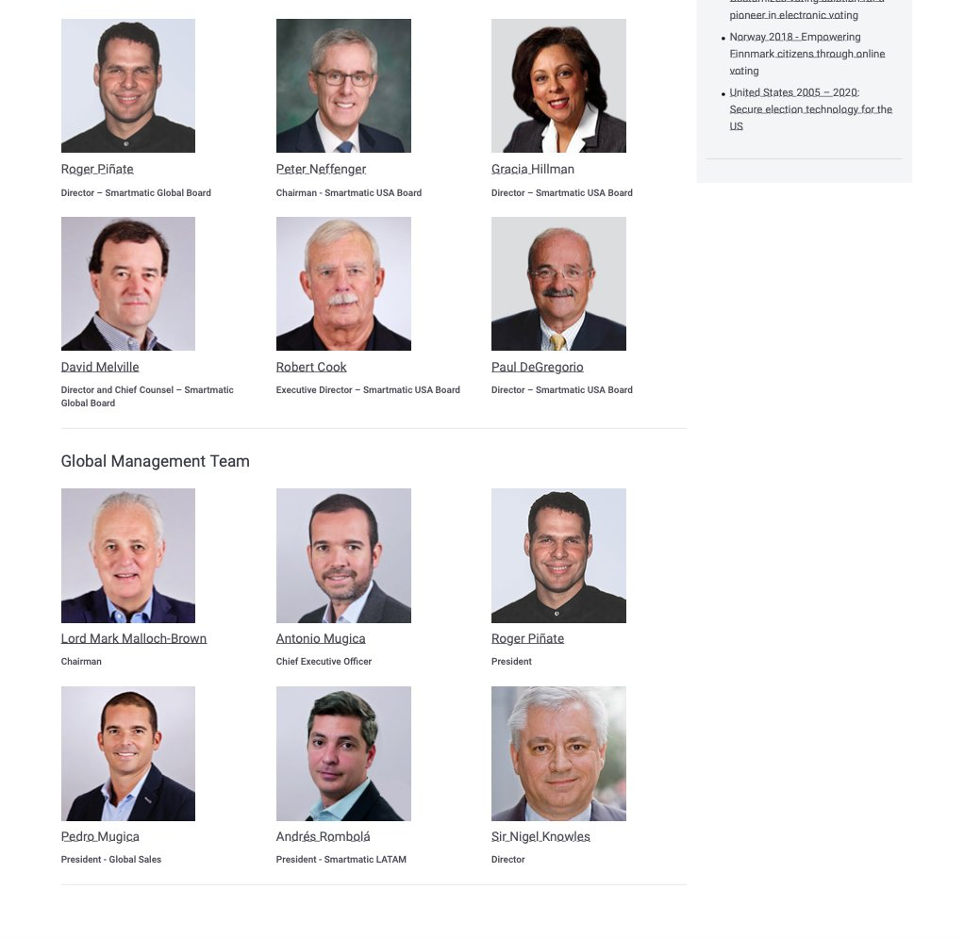
Company information
Smartmatic company board

Slide 4
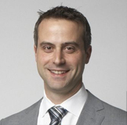
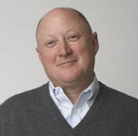

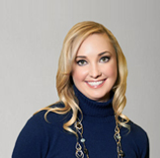
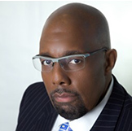
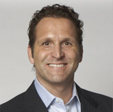
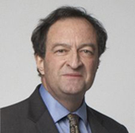
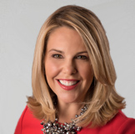
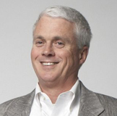
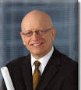
Dominion Executive Board
John Poulos
President & CEO
Ian MacVicar
Executive Chairman
Chief Financial Officer
Waldeep Singh
Executive Vice-President, Sales
Nicole Nollette
Executive Vice-President, Operations
Matt Horace
Vice-President
Chief Security Officer
Mike Frontera
Executive Vice-President, General Counsel
Howard Cramer
Vice-President, Strategic Opportunities
Kay Stimson
Vice-President, Government Affairs
Steve Moreland
Vice-President, Fulfillment
Jean-Pierre Kingsley
Chair
Executive Advisory Committee
https://web.archive.org/web/20180625105622/http://www.dominionvoting.com/company

Slide 5
Hootan Yaghoobzadeh
Hootan Yaghoobzadeh is on the BOARD OF DIRECTORS for DOMINION VOTING SYSTEMS.
Also works at Staple street capital with 2 other employees including the vice president of the company. All three of these individuals, Hootan Yaghoobzadeh, Scott leffler, and Jeffery D hyslop, were high up individuals within Cerberus Capital, which own both Bushmaster and Remmington.
Hootan Yaghoobzadeh, who is on the board of directors for Dominon Voting systems, before working at Cerberus Capital, he was working at the Carlyle Group…
Which, had DIRECT TIES TO SADAM HUSSAIN and yup…
Hootan Yaghoobzadeh worked at the carlyle group from 1998-2003, right during 9/11..

Slide 6
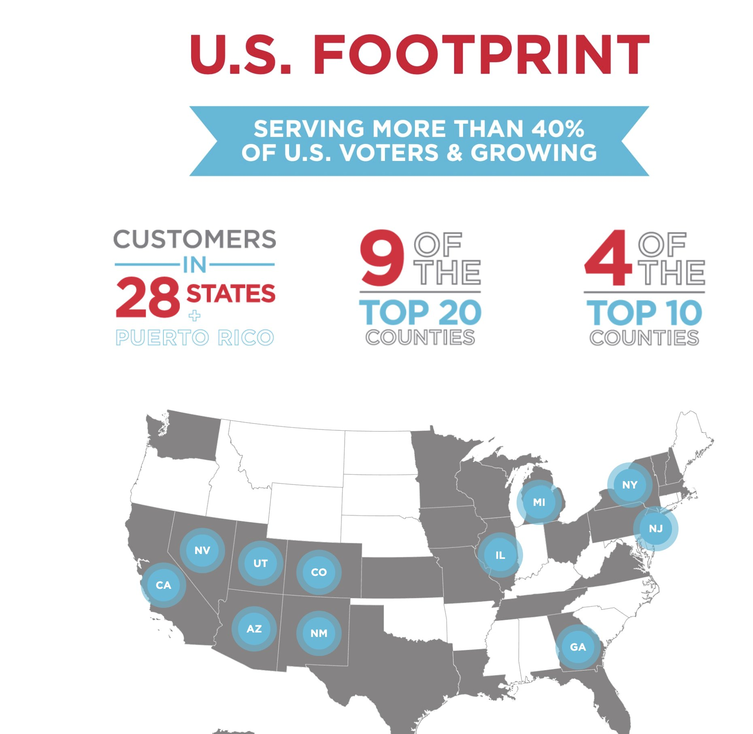
Dominion footprint in the US

Slide 7
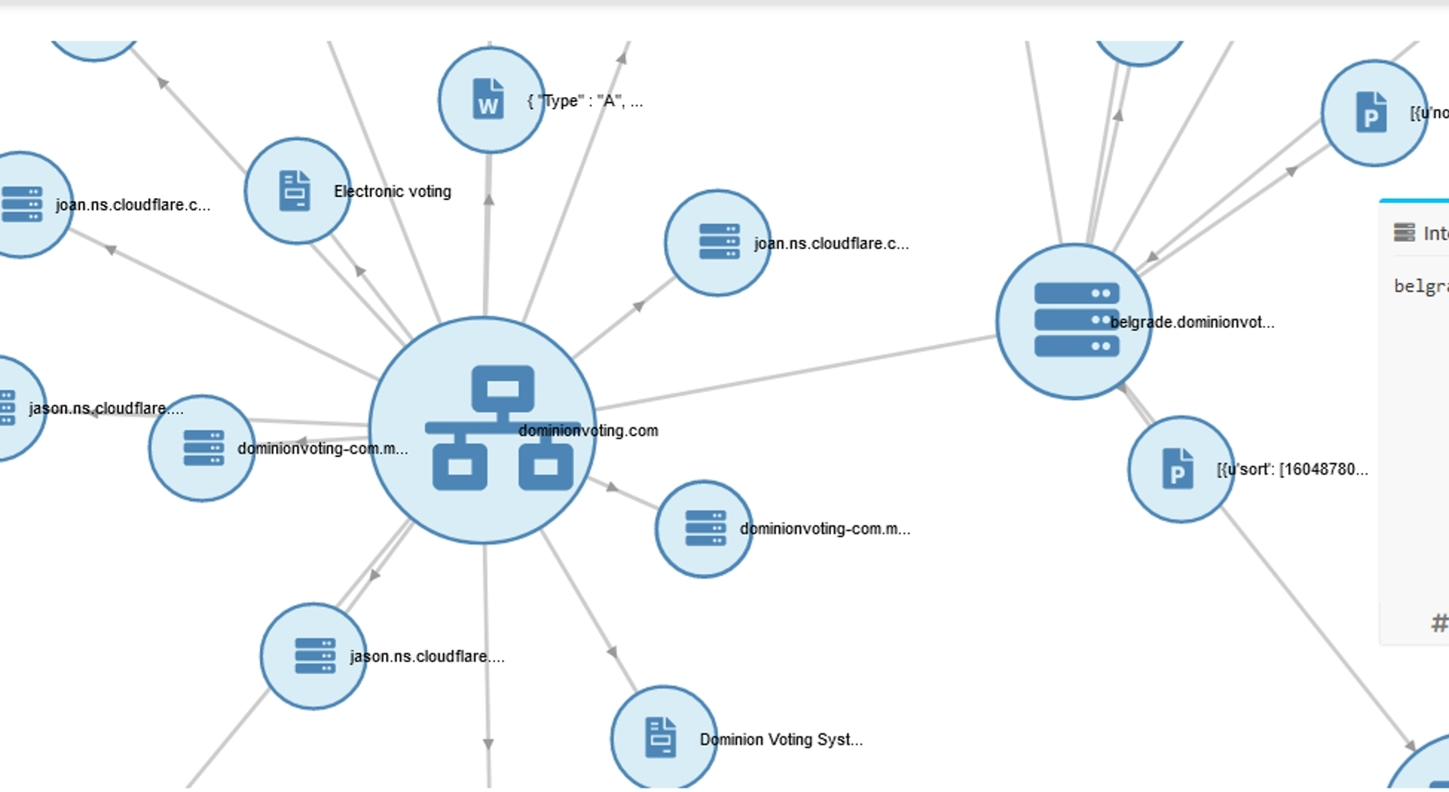

Slide 8
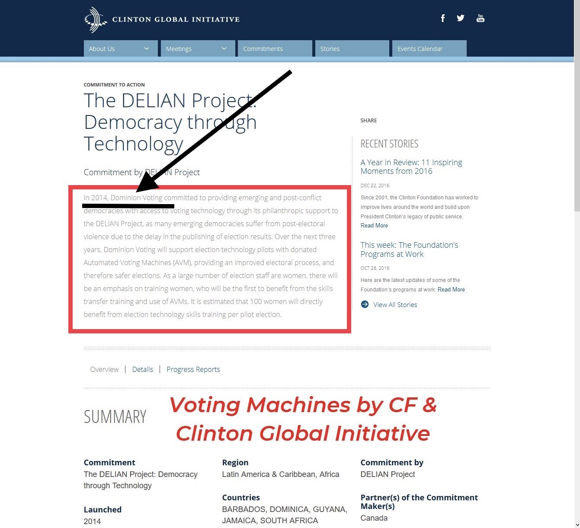
External ties

Slide 9
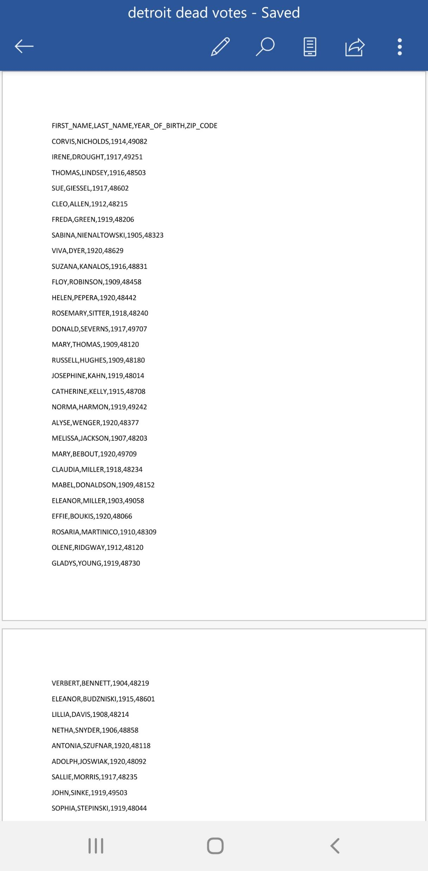
Detroit voter roles over 14,000 dead voters see add on document

Slide 10
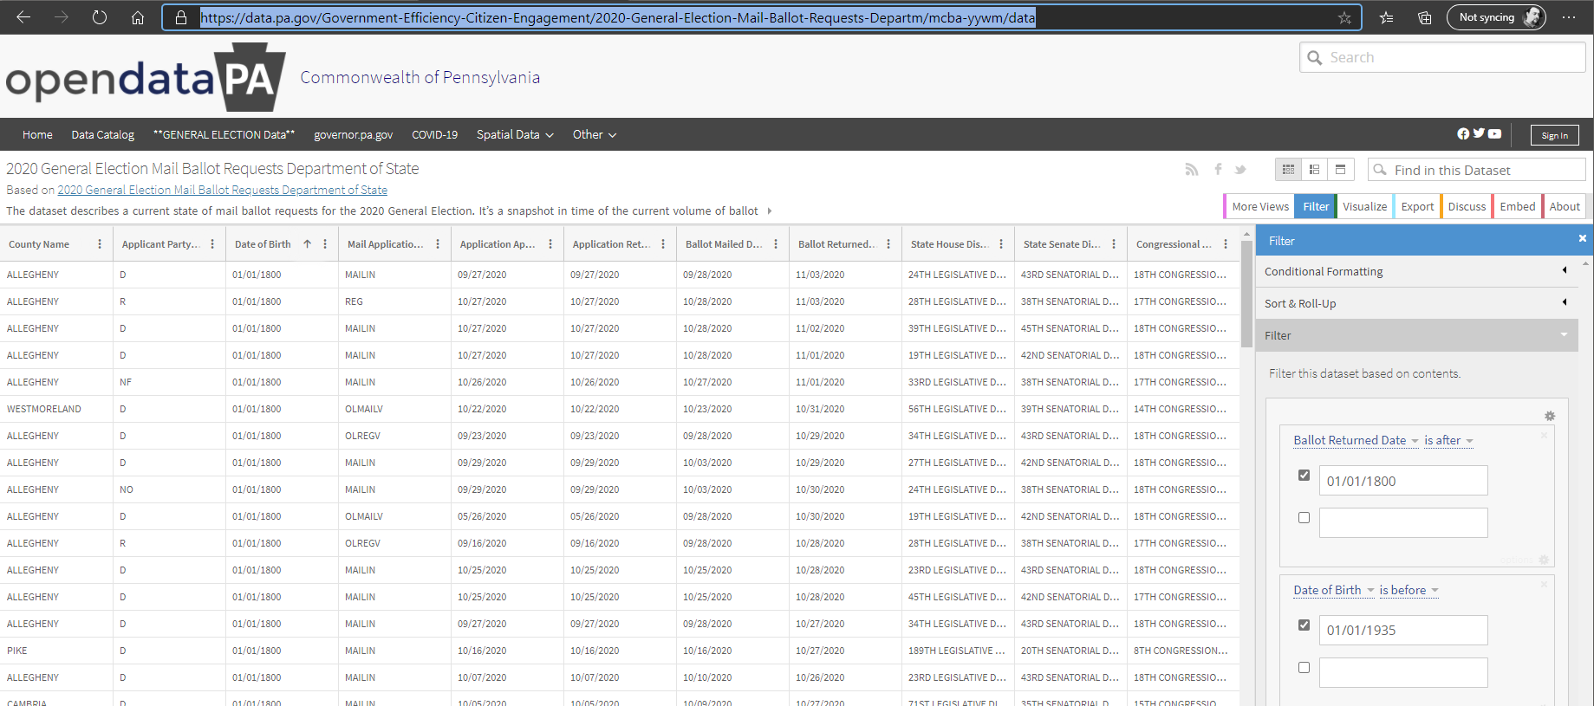
Pennsylvania Voter roles

Slide 11
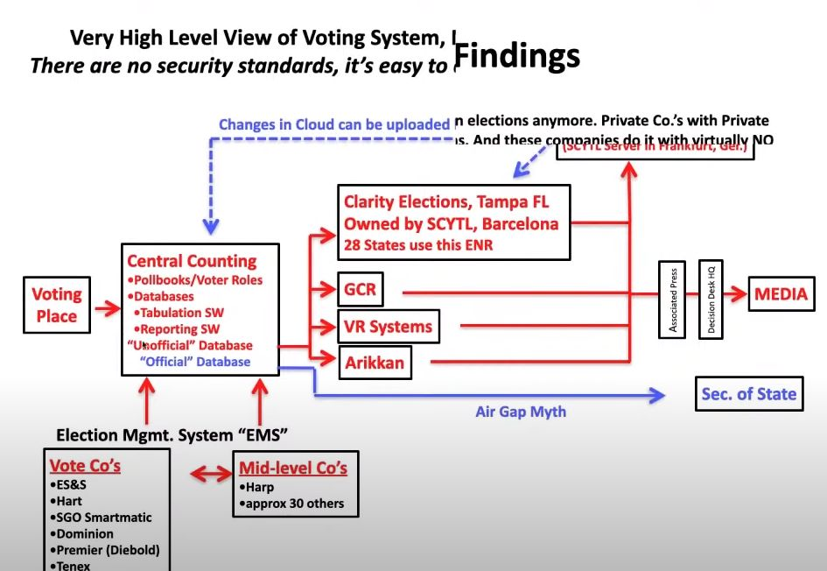

Slide 12
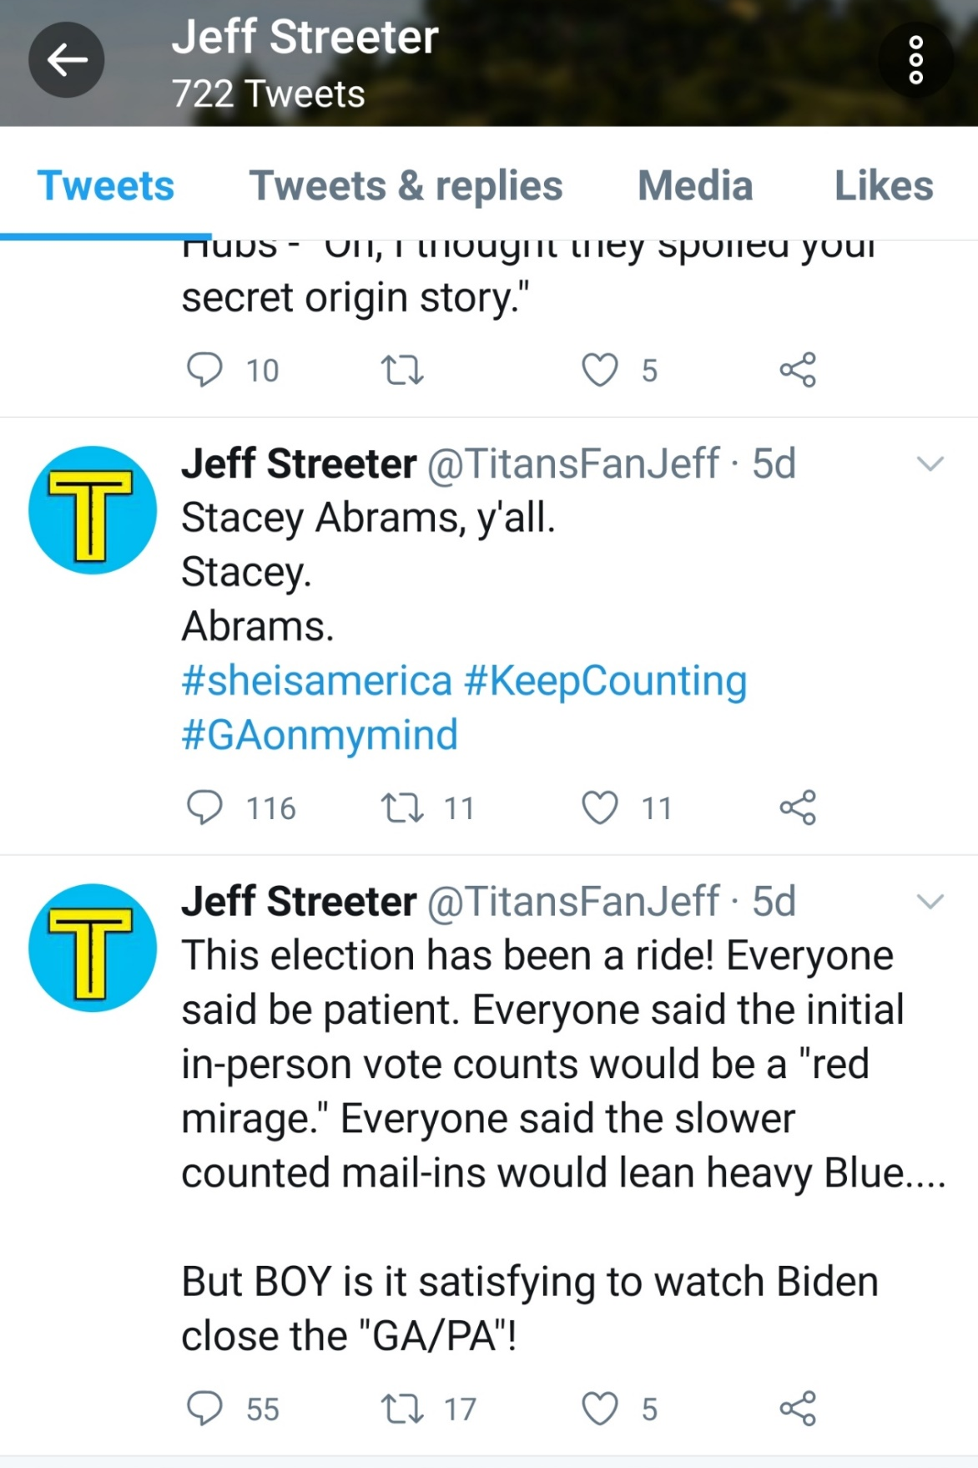
USPS IG Investigator Jeff Streeter
USPS whistleblower Richard Hopkins was questioned by Jeff Streeter and was recorded by Project Veritas. IG Streeter was recorded using advanced interrogation methods employed by the US military and used the tactic known as “Fear up” as a method to get the whistleblower to change his statement. IG Streeter believed his tactics worked and reported to the House Oversight Committee leaving it suspect that Streeter was speaking to staff from the Oversight committee.

Slide 13

How the calculation for manipulation was made
The following file was found in a leak that was posted in 2016 and was attributed to Seth Rich.

Slide 14
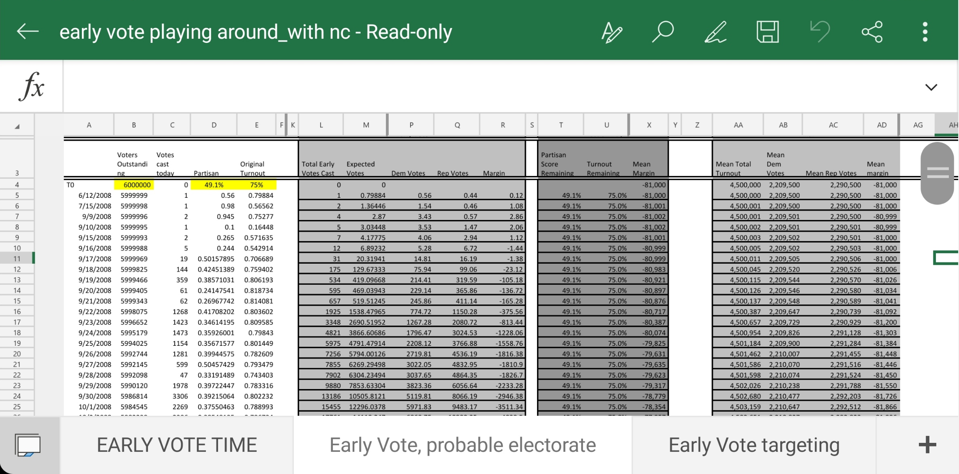
Footprint of digital manipulation

Slide 15
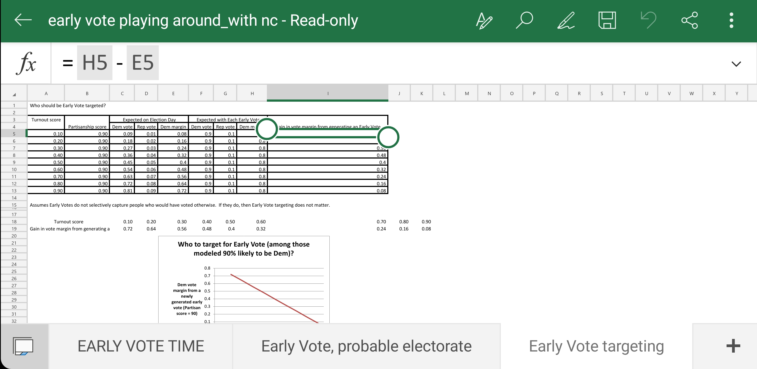

Slide 16
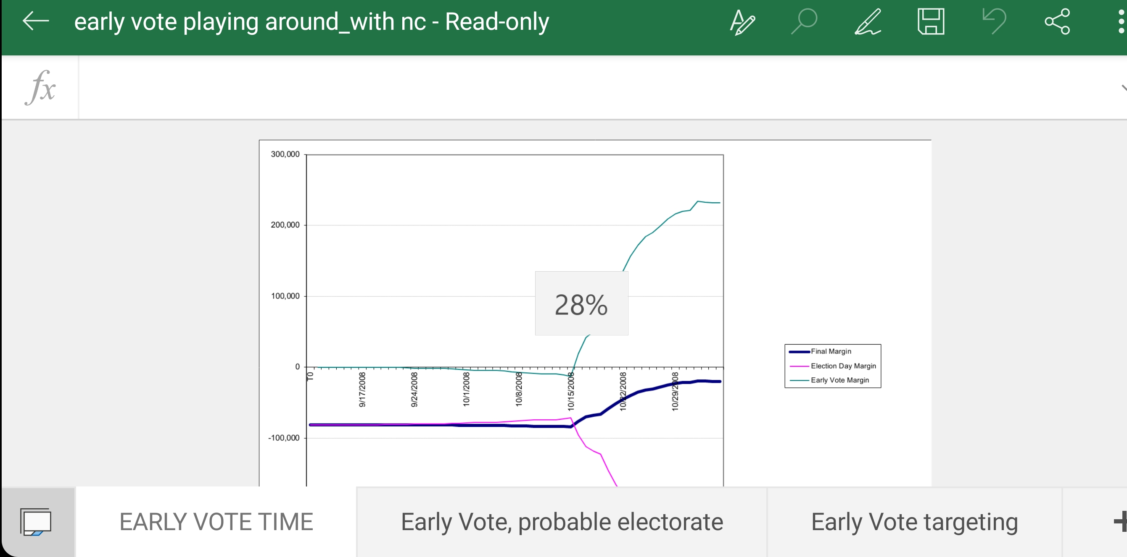

Slide 17
How they rigged the election by area’s
NV: zero signature verification
PA: counting late ballots for three full days
Wi, MI, PA, GA: stoppage of count/100 to 0 ballot dumps
AZ, NV, WI, MI, GA, VA, NH: electronic flipping of totals

Slide 18
Bedford’s law
Dr. Shiva has helped corroborate this proven method that was used by the US state Dept to evaluate voter fraud in Ukraine
As per information taken from the following news article:
https://voxukraine.org/en/election-fraud-in-2014-parliamentary-elections/
  Method #1: voter turn out and party share
  Method #2: voter turn out and contribution of extreme stations
  Method #3: Bedford’s Law
As well as information from the Cambridge University press written in 2011 by Joseph Deckert, Mikhail Myagkov and Peter C. Ordeshook. Vol. 19, No. 3 (Summer 2011), pp. 245-268 (24 pages)

Slide 19
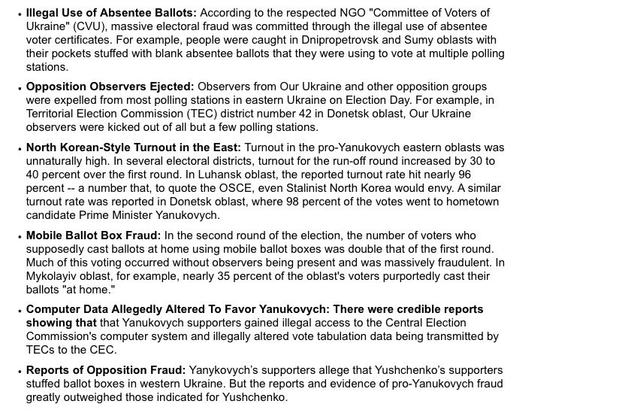
Excerpt from Cambridge report

Slide 20
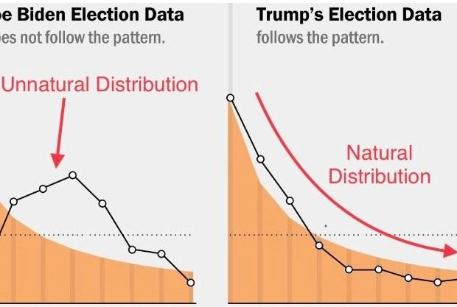
Statistical anomalies present within voting tabulation

Slide 21
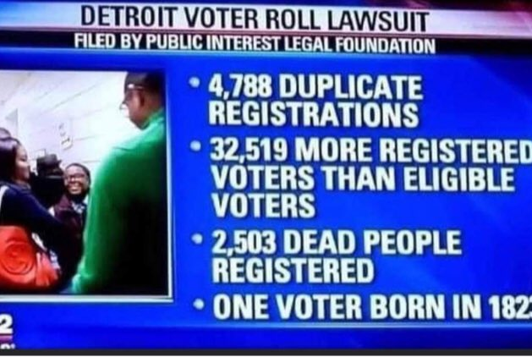
Public reporting

Slide 22
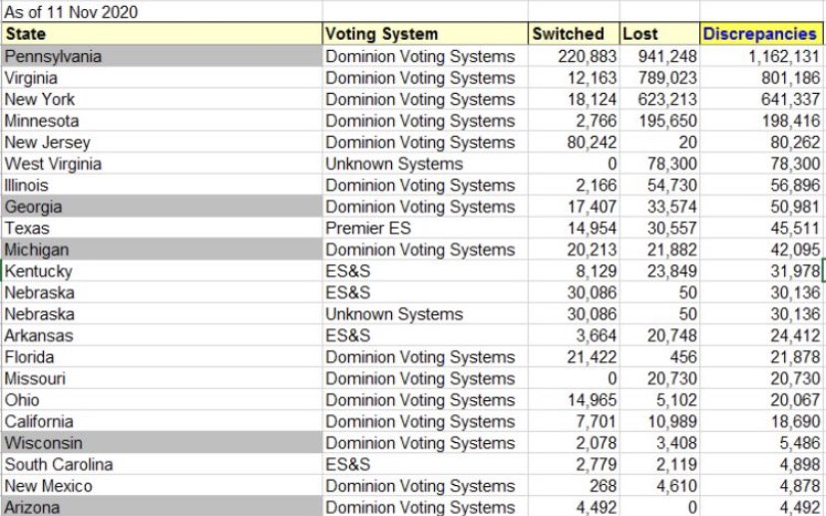
Vote switching on election equipment

Slide 23
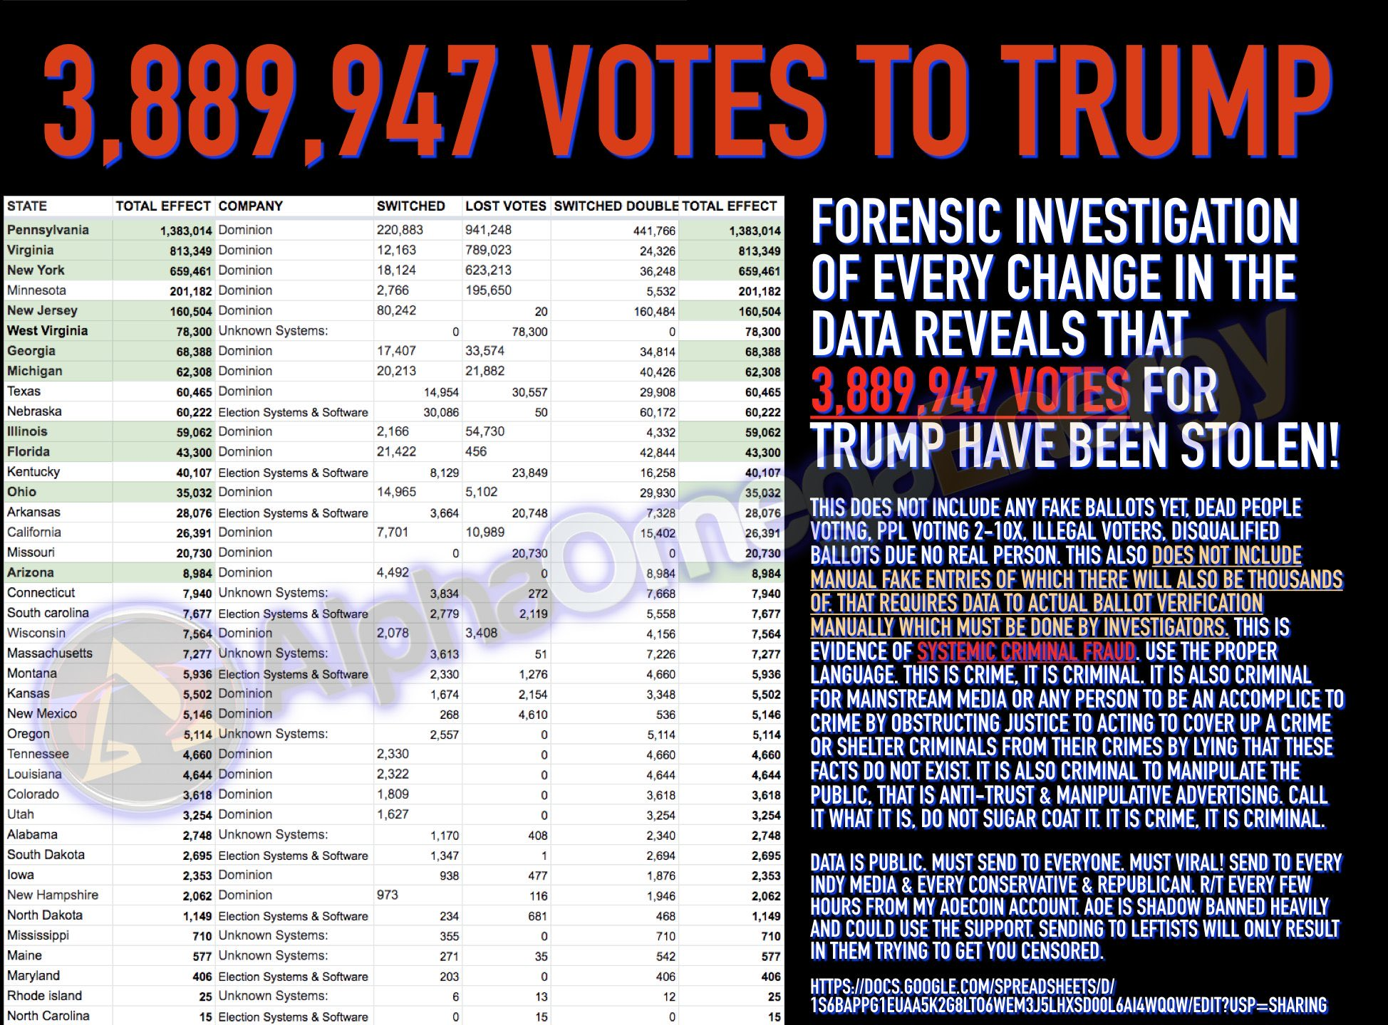
AlphaOmega twitter researcher

Slide 24
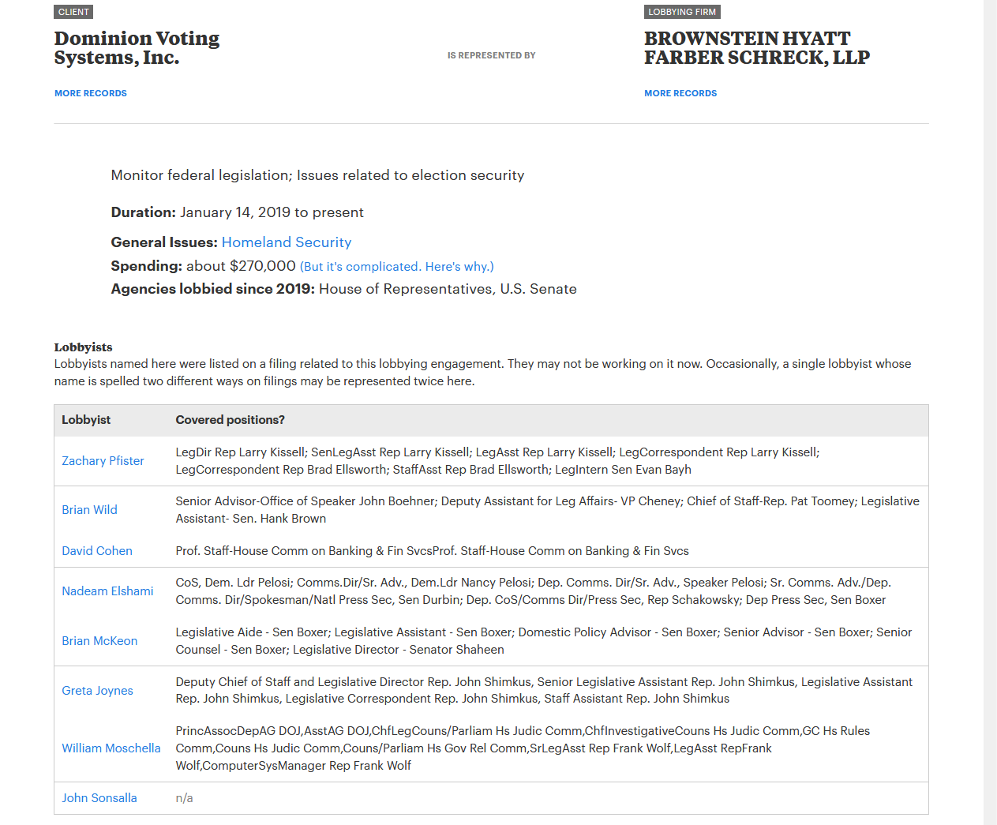

Slide 25
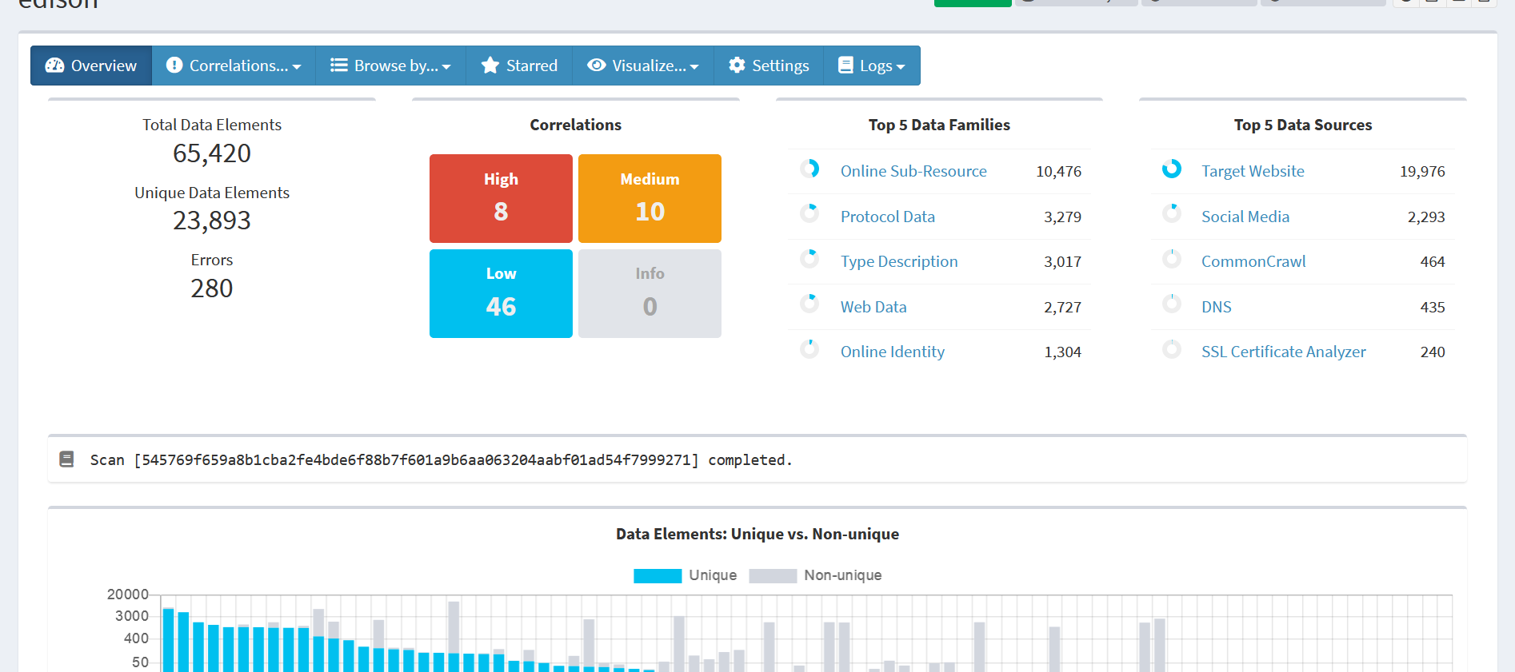
Edison Research

