Slide 1

Voter Registration in Wisconsin
Dr Douglas G Frank
12/2/2021
© 2021 Douglas G Frank, All rights reserved.
Proprietary and confidential analysis.
Requires prior written permission for use.

Slide 2
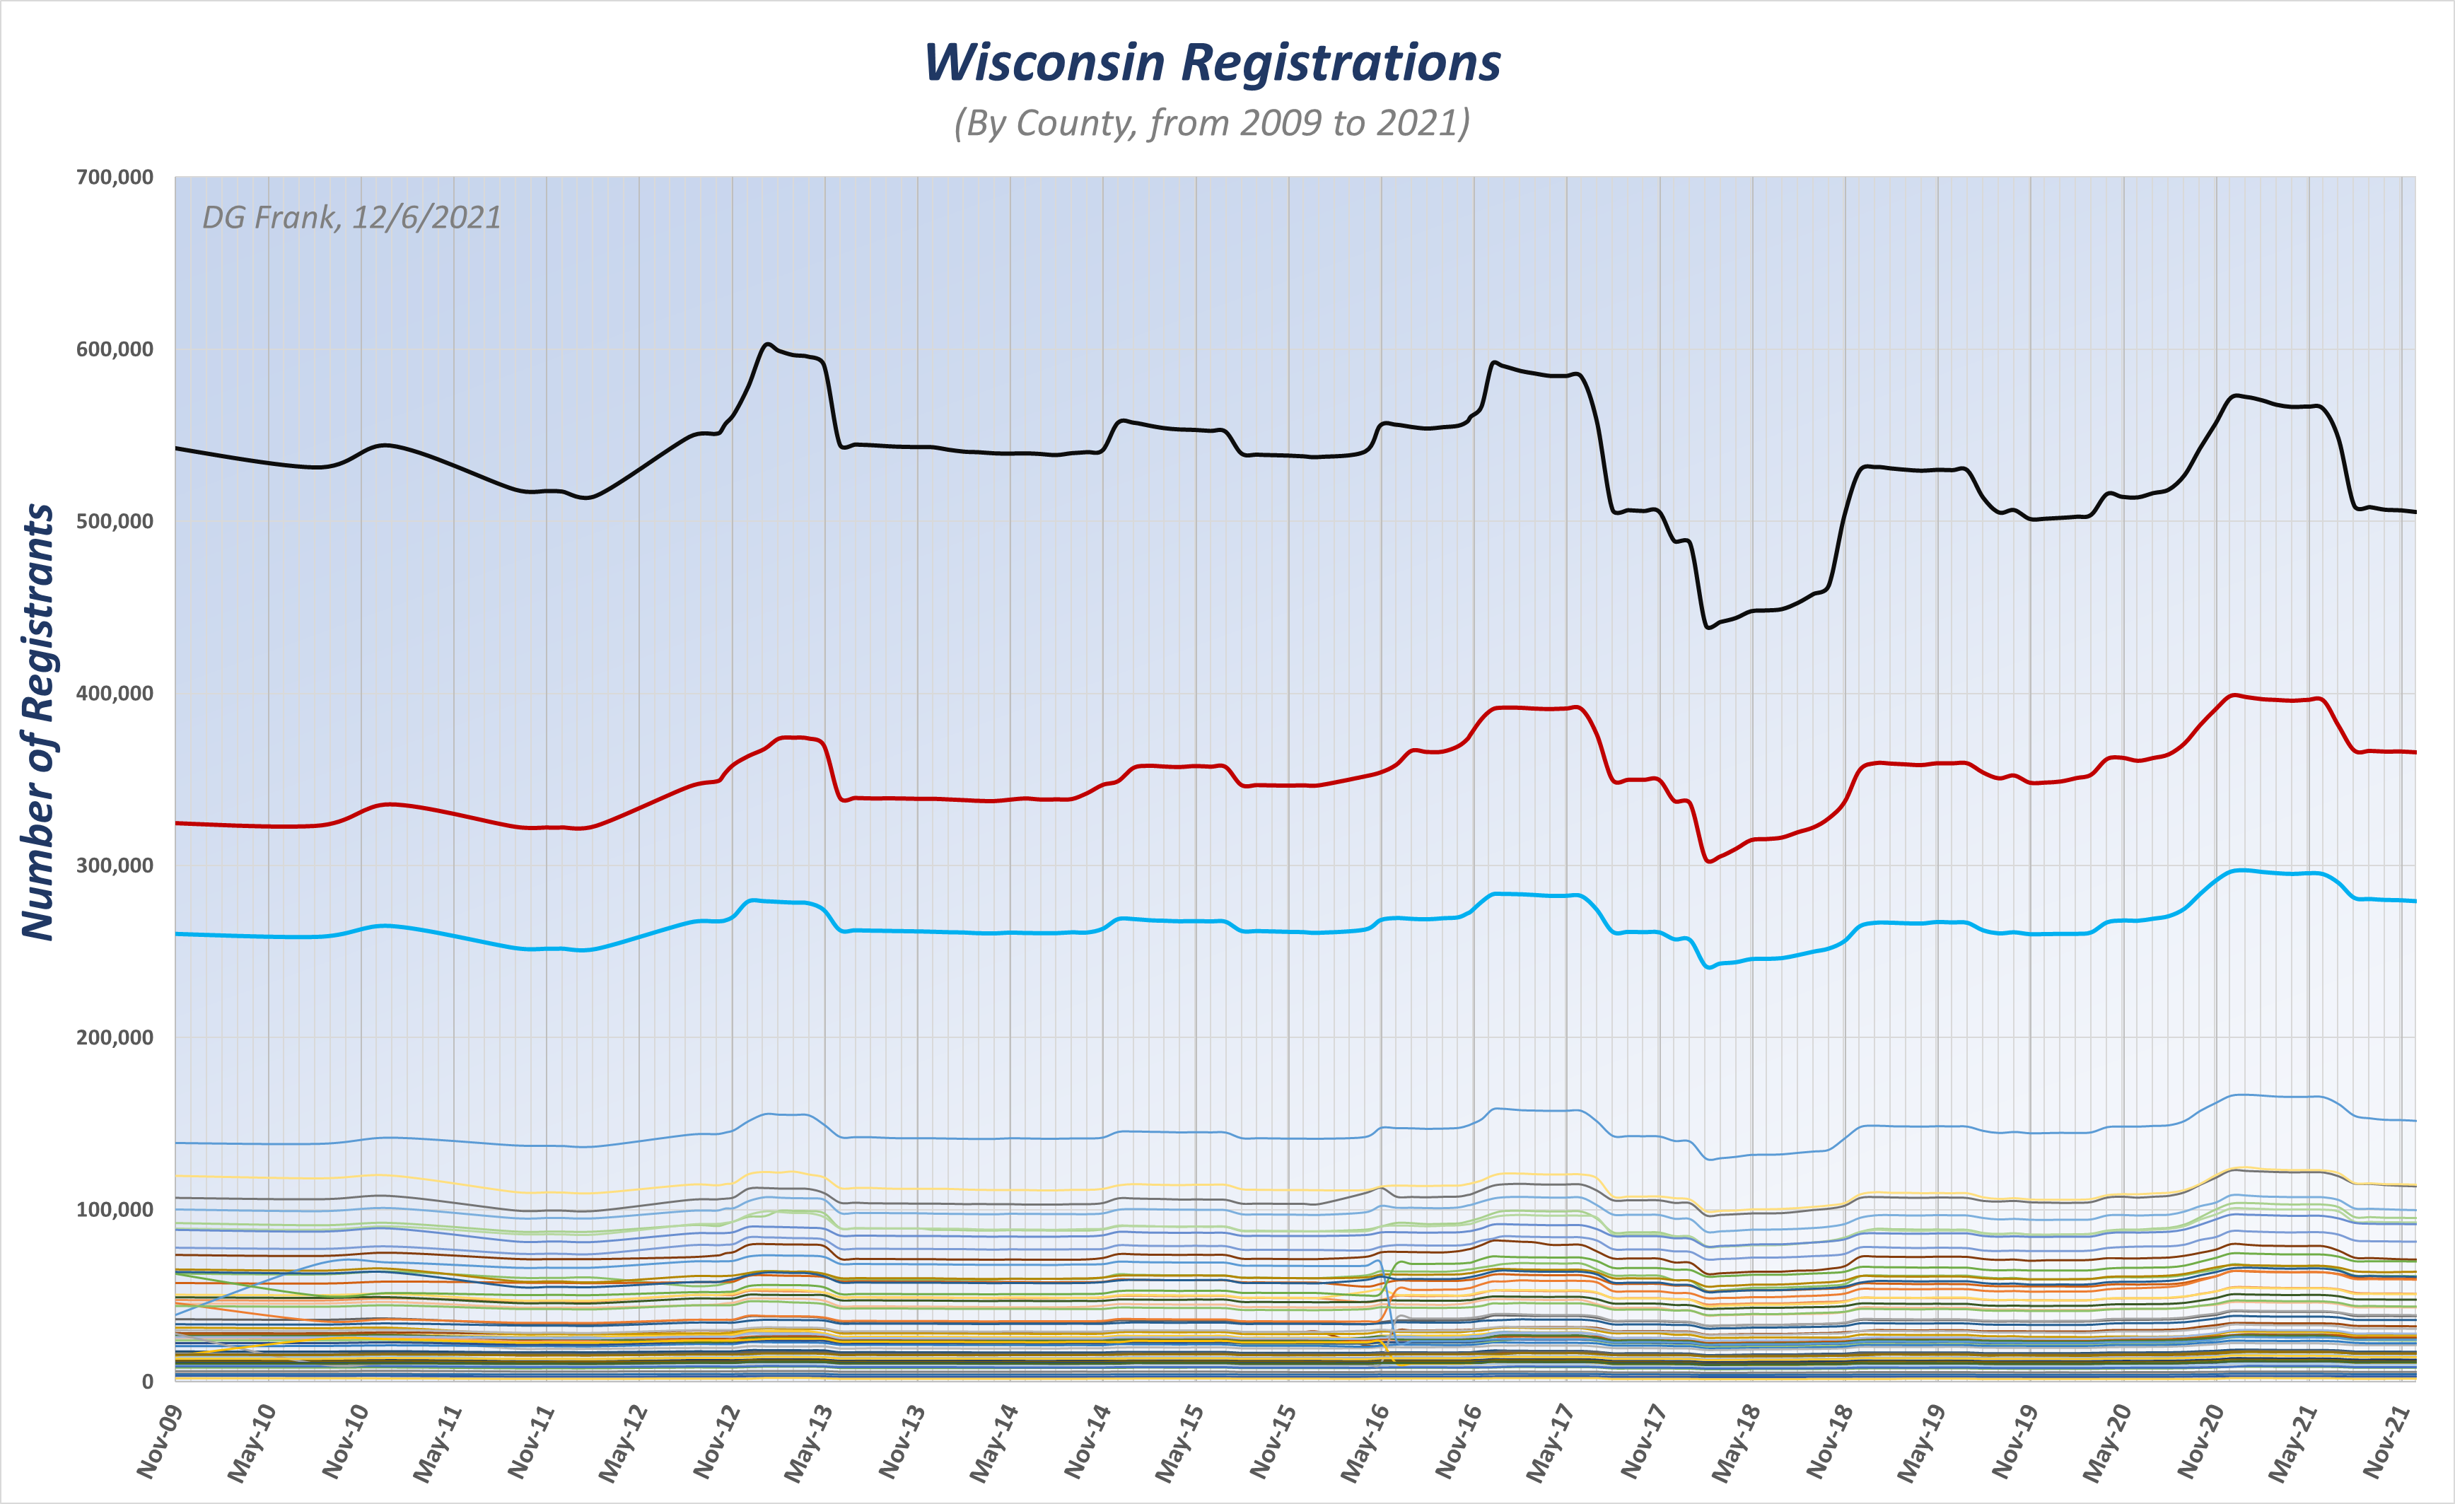
https://elections.wi.gov/elections-voting/statistics

Slide 3
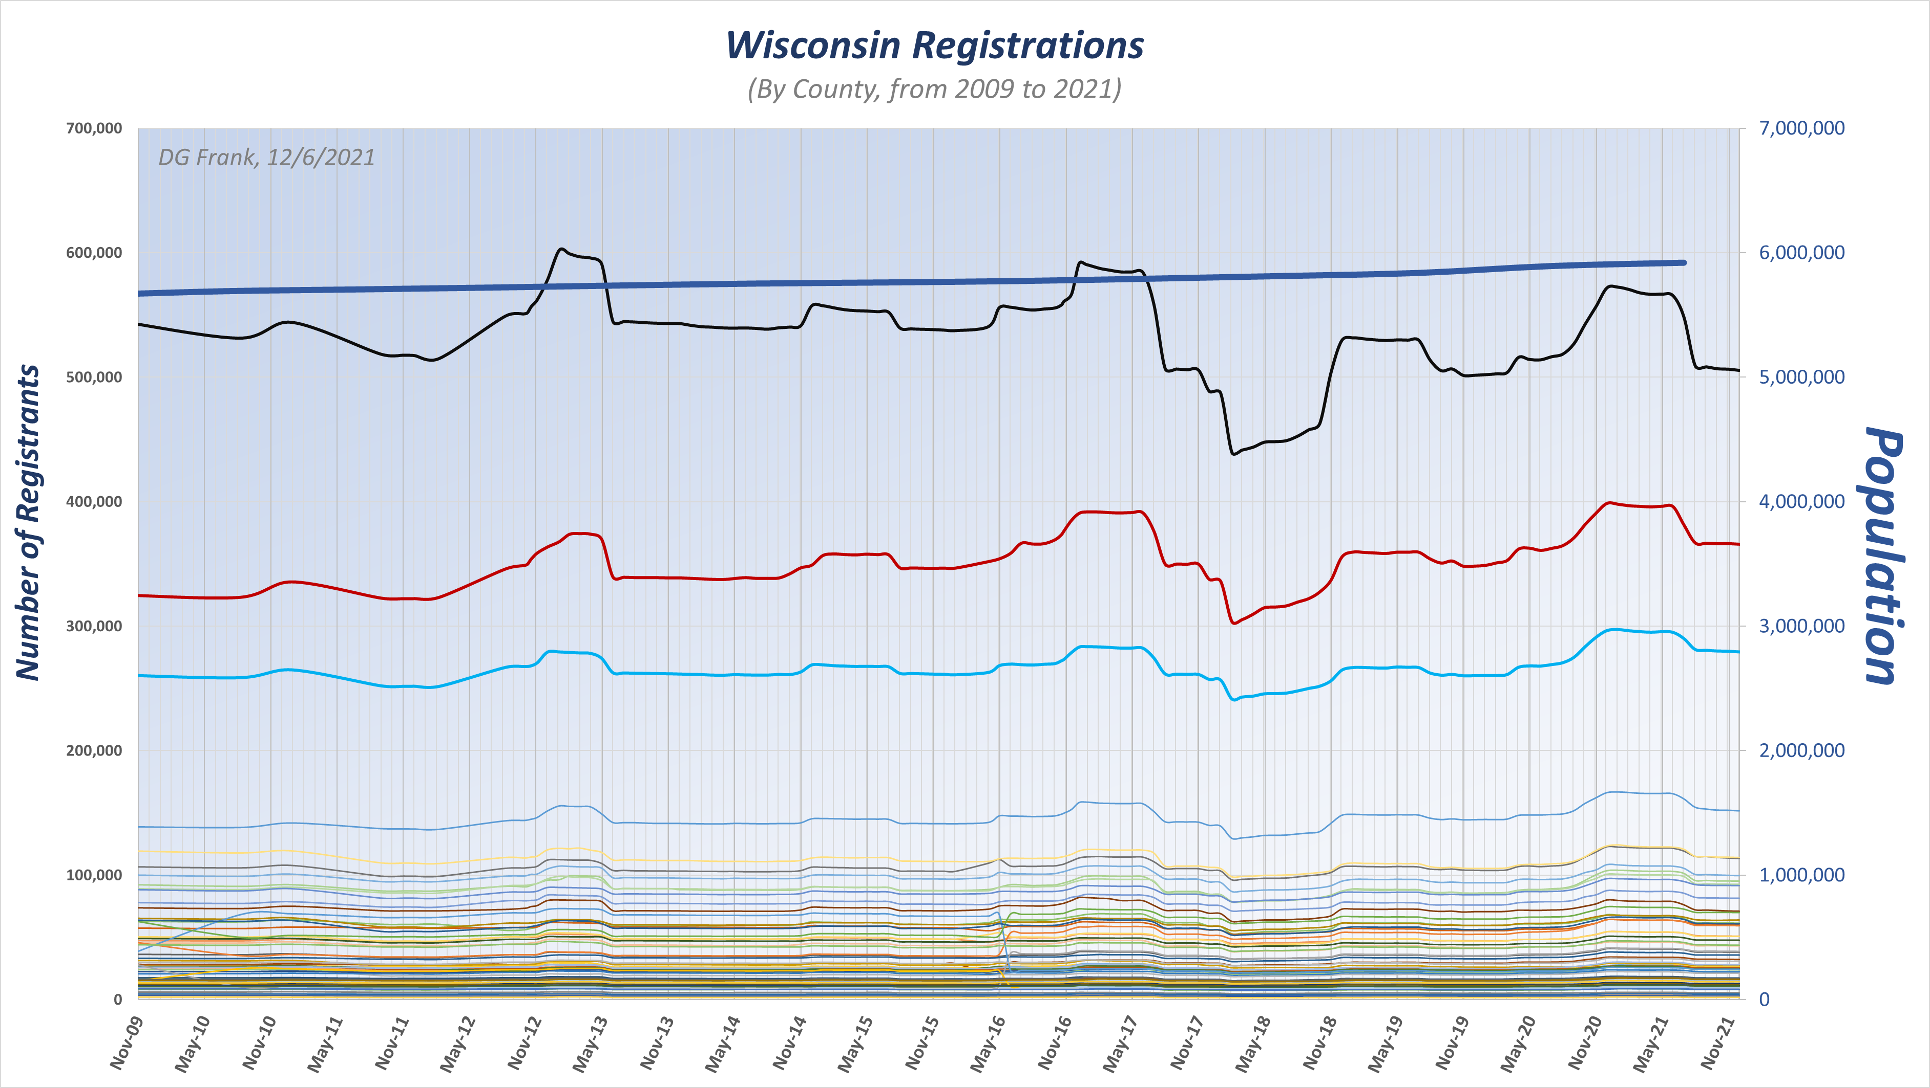
https://elections.wi.gov/elections-voting/statistics
Total Population

Slide 4
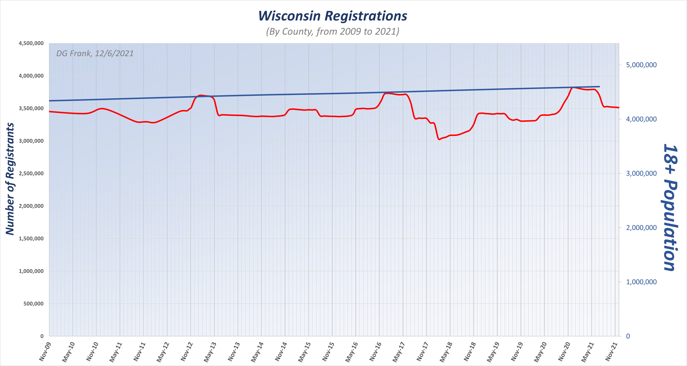
18+ Population
Total Registrations

Slide 5
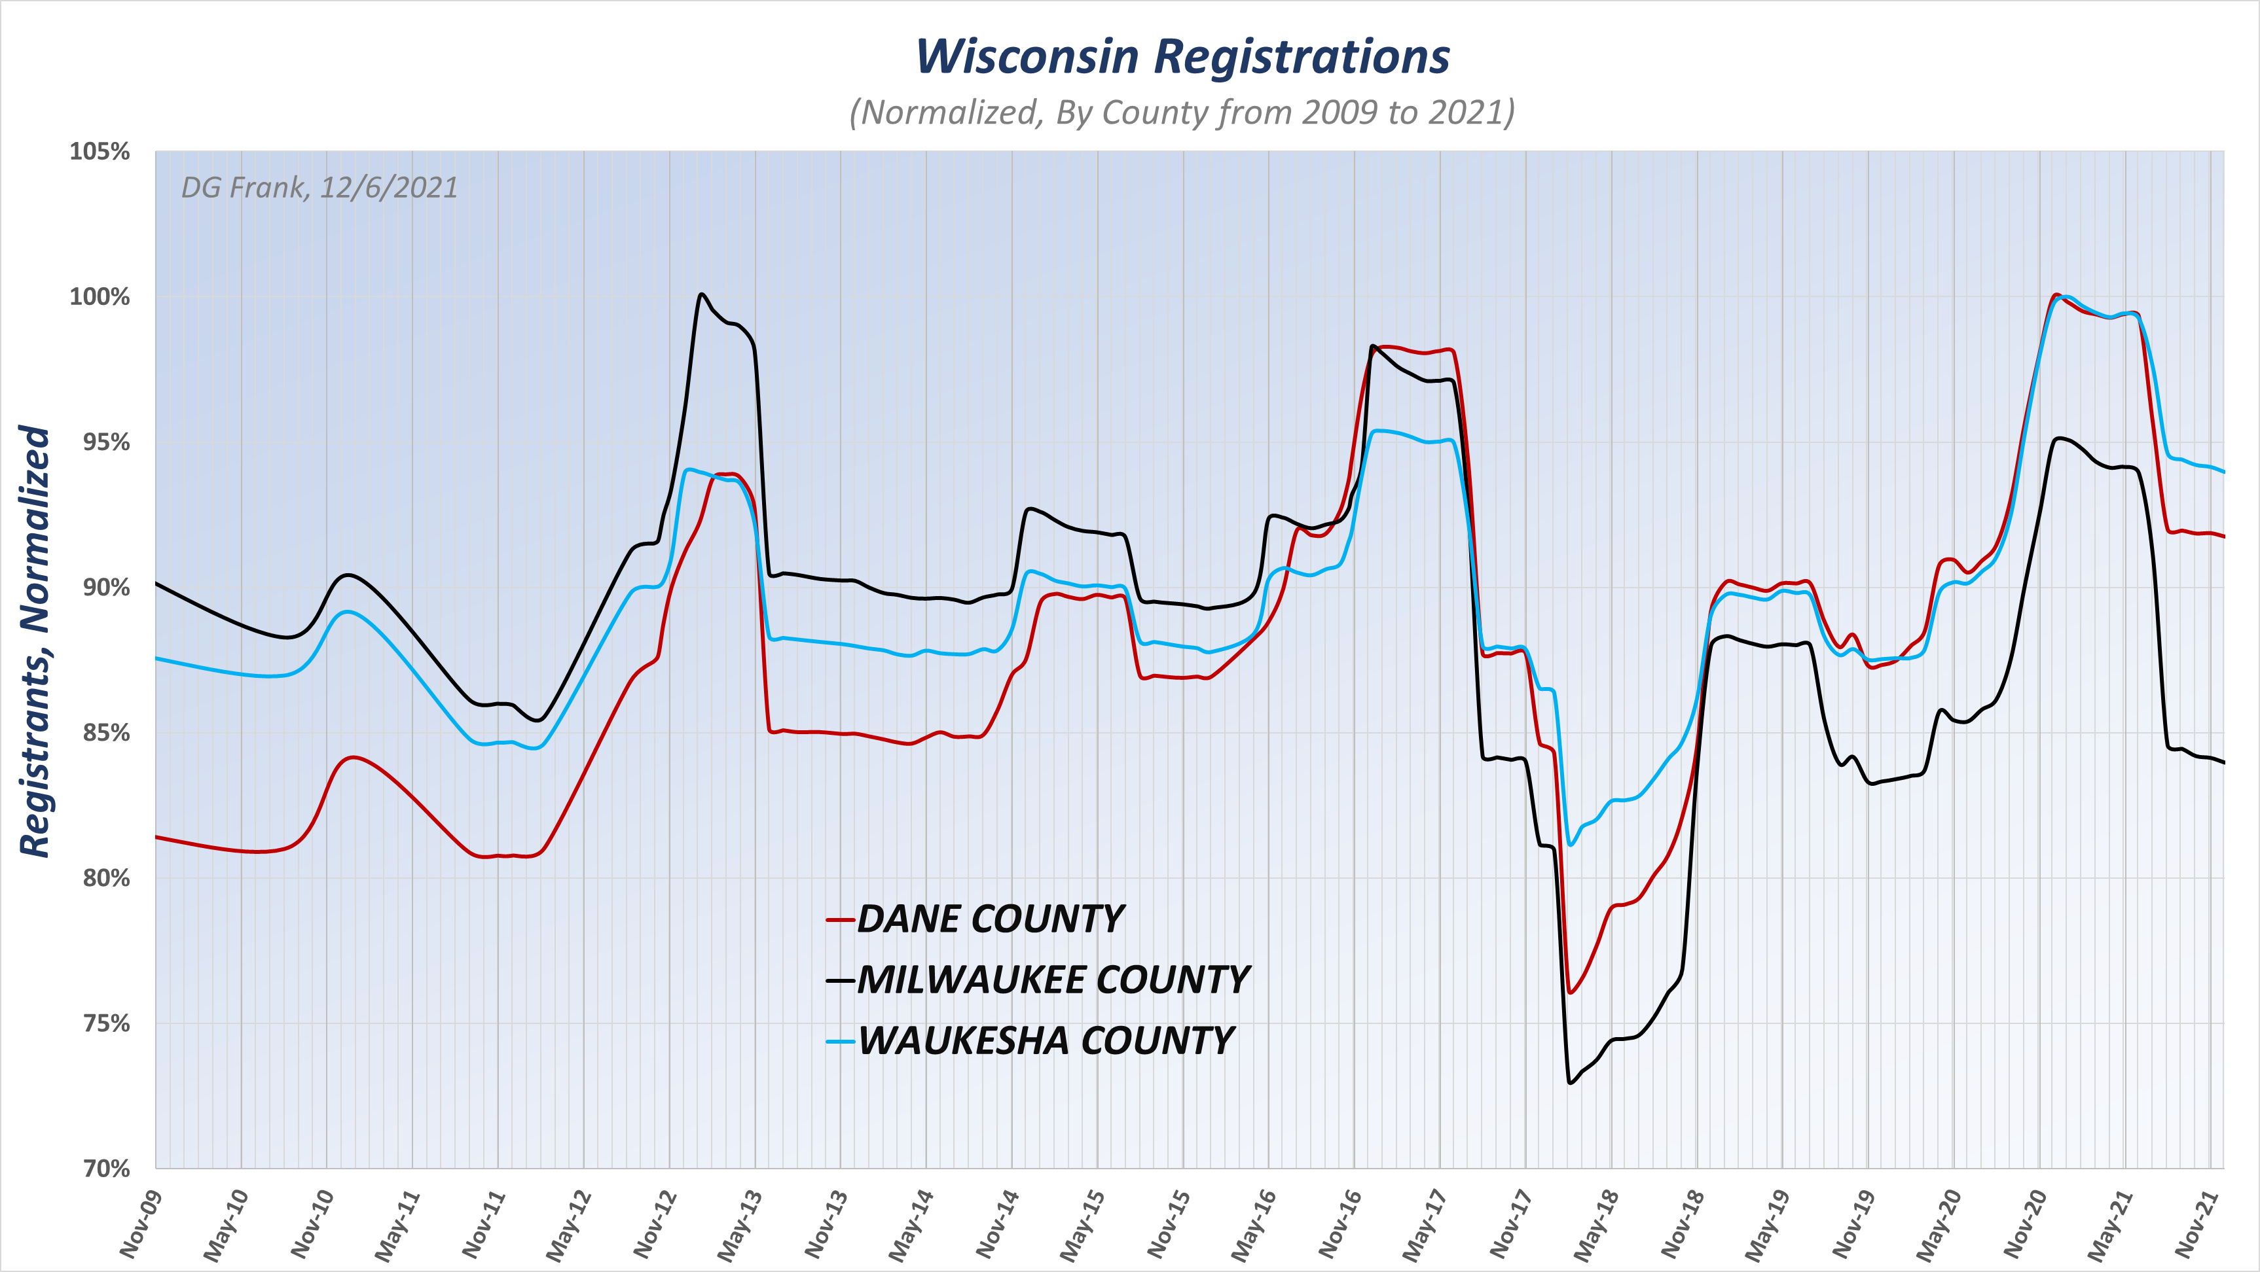
25%
Added Back

Slide 6
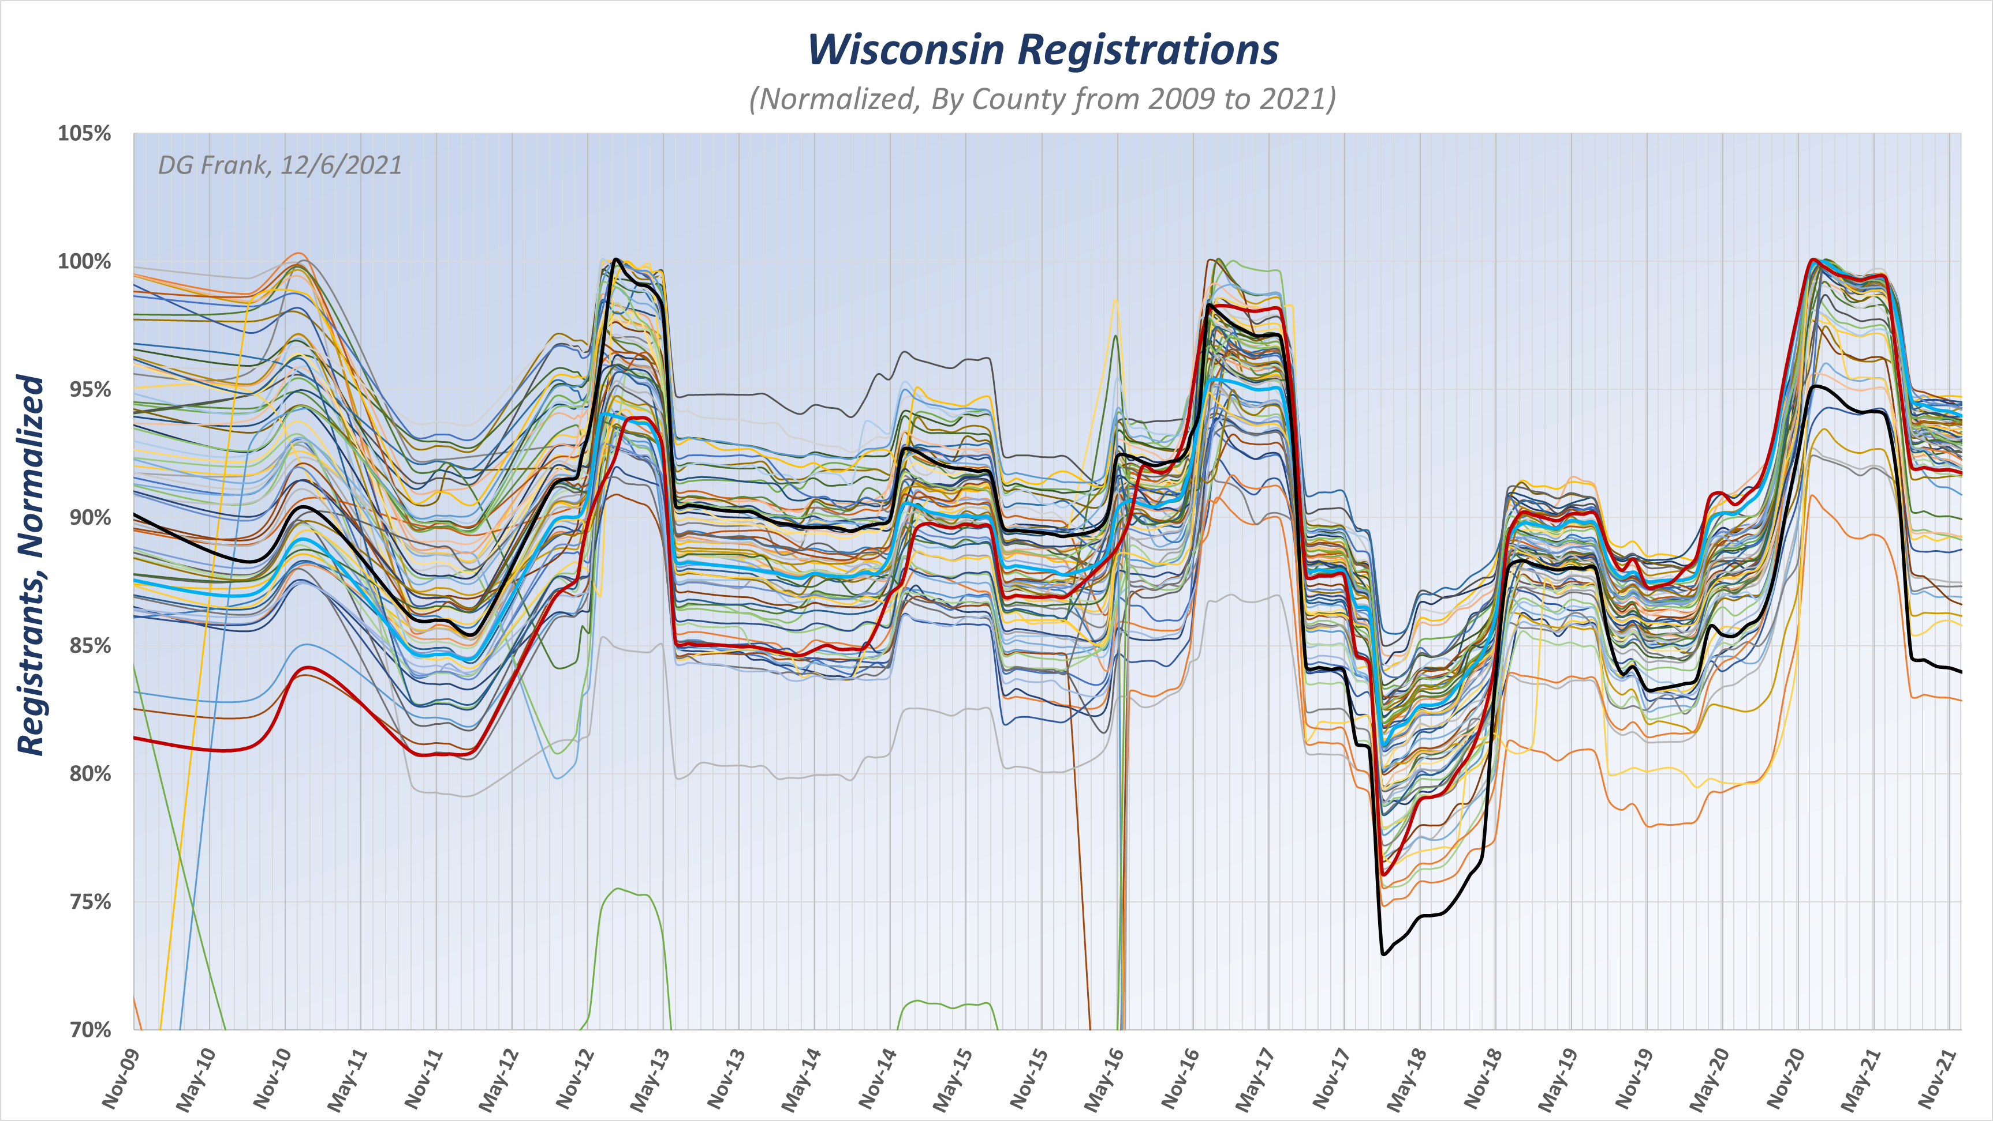

Slide 7
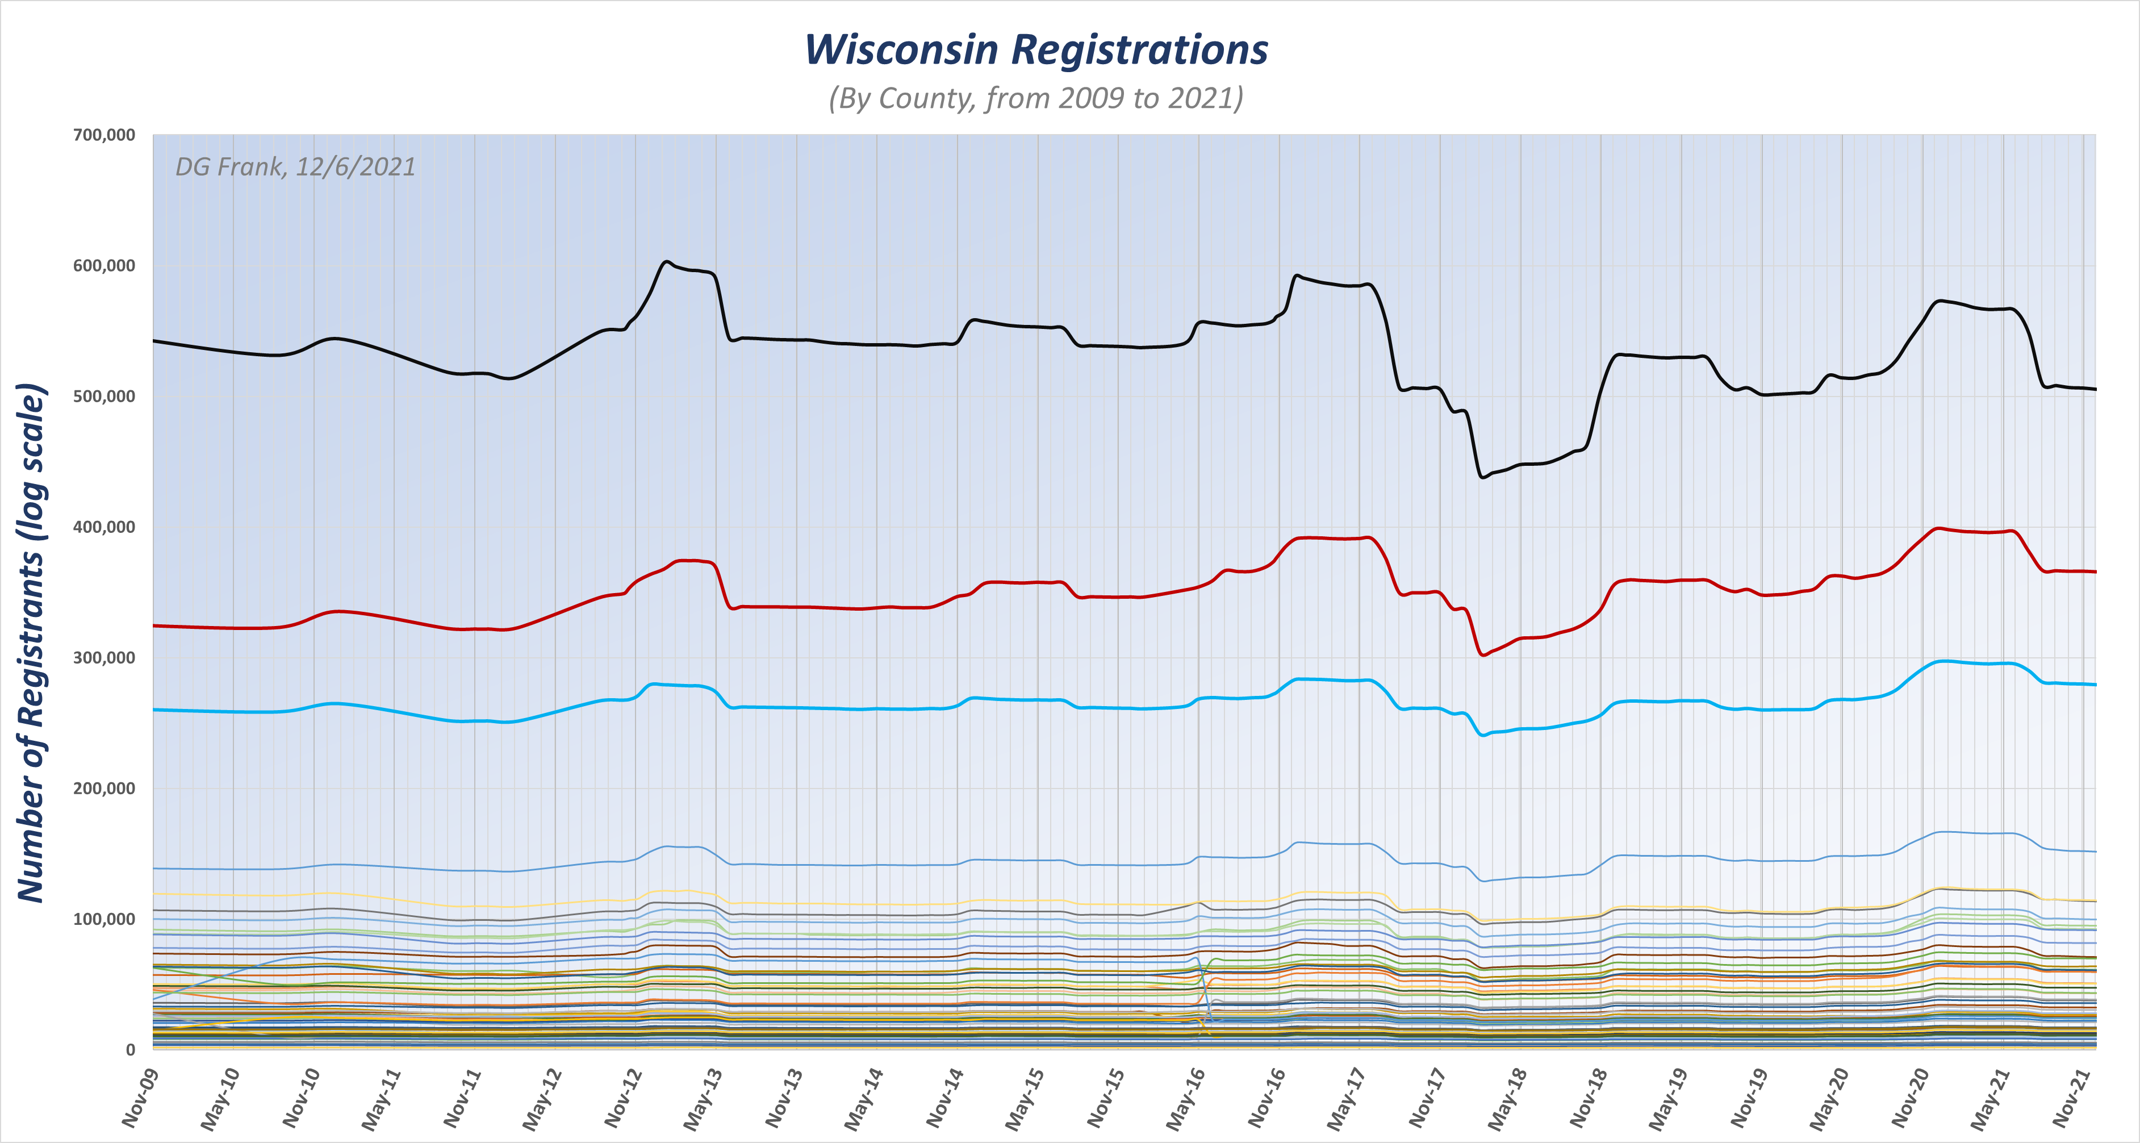

Slide 8
