Slide 1
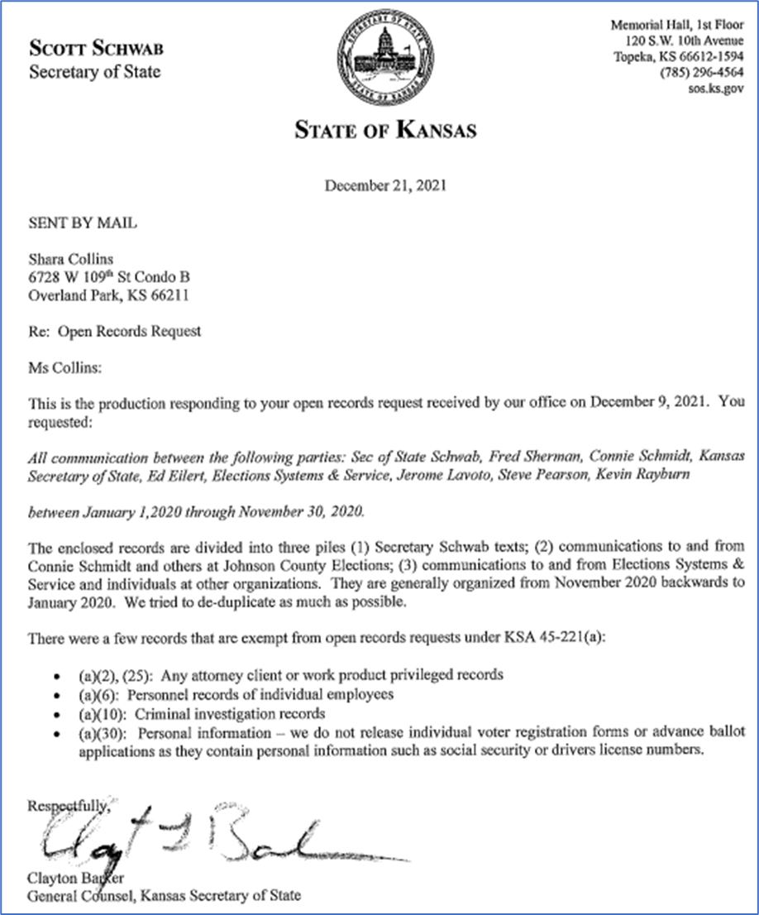
Analysis of KORA Communications
E-mail and Text Communications
From: KS SOS, JOCO Elections Commissioner, & ES&S
Date Range: January 2020 to November 2020

Slide 2
The 14 KORA Files Analyzed
1. KORA File: 20211223080824428.pdf, 91 pages, 09/10 - 11/24/2020, Text Messages & Email from Connie Schmidt
2. KORA File: 20211223080943689.pdf, 51 pages, 06/02 – 09/09/2020, Connie Schmidt
3. KORA File: 20211223081034342.pdf, 76 pages, 03/23 - 06/19/2020, Connie Schmidt
4. KORA File: 20211223081143828.pdf, 65 pages, 03/23 - 06/19/2020, Bryan Caskey
5. KORA File: 20211223081239239.pdf, 69 pages, 07/30 – 10/01/2020, Bryan Caskey
6. KORA File: 20211223081336815.pdf, 69 pages, 06/11 – 07/27/2020, Bryan Caskey
7. KORA File: 20211223081439003.pdf, 79 pages, 05/08 - 06/16/2020, Bryan Caskey
8. KORA File: 20211223081525057.pdf, 72 pages, 05/7 – 05/8/2020, Bryan Caskey – mostly a System Manual
9. KORA File: 20211223081608006.pdf, 67 pages, 05/7 – 05/8/2020 – a continuation of the above System Manual
10. KORA File: 20211223081657816.pdf, 64 pages, 04/21 - 05/05/2020 – a few emails from Bryan Caskey, more Manual
11. KORA File: 20211223081726636.pdf, 35 pages, 04/10 – 04/17/2020, Bryan Caskey
12. KORA File: 20211223081824991.pdf, 76 pages, 02/25 – 04/08/2020, Bryan Caskey
13. KORA File: 20211223081908792.pdf, 71 pages, 11/07/2019 – 02/20/2020, a Power Profile Manual
14. KORA File: 20211223082015496.pdf, 68 pages, 11/07/2019 – 02/27/2020, Bryan Caskey

Slide 3
Summary of Findings
NOTE: Because of how the KORA Files are segregated by individuals; the following slides not in chronological order, but are close.. Pay attention to the dates provided.
Slide 36: Jan. 28 & Feb. 20: Acknowledgement that KS is using ExpressVote Software, Vers. EVS 6040 and requesting to upgrade to Vers. 6043.
Slide 34: March 20: The pandemic caused the election staff to work from home, requiring the capability to work within ELVIS, the ES&S Election Software to be accessed from home via the internet.
Slide 33: April 17: Installation of ELVIS Ver. 14.5 statewide was planned for May 9, 2020
Slide 29: May 8 & June 3: Pre and Post ELVIS 14.5 Software upgrade; planning and software issues; inability to track user activity.
Slide 28: June 16: ES&S informs KSSOS that they will not certify ExpressVote vers. EVS 6043
Slide 26: June 22: Due to apparent security concerns with ELVIS, Bryan Caskey, Dir. Of Elections, asks for a phone call with Victor Williams, Sr. Vice Pres-Product Development of ES&S. Nothing more stated.
  I think this is related to the June 3rd email regarding the inability to track user activity. Perhaps outside activity couldn’t be spotted either….?
Slides 26 & 27: July 3 & 4: EI-ISAC (Election Infrastructure-Information Sharing & Analysis Center) a unit of CISA (Cyber & Infrastructure Security Agency) informed KS SOS & ES&S of potential unauthorized OUTBOUND activity. Victor of ES&S responds, saying that this is legitimate traffic from internal monitoring systems.
  Seems to me that this is the Fox guarding the hen house.
Slide 25: June 17: ES&S – Undetected activity by an employee in ELVIS when using her Token (a physical key to access the network); No remedy or additional conclusion provided.
Slide 24 & 25: June 11 & 12: It is apparent that the Election System is housed on Data Servers in a different state owned by Teirpoint. When a power outage was reported at the location of the server, two counties reported immediately, as their work stops.
Slide 23: Sept. 17: When asked about the presence of “wireless” modems, Angie Frison, ES&S RSM, “guarantees that 100% of Kansas Counties do not have wireless modems installed within precinct and central count scanners purchased from ES&S.
  They mention nothing about “wired” internet connections.
Slide 19: Oct. 1, 2020: Pro V&V, a third party auditor, concluded that although there was 1 discrepancy in the ExpressVote software it had no impact on functionality.
Slide 20: Oct. 1, 2020: ES&S admits they failed a validation test of the ExpressVote Software, but claim this has no impact on the performance of the machine and accuracy.
Slides 16, 17, &18: May 21, 2020: The BOCC approved DS200’s for every polling place”… in JOCO. The DS200 is a Scanner & Tabulator. The “Express Vote” mentioned is a “ballot marking device” reportedly used in Shawnee, Wyandotte, Sedgwick and Johnson Counties….

Slide 4
Summary of Findings
Slide 15: April 1: Sedgwick Co purchased voting software from EasyVote. EasyVote’s website, states their data is stored in the AZURA Cloud rather than on servers.
Slide14: March 24: JOCO Election Employees Work From Home Solution – allows employees to communicate to ELVIS – the Election Voter Information System, via the internet, in order to process voter registrations and advance mail ballot applications. ELVIS is software made by ES&S.
Slide 13: July 1, 2020 JOCO participates in the EI-ISAC Election Systems Pilot Program. And Sept. 1, JOCO is aware of 7 Drop Boxes they will receive.
Slide 12: Sept. 21, 2020: Re, Mail Ballot Cancellation Requests. Because this election system and approach was being custom designed on the fly, there was no consistency on how to address issues in a standard approach across all counties. Thus, voters were not treated the same across the state. This email would indicate that advanced ballots were being mailed out ahead of time; even without a request for one. Hence, the voters were requesting they not be sent.
  Seems like a recipe for chaos and for fraud.
Slide 11: Oct. 8, 2020: Acceptance of the CTCL funding for $856,256 for JOCO and detail about how the money was designed to be spent.
Slide 10: Oct. 16, 2020; This an internal certification of the election system. Shouldn’t there be an External Certification? This is a well crafted letter to report to the public that essentially none of the equipment is ever connected to the internet. Re, CONNECTIVITY – The ElectionWare System operates on a closed, air-gapped network in a locked, secured area…. My cell phone also has an “air-gap” between it and the cell tower, but it can still connected to the internet.
Slide 8 & 9: Oct. 21-26, 2020: Interesting case where a registered democrat reported that he received 5-five letters from the “Center of Voter Information” group. He decided to test the system, making up data on a request for a ballot. His registered Republican wife and son, only received one letter. He self reported after receiving a ballot from JOCO that he falsified data as a test of the system. Because this story reached the news room of KCTV5, they decided to forward this case to the County DA for prosecution.
  This case begs the question, how many times could this have happened?
  The Center of Voter Information probably did not receive a phone call for their part in this… just guessing
Slide 7: Nov. 2, 2020: A citizen reported suspicious USPS Activity. A Black SUV was spotted giving ballots to USPS drivers in a parking lot… USPS explained this was done with their knowledge.
Slide 6: Nov. 12, 2020: Two extremely tight races; both within 0.5% of each other. This underscores the need for election system accuracy.
Slide 5: Nov. 23 & 24, 2020: A post election acknowledgement that the final numbers from the voting software did not balance. The voter history by precinct from ELVIS did not match the votes counted in the vote tabulation software.
  There was concern about how this might look to the public. Subsequent messages provide additional context; as they sought greater reporting capability and more functions to address invalid voters from ES&S.
The ES&S systems are custom made. On several occasions, Change Orders were provided to ES&S to add additional functionality to the voting system.

Slide 5
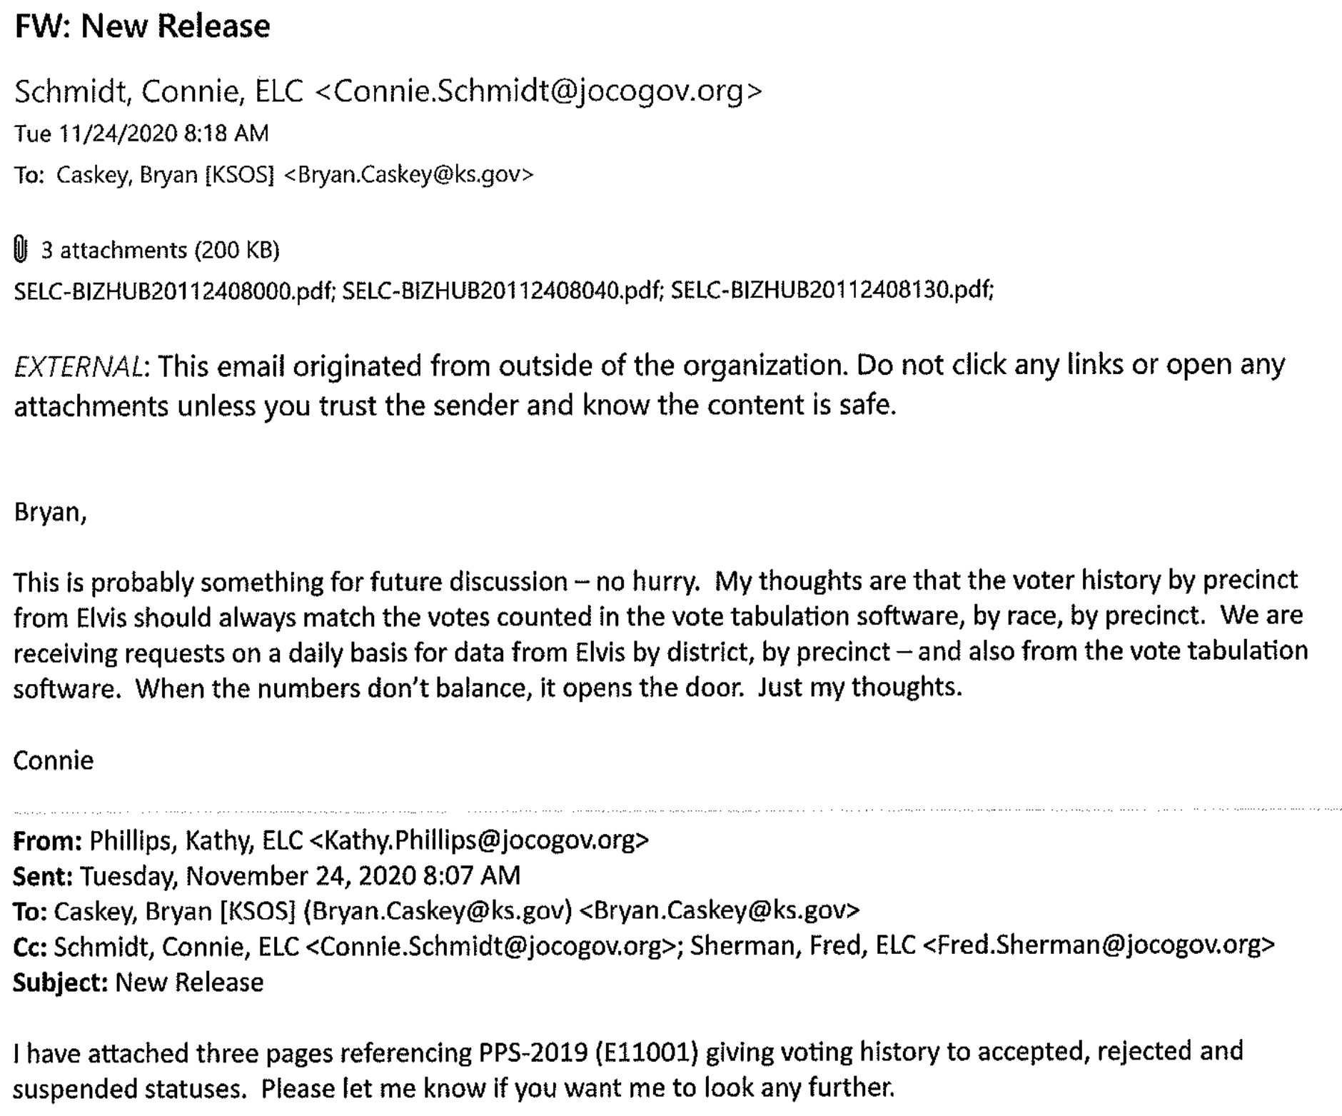
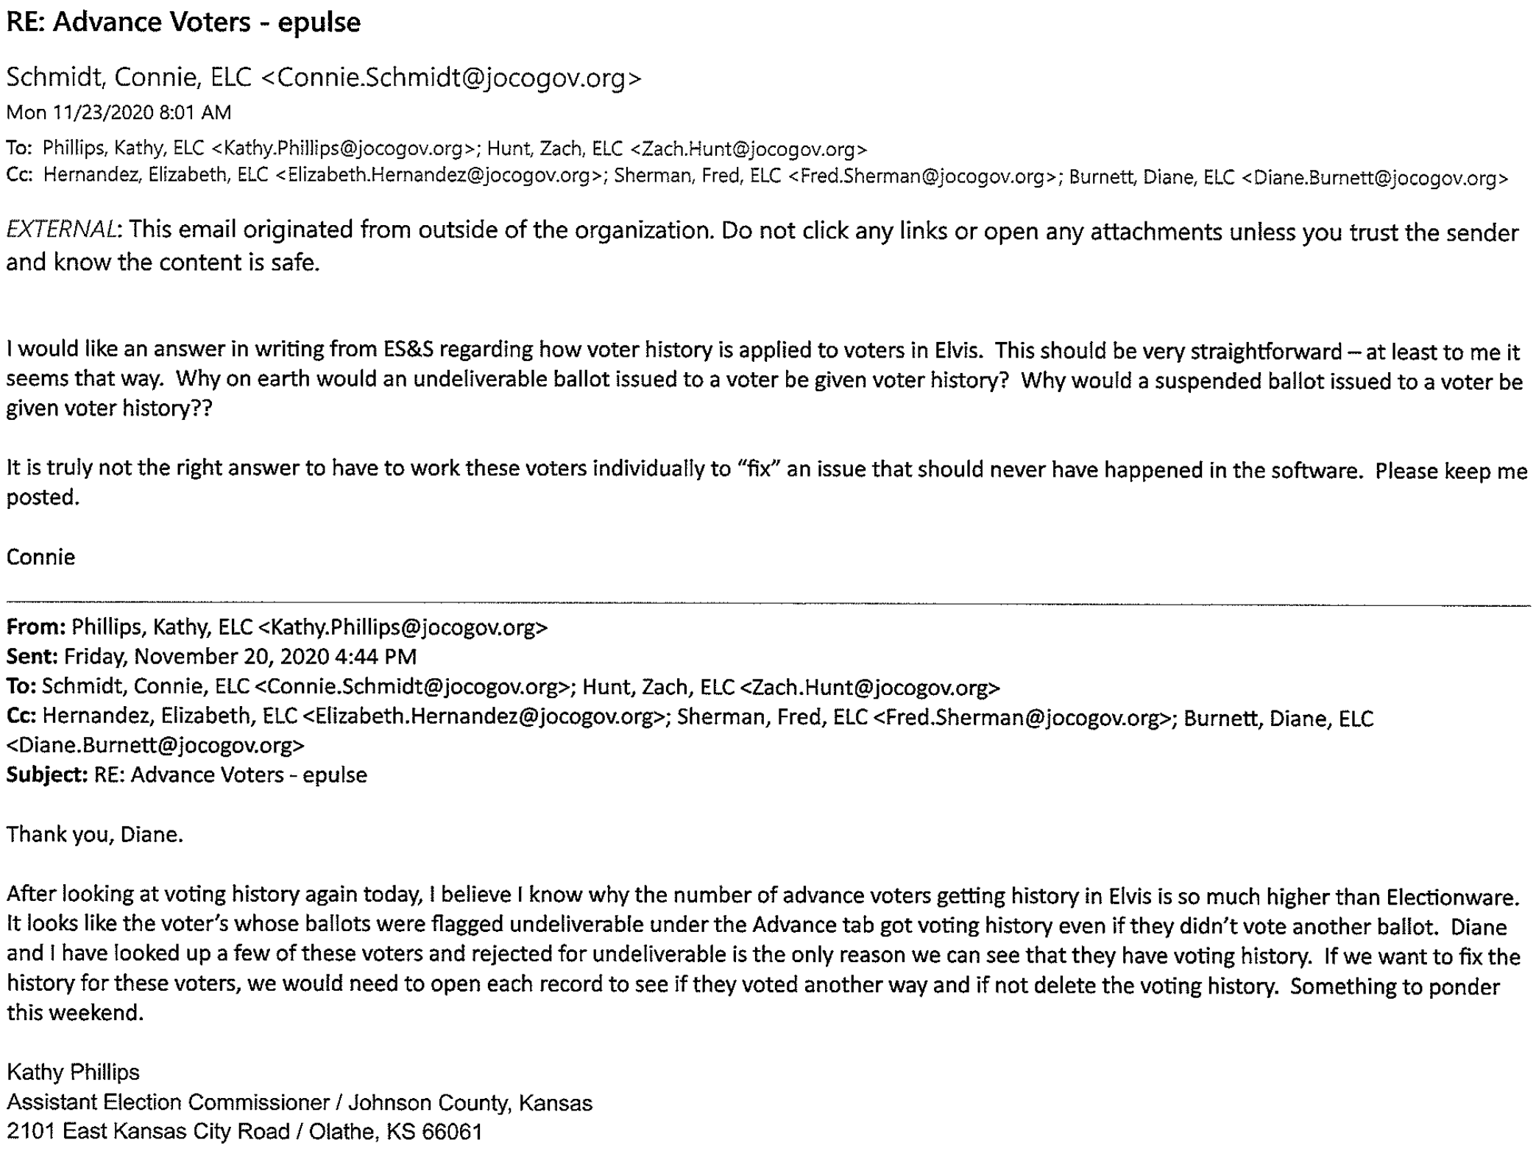
1. KORA File: 20211223080824428.pdf, 91 pages,
Date Range: 09/10 - 11/24/2020, Text Messages & Email from Connie Schmidt
Above, Page 19:
A post election acknowledgement that the final numbers from the voting software did not balance. The voter history by precinct from ELVIS did not match the votes counted in the vote tabulation software.
There was concern about how this might look to the public.
The following pages provide additional context; as they sought greater reporting capability and more functions to address invalid voters.
Above, Page 23:
Post election discrepancy: the number of Advance Voters in ELVIS do not match the number of voters in Electionware.

Slide 6
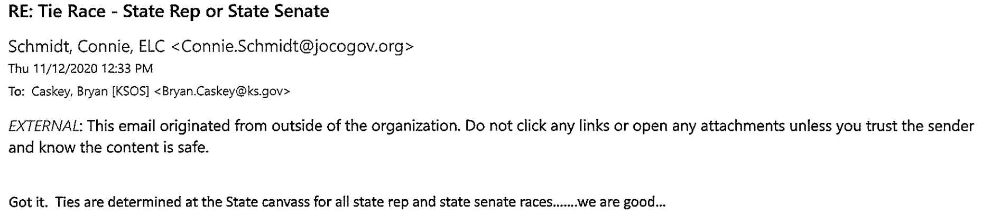
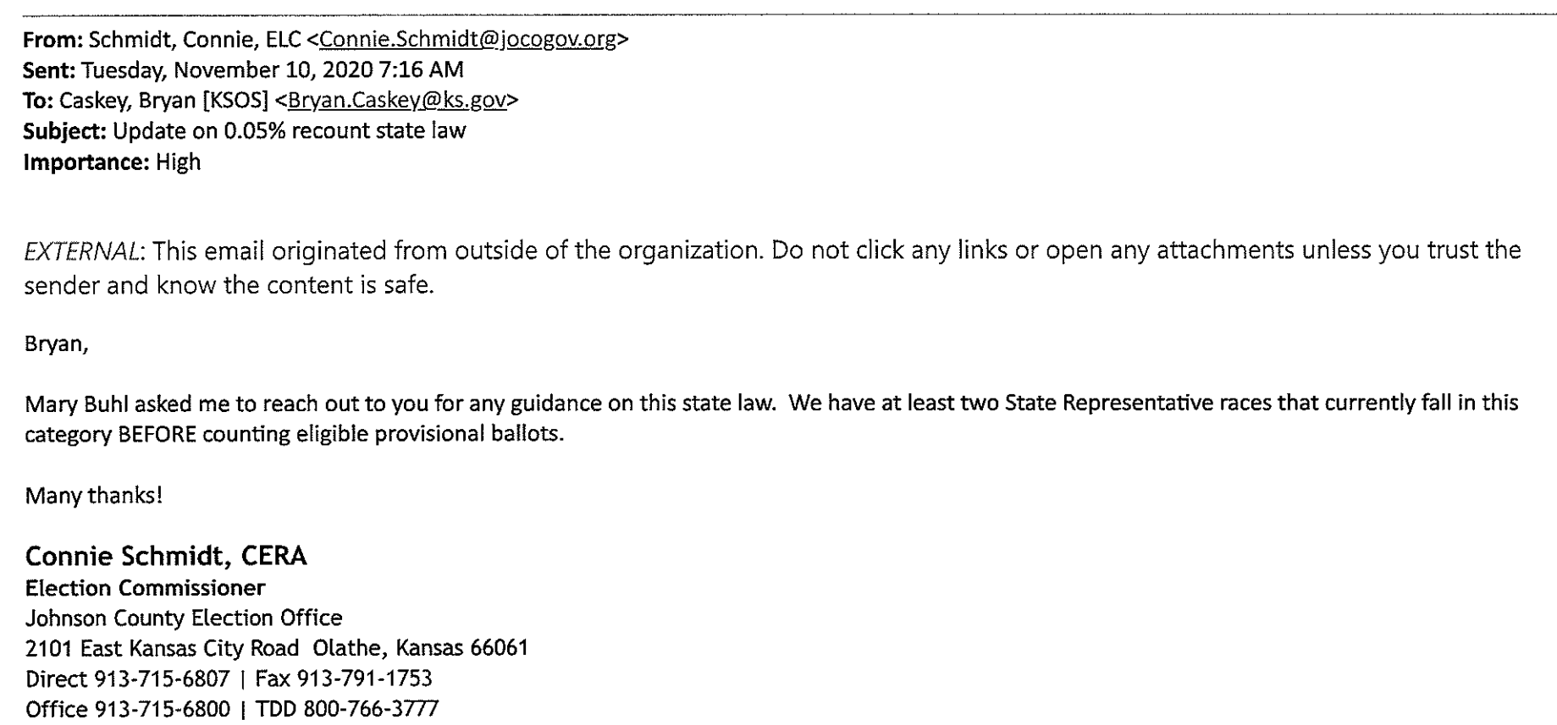
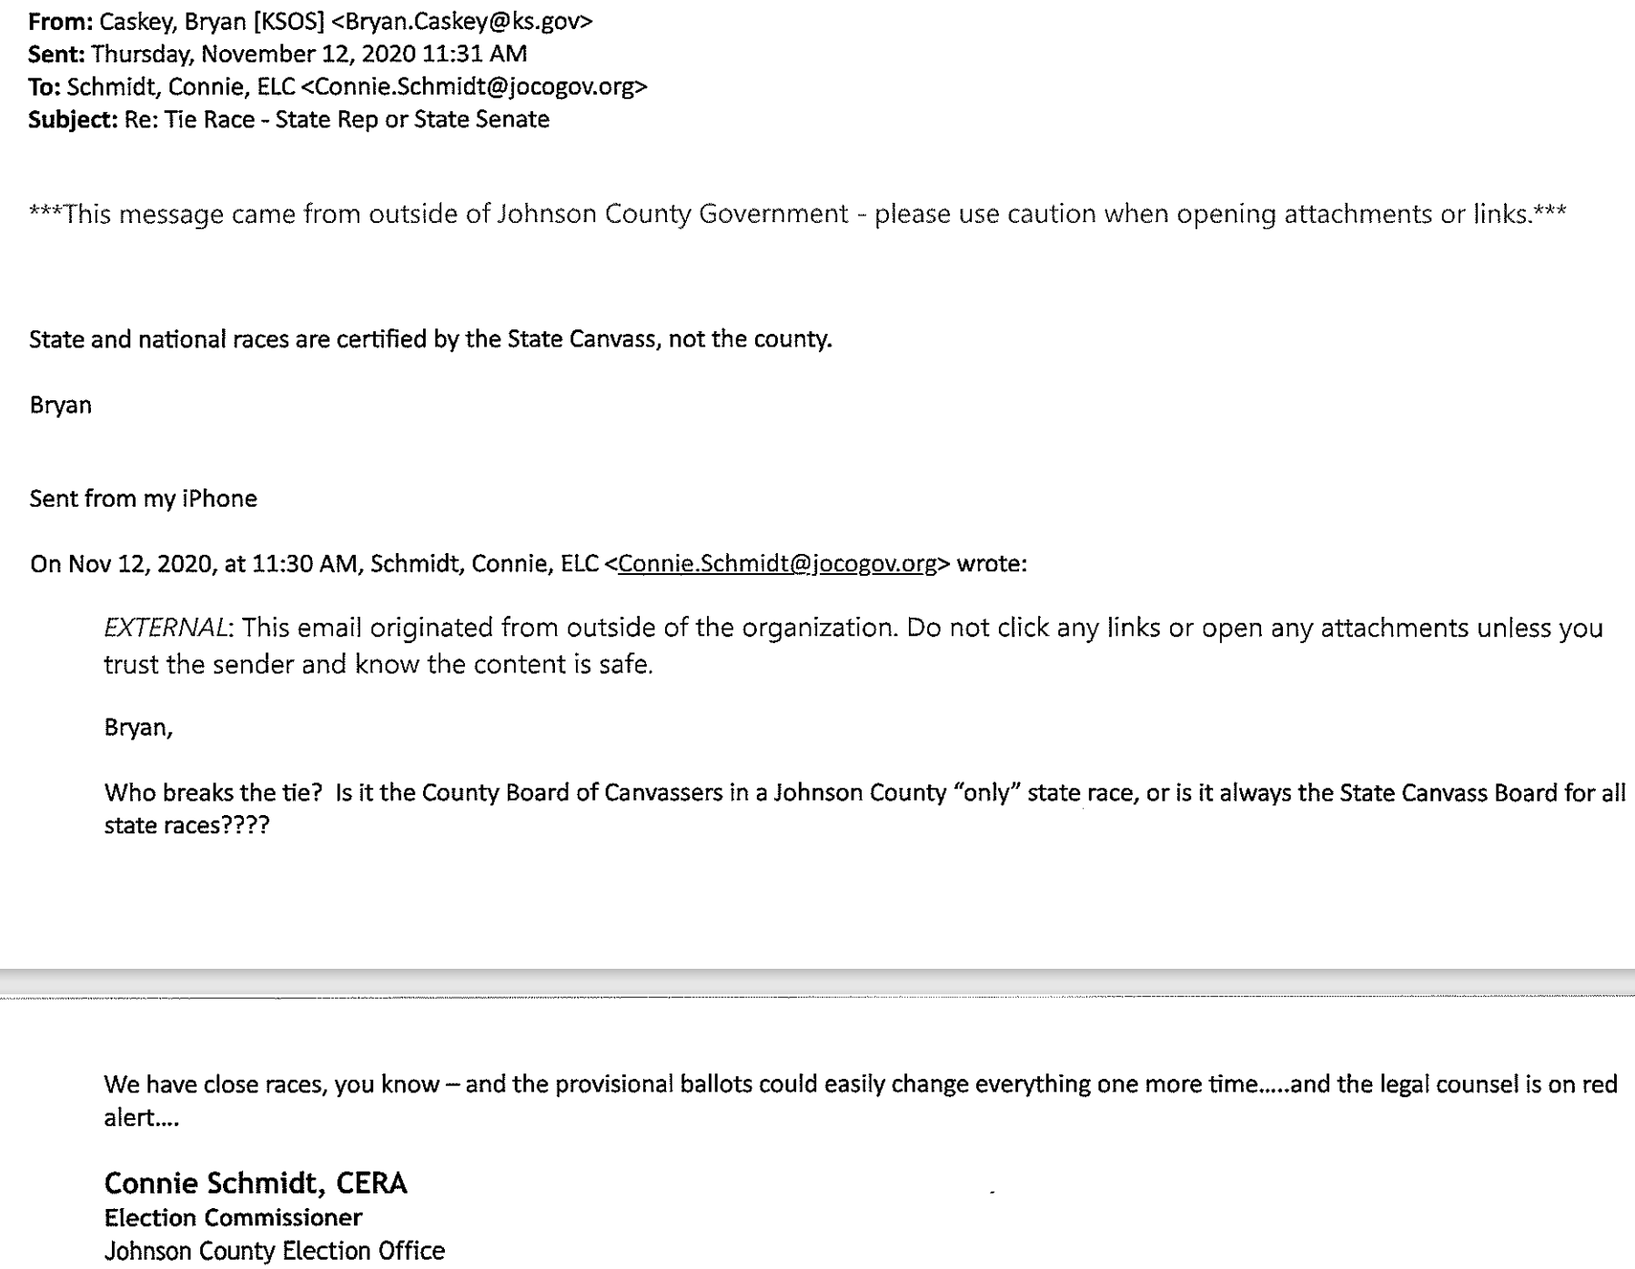
1. KORA File: 20211223080824428.pdf, 91 pages,
Date Range: 09/10 - 11/24/2020, Text Messages & Email from Connie Schmidt
Left, Pages 29 & 30:
Acknowledgement of very tight races.
Above, Page 32:
Two extremely tight races; both within 0.5% of each other.

Slide 7
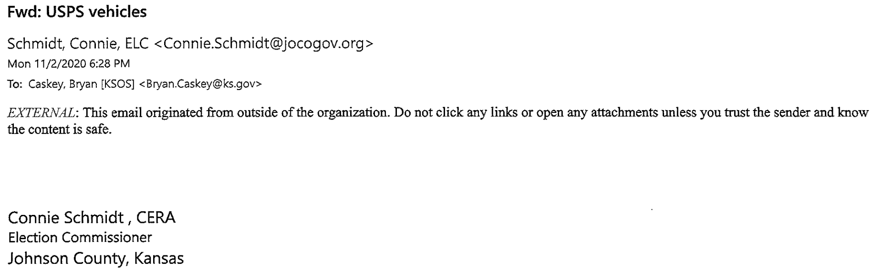
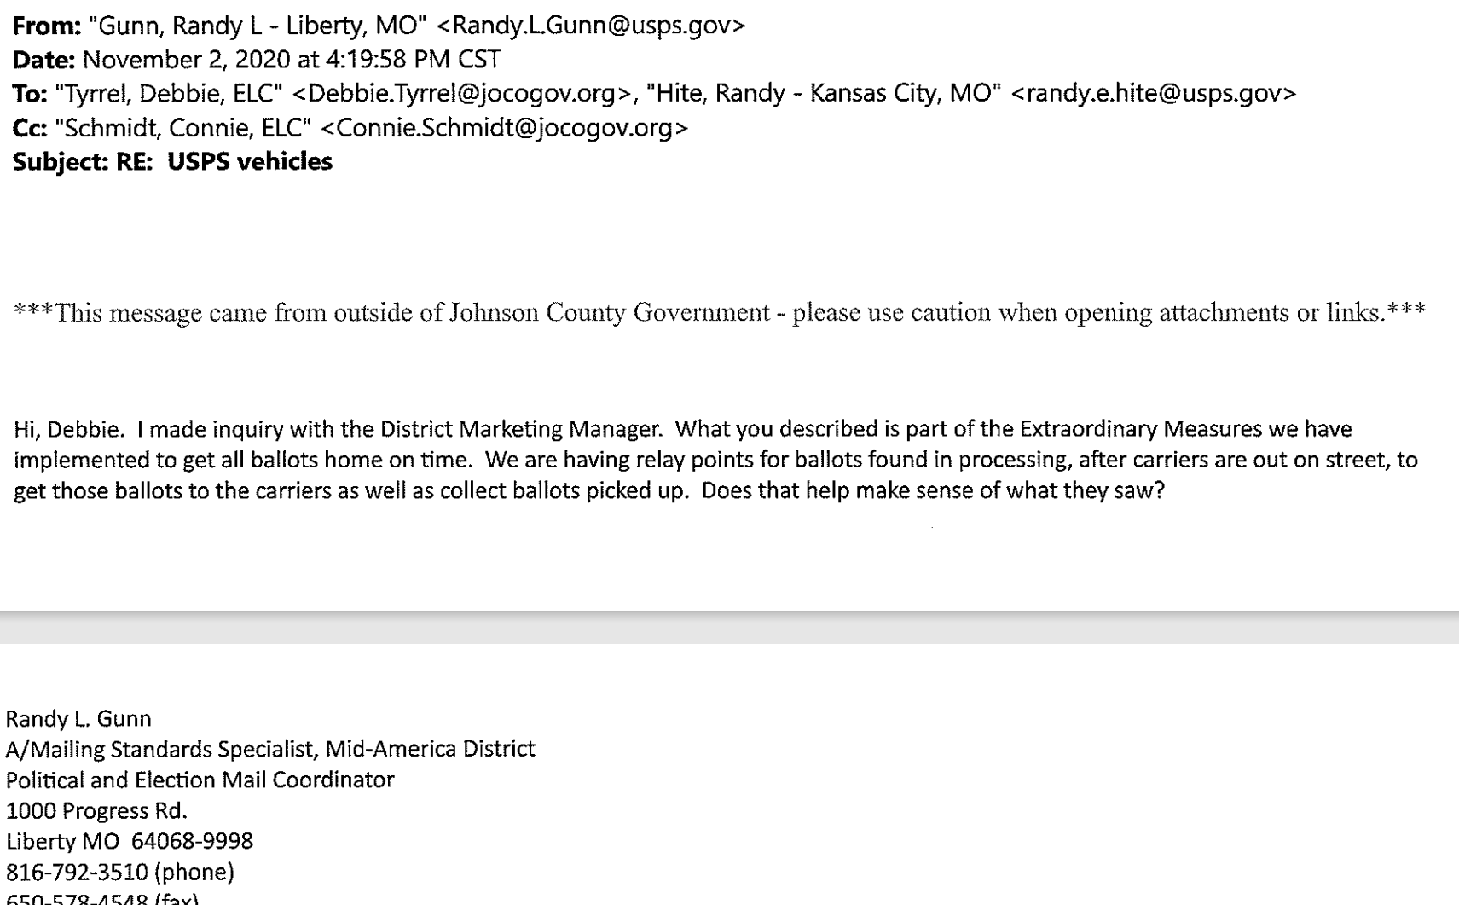
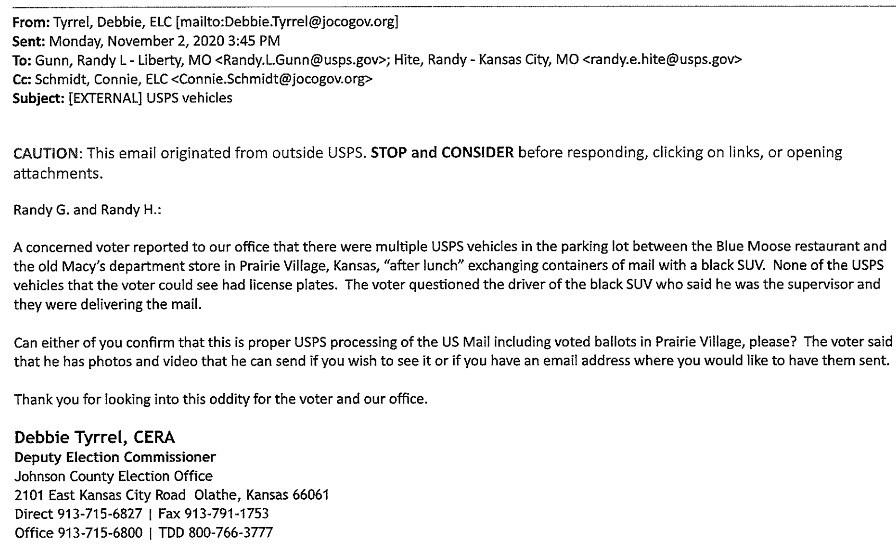
1. KORA File: 20211223080824428.pdf, 91 pages,
Date Range: 09/10 - 11/24/2020, Text Messages & Email from Connie Schmidt
Left & Above, Pages 37 & 38:
Suspicious USPS Activity
Black SUV giving ballots to USPS drivers in a parking lot…

Slide 8
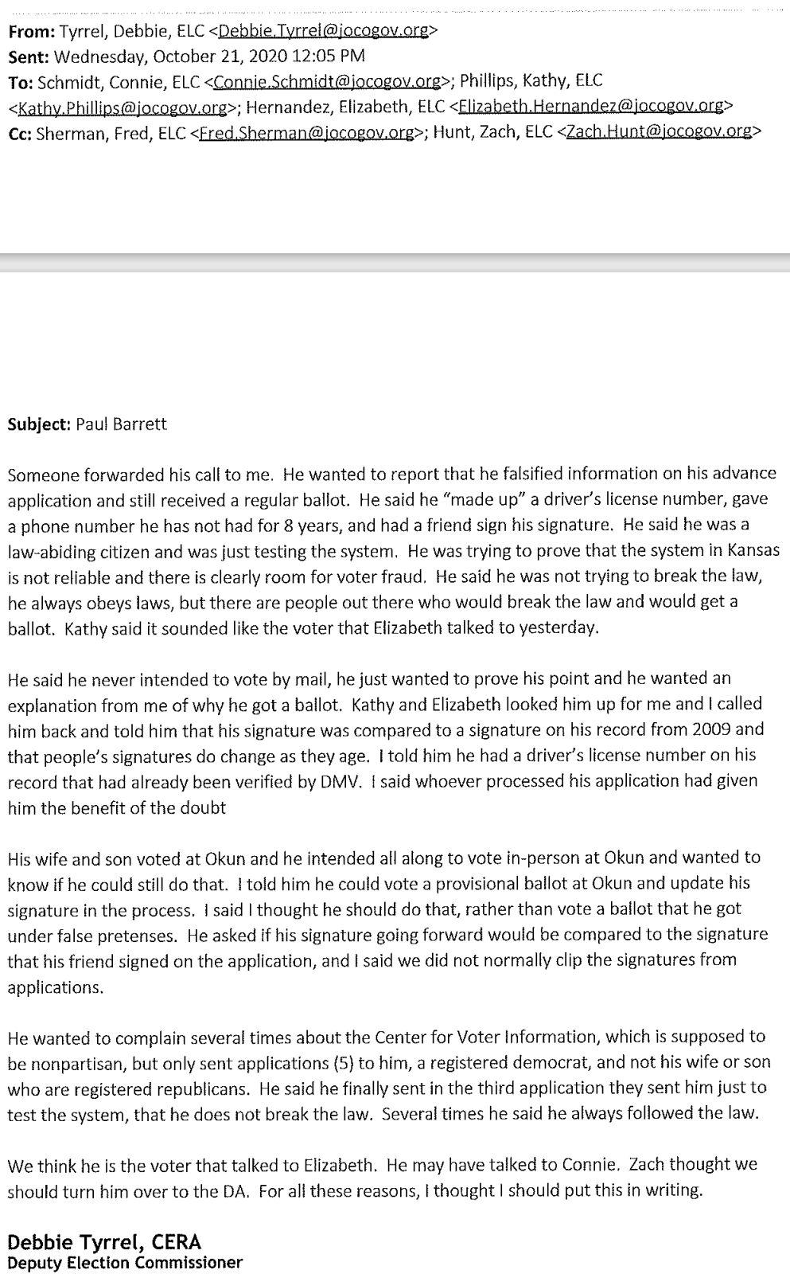
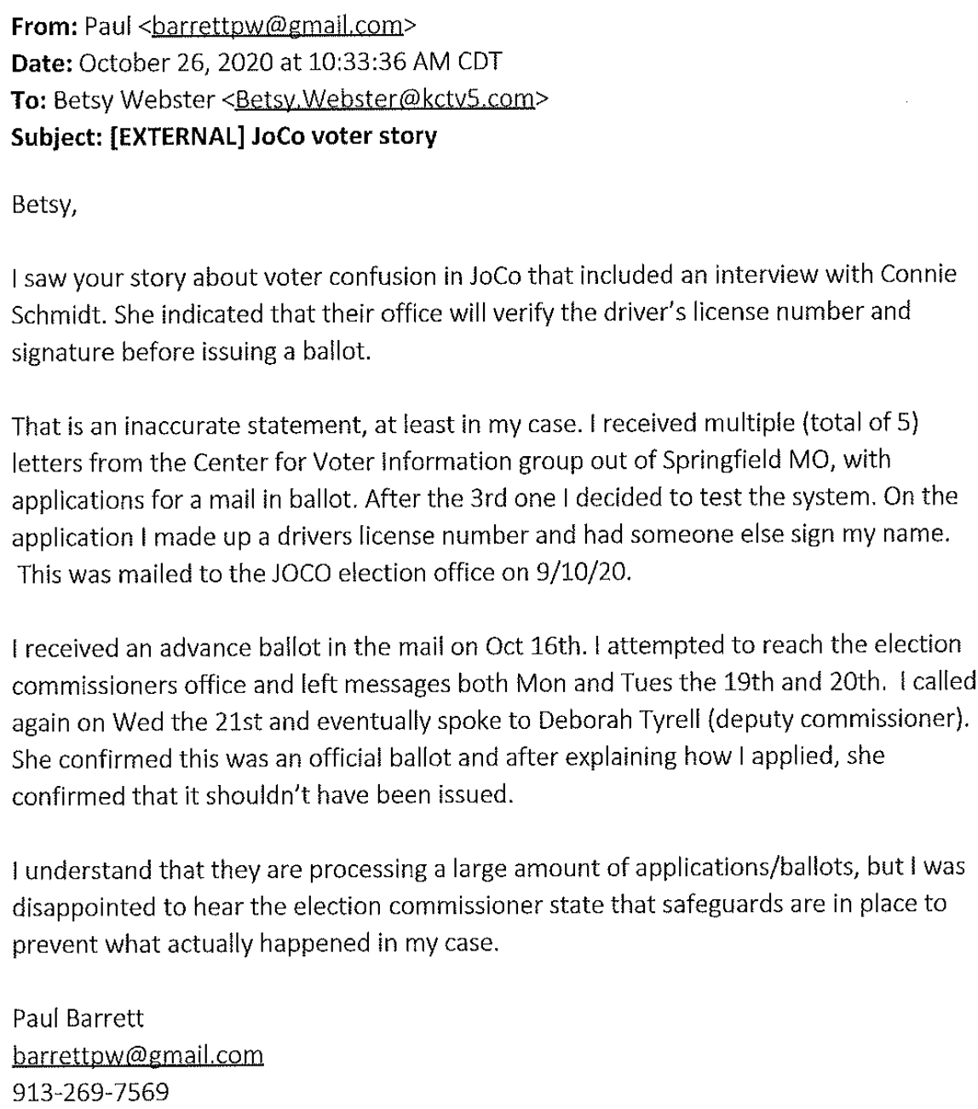
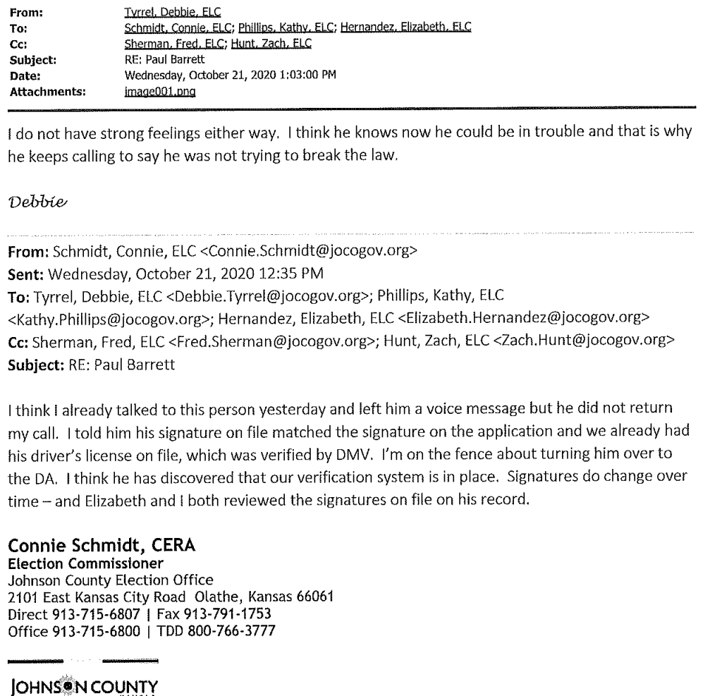
1. KORA File: 20211223080824428.pdf, 91 pages,
Date Range: 09/10 - 11/24/2020, Text Messages & Email from Connie Schmidt
Above Pages: 53, 54, & 55:
Interesting case where a registered democrat reported that he received 5-five letters from the “Center of Voter Information” group. He decided to test the system, making up data….
His registered Republican wife and son, only received one letter.
More on next slide.

Slide 9
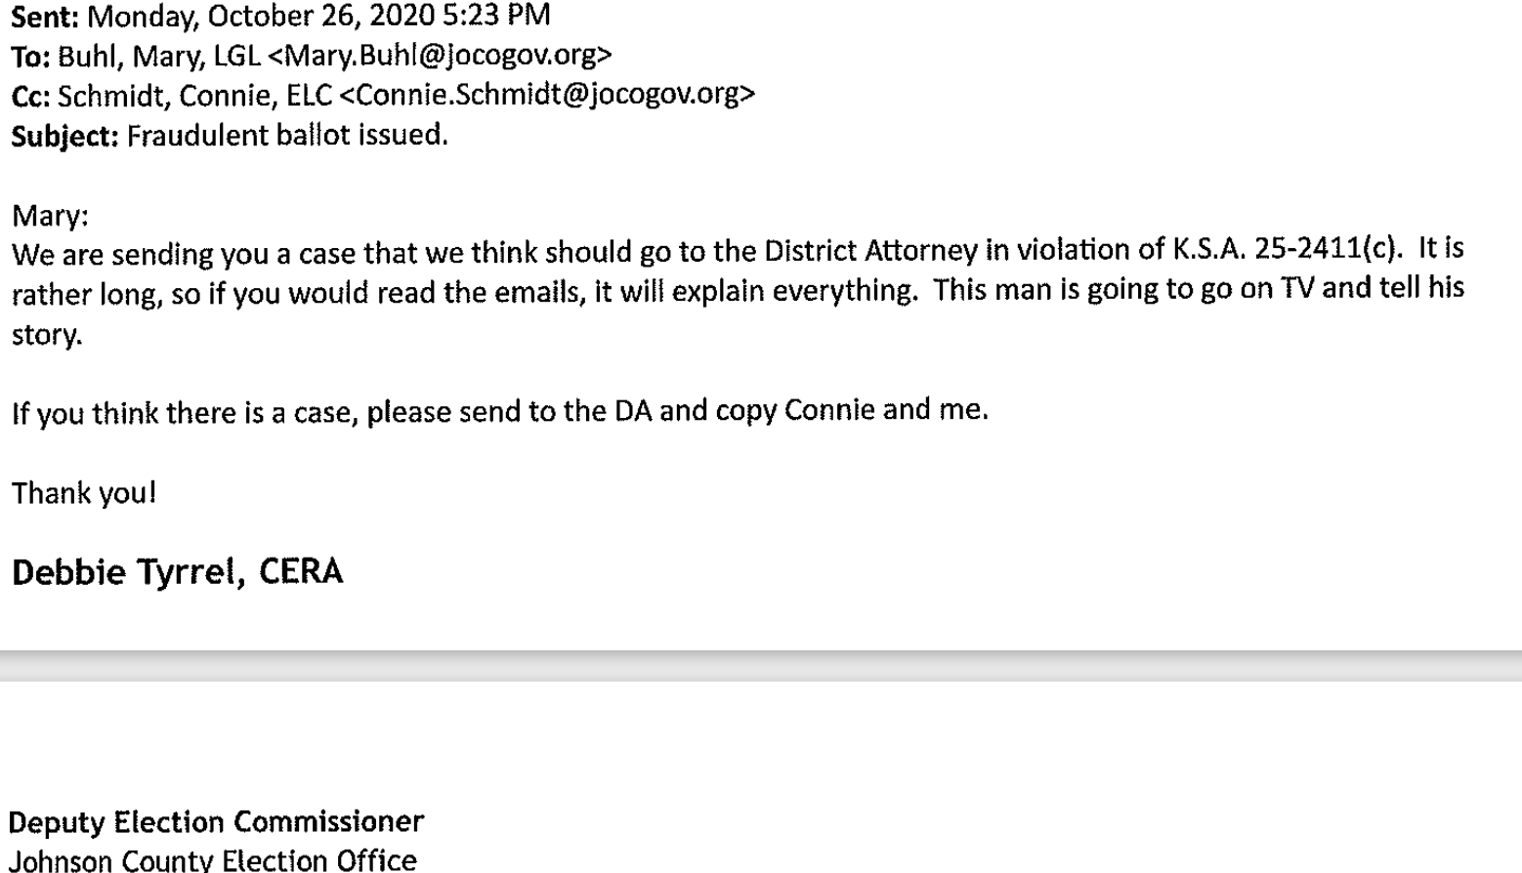
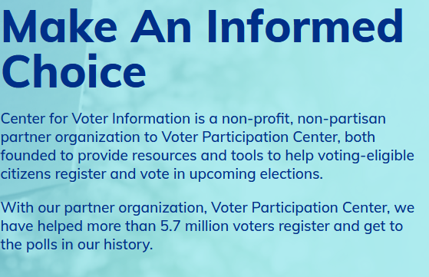
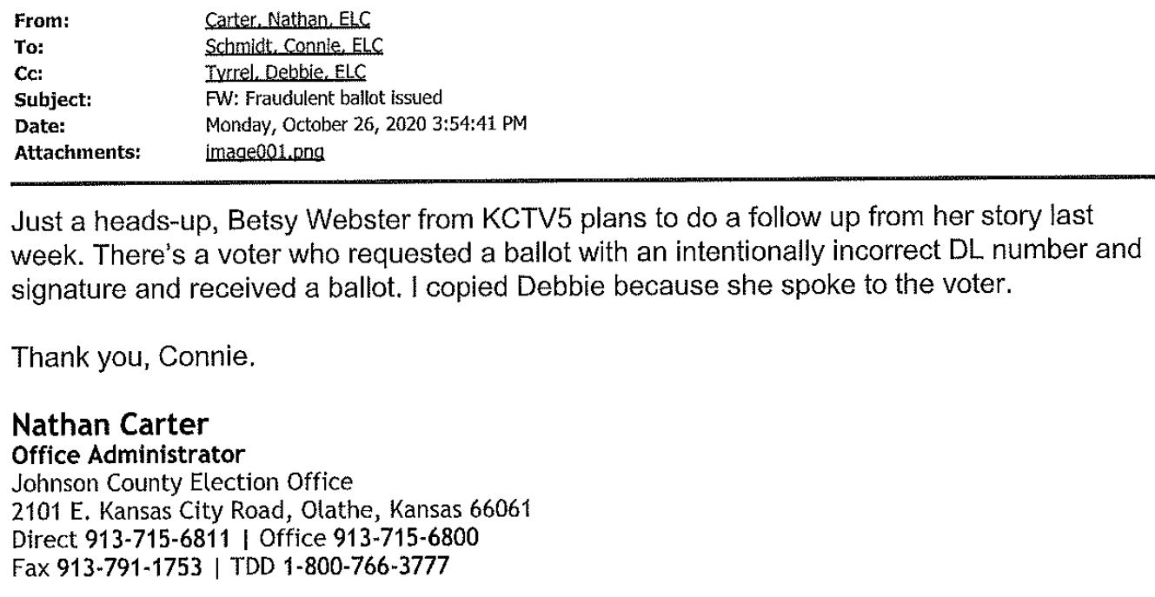
1. KORA File: 20211223080824428.pdf, 91 pages,
Date Range: 09/10 - 11/24/2020, Text Messages & Email from Connie Schmidt
Above and Right:
From the Center for Voter Information Website
Left, Pages 50 & 52:
From previous slide, this gentleman, Paul Barrett, self reported that he falsified data and was still able to receive a ballot.
Because this story reached the news room of KCTV5, they decided to forward this case to the County DA for prosecution.
The “Center for Voter Information”, probably did not receive a phone call for their part in this… just guessing.
This case begs the question, how many times could this have happened?

Slide 10
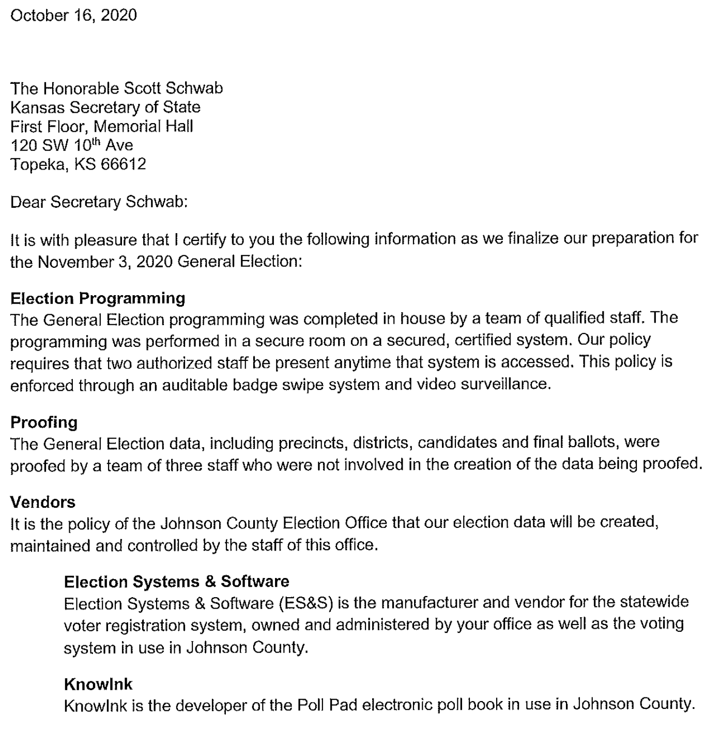
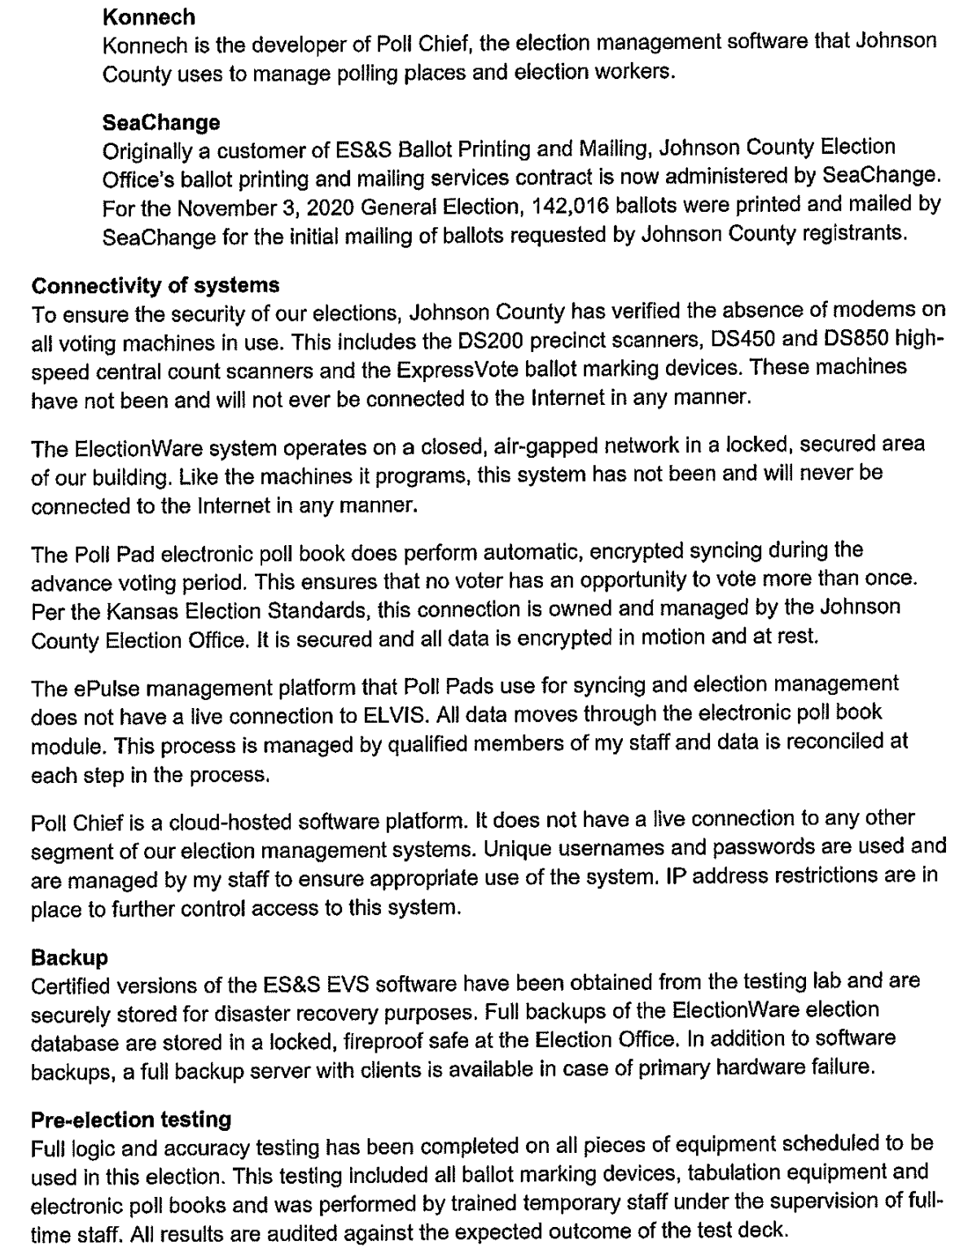
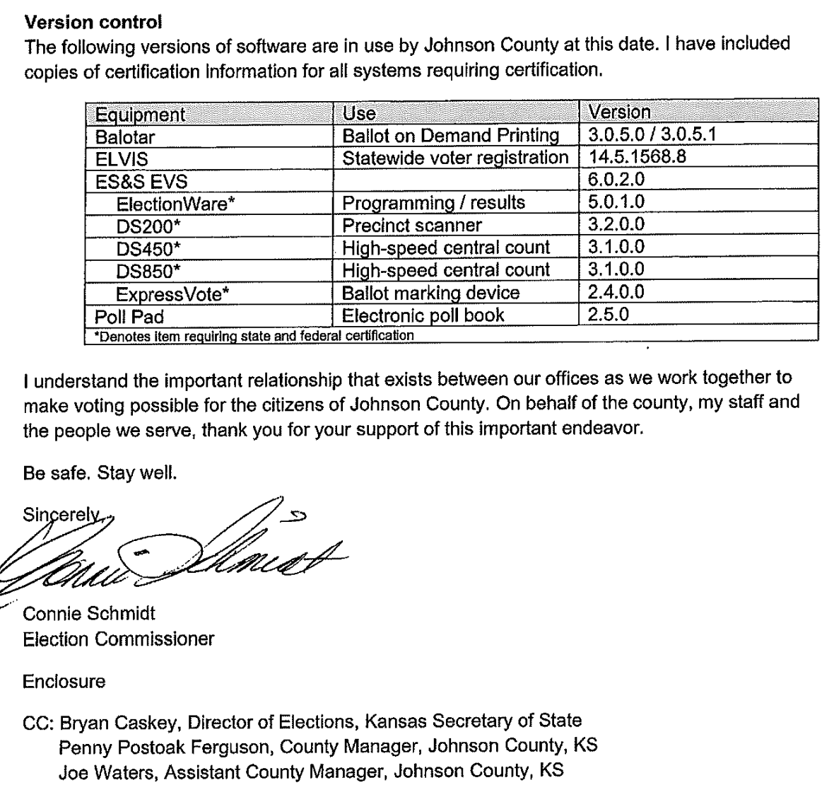
1. KORA File: 20211223080824428.pdf, 91 pages,
Date Range: 09/10 - 11/24/2020, Text Messages & Email from Connie Schmidt
CONNECTIVITY – The ElectionWare System operates on a closed, air-gapped network in a locked, secured area….
My cell phone also has an “air-gap” between it and the cell tower.
Above Pages 64, 65, & 66:
This an internal certification of the election system.
Shouldn’t there be an External Certification?
This is a well crafted letter to report to the public that essentially none of the equipment is ever connected to the internet.

Slide 11
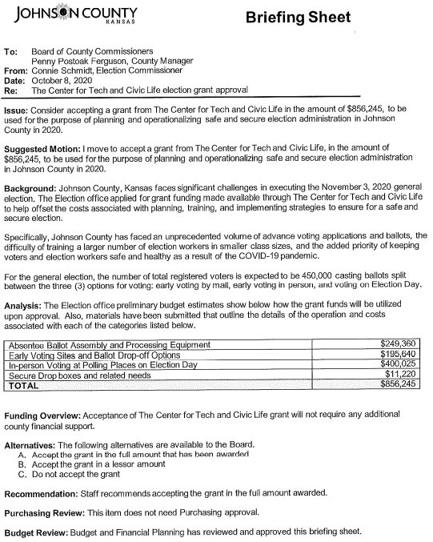
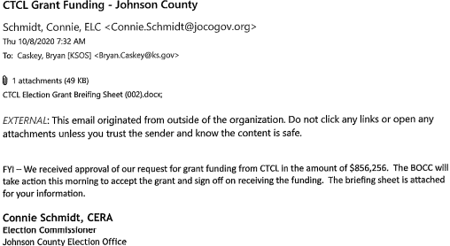
1. KORA File: 20211223080824428.pdf, 91 pages,
Date Range: 09/10 - 11/24/2020, Text Messages & Email from Connie Schmidt
Above & Right, Pages 71 & 72:
Above is the acceptance of the CTCL funding for $856,256 for JOCO.
To the right you can find how the money was designed to be spent.

Slide 12
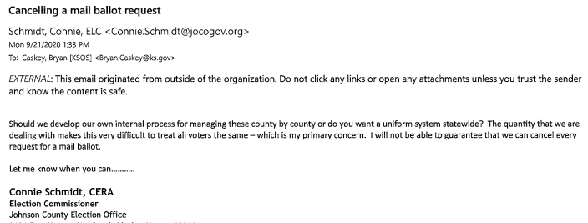
1. KORA File: 20211223080824428.pdf, 91 pages,
Date Range: 09/10 - 11/24/2020, Text Messages & Email from Connie Schmidt
Above, Page 81 :
Re, Mail Ballot Cancellation Requests.
Because this election system and approach was being custom designed on the fly, there was no consistency on how to address issues in a standard approach across all counties.
Thus, voters were not treated the same across the state.
This email would indicate that advanced ballots were being mailed out ahead of time; even without a request for one.
Thus, the voters were requesting they not be sent.
Seems like a recipe for chaos and for fraud.

Slide 13
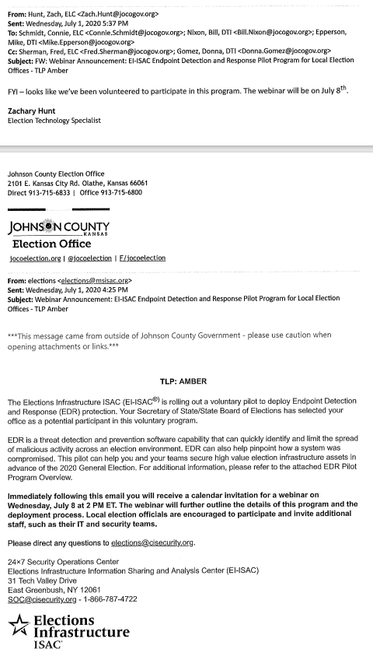
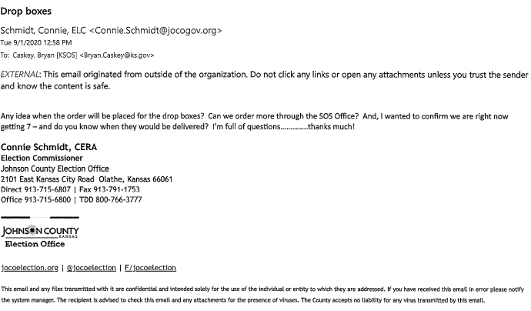
2. KORA File: 20211223080943689.pdf 51 pages
E-mail communications from 06/02 – 09/09/2020 from Connie Schmidt, CERA
Above, Page 10:
7 Drop Boxes sent to JOCO
This is FYI
Left, Page 43:
EI-ISAC is Election Infrastructure – Information Sharing and Analysis Center
EDR is an Endpoint Detection and Response EDR Software. That reportedly detects “on-line” malicious activity.
This is a voluntary program that SOS Schwab must have assigned to JOCO staff… likely others.
This group alerted JOCO of potential threats, as later emails will show.

Slide 14
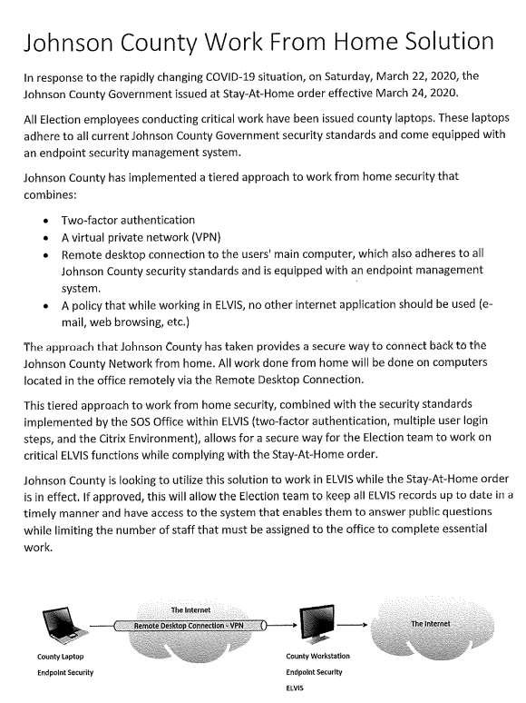
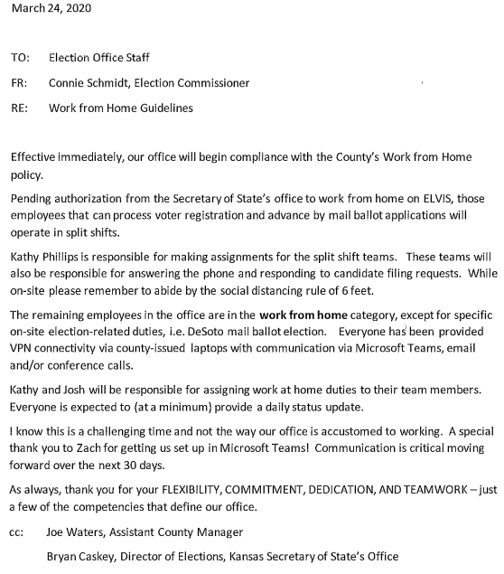
3. KORA File: 20211223081034342.pdf 76 pages
E-mail Communications from 03/23 - 06/19/2020 from Connie Schmidt
Left: Page 68:
JOCO Election Employees Work From Home Solution – allows employees to communicate to ELVIS – the Election Voter Information System, via the internet. ELVIS is software made by ES&S.
Right: Page 61:
JOCO Election Employees can communicate to ELVIS from home, via the web, in order to process voter registrations and advance mail ballot applications.

Slide 15
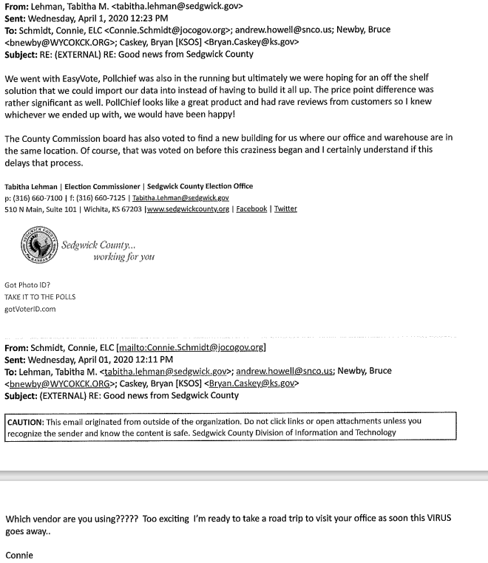
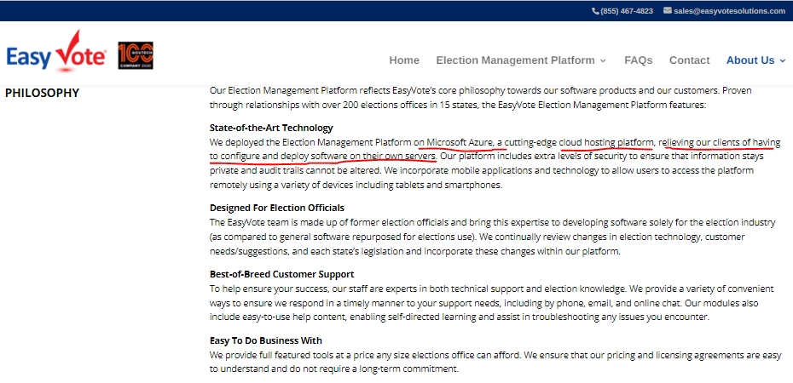
3. KORA File: 20211223081034342.pdf 76 pages
E-mail Communications from 03/23 - 06/19/2020 from Connie Schmidt
Left: Page 56:
Sedgwick Co purchased voting software from EasyVote
Right: From EasyVote’s Website: Their data is stored in the AZURA Cloud rather than on servers; taking it out of our control.

Slide 16
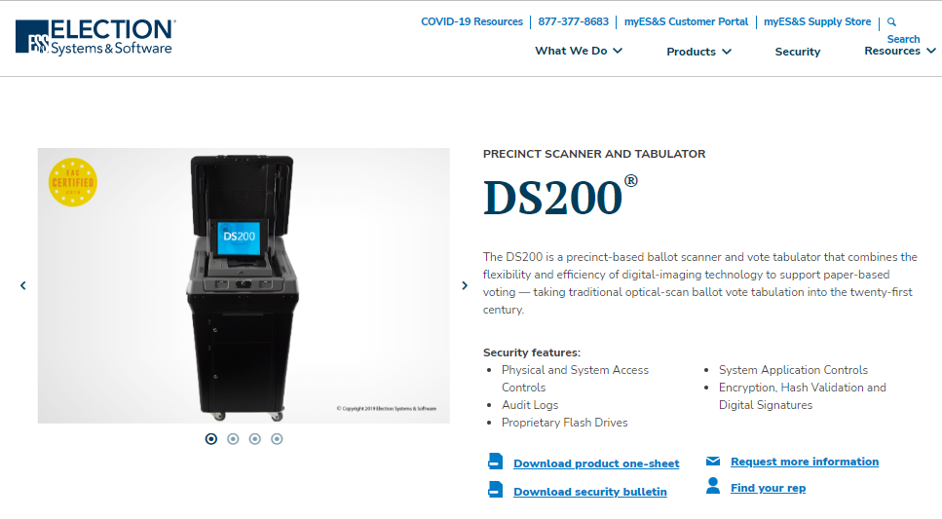
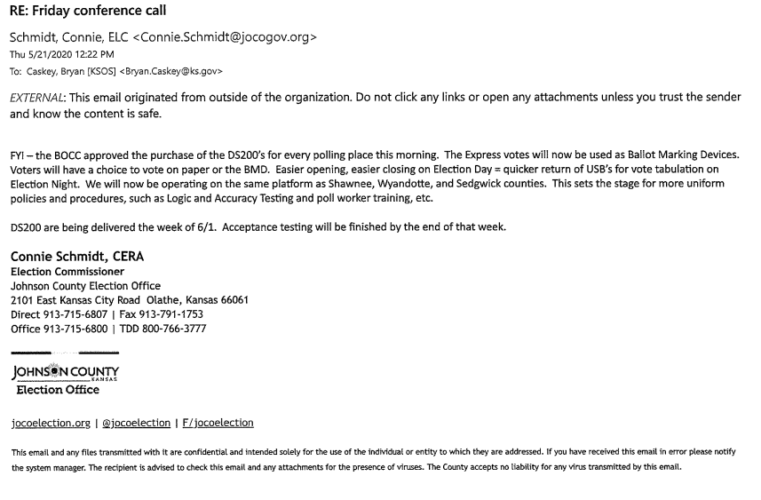
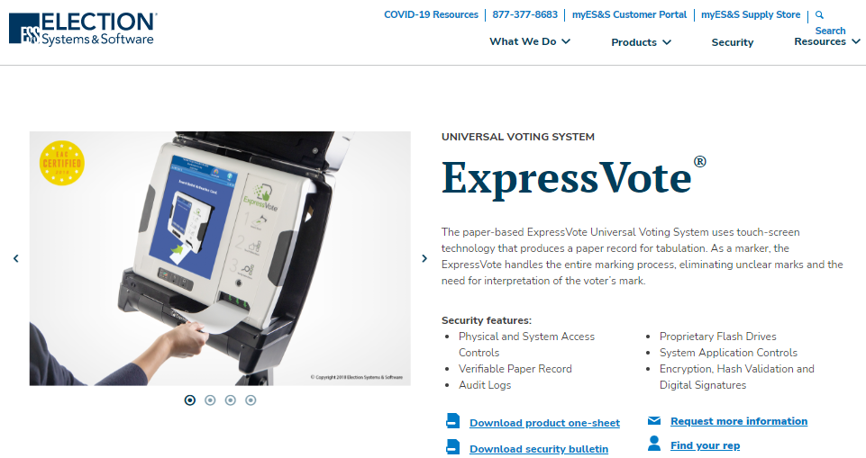
3. KORA File: 20211223081034342.pdf 76 pages
E-mail Communications from 03/23 - 06/19/2020 from Connie Schmidt
Above: Page 23:
This is FYI… “The BOCC approved DS200’s for every polling place.” The DS200 is a Scanner & Tabulator. The “Express Vote” mentioned is a “ballot marking device” used in Shawnee, Wyandotte, Sedgwick and Johnson Counties….
Above: DS200 & ExpressVote brochures from the ES&S Website

Slide 17
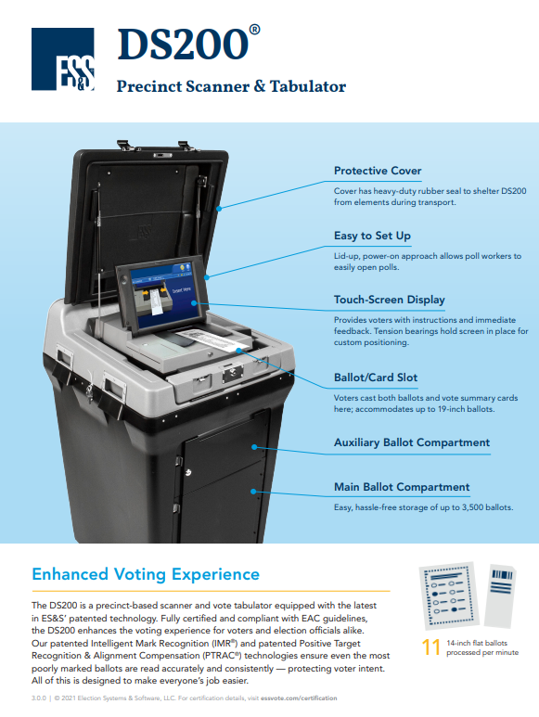
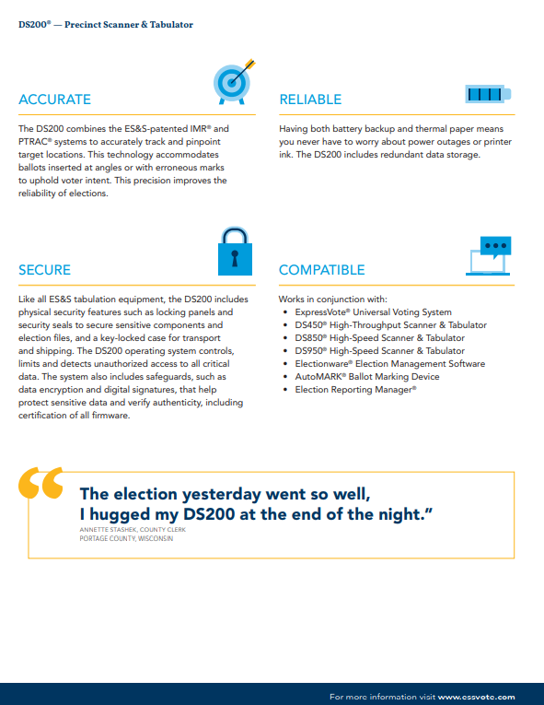
DS200 brochures from the ES&S Website

Slide 18
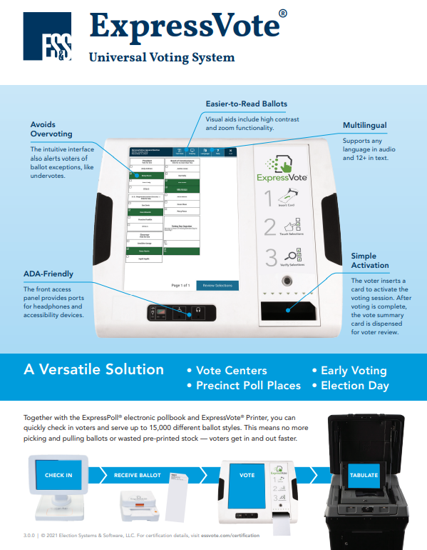

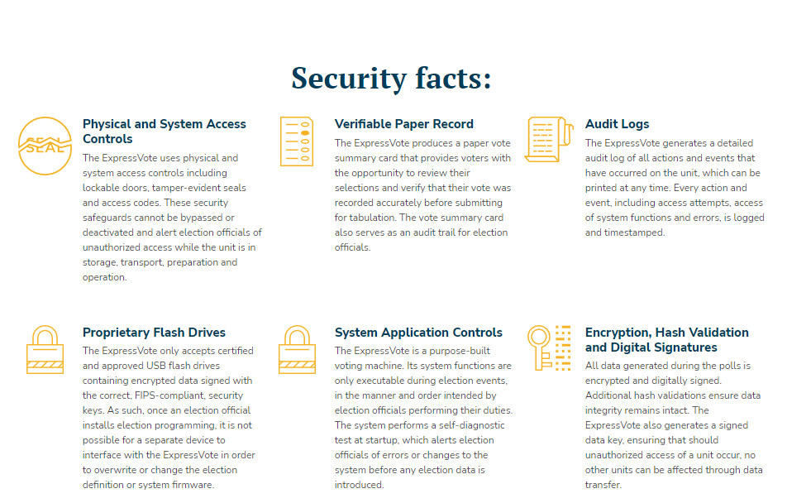
EXPRESSVOTE brochure from the ES&S Website

Slide 19
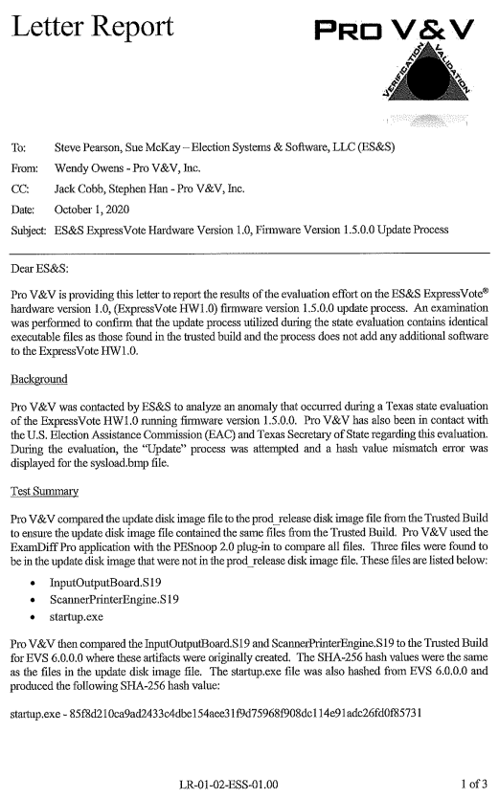
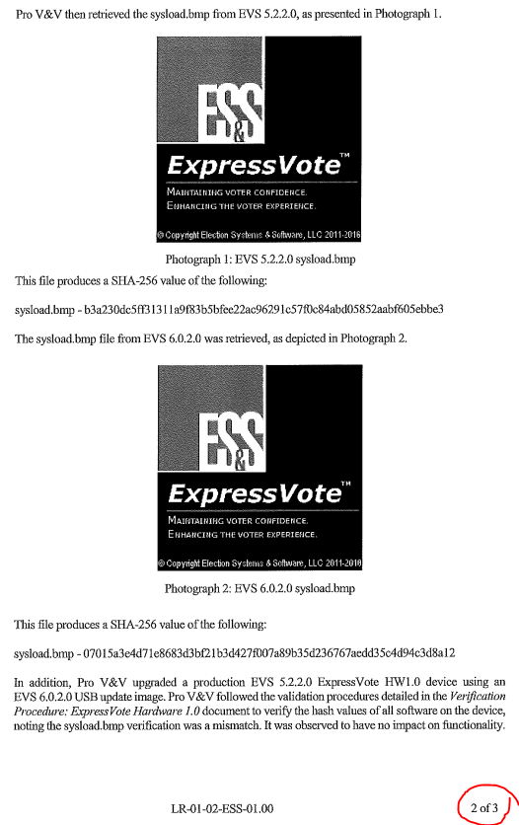
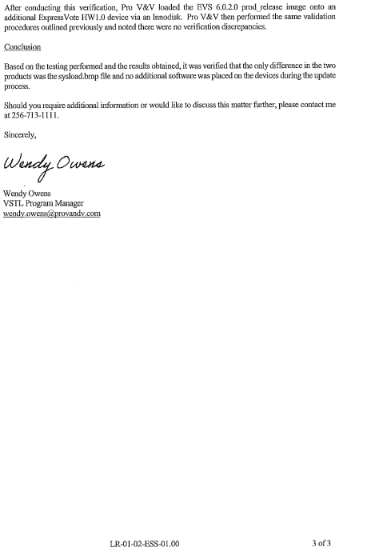
4. KORA File: 20211223081143828.pdf 65 pages
E-mail Communications from 03/23 - 06/19/2020 from Bryan Caskey regarding ES&S
Left: Pages 64 & 65 and page 1 of subsequent file compilation (20211223081239239.pdf)
Pro V&V, Inc was contracted to evaluate/certify the Express Vote system. They found 3 anomalies. Three extra files were found on the system.
Pro V&V concluded that although there was only 1 discrepancy in software, it had no impact on functionality.
The next slide, emails from ES&S, expands on this issue in further detail.

Slide 20
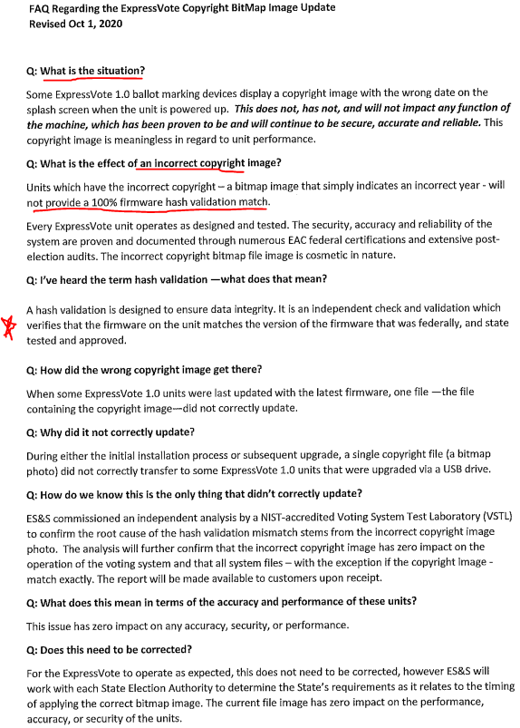
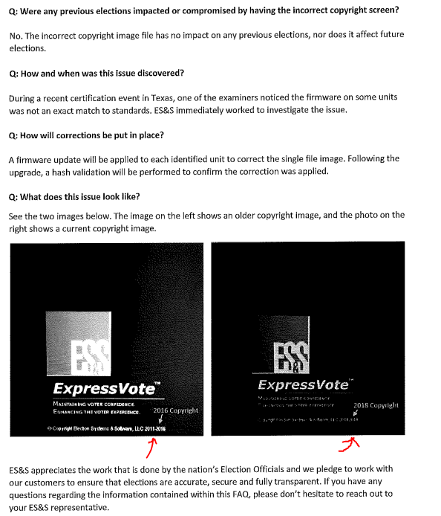
4. KORA File: 20211223081143828.pdf 65 pages
E-mail Communications from 03/23 - 06/19/2020 from Bryan Caskey regarding ES&S
Left: Page 62 & 63:
These two pages were attachments from a 9/29/2020 email from Victor Williams, Sr. Vice Pres-Product Development of ES&S to Bryan Caskey, Dir of Elections.
ES&S admits they failed the validation test of the ExpressVote Software, but claim this has no impact on the performance of the machine and accuracy.

Slide 21
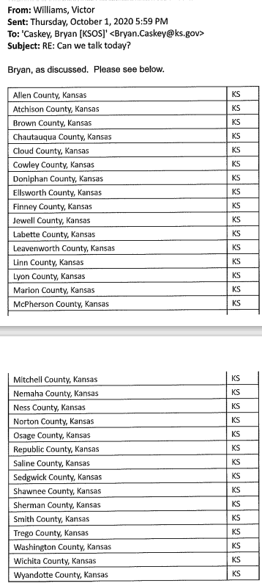
4. KORA File: 20211223081143828.pdf 65 pages
E-mail Communications from 03/23 - 06/19/2020 from Bryan Caskey regarding ES&S
Right: Page 58 & 59:
In an October 1, 2020 email from Victor Williams, Sr. Vice Pres-Product Development of ES&S to Bryan Caskey, Dir of Elections.
There is no context other than this list of counties included in the same string of emails regarding the failed validation of the Express Vote System.
But I would assume all of these counties are implicated in the failed validation.

Slide 22
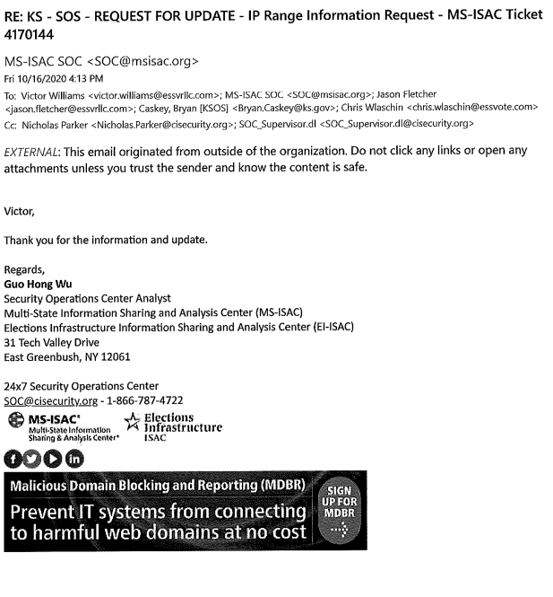
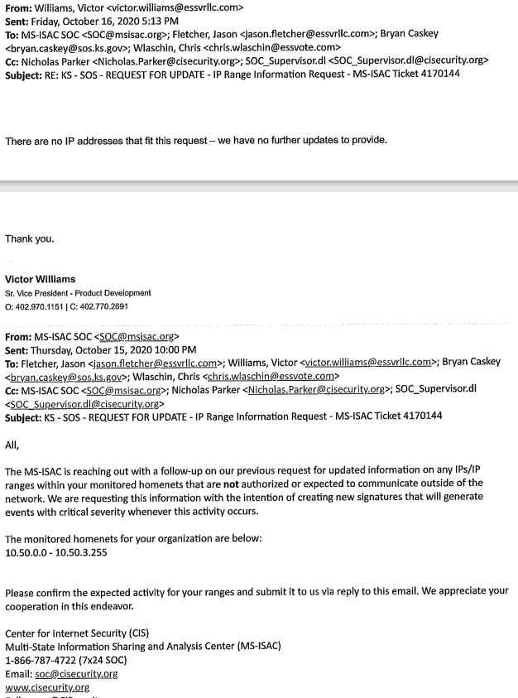
4. KORA File: 20211223081143828.pdf 65 pages
E-mail Communications from 03/23 - 06/19/2020 from Bryan Caskey regarding ES&S
Right: Page 37 & 38:
In an October 16, 2020 email from MS-ISAC (Multi-State Information Sharing and Analysis) to Victor Williams, Sr. Vice Pres-Product Development of ES&S and to Bryan Caskey, Dir of Elections.
The MS-ISAC is a component of a federal agency, CIS.
They are requesting IPs/IP address ranges for monitoring purposes.

Slide 23
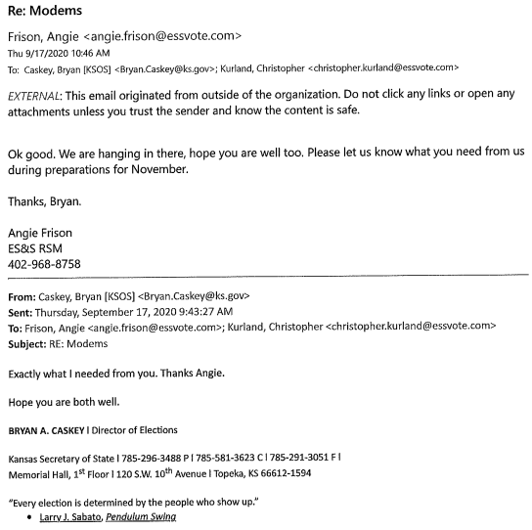
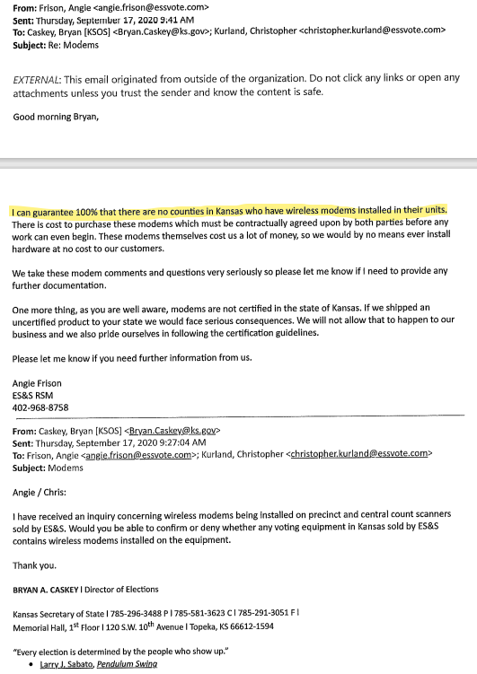
5. KORA File: 20211223081239239.pdf 69 pages
E-mail Communications from 07/30 - 10/01/2020 from Bryan Caskey regarding ES&S
Right: Pages: 18 & 19
September of 2020, Regarding Wireless Modems
Angie Frison, ES&S RSM, “guarantees that 100% of Kansas Counties do not have wireless modems installed in precinct and central count scanners purchased from ES&S.
However, they obviously have wired modems installed or the CIS would not have contacted them.

Slide 24
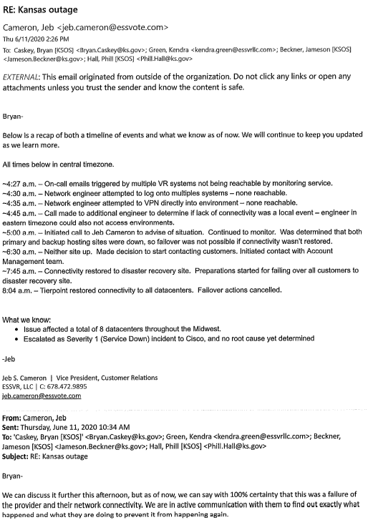
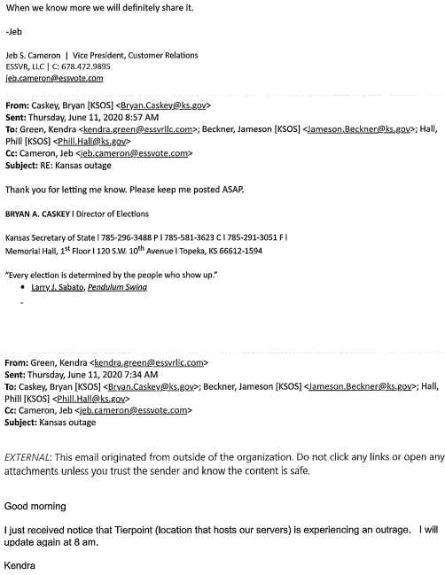
6. KORA File: 20211223081336815.pdf 69 pages
E-mail Communications from 06/11 – 07/27/2020 from Bryan Caskey regarding ES&S
Right: Pages 66 & 67:
June 11, 2020: ES&S Midwest Data Center is down.
This was a Severity 1 (highest level) alert.

Slide 25
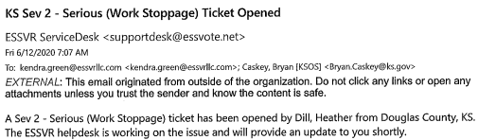
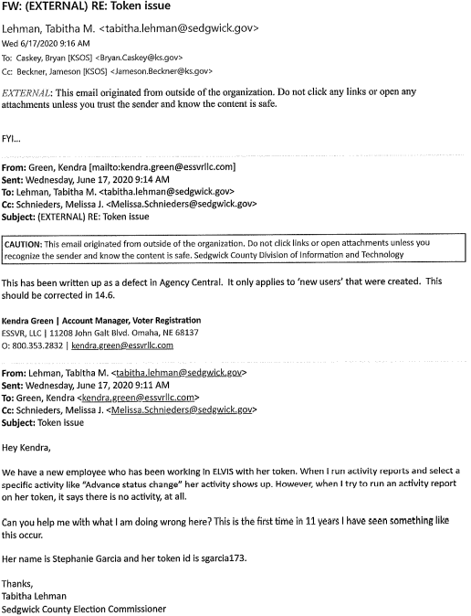
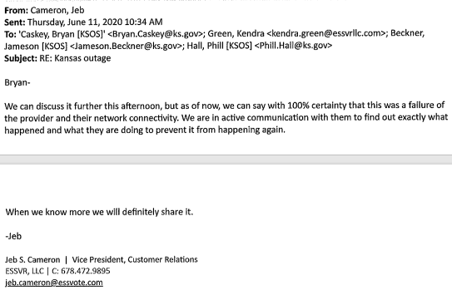
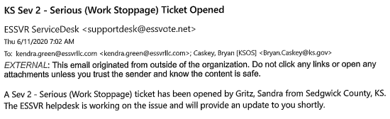
6. KORA File: 20211223081336815.pdf 69 pages
E-mail Communications from 06/11 – 07/27/2020 from Bryan Caskey regarding ES&S
Right: Pages 60:
ES&S – Undetected activity by an employee in ELVIS when using her Token.
No remedy or additional conclusion provided.
Could mean other outsiders could enter undetected as well…?
Above: Page 62:
June 12, 2020, ES&S Midwest Data Center is down, again.
In file: 20211223081439003, pages 11-17, see below, more details were provided.
Multiple Counties Reporting & No root cause.
Blamed Tierpoint (the location that hosts our (ks) servers.
Jeb Cameron of ES&S explained that the lack of network connectivity was an issue of the service provider (Tierpoint).

Slide 26


6. KORA File: 20211223081336815.pdf 69 pages
E-mail Communications from 06/11 – 07/27/2020 from Bryan Caskey regarding ES&S
Left: Page 47:
June 22, 2020,
Bryan Caskey, Dir. Of Elections, asks for a phone call with Victor Williams, Sr. Vice Pres-Product Development of ES&S
Due to apparent security concerns with ELVIS.
No further context provided. Phone calls are an easy way to avoid KORA detection.
Right: Pages 37:
ES&S – Undetected activity by an external employee in ELVIS.
No remedy or additional conclusion provided.
Could mean other outsiders could enter undetected as well…?

Slide 27


6. KORA File: 20211223081336815.pdf 69 pages
E-mail Communications from 06/11 – 07/27/2020 from Bryan Caskey regarding ES&S
Left: Page 37, 38, :
June 4, 2020,
Muhammed Zahid Ayar, Sr. Security Operations Analyst of CIS, MS-ISAC & EI-ISAC informed
Bryan Caskey, Dir. Of Elections and Victor Williams, Sr. Vice Pres-Product Development of ES&S
Of a potential unauthorized OUTBOUND activity.
Victor of ES&S responds say that this is legitimate traffic from internal monitoring systems.
Seems to me that this is the Fox guarding the hen house.

Slide 28

6. KORA File: 20211223081336815.pdf 69 pages
E-mail Communications from 06/11 – 07/27/2020 from Bryan Caskey regarding ES&S
Left: Page 69
June 16, 2020,
Mark Manganaro, State Certification Manager of ES&S
Sent a notice to Bryan Caskey, KS Election Director
To inform him that ES&S will not certify the ExpressVote Software, Vers. 6.0.4.3

Slide 29



7. KORA File: 20211223081439003.pdf, 79 pages, 05/8 - 06/16/2020, Bryan Caskey
Above & Right: Page 33 & 34:
ELVIS Issues.
Acknowledgement of bugs in the ELVIS system.
This is exceptionally interesting as it is not apparently tracking the activity of certain users in the system.
ES&S confirmed that they have a “defect”.
Above: Page 60:
An major ELIVIS Upgrade occurred on May 9 & 10.

Slide 30
8. KORA File: 20211223081525057.pdf 72 pages
E-mail Communications from 05/7 – 05/8/2020 from Bryan Caskey regarding ES&S
The subject docket consists of training schedules, a manual, and election calendar information.
Nothing concerning sticks out.

Slide 31
9. KORA File: 20211223081608006.pdf 67 pages
E-mail Communications from 05/7 – 05/8/2020 from Bryan Caskey regarding ES&S
The subject docket is a continuation of 20211223081525057.pdf
It’s a manual…. nothing concerning sticks out.

Slide 32
10. KORA File: 20211223081657816.pdf 64 pages
E-mail Communications from 04/21 - 05/05/2020 from Bryan Caskey regarding ES&S
The subject file is mostly a manual.
Of the few e-mails, nothing concerning sticks out.

Slide 33


11. KORA File: 20211223081726636.pdf 35 pages
E-mail Communications from 04/10 – 04/17/2020 from Bryan Caskey regarding ES&S
Left: Page 5 & 6 :
April 17, 2020,
From: Bryan Caskey, Dir. Of Elections
To: ES&S Staff
RE, Installation of ELVIS Ver. 14.5 statewide.

Slide 34

12. KORA File: 20211223081824991.pdf 76 pages
E-mail Communications from 02/25 – 04/08/2020 from Bryan Caskey regarding ES&S
The subject File is mainly work from home planning, due to the pandemic.
No concerns noted within the messages.
However, due to the pandemic, numerous access points were created…

Slide 35
13. KORA File: 20211223081908792.pdf 71 pages
E-mail Communications from Bryan Caskey regarding ES&S
The subject file is a continuation of the Power Profile manual.
Nothing concerning sticks out.

Slide 36


14. KORA File: 20211223082015496.pdf 71 pages
E-mail Communications from 11/07/2019 – 02/20/2020 from Bryan Caskey regarding ES&S
Left: Page 66
The subject file is mostly a manual.
Of the few e-mails, this one sticks out:
On 1/28/2020, Bryan Caskey SOS, sends a Certification Letter for EVS 6040 to Mark Manganaro of ES&S.
This was needed to allow counties to upgrade.
Above, Page 65
On 2/20/2020, less than a month later, Mark Manganaro of ES&S, is requesting formal certification of EVS Vers: 6.0.4.3.

