Slide 1
Forensic Election Audit
Maricopa County:

Slide 2
Introduction

Slide 3
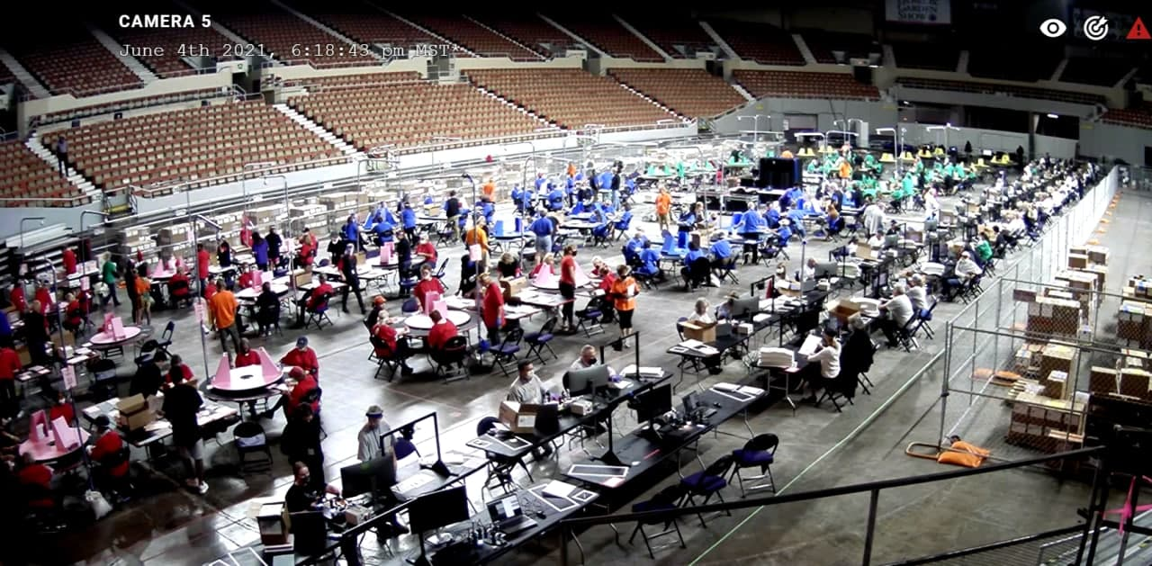
Introduction – MC Forensic Audit

Slide 4
Overview
Introduction – MC Forensic Audit
2.1M ballots processed by hand
Over 1,500 people involved
Over 100,000 hours of time contributed

Slide 5
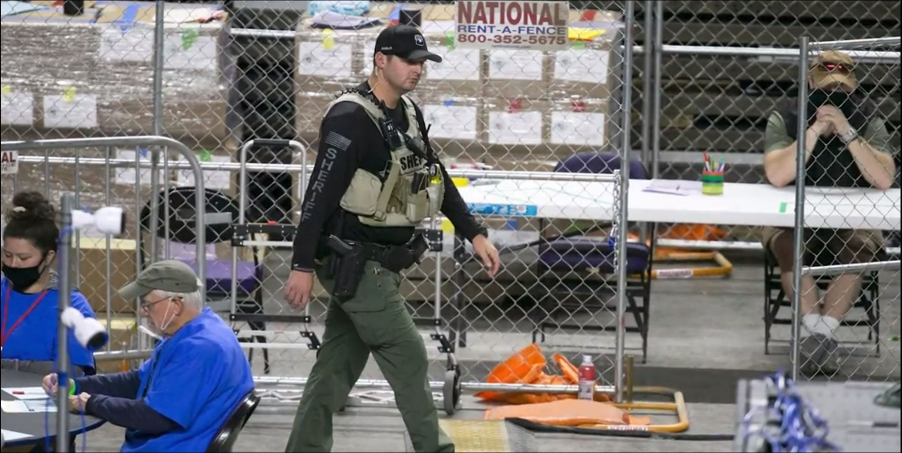
Introduction – MC Forensic Audit

Slide 6
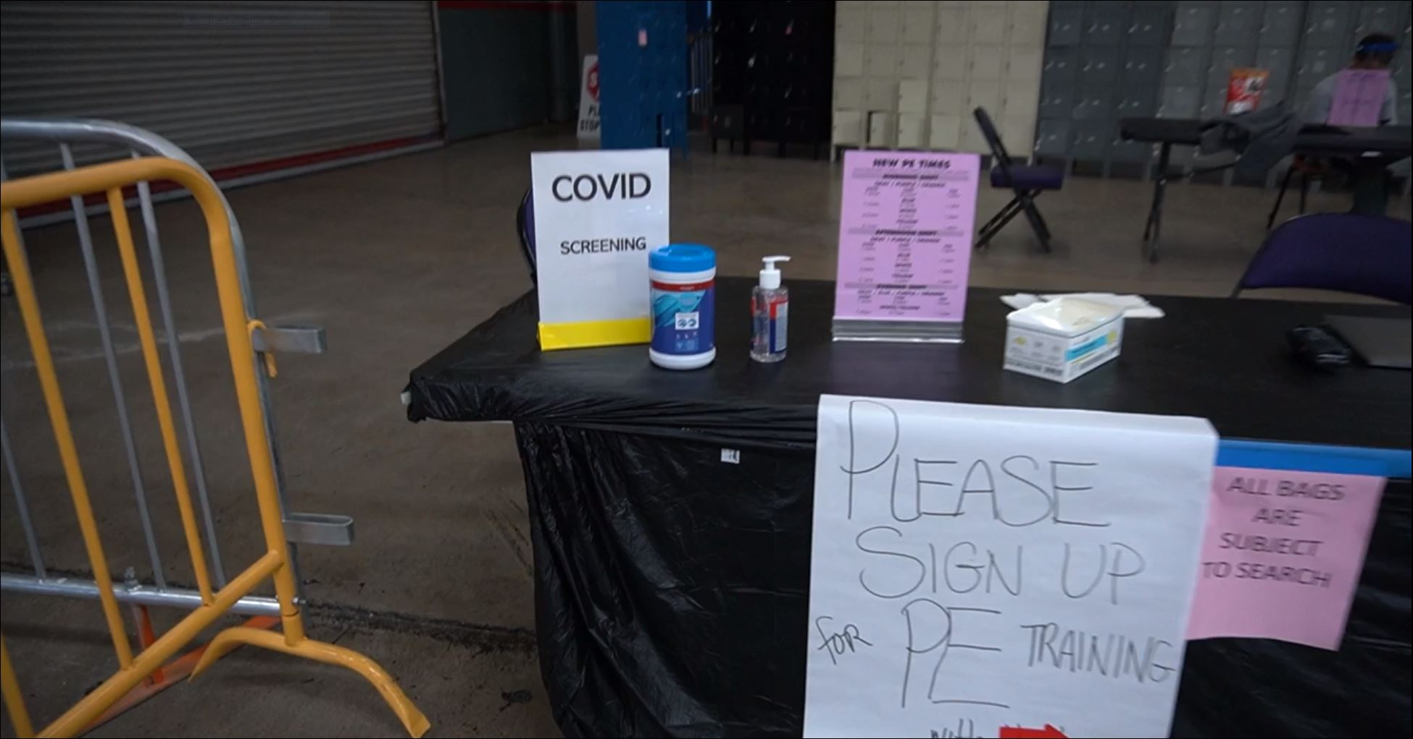
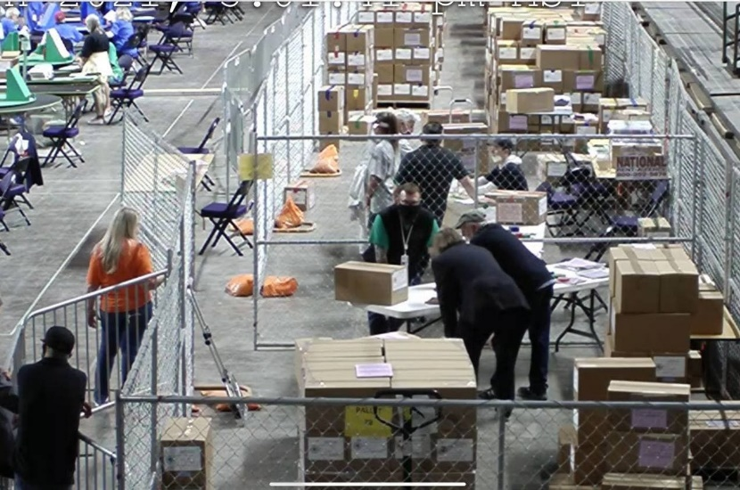
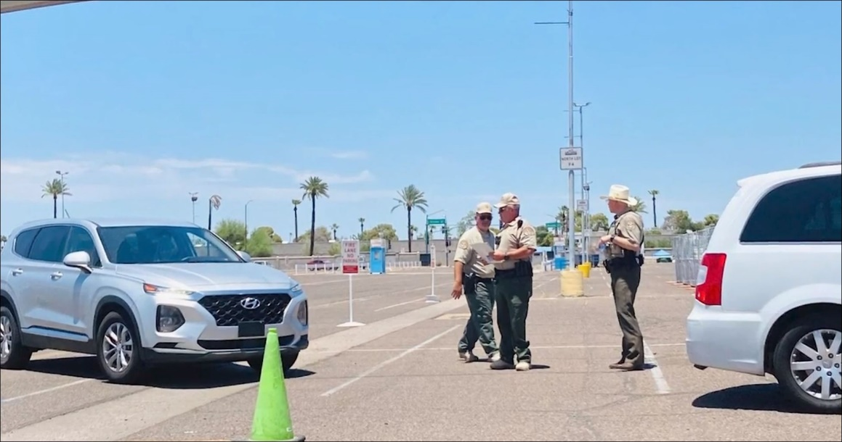
Security
Introduction – MC Forensic Audit
The perimeter was secured at the coliseum
COVID checks & access validation
Ballots & election equipment were secure in corrals
24/7 video surveillance & law enforcement guard

Slide 7
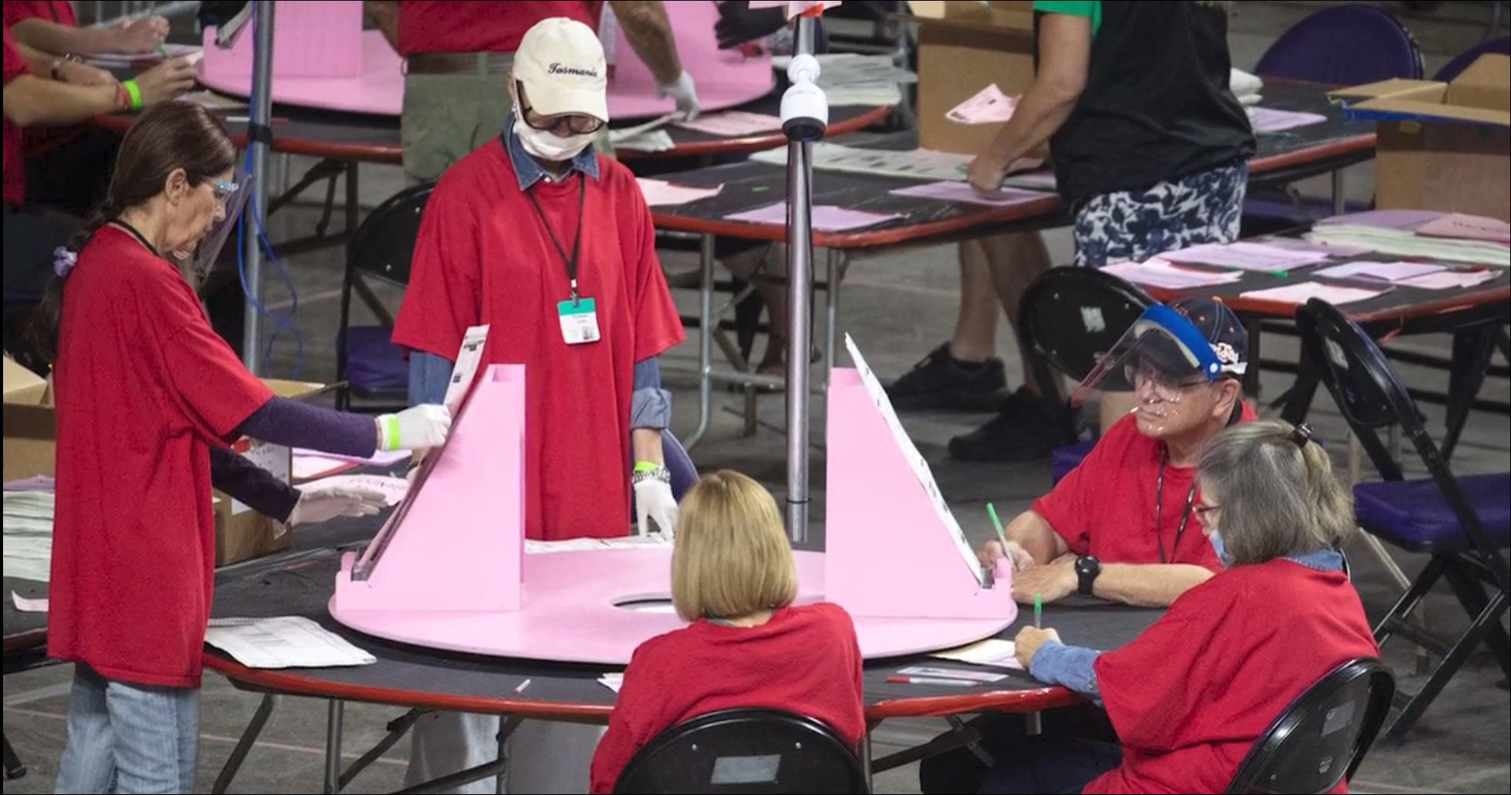
Introduction – MC Forensic Audit

Slide 8
Tallying
Introduction – MC Forensic Audit
All counters were Maricopa residents who voted in the last election.
Each person was run through a standard background check.
All three counters counted “blind” without any talking.
Roughly every ~50 ballots tallies were compared and needed to agree or be redone.

Slide 9
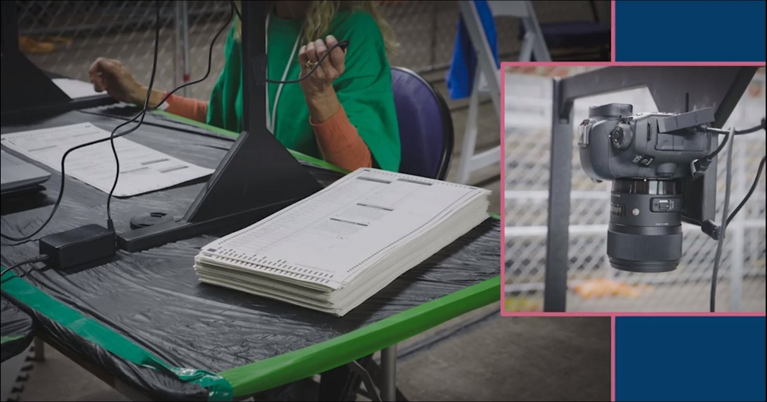
Introduction – MC Forensic Audit

Slide 10
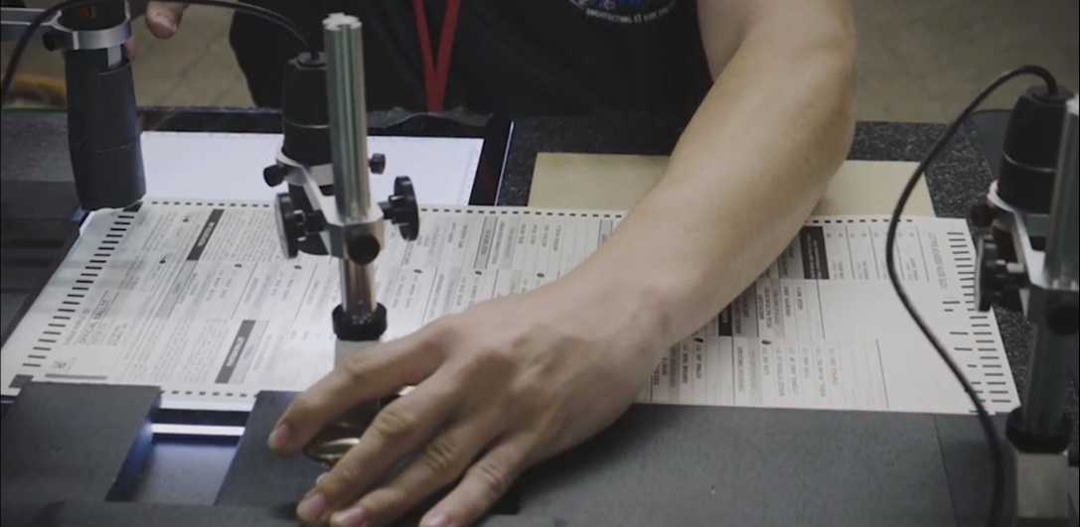
Paper Examination (PE)
Introduction – MC Forensic Audit
High quality DLSR images captured of the front and back of all ballots
Microscope images captured of key ballot locations
Over 140TB of data storage for PE alone

Slide 11
Status

Slide 12
Current Status
Status – MC Forensic Audit
Complete
Hand-counting of all federal races
Image and microscope capture of all ballots
Review & Comparison of Official Results
Analysis of the Voter Rolls
Expected Soon
Review of Splunk Logs and Routers via Settlement Agreement terms.
Completion of Paper Analysis

Slide 13
Current Status
Status – MC Forensic Audit
No Longer In Scope
Canvasses to confirm voter rolls
Removed from scope of work.
Review of tabulator configuration to check internet configuration.
Hardware tokens never provided by the County.
Review of Voter Roll System
Systems accessing rolls never provided by the County.
Review of ICX Devices
Systems never provided by the County.
Review of provisional ballots
Provisional Ballots Never Provided by County.
Review of undeliverable ballots
Undeliverable ballots never provided by county.

Slide 14
Ballots & Tallying

Slide 15
Ballots & Tallying - Background
Ballots & Tallying – MC Forensic Audit
Ballots that are damaged or can’t be processed by a tabulator are duplicated.
Damaged Sent to Duplicates (DSD) are the originals, DUPs the Duplicate.
There should be one DSD per DUP.
There should be a unique serial number to match up a DSD to its DUP.
Duplicate ballots should be stored separately from original ballots.

Slide 16
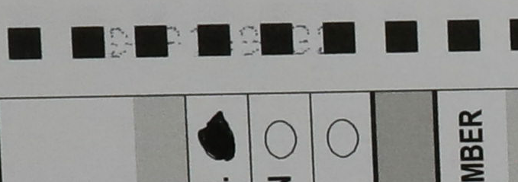
Findings
Ballots & Tallying – MC Forensic Audit
Duplicate ballots comingled with original ballots
Duplicated ballots with incorrect & missing serial numbers
Duplicates that reuse serial numbers
More duplicates than original ballots
Duplicate Ballot Serial Number | Precinct | Ballot Type | Presidential Selection | Original Damaged Ballot Serial Number
DUPBOARD3HAND0214 | 643 | 0 | Biden | Board 1 Hand Dup 214
DUPBOARD3HAND0215 | 239 | 99 | Trump | Board 1 Hand Dup 215
DUPBOARD3HAND0216 | 391 | 99 | Biden | Board 1 Hand Dup 216
DUPBOARD3HAND0217 | 144 | 99 | Biden | Board 1 Hand Dup 217
DUPBOARD3HAND0218 | 492 | 0 | Biden | Board 1 Hand Dup 218
BOX ID | TYPE | SERIAL NO.
Original Damaged Ballots SD 8 | DSD | DUP294104
Original Large Print Sent to Duplication 2 | DSD | DUP294104
DSD RANDOM SAMPLE REVIEW 2 | DSD | DUP171329
Original Damaged Ballots SD 8 | DSD | DUP171329
Description | Ballots Count
Maricopa County Forensic Audit - Original Ballots Sent to Duplication | 26,965
Maricopa County Forensic Audit – Duplicate Ballots Counted | 29,557
Maricopa County – Reported Duplicate Ballots | 27,869
Notes:
2592 more DUPS than DSDs

Slide 17
Findings
Ballots & Tallying – MC Forensic Audit
Description | Damaged Sent to Duplication (DSD) | Duplicate Ballots (DUP) | Expected % To Candidate | % Difference To Candidate
Trump | 995,404 | 996,896 | 48% | 58%
Biden | 1,040,873 | 1,041,733 | 50% | 33%
Jorgenson | 31,501 | 31,580 | 2% | 3%
Duplicate ballots comingled with original ballots
Duplicated ballots with incorrect & missing serial numbers
Duplicates that reuse serial numbers
More duplicates than original ballots
Extra DUPS favor Trump & Jorgenson
Extra DUPS favor McSally
Description | Damaged Sent to Duplication (DSD) | Duplicate Ballots (DUP) | Expected % To Candidate | % Difference To Candidate
McSally | 983,662 | 985,100 | 47% | 55%
Kelly | 1,064,336 | 1,065,266 | 51% | 36%

Slide 18
Tally Results – (Based on DSD)
Ballots & Tallying – MC Forensic Audit
 | McSally | Kelly | Write In / Over / Under | Total
Maricopa County Forensic Audit | 983,662 | 1,064,336 | 40,398 | 2,088,396*
Official Maricopa County Canvass | 984,203 | 1,064,396 | 40,964 | 2,089,563
DELTA | (541) | (60) | (566) | (1,167)

Slide 19
Tally Results – (Based on DSD)
Ballots & Tallying – MC Forensic Audit
 | Trump | Biden | Jorgenson | Write In / Over / Under | Total
Maricopa County Forensic Audit | 995,404 | 1,040,873 | 31,501 | 20,791 | 2,088,569
Official Maricopa County Canvass | 995,665 | 1,040,774 | 31,705 | 21,419 | 2,089,563
DELTA | (261) | 99 | (204) | (628) | (994)
* Slight difference in Presidential & Senate ballot totals are due to small differences in hand counts across 2.1M ballots

Slide 20
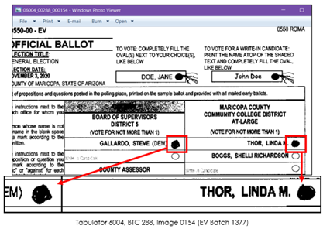
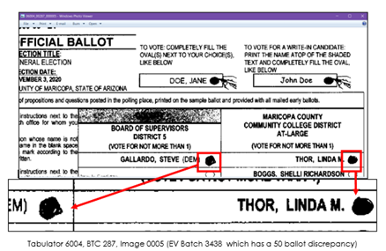
Findings
Ballots & Tallying – MC Forensic Audit
At least a batch of 50 ballots was run through the tabulators twice.
Notes:
2592 more DUPS than DSDs

Slide 21
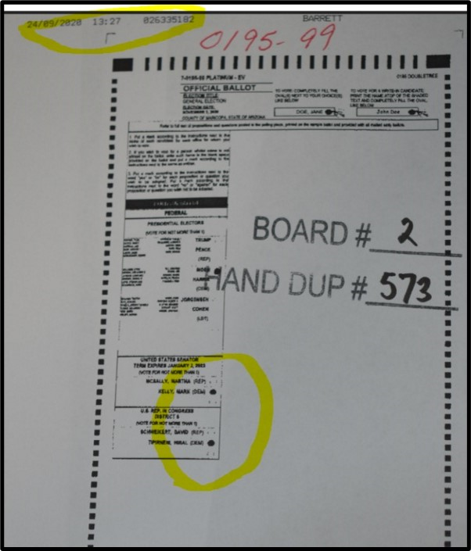
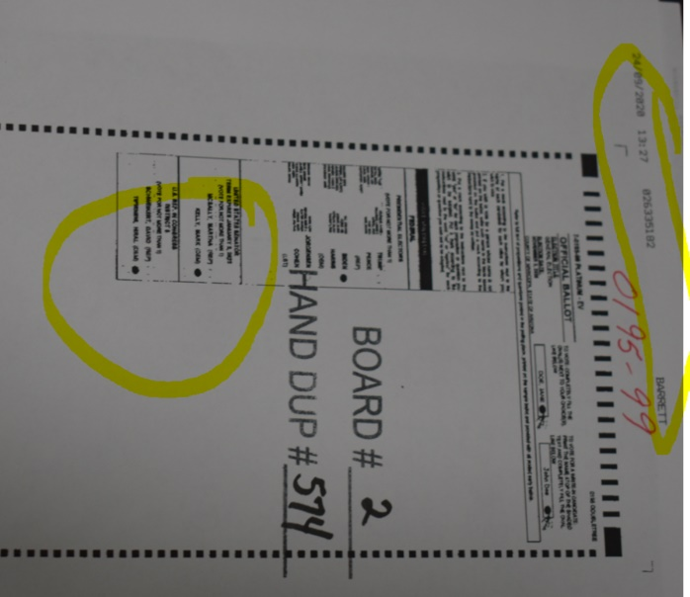
Findings
Ballots & Tallying – MC Forensic Audit
Several UOCAVA ballots have been double-counted
Notes:
2592 more DUPS than DSDs

Slide 22
Official Results

Slide 23
Official Results - Background
Official Results – MC Forensic Audit
Official Canvass – Tallies of the ballots cast
Per candidate, per precinct, provisional, etc.
VM55 Final Voted File – A list of all the people who cast a ballot in the election
Indicates method of voting and other details
VM34 Full Voter File – A list of all people eligible to vote
Released on a monthly basis

Slide 24
Definitions
Official Results – MC Forensic Audit
EV32 Early Voting Sents – A list of all the ballots mailed out
Includes the date mailed, the address mailed to, the ballot type, etc.
EV33 Early Voting Returns – A list of all the ballots received for Early Voting
Includes the date returned and the method (Mail-in or in Person)

Slide 25
Election System Balance
Official Results – MC Forensic Audit
If the following situation happened
10 people mailed in a ballot
10 people voted early in person
10 people voted on election day in person
You would expect
The Official Canvas has a total of 30 votes across all the candidates / precincts etc.
The VM55 should show a list of 30 people:
10 people who voted via mail-in
10 via Early Voting in Person
10 via Election Day in person
EV32 Sents would show 10 ballots mailed
EV33 Returns would show 10 mail-in ballots received, and 10 mail-in ballots for EV In Person
None of these system balance.

Slide 26
Findings
Official Results – MC Forensic Audit
Official Canvass has 3,432 more ballots cast than the list of people who show as having cast a vote (VM55)
9,041 mail-in voters show returning more ballots (EV33) than they were sent (EV32).
277 Precincts show in the Official Canvass as having more ballots cast than people who showed up to vote (VM55) for a total of 1,551 excess votes.
There are 2,472 ballots shown in EV33 that don’t have corresponding entries in the VM55, and only 2,042 ballots show as rejected in the Official Canvas for a discrepancy of 430.
397 mail-in ballots show as received (EV33) that never show as sent (EV32).
255,326 Early Votes show in the VM55 that do not have a corresponding EV33 entry.
Notes:
2592 more DUPS than DSDs

Slide 27
Voters Who Moved

Slide 28
Moving - Background
Moving– MC Forensic Audit
Individuals who voted were compared against a commercial database called Melissa to see who moved before the October 5th cutoff. Melissa Personator
Checks addresses associated with a user
Shows prior and current addresses
Tracks moves and move dates
Tracks date-of-birth and death dates

Slide 29
Findings
Moving – MC Forensic Audit
23,344 voters voted via mail-in ballot even though they show in Melissa as having moved, and no one with the same last name shows as living at the address.
2,382 voters voted in-person even though they show in Melissa as having moved out of Maricopa County.
2,081 voters moved out-of-state during the 29 days before the election and were given a full ballot instead of a presidential-only ballot.
Notes:
2592 more DUPS than DSDs

Slide 30
Voter Rolls

Slide 31
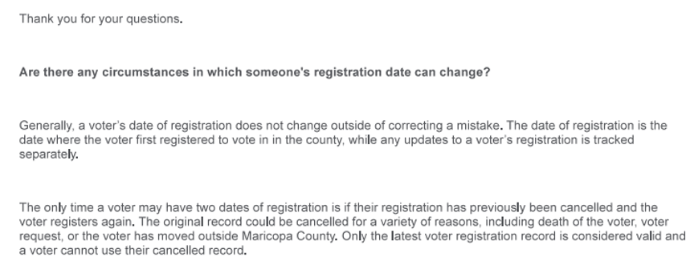
Voter Rolls - Background
Official Results – MC Forensic Audit
Registration dates do not generally change unless to correct a mistake.

Slide 32
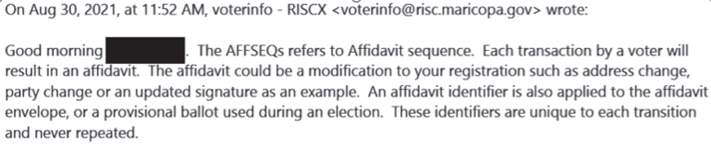
Voter Rolls - Background
Official Results – MC Forensic Audit
AFFSEQ is a unique number found in the voter roll system that is associated with a single transaction to a single user.
That change transaction has an image to go along with it to reference the document that authorized the change.
AFFSEQ’s should be unique and only happen once and definitely shouldn’t be shared by users.
A.R.S. 16-152 requires that complete names be used.

Slide 33
Findings
Ballots & Tallying – MC Forensic Audit
Potentially as many as 5,047 individuals who voted in more than one county for up to 5,295 votes.
393 voters with incomplete names voted in the election.
198 individuals registered after the October 15th cutoff and voted in the election.
2,861 voters have shared an AFFSEQ number with another voter at some point.
282 potentially deceased voters voted in the election.
186 people potentially have duplicate voter IDs that both voted.
Description | Number of voters
Last name only | 15
Last name is an initial only | 9
No last name | 45
First name is an initial only | 324
Total | 393
Notes:
2592 more DUPS than DSDs

