Slide 1
COLORADO CANVASSING RESULTS
All political power is vested in and derived from the people; all government, of right, originates from the people, is founded upon their will only, and is instituted solely for the good of the whole.
Constitution of the State of Colorado, Article II (Bill of Rights), Section 1

Slide 2
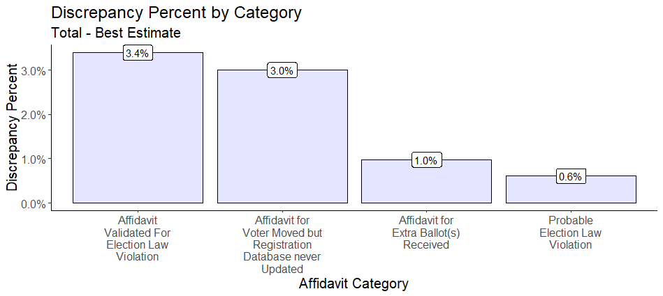
Total Issues Found – All Counties
Notes:
I&W = Indicators and Warnings

Slide 3
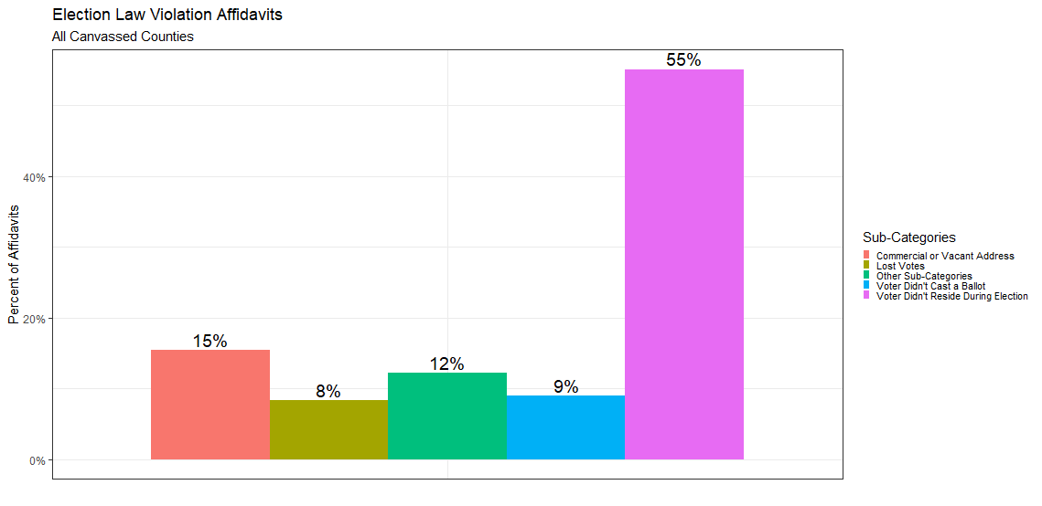
Election Law Violation Affidavits – All Counties
Notes:
I&W = Indicators and Warnings

Slide 4
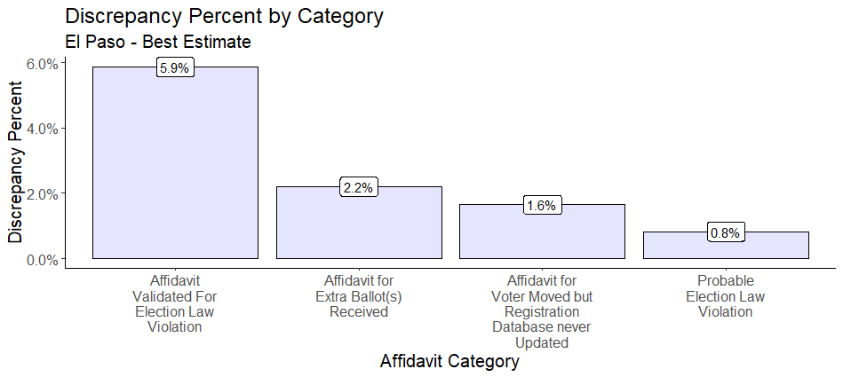
Total Issues Found – El Paso
Notes:
I&W = Indicators and Warnings

Slide 5
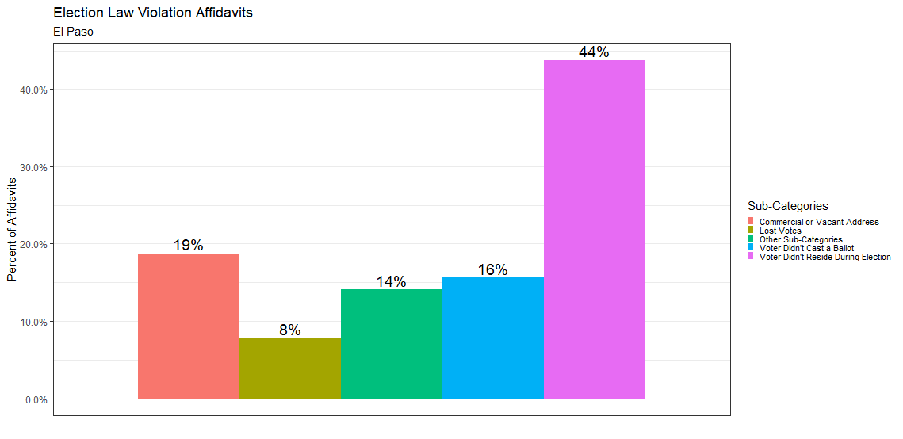
Election Law Violation Affidavits – El Paso
PRISTINE VOTER ROLLS
Notes:
I&W = Indicators and Warnings

Slide 6
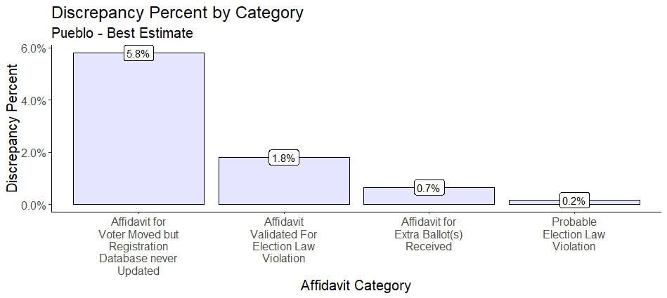
Total Issues Found – Pueblo
Notes:
I&W = Indicators and Warnings

Slide 7
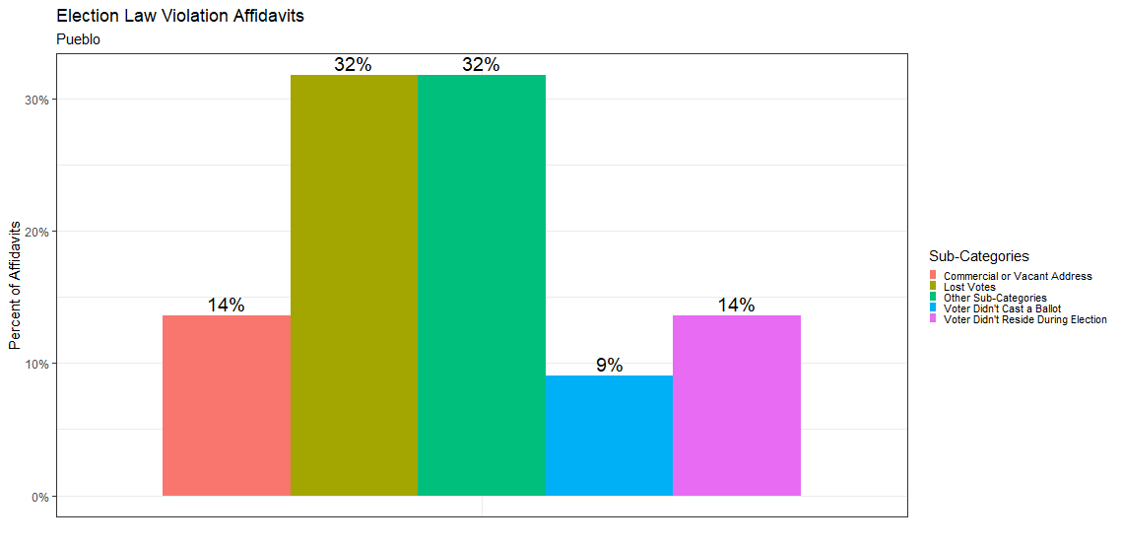
Election Law Violation Affidavits – Pueblo
Notes:
I&W = Indicators and Warnings

Slide 8
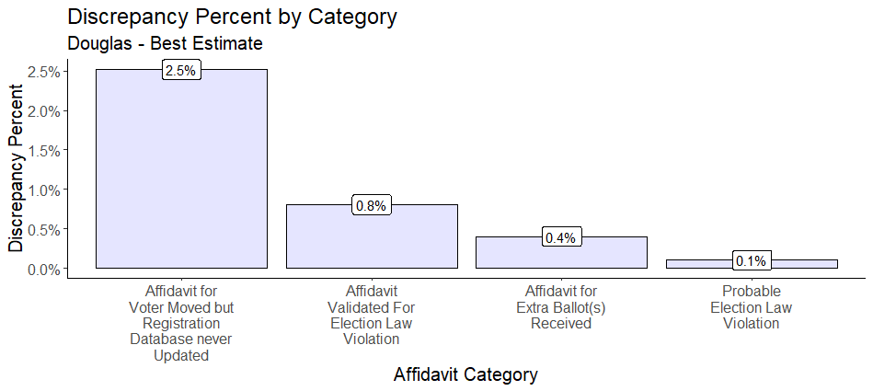
Total Issues Found – Douglas
Notes:
I&W = Indicators and Warnings

Slide 9
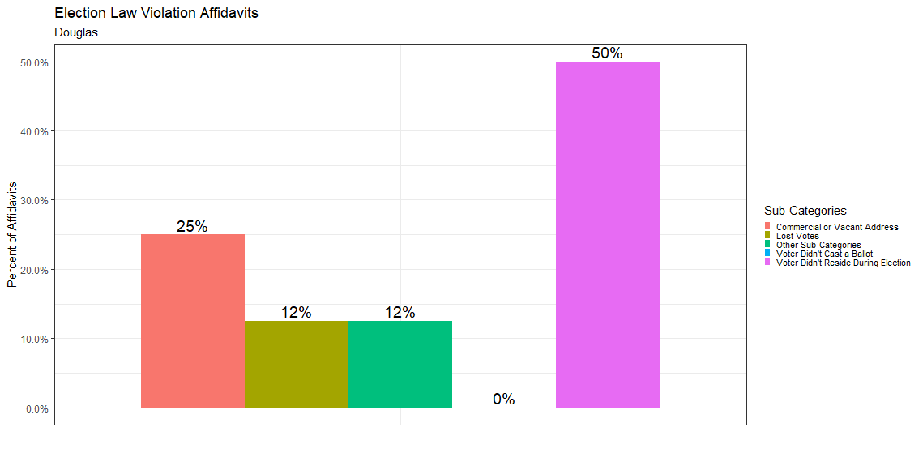
Election Law Violation Affidavits – Douglas
Notes:
I&W = Indicators and Warnings

Slide 10
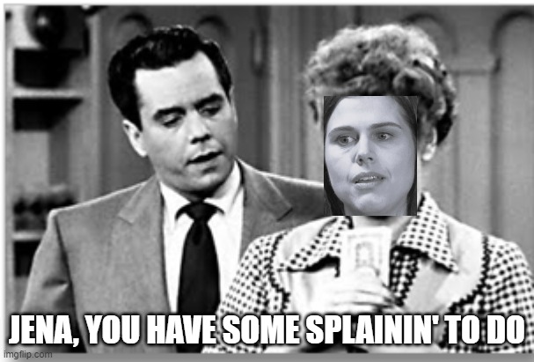
Comments and Questions from Canvassing
Colorado citizens are negatively impacted by the current system
What is the point of ERIC?
Rolls don’t appear accurate
Mail-in ballots are a major problem
No chain of custody
No one is watching the videos of the ballot drop boxes
GA ballot mules anyone?
Huge cost increase to counties and the state
Cost to mail out and monitor versus just having people show up with a driver’s license or another ID method
Built for Integrity Solution is the only way to improve our election system

Slide 11
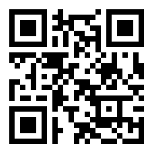
Join the Cause

