Slide 1
COLORADO CANVASSING RESULTS
All political power is vested in and derived from the people; all government, of right, originates from the people, is founded upon their will only, and is instituted solely for the good of the whole.
Constitution of the State of Colorado, Article II (Bill of Rights), Section 1

Slide 2
Reviewer Credentials
Ph.D. in Economics; MS in Mathematics; MA in International Economics; MA in Education; Retired USAF, LtCol (served 25yrs); Assistant Professor in Mathematics (USAFA) and Assistant Professor in Economics (USAFA); Financial & Economic advisor to Deputy Assist Secretary of the Air Force (Pentagon); Additional Experience includes Flight Test Analyst, Satellite Tester, and Laser Lab Intern
Master's and Ph.D. in Mathematical Statistics; 30+ years as a Professional Statistician
Exemplary prior US military service; Bachelor and Master's Degrees in Arts, Sciences, and Information Technologies; 40 Years of Combined Experience: Programming, Systems Engineering, Product Development, Curriculum Planning, Operations Analysis, and Systems Architecture; Additional Experience: Fortune 500 Companies, Corporate & Commercial education, Higher Education, Communications, Video Game/Simulations, and defense industries.
40+ years of software development and engineering expertise; Experience in Marketing, Real Estate, and Voter Data Acquisition and Development
25+ years Active-Duty military, including command of military installations and operational forces, staff assignments, including Office of the Secretary of Defense, and formal research for Department of Defense; BA, Political Science/MAS, Aeronautical Science/MA, National Security Affairs; operational test manager, director, analyst; trained in Scientific Test and Analysis Techniques (STAT), statistical research.
27+ years of software development and engineering expertise; Experience in Healthcare, Jail Systems, and Marketing development
Certified Public Accountant; 10+ Years of Accounting Experience
Master's in Business Analytics; Certified Analytics Professional; 10+ Years of Analytical and Financial Experience
Notes:
I&W = Indicators and Warnings

Slide 3




Statistical Methodology – Stratified Sampling
Voting Population
Final Sample
Advantages
Lower cost compared to simple random sampling
Sample is less variable
Estimates more precise
Low Voter Opportunity Score Precinct
High Voter Opportunity Score Precinct
Notes:
I&W = Indicators and Warnings

Slide 4
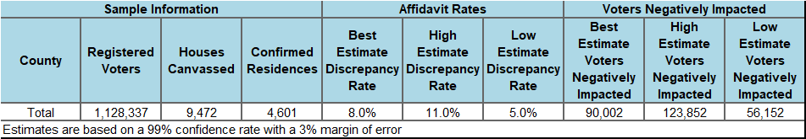
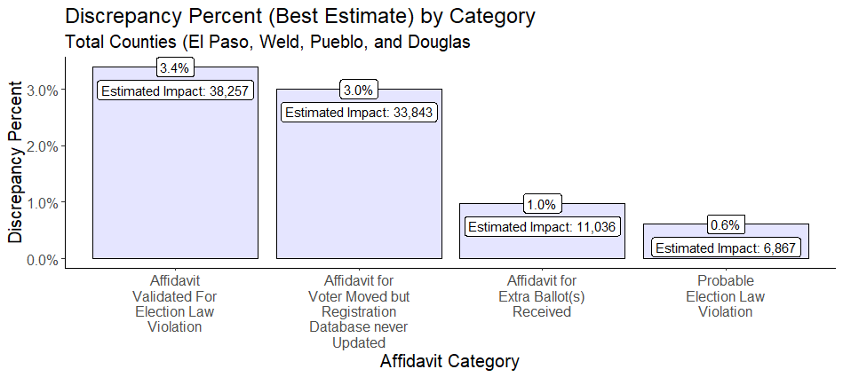
Total Issues Found – All Counties
Notes:
I&W = Indicators and Warnings

Slide 5
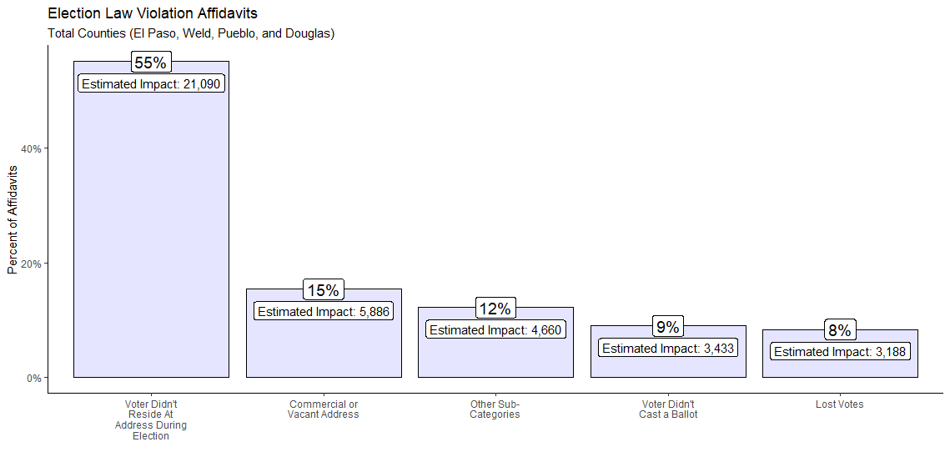
Election Law Violation Affidavits – All Counties
Breaking Down the Best Estimate Impact of Election Law Violations: Of that 3.4%...
Notes:
I&W = Indicators and Warnings

Slide 6
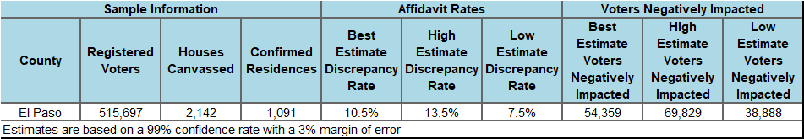
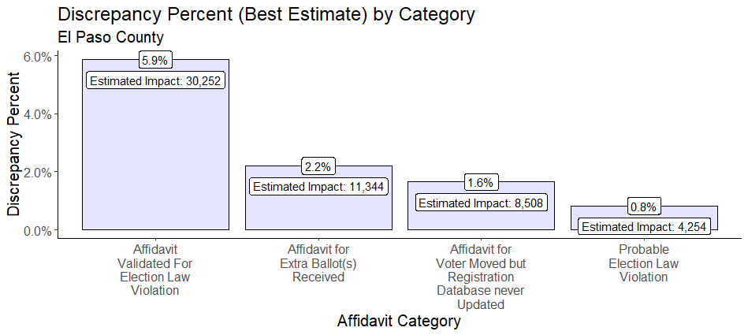
Total Issues Found – El Paso
Notes:
I&W = Indicators and Warnings

Slide 7
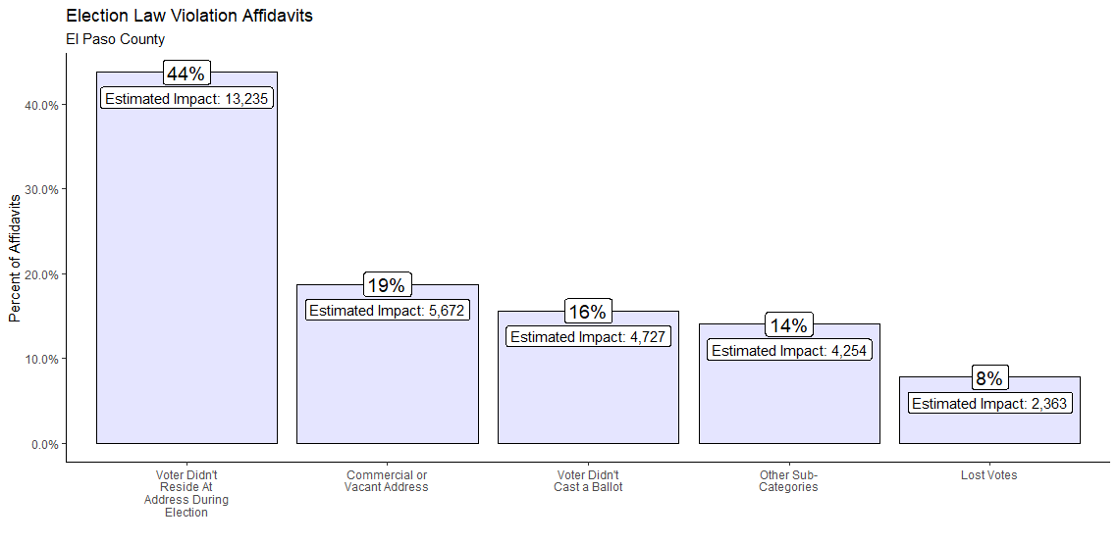
Election Law Violation Affidavits – El Paso
Breaking Down the Best Estimate Impact of Election Law Violations: Of that 5.9%...
PRISTINE VOTER ROLLS
Notes:
I&W = Indicators and Warnings

Slide 8

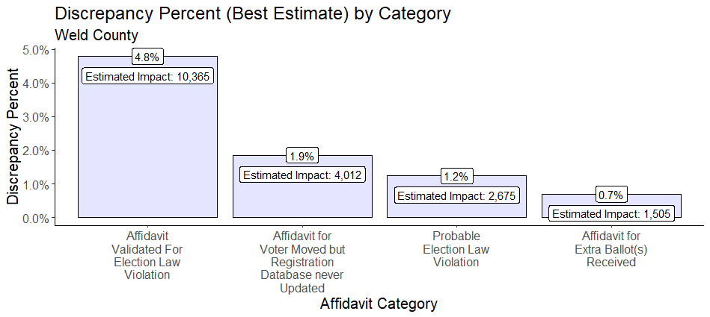
Total Issues Found – Weld
Notes:
I&W = Indicators and Warnings

Slide 9
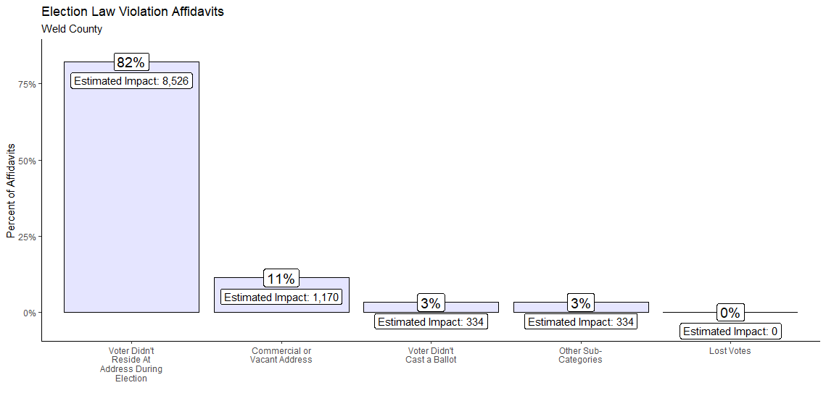
Election Law Violation Affidavits – Weld
Breaking Down the Best Estimate Impact of Election Law Violations: Of that 4.8%...
Notes:
I&W = Indicators and Warnings

Slide 10
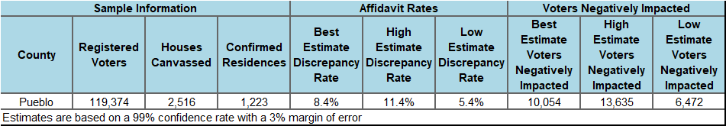
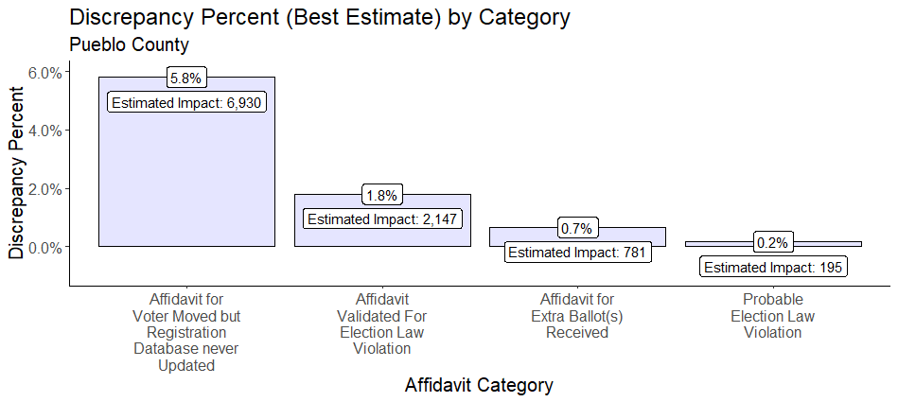
Total Issues Found – Pueblo
Notes:
I&W = Indicators and Warnings

Slide 11
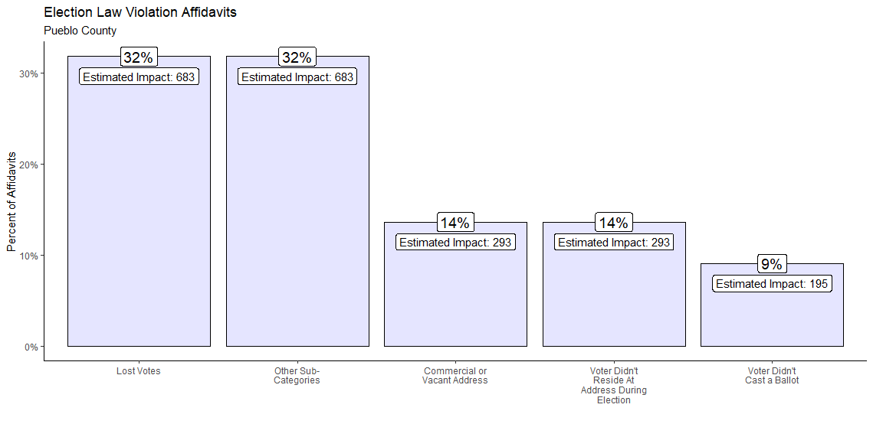
Election Law Violation Affidavits – Pueblo
Breaking Down the Best Estimate Impact of Election Law Violations: Of that 1.8%...
Notes:
I&W = Indicators and Warnings

Slide 12
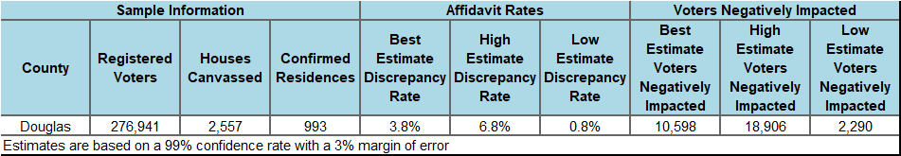
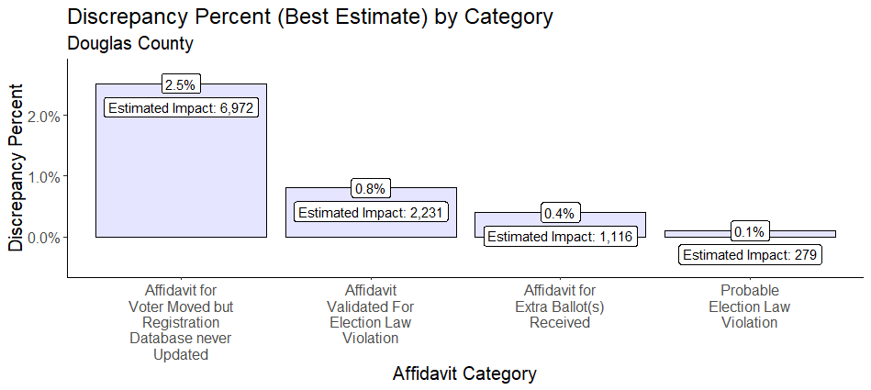
Total Issues Found – Douglas
Notes:
I&W = Indicators and Warnings

Slide 13
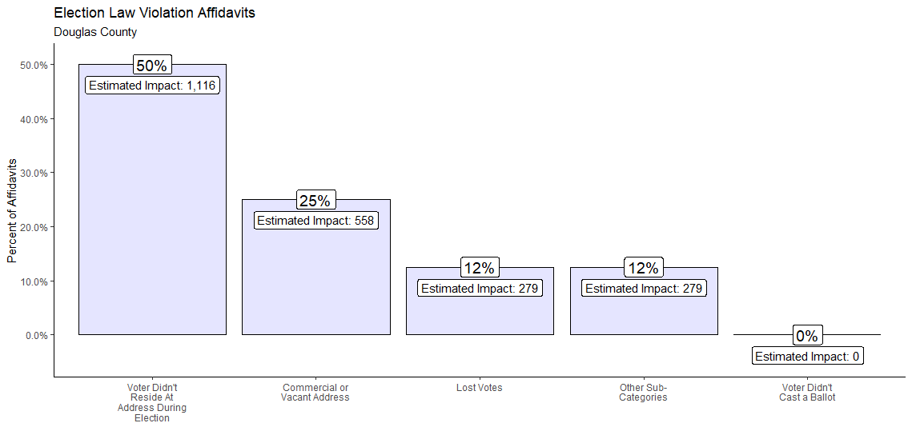
Election Law Violation Affidavits – Douglas
Breaking Down the Best Estimate Impact of Election Law Violations: Of that 0.8%...
Notes:
I&W = Indicators and Warnings

Slide 14
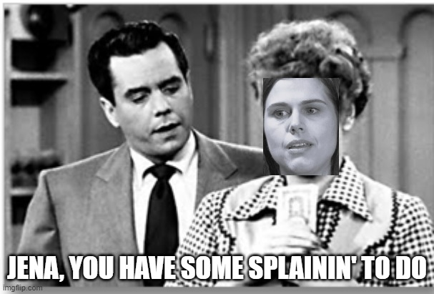
Comments and Questions from Canvassing
Colorado citizens are negatively impacted by the current system
What is the point of ERIC?
Rolls don’t appear accurate
Mail-in ballots are a major problem
No chain of custody
No one is watching the videos of the ballot drop boxes
GA ballot mules anyone?
Huge cost increase to counties and the state
Cost to mail out and monitor versus just having people show up with a driver’s license or another ID method
Built for Integrity Solution is the only way to improve our election system

Slide 15
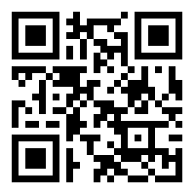
Join the Cause

