Slide 1
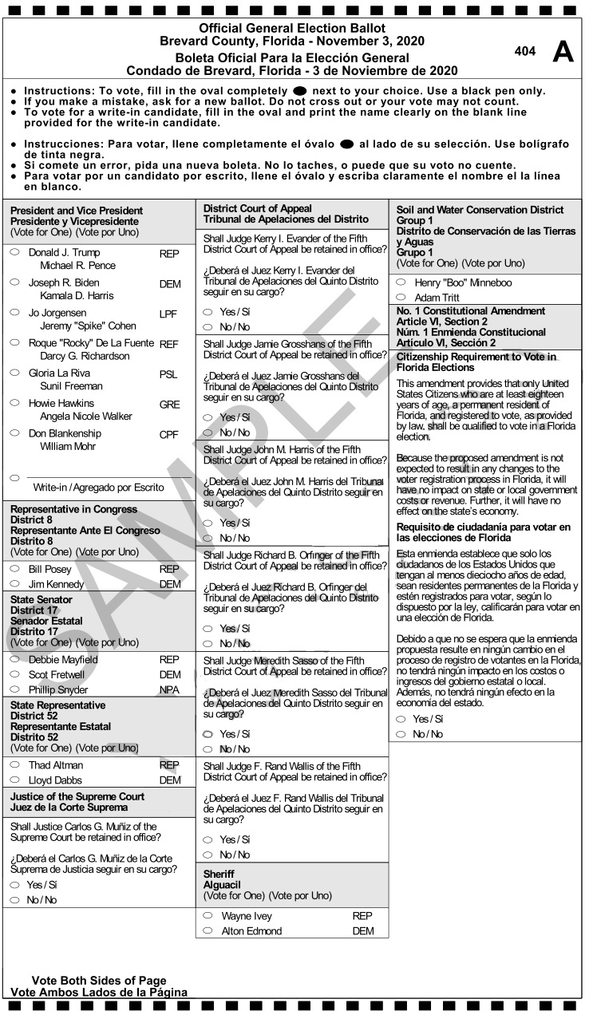

Ballot Control Number
Format
As per Florida “Uniform Design for Election Ballots” rule 1S-2.032
Ballot Control Number and Barcode
Instructions: Remove and retain perforated stub below.
2 0 2 0 9 1 0 4 3 4 5 0 0 0 1
Removable Stub
2 0 2 0 9 1 0 4 3 4 5 0 0 0 1
1

Slide 2
Ballot Control Number
Format
Election Type
County
Precinct
Number
Year
State
2 0 2 0 9 1 0 4 3 4 5 0 0 0 1
2

Slide 3

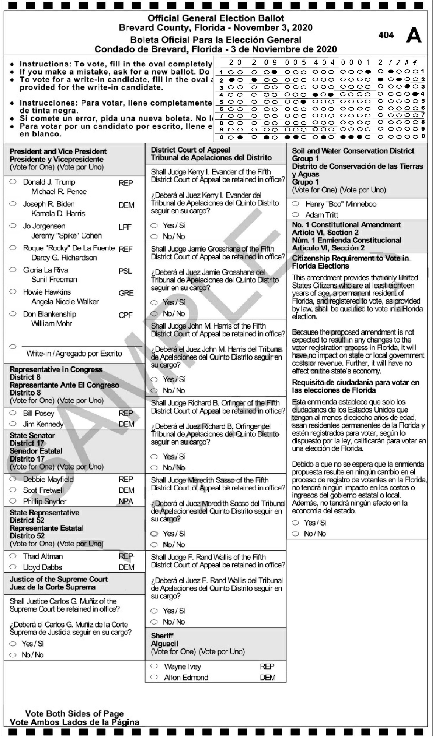



Assure Secrecy of a Ballot Control Number
Printing the Ballot
Walk-in
1
2
3
4
5
6
7
B
B
B
S1
B
B
B
B
B
Stub
SOE authorizes ballot number print range
Printer prints
ballots with control
numbers
SOE inspects & approves ballots
Insert ballots inside
blank envelope
Shuffle mix blank envelopes
Re-stack
blank envelopes
Distribute to Walk-in or Mail-out
Mail-out
3

Slide 4




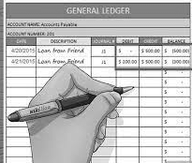
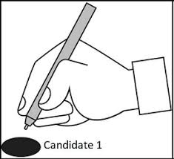




Assure Secrecy of a Ballot Number
Walk-in Voter
1
2
3
4
5
6
Registry
B
B
B
2 0 2 0 9 4 0 4 3 4 5 6
Record voter
Ballot in blank envelope
Enter Booth
Open
Vote
Remove Stub
8
9
10
11
7
Official Ballot
Official Ballot
2 0 2 0 9 4 0 4 3 4 5 6
Official Ballot
Control Number Stub
Secrecy Envelope
Retain stub
Cast ballot
Ballot sealed until ready to scan
Scan & tally ballot
4

Slide 5
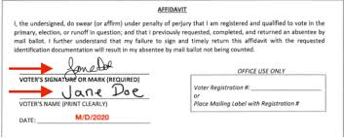



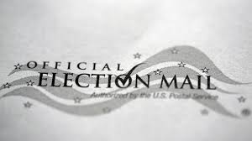

Assure Secrecy of a Ballot Number
Absentee Mail-in Ballot
1
2
3
4
5
6
7
8
Official Ballot
Official Ballot
2 0 2 0 9 4 0 4 3 4 5 6
2 0 2 0 9 4 0 4 3 4 5 6
B
Receive
Remove
Vote
Remove Stub
Secrecy Envelope
Mailer
Sign
Mail
9
10
11
12
13
14
15
Registry
Official Ballot
Name Address & Signature
Ballot sealed until
ready to scan
Receive
Compare & Verify Mailer
Record voter
Scan & Archive
Scan & tally ballot
5

Slide 6
Reconciliation of Ballot
Vote Tally Summary
Example:
Ballot numbers in sequential order by precinct with vote summary posted on-line
Ballot Number
President & VP
State Rep. 8
Senator
Justice
Issue 1
202091043450001
John Smith
Jane Doe
Steve Ho
Bob White
No
202091043450002
John Smith
Jane Doe
Mike Green
Bob White
No
202091043450003
Paul Jones
Chris Public
Mike Green
Joe Black
No
202091043450004
Write-in
Jane Doe
Mike Green
Joe Black
Yes
202091043450005
Chris Public
Mike Green
No
202091043450006
Paul Jones
Jane Doe
Write-in
Joe Black
No
Voter can check their own ballot to verify how their vote was recorded.
6

Slide 7

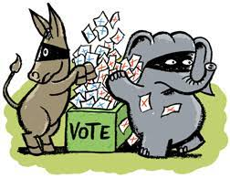
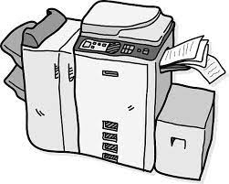

Advantages of Control Numbers on Ballots
Voter can check how their ballot was recorded
Thwarts counterfeit ballots
Stops photocopied ballots
Stops multiple scanning of the same ballot
7

Slide 8
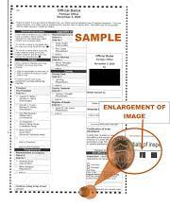


Advantages of Control Numbers on Ballots
Thwarts improperly adjudicated ballots
No special paper required
Check against cyber manipulation of ballot tally
Allows 1-to-1 comparison of ballot hard copy to image
8

