Slide 1
Why serial numbers on ballots do not tie the ballot to a voter.

Slide 2

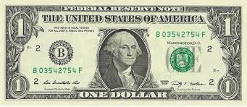
Illustration:
Gather $1 bills from several people.

Slide 3

Illustration:
Mix up the money

Slide 4

Illustration:
Randomly hand one $1 bill to the person.

Slide 5

Illustration:
The ask them “Who’s dollar bill is this?”

Slide 6
Illustration:
Why don’t they know?
It has a serial number on it!

Slide 7

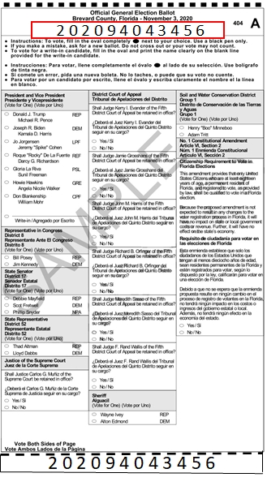




Likewise, a concealed ballot number does not reveal the voter.
Secrecy of Ballot
Printing Ballot
1
2
3
4
5
6
7
?
B
B
B
B
B
S1
B
B
B
Print
Sequential
Control Numbered (CN) Ballot
CN Ballot Inside
Unmarked
Ballot Envelope
Randomize Ballot Envelopes
Organize
Ballot Envelopes
Deliver
To
SOE
Distribute to Walk-in or Mail-out
8

