Slide 1
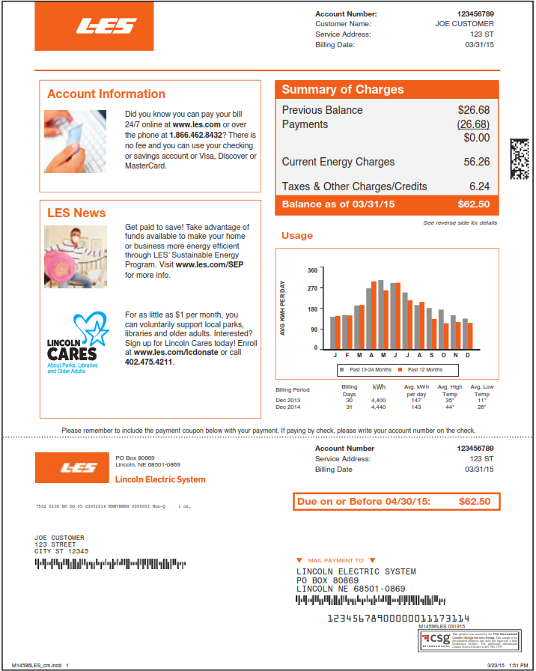


MIKE HILGERS
6907 STONEBROOK PKWY
6907 STONEBROOK PKWY
MIKE HILGERS
6907 STONEBROOK PKWY
LINCOLN NE 68521

