Slide 1

Restoring Liberty Through Civic Action

Slide 2

Non – Citizens Voting in NY
Requirements to verify Citizenship in Federal Elections is not uniform across the US due to the decentralized nature of our system
There are NO federal laws that set the standard on verification
  National Voter Registration Act of 1993 (NVRA): requires states to offer registration opportunities at the motor vehicle departments and other public offices. Requires applicants to affirm citizenship through a check box and signature under penalty of perjury
  Help America Vote Act of 2002 (HAVA): requires states to ask for driver’s license numbers or the last four digits of a Social Security number
  State Laws and Case Law
Restoring Liberty Through Civic Action

Slide 3
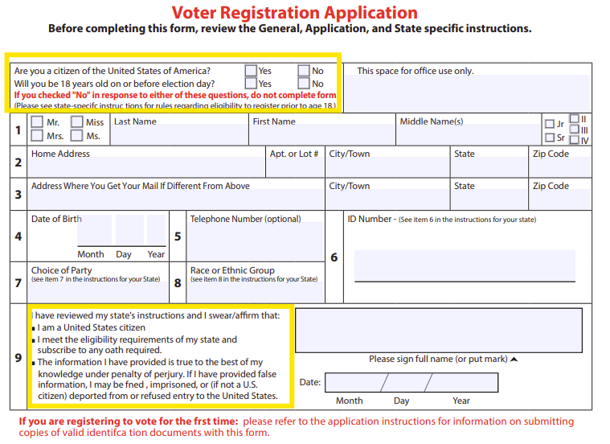

NVRA Voter Registration Application

Slide 4
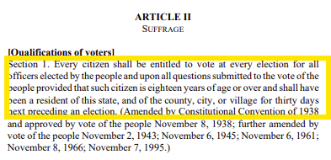
What does the NY State Constitution say?

Slide 5
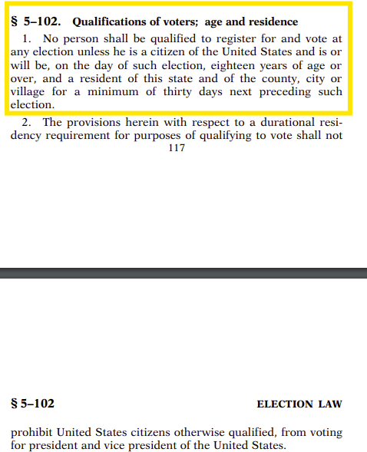
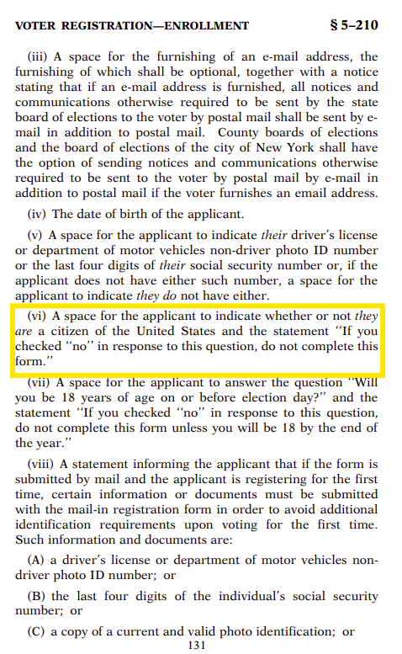
New York State Election Law

Slide 6
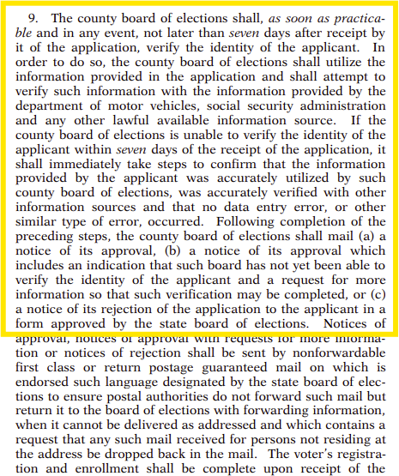
NY State Election Law Verification of Identity:
Counties are responsible

Slide 7
NY State Election Law:
Qualifications of Voters

Slide 8
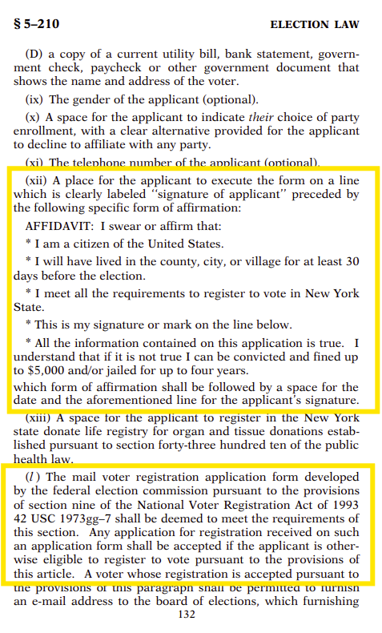
NY State Election Law: Affidavit and NVRA reference

Slide 9
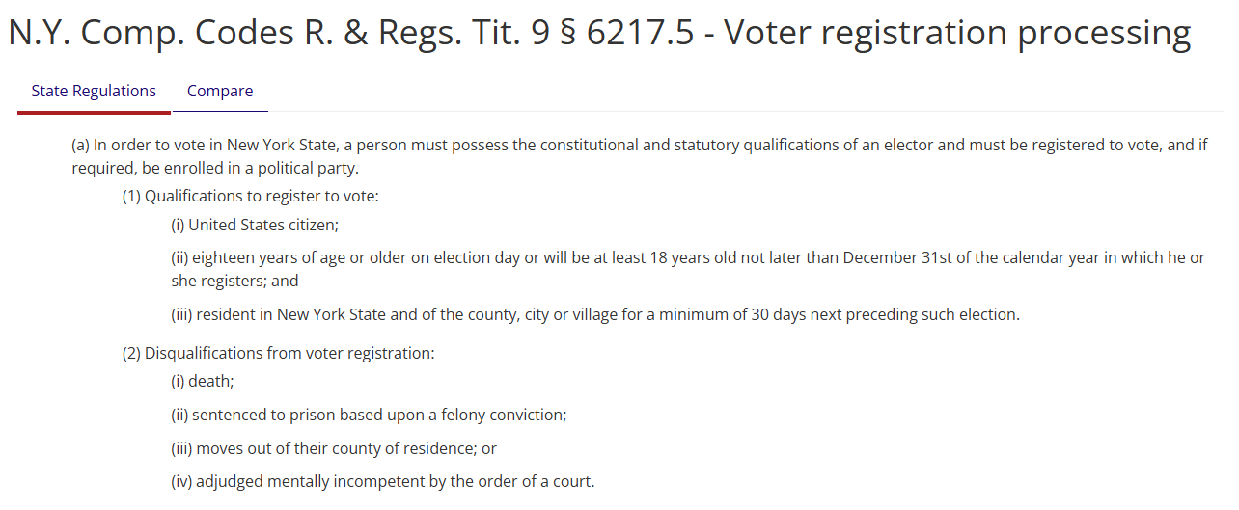
NY Comp. Codes R. and Regs

Slide 10
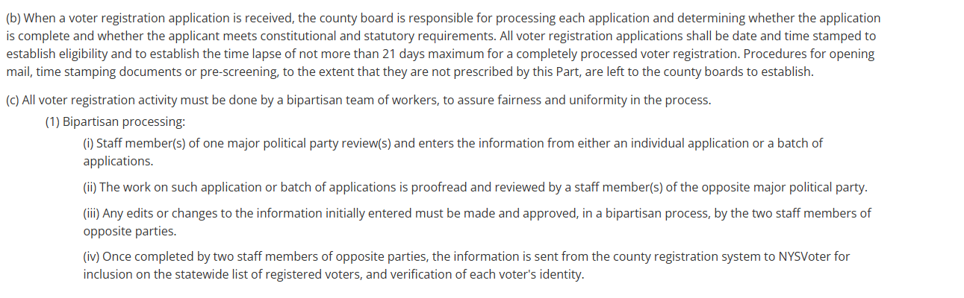
NY Comp. Codes R. and Regs

Slide 11
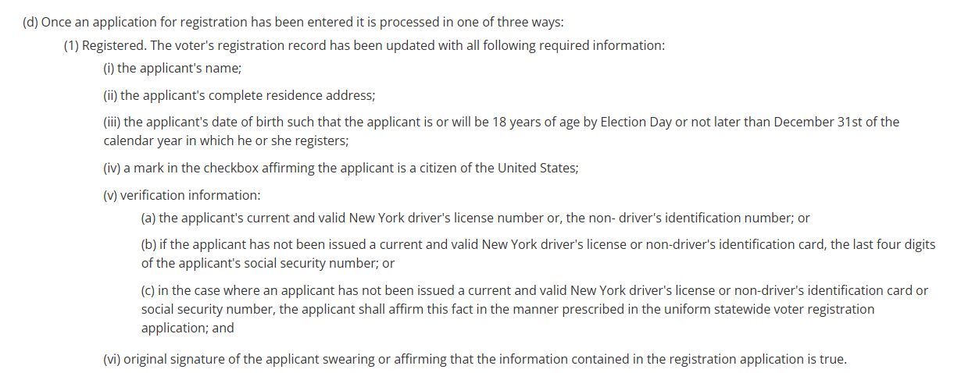
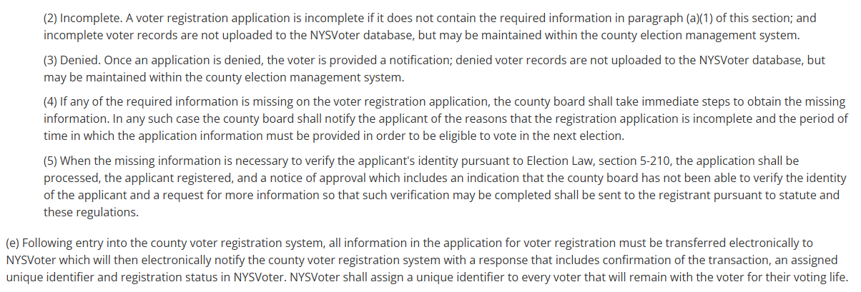
NYCCRR

Slide 12
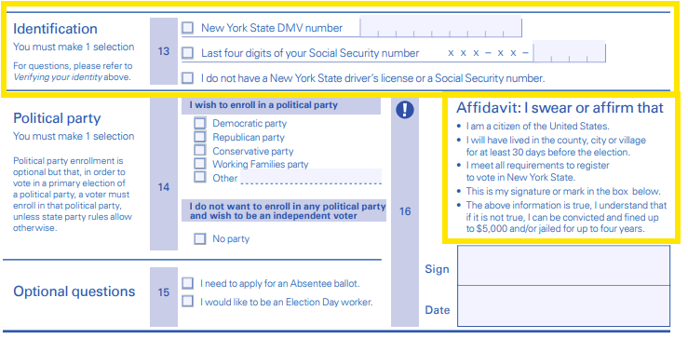
NY State On-line Voter Registration Form

Slide 13
New York Election Law: Section 15: Village Elections
Village Elections have a whole section NY Law. Village Elections are run differently.
Certification of Village Elections:
Under Section 15-126, it states in part, "The village clerk shall produce at such meeting the returns of the inspectors of election, at which time the board of trustees shall canvass such returns and file in the office of the village clerk a certificate declaring the result.
So, the Village Trustees MUST certify the election at a public meeting, because the required certificate would have to be approved during a meeting of the Trustees.

Slide 14
Sanctuary State Status: Petition for a Ballot Referendum in support of Legislation
We, the undersigned eligible voters of New York submit this Petition for a Ballot Referendum to be added on the 2025 General Election Ballot allowing New York Citizens to decide sanctuary state status for New York. A vote would make unnecessary Executive Order # 170 (CUOMO/HOCHUL) authorizing Sanctuary State status that intentionally shields illegal immigrants from lawful enforcement of federal immigration law and bypasses the checks and balances of power provided for in the NY Constitution.
Executive Orders issued by the Governor must be utilized with great prudence. The New York State Constitution gives the legislature the authority to grant temporary power to a governor with limits, and only for emergency measures. Executive Orders and emergency power must not be used as a circumvention to the legislature. On 9/15/2017, Governor Andrew Cuomo signed Executive Order #170 authorizing NY State to be a sanctuary state circumventing the appropriate legislative process.
After taking office, Governor Kathy Hochul has not revoked Andrew Cuomo’s executive order and on May 9, 2023, in response to the expiration of Federal Title 42, Executive Order #28 declaring a state of emergency for asylum seekers. This order has repeatedly been extended, creating a burden on the people of the State of NY, and disregarding Constitutional limitations. The Legislature has refused TO TAKE RESPONSIBILITY to end the executive abuse of power.

Slide 15
Applicable Laws:
NY State Constitution: Article 3, section 25: gives power to the NY state legislature to assure continuity of government during emergencies caused by “enemy attacks or disasters (natural or otherwise)”
Executive Law 28: authorizes the Governor to declare a statewide emergency with an executive order, if a disaster has already occurred or may be imminent and if the local government will not be able to respond effectively
Executive Law 29: gives the Governor the authority to order State agencies to respond with needed assistance when the Governor has declared a state of emergency which is coordinated through the Disaster Preparedness. also gives authority to the Governor to suspend parts of any statutes, laws, ordinances, regulations etc… if compliance would get in the way of prompt actions needed to respond to and mitigate the emergency
  Limits: length of time the statewide emergency can be in effect which is 6 months; while the suspension of laws, statutes, ordinances, regulations can only be for 30 days. The Governor can extend the state of emergency in 6 month blocks and provisions in 30 day blocks.
  The deviation from the law has an additional caveat in that the suspension of law must be a “minimum deviation” from the law and needed as related to the emergency being addressed and must “safeguard the health and welfare of the public.”
  The Legislature can terminate the executive orders by resolutions in both houses. The courts in NY have interpreted the minimum deviation clause regarding the suspension of laws narrowly but have not used it to override any Executive Orders.

