Slide 1
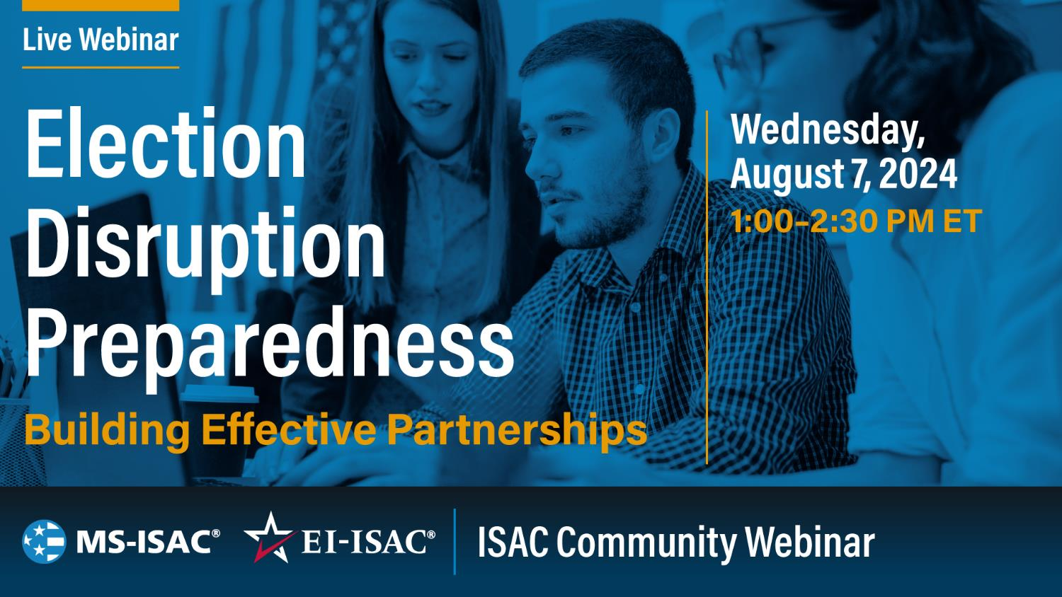
Marci Andino
Kaitlin Drape
Jared Dearing
Mike Garcia
Chris Harvey
Mike Moser
Taylor Oldaker
Megan Noland
Laura Cooper
Paul Lux
Aaron Kustermann

Slide 2
Traffic Light Protocol
TLP: AMBER
Color | When should it be used? | How may it be shared?
TLP: AMBER Limited disclosure, restricted to participants’ organizations. | Sources may use TLP: AMBER when information requires support to be effectively acted upon, yet carries risks to privacy, reputation, or operations if shared outside of the organizations involved. | Recipients may only share TLP: AMBER information with members of their own organization, and with clients or customers who need to know the information to protect themselves or prevent further harm. Sources are at liberty to specify additional intended limits of the sharing: these must be adhered to.
TLP:AMBER
Notes:
Rach -> Carlos

Slide 3

Closed Captioning
  To enable closed captioning, navigate to the bottom left-hand corner of the WebEx application and click on the ‘cc’ button as shown below.
  Closed captioning is available in English, French, Spanish, German and Italian.
TLP:AMBER
Notes:
As a reminder, WebEx allows you to utilize closed captioning during our webinars. If you would like to enable closed captioning, please navigate to the bottom left-hand corner of the WebEx application and click on the ‘cc’ button as shown on this slide.

Slide 4
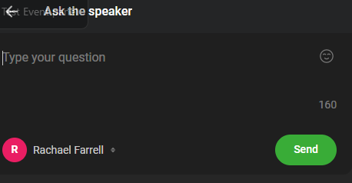
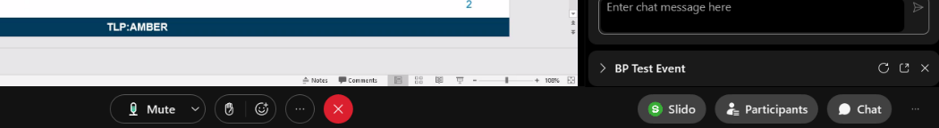
WebEx Application: Slido
Ask the Speaker
YN
Your Name
TLP:AMBER
Notes:
Before we pass this over to our Presentation Team, we wanted to mention a couple quick WebEx reminders.
Please utilize the chat feature for any comments or feedback that you would like to leave for our presentation team. However, if you have a question, we ask that you please utilize the Slido application for any Q&A questions you may have, as there will be time at the end of the presentation for Q&A with our presenters.

Slide 5
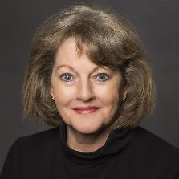
Welcome
Marci Andino
Vice President, EI-ISAC

Slide 6

2024 Election
The Evolving Threat
Kaitlin Drape
Hybrid Threat Intelligence Analyst
Notes:
10 minutes

Slide 7
Background
What is the Center for Internet Security (CIS)?
CIS mission - Build confidence in the connected world by providing state and local governments with cutting edge cybersecurity support
Role of Countering Hybrid Threat Program
  Established in April 2022 to enable state, local, county and territorial governments to be better able to detect, evaluate, and mitigate:
    Emerging cyber threats
    Physical threats facilitated through use of internet communication tools, and
    Foreign malign information operations that seek to inspire, inform or facilitate acts of violence or other illegal activity and that directly impact public safety and/or the domestic threat environment
    Focus includes evaluating hostile activities emanating from foreign and domestic threat actors - foreign intelligence services, terrorist groups, violent extremists, and criminal entities – to support operational responses
CIS works closely with state and local law enforcement organizations and fusion centers across the Nation
TLP:AMBER

Slide 8
Current Threat Environment
Overview
Threat environment is complex, dynamic, evolving at internet speed, and dangerous
  Foreign and domestic threat actors have fully embraced the power of the internet
Underlying Factors
  Nation is polarized – angry and divisive rhetoric has become ingrained in our public discourse
  Growing number of people believe violence and/or destructive activity is an acceptable way to express one’s ideological/political beliefs – or opposition to the beliefs of others
    The Nation continues to experience violent attacks and destructive activity by unaffiliated lone offenders and small groups
    Those engaged in this illegal activity often self-connect with a cause or grievance developed through the consumption of online content
    Targets have included law enforcement personnel, election and other government officials, and others targeted due to race, religious beliefs, political affiliation, immigration status and gender identity
TLP:AMBER

Slide 9
Current Threat Environment Cont’d
Overview
  Violence and destructive activity is fueled by an online/media ecosystem saturated with content purposefully placed there by foreign and domestic threat actors in furtherance of threat-related or illegal objectives
    Advanced computing such as artificial intelligence is increasingly being used by threat actors to conduct cyber attacks and information operations
  International conflicts such as those in Ukraine and Middle-East directly impact the domestic threat environment
  Threat actors increasingly use cyber attacks, information operations and physical activities in cohesive and integrated manner
TLP:AMBER

Slide 10
Threats to the 2024 Election
Areas of Concern
Acts of targeted violence and destructive activity directed at:
  Election and other government officials
  Law enforcement
  Those targeted for ideological reasons
Cyber attacks
  Intended to disrupt government activities
  Ransomware attacks blocking access to election system or data
  Denial of Service attacks
  Often goal is to undermine confidence in public and private institutions
TLP:GREEN

Slide 11
Threats to the 2024 Election
Areas of Concern - continued
Information operations
  Intended to inspire destructive activities, violence and confrontational interactions at drop boxes, polling sites and election offices
  Objective is to sow discord and undermine confidence in government and non-government institutions
  Have been used to inspire, inform, and facilitate illegal activities
  Increasing use of Artificial Intelligence
  Response should focus on detecting and mitigating threats NOT policing thought or restricting speech
Election day disruptions
  Swatting, bomb threats, white powder envelope, demonstrations, and DDoS attacks intended to disrupt voting
TLP:AMBER

Slide 12
Threat is Serious – But There is Good News
State, Local and County Law Enforcement and Election Officials are Preparing
Enhanced collaboration between law enforcement and election communities
  Information sharing – greater awareness of the threat
  Cybersecurity – assessment, mitigation of vulnerabilities, training, exercises
  Planning and exercises – planning on topics such as election day disruptions (swatting, bomb threats, etc.…)
  Crisis communications – developing strategies and relationships to rapidly respond to information operations intended to disrupt election process
Resources
  Government DHS (CISA, FEMA, I&A), FBI
  Major County Sheriffs Association (MCSA), Major Cities Chiefs of Police Association (MCCA), National Fusion Center Association (NFCA)
  Non-government groups such as Committee for Safe and Secure Elections (CSSE)
TLP:AMBER

Slide 13
Additional Resources
Publicly Available Joint-Guidance
#StopRansomware Guide
Phishing Guidance, Stopping the Attack Cycle at Phase One
CISA Insider Threat Guidance
CIS Intelligence Blogs
CISA, NSA, FBI, MS-ISAC Guide on Preventing Phishing Intrusions
TLP:AMBER

Slide 14
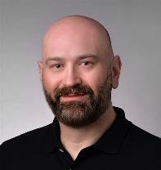
Election Day Disruptions
Preparedness Plan
Jared Dearing
Senior Director, CIS Elections Best Practices
Notes:
10 minutes

Slide 15
Introduction
Overview:
  Election Day disruptions pose significant risks to electoral integrity and stability.
  Goal: Ensure voter and worker safety, maintain public confidence, and guarantee continuity of operations.
Objectives:
  Coordinate with local, state, and federal agencies.
  Establish preparedness and training.
  Develop crisis communication strategies.
TLP:AMBER

Slide 16
Examples of Election Day Disruptions
Bomb threats:
Bomb threats involve communications about the presence or intent to detonate explosives. These threats can cause panic, fear, and significant disruptions to the election process.
It is important to note that while Bomb threats can be used to disrupt elections, these threats can also be real and related to the placement of explosive devices. Every threat must be taken seriously.
TLP:AMBER
TLP:WHITE TLP:RED TLP:AMBER TLP:GREEN (Delete unused designations)

Slide 17
Examples of Election Day Disruptions
Swatting:
Swatting is the act of deceiving emergency services into sending a police or emergency response team to a targeted individual or location.
This is done by falsely reporting a serious law enforcement emergency, such as a bomb threat, hostage situation, or other critical incident.
TLP:AMBER
TLP:WHITE TLP:RED TLP:AMBER TLP:GREEN (Delete unused designations)

Slide 18
Examples of Election Day Disruptions
White powder incidents:
White powder incidents involve the distribution of suspicious powdery substances, often intended to cause fear and disrupt operations. These powders are typically sent through the mail or scattered in public places.
Other disruptions:
Other disruptions can include protests & counter protests, active shooters, threats of violence, and other activities aimed at interfering with the electoral process.
TLP:AMBER
TLP:WHITE TLP:RED TLP:AMBER TLP:GREEN (Delete unused designations)

Slide 19
Examples of Election Day Disruptions
Election Disruptions Objectives:
To disrupt the electoral process and create a climate of fear and uncertainty.
To cause disruption, create chaos, and divert resources from actual emergencies.
To interfere with elections, create safety hazards, and deter voter participation.
TLP:WHITE TLP:RED TLP:AMBER TLP:GREEN (Delete unused designations)
TLP:AMBER

Slide 20
Examples of Election Day Disruptions
Commonalities
TLP:WHITE TLP:RED TLP:AMBER TLP:GREEN (Delete unused designations)
TLP:AMBER

Slide 21
The Importance of Partner Engagement
Law Enforcement & Emergency Management Officials:
  Partnerships: Access to expertise and resources.
  Collaborative Efforts: Joint training, information sharing, communication protocols.
  Security Plans: Conduct risk assessments and coordinate responses.
Media Outlets:
  Pre-established Relationships: Ensure transparency and open communication.
  Points of Contact: Provide timely information during a crisis.
TLP:WHITE TLP:RED TLP:AMBER TLP:GREEN (Delete unused designations)
TLP:AMBER

Slide 22
Preparing Your Partners and Community
Steps to Engage Partners:
  Initial Meetings: Establish communication channels.
  Formalize Partnerships: Create a memorandum of agreement.
  Joint Training and Exercises: Simulate disruption scenarios.
  Information Sharing: Share polling place locations and contact info.
  Communication Protocols: Designate points of contact and secure channels.
TLP:WHITE TLP:RED TLP:AMBER TLP:GREEN (Delete unused designations)
TLP:AMBER

Slide 23
Critical Engagement Topics
Steps to Engage Partners
  Initial Meetings: Establish communication channels.
  Formalize Partnerships: Create a memorandum of agreement.
  Joint Training and Exercises: Simulate disruption scenarios.
  Information Sharing: Share polling place locations and contact info.
  Communication Protocols: Designate points of contact and secure channels.
  Community Engagement: Build trust and cooperation between election officials, law enforcement, and the public.
  Understanding Laws and Regulations: Educate both parties on relevant laws and regulations pertaining to election-related activities.
TLP:WHITE TLP:RED TLP:AMBER TLP:GREEN (Delete unused designations)
TLP:AMBER

Slide 24
Preparing Your Office
Key Activities:
  Assign and Coordinate Roles: Clarity in duties for all staff.
  Appoint a Point of Contact (POC): Coordinate emergency contacts and responses.
  Budget Assessment: Allocate resources for security and COOP plans.
  Develop a Security Plan: Manage various disruptions; use CISA’s Protective Security Advisors program for physical security assessments.
  Brief Election Staff: Equip staff with necessary knowledge and tools.
  Ensure COOP Readiness: Develop, maintain, and practice Continuity of Operations Plan (COOP).
TLP:WHITE TLP:RED TLP:AMBER TLP:GREEN (Delete unused designations)
TLP:AMBER

Slide 25
Resources
Election Day Disruptions Resources & Preparedness Plan
The Committee for Safe and Secure Elections: Resources for election and law enforcement officials.
CISA’s Bomb Threat Guide: Detailed guide on managing bomb threats.
CISA’s Swatting Prevention and Response Guidance: Strategies for preventing and responding to swatting incidents.
EAC Continuity of Operations Plan Template: Template for developing a Continuity of Operations Plan.
The Elections Group: Resources for de-escalation and Dropbox security strategies.
TLP:WHITE TLP:RED TLP:AMBER TLP:GREEN (Delete unused designations)
TLP:AMBER

Slide 26
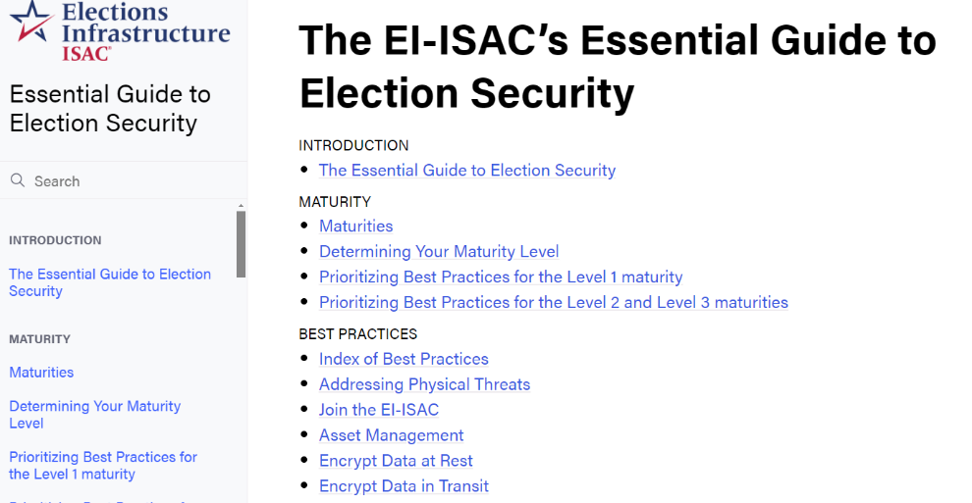
Resources
https://essentialguide.docs.cisecurity.org
TLP:WHITE TLP:RED TLP:AMBER TLP:GREEN (Delete unused designations)
TLP:AMBER

Slide 27
Elections Officials Only
Please Respond to the Polling Questions
Notes:
10 minutes

Slide 28
Guide for Collaborative Discussions on Election Disruption Preparedness
Mike Garcia
Senior Cybersecurity Consultant, CIS Election Best Practices
Notes:
10 minutes

Slide 29
Facilitating Productive Discussions
Discussions are meant to establish:
  The importance of maintaining election operations even in the face of disruptions
  A common understanding of election disruptions through the lens of public safety and criminality
  Predefined roles and mutual understanding
  Mutual support each party’s core mission
TLP:WHITE TLP:RED TLP:AMBER TLP:GREEN (Delete unused designations)
TLP:AMBER

Slide 30
Critical Engagement Topics
Steps to Engage Partners
  Initial Meetings: Establish communication channels.
  Formalize Partnerships: Create a memorandum of agreement.
  Joint Training and Exercises: Simulate disruption scenarios.
  Information Sharing: Share polling place locations and contact info.
  Communication Protocols: Designate points of contact and secure channels.
  Community Engagement: Build trust and cooperation between election officials, law enforcement, and the public.
  Understanding Laws and Regulations: Educate both parties on relevant laws and regulations pertaining to election-related activities.
TLP:WHITE TLP:RED TLP:AMBER TLP:GREEN (Delete unused designations)
TLP:AMBER

Slide 31
An Example
Guide for Collaborative Discussions on Election Disruption Preparedness
Establishing Initial Meetings:
  Goal: Initiate dialogue to set the foundation for ongoing collaboration. Determine who should attend, including law enforcement, fire, and Emergency Management officials.
  Discussion Prompts:
    What are the primary concerns each party has regarding election day disruptions?
    How can we establish regular communication channels for updates and coordination?
    Who will be the points of contact in each organization for election-related matters?
TLP:WHITE TLP:RED TLP:AMBER TLP:GREEN (Delete unused designations)
TLP:AMBER

Slide 32
Tailoring to Meet your Needs
The 2-page guide provides basic questions, but you and your partners should dig deeper.
  Modify the guide as you see fit
  Include particularities of your state or locality that your partners may not realize
  If you can’t answer right away, give homework and set a follow up
  Once you’re on the same page, widen the circle to include other parties that can improve your response during a disruption
TLP:WHITE TLP:RED TLP:AMBER TLP:GREEN (Delete unused designations)
TLP:AMBER

Slide 33
Law Enforcement Only
Please Respond to the Polling Questions
Notes:
10 minutes

Slide 34

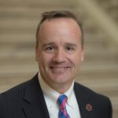
Preventing and Responding to Election Day Disruptions
Chris Harvey
Deputy Executive Director
Georgia Peace Officer Standards and Training Council
TLP:AMBER
Notes:
5 min

Slide 35
CSSE Goals
To build trust and stronger relationships between election officials and law enforcement;
To develop solutions that respond to and help curb the rise in intimidation, threats and violence against elections workers;
And to create and share resources and best practices for law enforcement and election officials.
TLP:AMBER

Slide 36
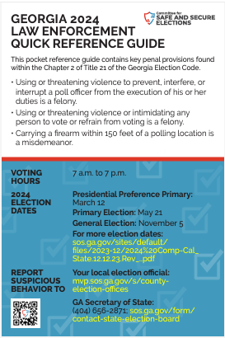

Training and Planning are the Antidotes for Disruptions
TLP:AMBER

Slide 37

Training is Fundamental
Identify critical responding agencies (police, fire, hazmat, transportation, public works, etc.)
Familiarize all responding agencies and officers with the applicable laws and regulations
Identify key dates, locations, and personnel who would be essential in a disruption scenario
TLP:AMBER

Slide 38
Tabletop Exercises
Building relationships prior to Election Day among partner agencies is key to dealing with
Working through potential disruptions in tabletop exercise will familiarize non-elections agencies with election-specific concerns
Tabletop exercises will identify necessary resources (and potential vulnerabilities) yet to be identified
TLP:AMBER

Slide 39
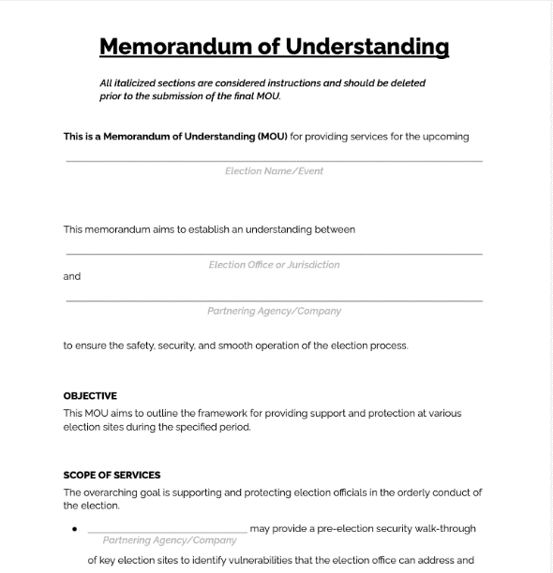
Memorandum of Understanding (MOU)
A basic Memorandum of Understanding (MOU) identifies and assigns responsibilities
Ensures that critical responsibilities are identified in advance
In the chaos of a disruptive event, an MOU minimizes duplication of response and unnecessary redundancy
TLP:AMBER

Slide 40
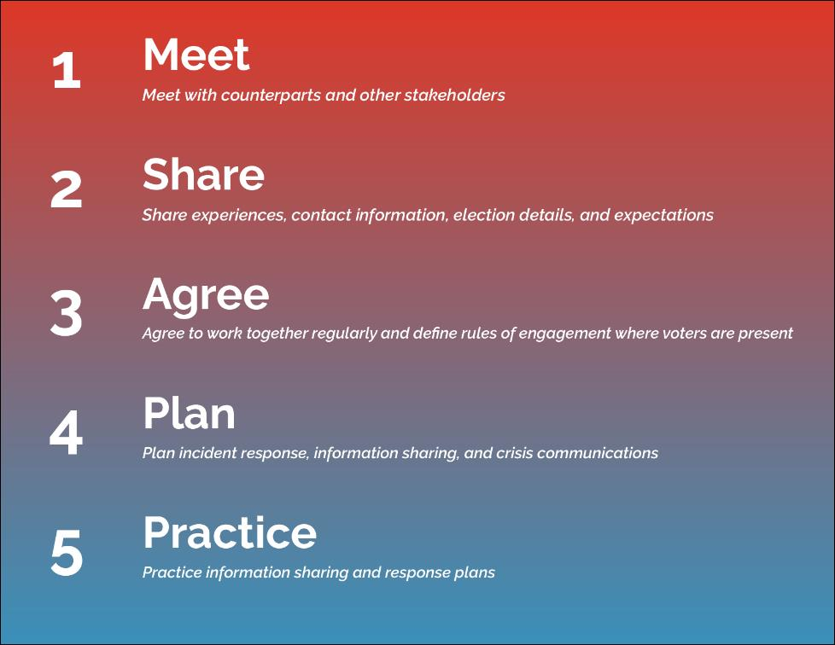
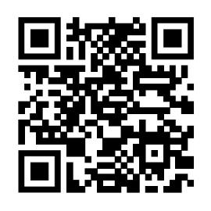
Five Steps to
Safer Elections
TLP:AMBER
Notes:
Justin

Slide 41

safeelections.org
TLP:AMBER
Notes:
Tina

Slide 42
CISA
#Protect2024 – Election Security
Mike Moser
IT Cybersecurity Specialist, Engagement, Assistance, & Training, Election Security & Resilience, CISA
Notes:
5 min

Slide 43

DHS Color Palette Per OPA RGB Colors
Use Arial Font For All Text
Change Presenter’s Name
In Slide Master
Notes:
Change Presenter’s Name and Date in Slide Master view.

Slide 44
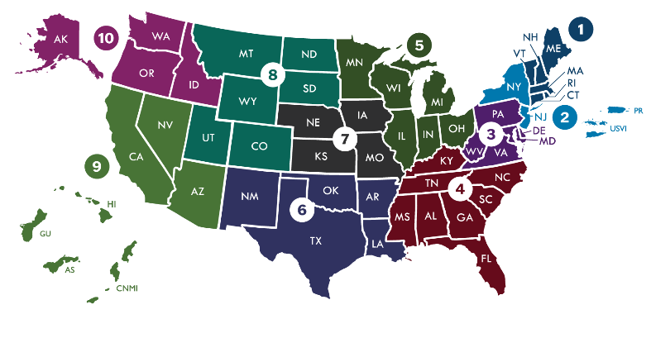
CISA & Election Infrastructure
CISA’s Regional Field Staff
The Cybersecurity and Infrastructure Security Agency’s (CISA) mission is to help secure our nation’s critical infrastructure.
In January 2017, the Department of Homeland Security (DHS) designated election infrastructure as critical infrastructure.
Through our CISA field staff across the country and our security experts at CISA headquarters, CISA offers a range of voluntary, free services and support to stakeholders to help ensure the security and resiliency of election infrastructure.
CISA’s Regional Election Security Advisors help ensure maximum support to the election community through tailored support to meet unique state and local needs.
TLP:AMBER

Slide 45


OUR ELECTION SECURITY MISSION
Help election officials and election infrastructure stakeholders protect against the cyber, physical, and operational security risks to election infrastructure during the 2024 election cycle.
TLP:AMBER

Slide 46

TLP:AMBER

Slide 47

Protect Election Offices
  THREATS TO OFFICE AND HOW TO PROTECT AGAINST THEM
Mailing of hazardous materials to election offices
  Address the risk against mailing of hazardous materials by:
    Referencing CISA’s “Election Mail Handling Procedures to Protect against Hazardous Materials” to identify and safely handle suspicious mail
    Using resources provided by the U.S. Postal Inspection Service (USPIS) for handling suspicious mail
Physical acts of violence against election offices and personnel
  Mitigate against physical acts of violence by:
    Referencing CISA’s “Enhancing Election Security Through Public Communications” guide for election officials
    Providing “Non-confrontational Techniques for Election Workers Training” for staff and poll workers
    Reaching out to CISA to request a Security Assessment at First Entry (SAFE) for election offices and supporting facilities
    Requesting specific virtual or in-person Election Security Trainings offered by CISA
    Referencing CISA’s “Physical Security of Voting Locations and Election Facilities” guidance
    Referencing CISA’s “Personal Security Considerations for Critical Infrastructure Workers” guidance
TLP:AMBER

Slide 48

Protect Election Officials
  THREATS TO ELECTION OFFICIALS AND HOW TO PROTECT AGAINST THEM
SWATTING
  Mitigate against swatting by referencing:
    “Swatting Prevention and Response Guidance for Election Workers and Law Enforcement” guide
DOXING
  Protect against doxing by referencing:
    “CISA Insights on Mitigating the Impacts of Doxing on Critical Infrastructure”
    “Personal Security Considerations Action Guide for Critical Infrastructure Workers” guide
FOREIGN INFLUENCE OPERATIONS
  Mitigate against foreign influence operations by referencing:
    “Securing Election Infrastructure Against the Tactics of Foreign Malign Influence Operations” guide
    “Risk in Focus: Generative A.I. and the 2024 Election Cycle” fact sheet
    “Contextualizing Deepfake Threats to Organizations” fact sheet
TLP:AMBER

Slide 49

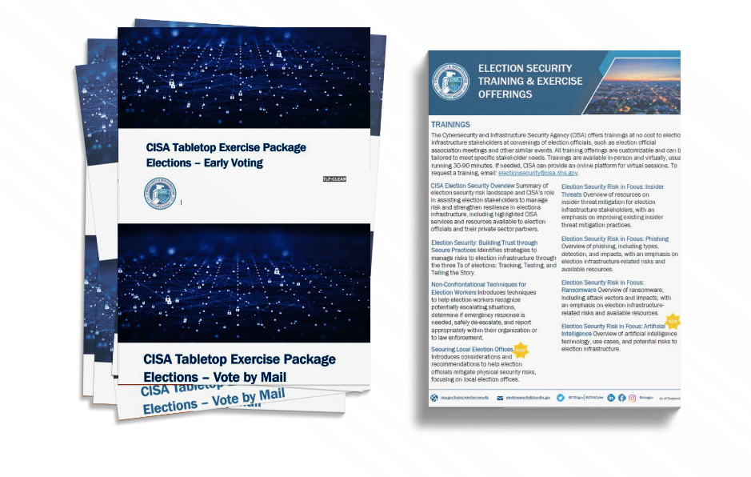
#PROTECT2024: CISA Training Support
Ready to Use Training Videos on Our Website
In Person or Virtual Training Offerings
  Operational Security for Election Officials
  Generative Artificial Intelligence
  Securing Local Election Offices
  Ransomware
  Building Trust through Secure Practices
  Non-Confrontational Techniques
  Insider Threats
  Phishing
Tabletop Exercises
  In-person state and local
  Annual National Tabletop the Vote
  TTX in a Box (Ready to Use TTX Guides for 3 Different Election Scenarios updated for the 2024 threat environment)
TLP:AMBER

Slide 50

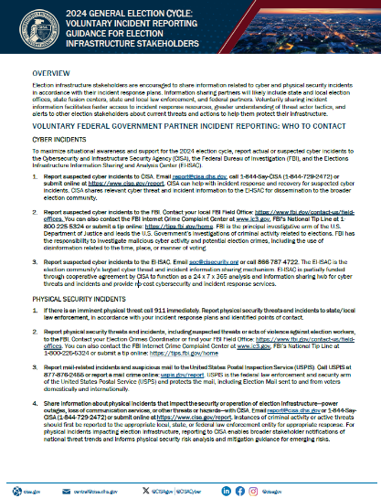
Voluntary Incident Reporting for EI Stakeholders
On July 8, 2024, CISA released the 2024 General Election Cycle: Voluntary Incident Reporting Guide for election stakeholders to share information related to cyber and physical security incidents in accordance with their incident response plans. Appropriate contact information is included in the guidance.
TLP:AMBER
Notes:
If there is an imminent physical threat call 911 immediately. Report physical security threats and incidents to state/local law enforcement.

Slide 51

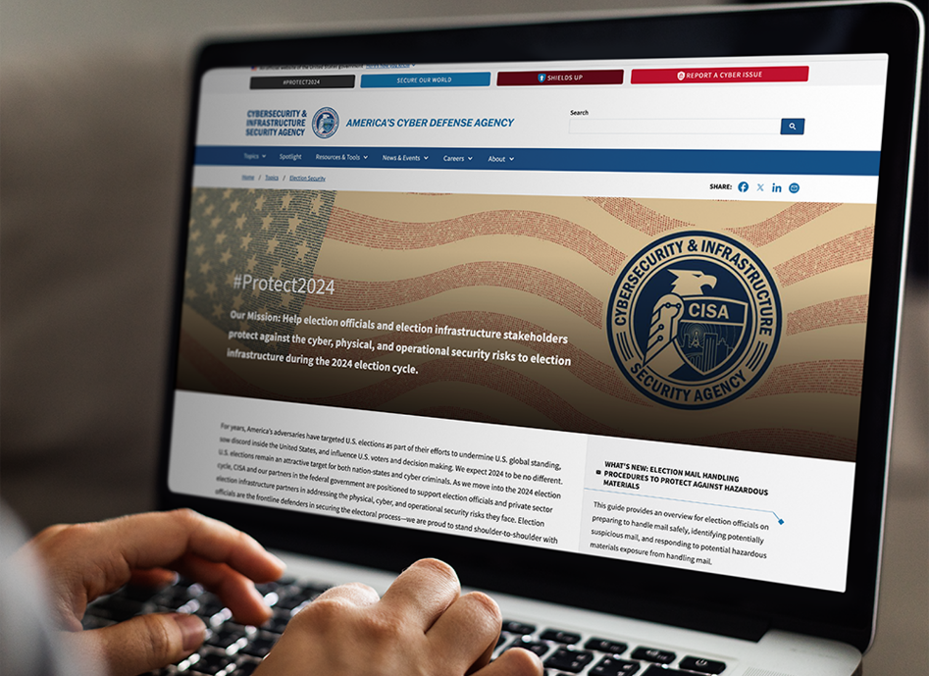
#Protect2024 Website
Specifically tailored to election officials to help them take full advantage of CISA’s services and resources
CISA.GOV/PROTECT2024
TLP:AMBER

Slide 53
E-ISAC Watch Operations
Taylor Oldaker, Senior Advisor – Security Operations
TLP:GREEN

Slide 54
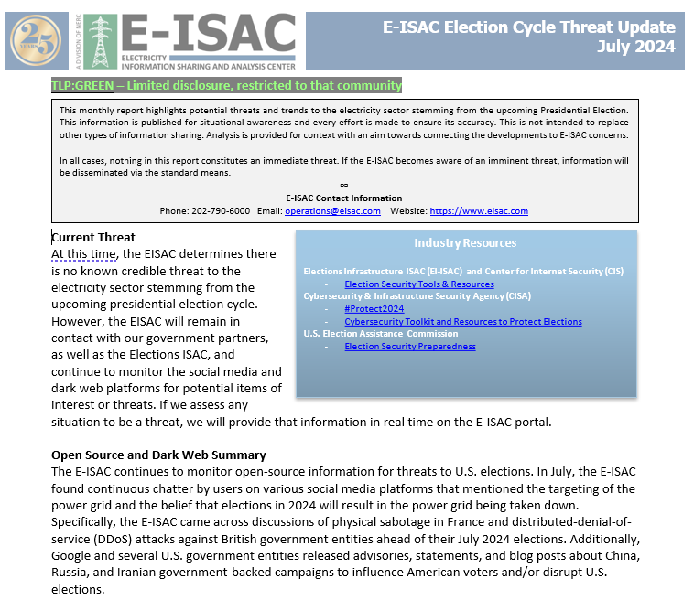
Election Cycle Threat Update
  Report on potential threats to the electricity sector related to or stemming from the upcoming U.S. presidential election.
  Posted to the E-ISAC Portal
    Emphasis on the electricity sector but also mentions observed threats to elections infrastructure
    Covers physical threats and cyber threats
    Includes links to government resources on elections security
TLP:AMBER

Slide 55
Physical Threats Observed
Threats to the Electricity Sector
  Copper theft
  Ballistic damage
    Usually impacts power lines and substations
  Tampering and vandalism
  Intrusion and surveillance
    Suspicious photography
  Drones and suspicious aircraft
  Online threats
    Includes extremist groups advocating for attacks against the power grid
Online Threats with Elections infrastructure nexus
  Image board users encouraging people to attack the power grid instead of voting
  Online chatter encouraging destruction of electricity assets in order to disrupt elections
    Shooting transformers or destroying power lines
  People claiming they will bomb the power grid if a presidential candidate gets elected
  Conspiracy theories about “false flag” attacks on the power grid meant to disrupt the U.S. presidential elections
TLP:AMBER

Slide 56
Cyber Threats Observed
Cyber Threats
  General threats: phishing, credential harvesting, scanning, domain impersonation, brute force attempts (i.e. against VPNs)
  Suspected APT activity, such as performing reconnaissance
  Ransomware
  Hacktivist groups making claims about carrying out DDoS or website defacement attacks against electricity sector sites
    Pro-Russia hacktivist groups have also claimed that they will target European and American election infrastructure
  Cybercrime forum users claiming to be selling initial access to electricity sector systems or leaking data from electricity companies.
    Threat actors have also made claims about selling or leaking data stolen from elections systems
TLP:AMBER

Slide 57
Contact Info
Contact Information – E-ISAC
Email: operations@eisac.com
Phone: 202-790-6000
Taylor Oldaker, Senior Advisor – Security Operations
Email: Taylor.Oldaker@eisac.com
Phone: 202-657-2826
TLP:AMBER

Slide 58
Major County Sheriffs and Major Cities Chiefs
Megan Noland
Executive Director, Major County Sheriffs of America
Laura Cooper
Executive Director, Major Cities Chiefs Association

Slide 59


Major County Sheriffs of America
Major Cities Chiefs Association
Major County Sheriffs of America
  98 Member Sheriffs across the USA
  Represents approximately 130 million in population
  Current President - Sheriff Bill Brown – Santa Barbara County Sheriffs, Office, CA
Major Cities Chiefs Association
  79 Member Chiefs across the USA and Canada
    70 in US; 9 in Canada
  Current President – Chief Eddie Garcia – Dallas Police Department, TX
TLP:AMBER

Slide 60
Major County Sheriffs of America Initiatives
MCSA Intel Commanders Group
  Real-time threat briefs, product sharing, and intelligence collection
  Regular meetings both in-person and virtually
  Shared with our partners including MCCA
Partnering with Committee for Safe and Secure Elections and Others
  Guides for Patrol Deputies
  Encouraging relationship building and outreach prior to Election Day
TLP:AMBER

Slide 61
Major County Sheriffs of America Initiatives
Partner with the Threat Reporting Exchange (TRX)
  Repository for real-time threats during Election Season
  Other partners include:
    Major Cities Chiefs Association
    National Sheriffs’ Association
    National Fusion Center Association
    Association of State Criminal Investigatory Agencies
Legislative Action and Policy Issues
TLP:AMBER

Slide 62
Major Cities Chiefs Association Initiatives
MCCA Intel Commanders Group
  Real-time threat briefs, product sharing, and intelligence collection
  Shared with our partners including MCSA
  Regular meetings and conferences
Futurist Initiative Resources
  First Guide: Artificial Intelligence
  Second Guide: Unidentified Anonymous Phenomena
TLP:AMBER

Slide 63
Major Cities Chiefs Association Initiatives
MCCA Guide to First Amendment Protests: Best Practices and Tactics
MCCA Quarterly Violent Crime Reports
Partner with the Threat Reporting Exchange (TRX)
TLP:AMBER

Slide 64
MCSA and MCCA Contact Information
Major County Sheriffs of America
Megan Noland, Executive Director
mnoland@mcsheriffs.com
mcsheriffs.com
Twitter: @MCSheriffs
Major Cities Chiefs Association
Laura Cooper, Executive Director
cooper@majorcitieschiefs.com
majorcitieschiefs.com
Twitter: @MjrCitiesChiefs
TLP:AMBER

Slide 65
Collaboration Discussion Guide
Getting the Conversation Started
Aaron Kustermann
Chief of Intelligence, Illinois State Police
Paul Lux
Supervisor of Elections, Okaloosa County Supervisor of Elections

Slide 66

Not a Member? Register Today!
TLP:AMBER
Notes:
Use EI-ISAC reg link

Slide 67
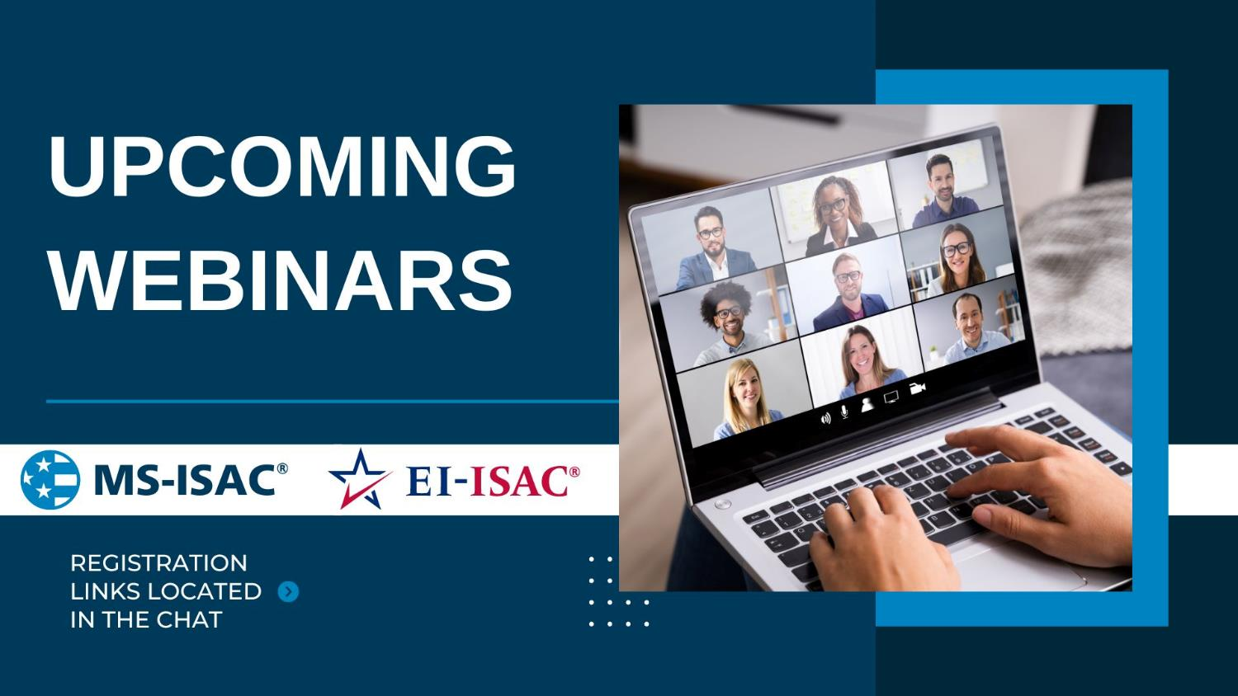
Title
Subtitle
Presenter Name, Presenter Title, Presenter Entity

Slide 68


Slide 69

TLP: WHITE

