Slide 1


Slide 2


Slide 3
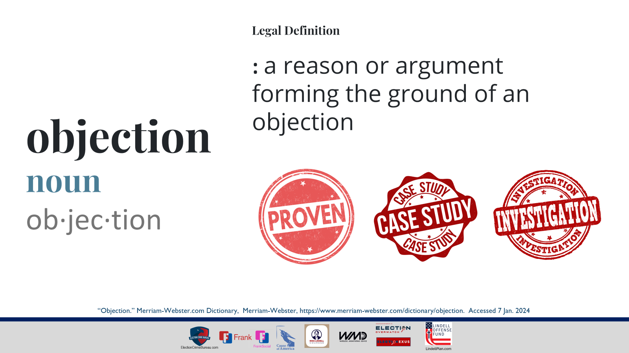
Notes:
“Objection.” Merriam-Webster.com Dictionary, Merriam-Webster, https://www.merriam-webster.com/dictionary/objection. Accessed 7 Jan. 2024.
Used legal definition:
objection
noun
ob·​jec·​tion
1
: an act or instance of objectingspecifically : a statement of opposition to an aspect of a judicial or other legal proceeding
file an objection to a proposed bankruptcy plan
2
: a reason or argument forming the ground of an objection
NOTE: Objections at trial are generally made for the purpose of opposing the admission of improper evidence. Such an objection must be made in a timely manner. Objections prevent the jury from seeing or hearing the evidence and preserve the issue for appeal. Objections may also be made on the ground of the opposing counsel's improper methods (as leading a witness) or for other technical reasons.
General definition:
objection
noun
ob·​jec·​tion əb-ˈjek-shən
Plural - objections
Synonyms of objection
1
: an act of objecting
2
a: a reason or argument presented in opposition
b: a feeling or expression of disapproval
c: a statement of opposition to an aspect of a judicial or other legal proceeding, file an objection to a proposed bankruptcy plan

Slide 4
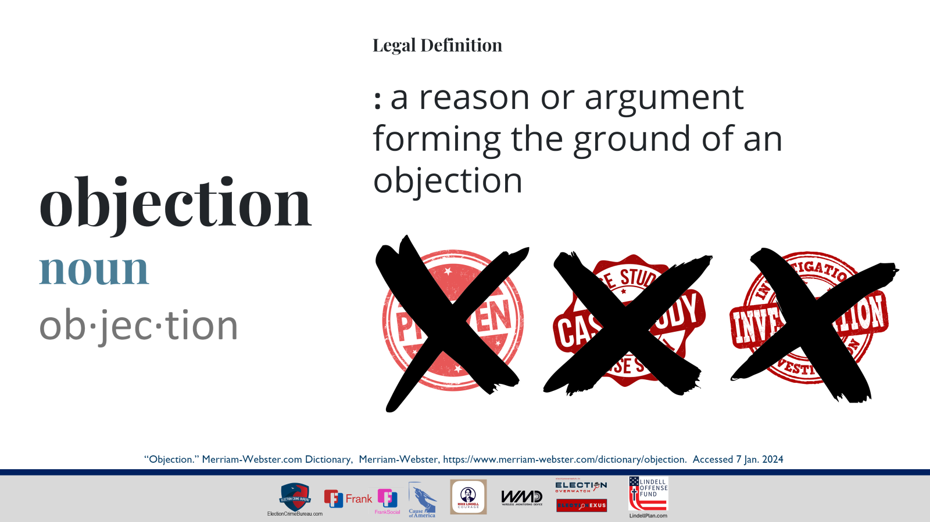
Notes:
“Objection.” Merriam-Webster.com Dictionary, Merriam-Webster, https://www.merriam-webster.com/dictionary/objection. Accessed 7 Jan. 2024.
Used legal definition:
objection
noun
ob·​jec·​tion
1
: an act or instance of objectingspecifically : a statement of opposition to an aspect of a judicial or other legal proceeding
file an objection to a proposed bankruptcy plan
2
: a reason or argument forming the ground of an objection
NOTE: Objections at trial are generally made for the purpose of opposing the admission of improper evidence. Such an objection must be made in a timely manner. Objections prevent the jury from seeing or hearing the evidence and preserve the issue for appeal. Objections may also be made on the ground of the opposing counsel's improper methods (as leading a witness) or for other technical reasons.
General definition:
objection
noun
ob·​jec·​tion əb-ˈjek-shən
Plural - objections
Synonyms of objection
1
: an act of objecting
2
a: a reason or argument presented in opposition
b: a feeling or expression of disapproval
c: a statement of opposition to an aspect of a judicial or other legal proceedingfile an objection to a proposed bankruptcy plan

Slide 5
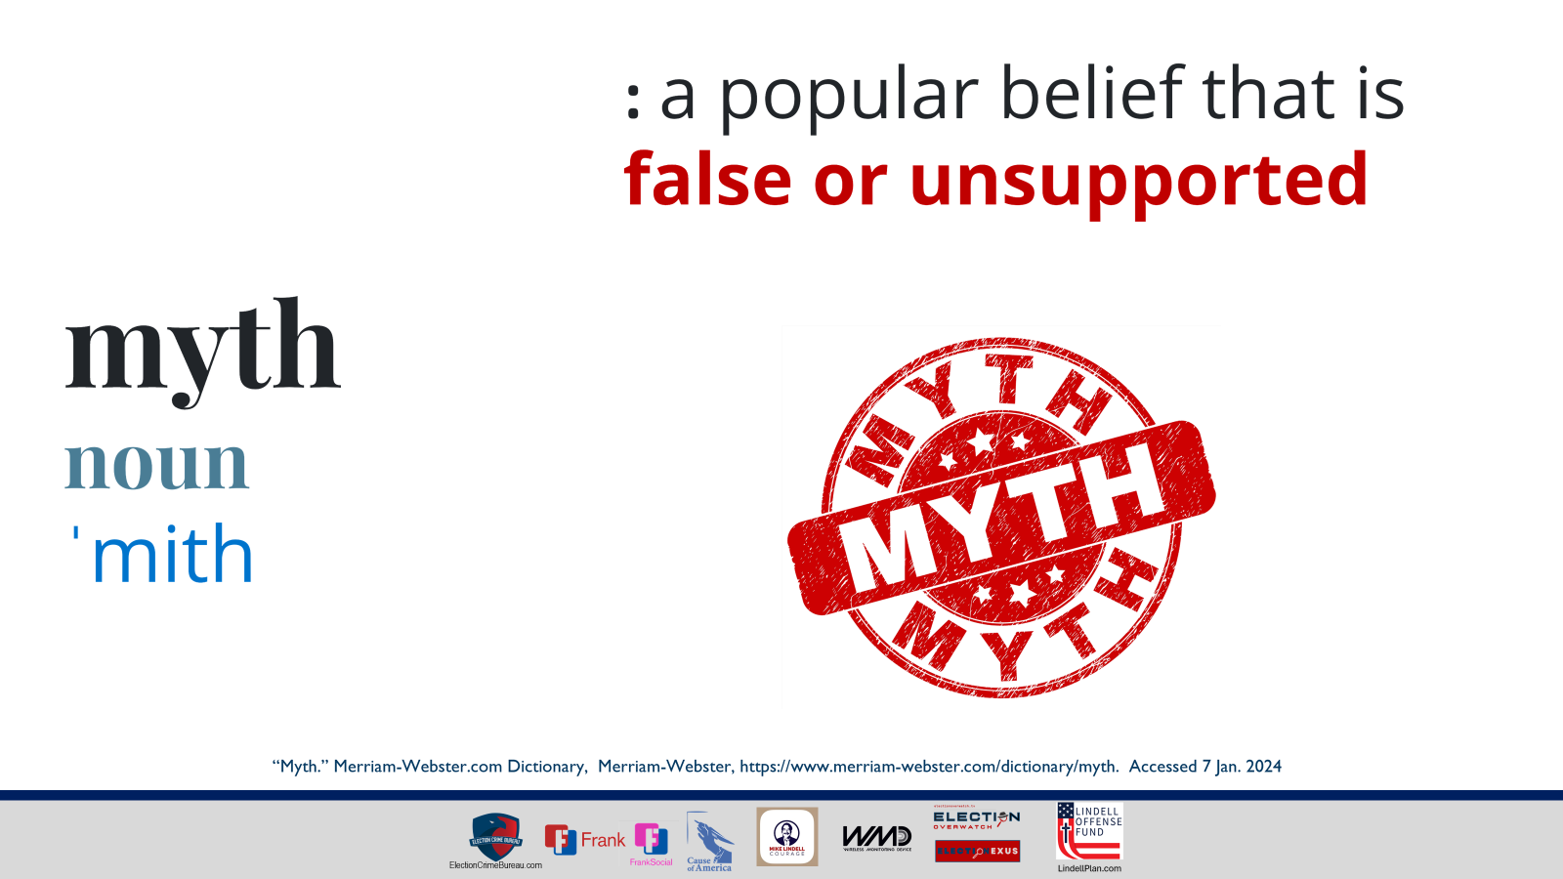
Notes:
myth
noun
ˈmith
1
: a story often describing the adventures of superhuman beings that attempts to describe the origin of a people's customs or beliefs or to explain mysterious events (as the changing of the seasons)
2
: a person or thing that exists only in the imaginationthe dragon is a myth
3
: a popular belief that is false or unsupported
“Myth.” Merriam-Webster.com Dictionary, Merriam-Webster, https://www.merriam-webster.com/dictionary/myth. Accessed 7 Jan. 2024

Slide 6
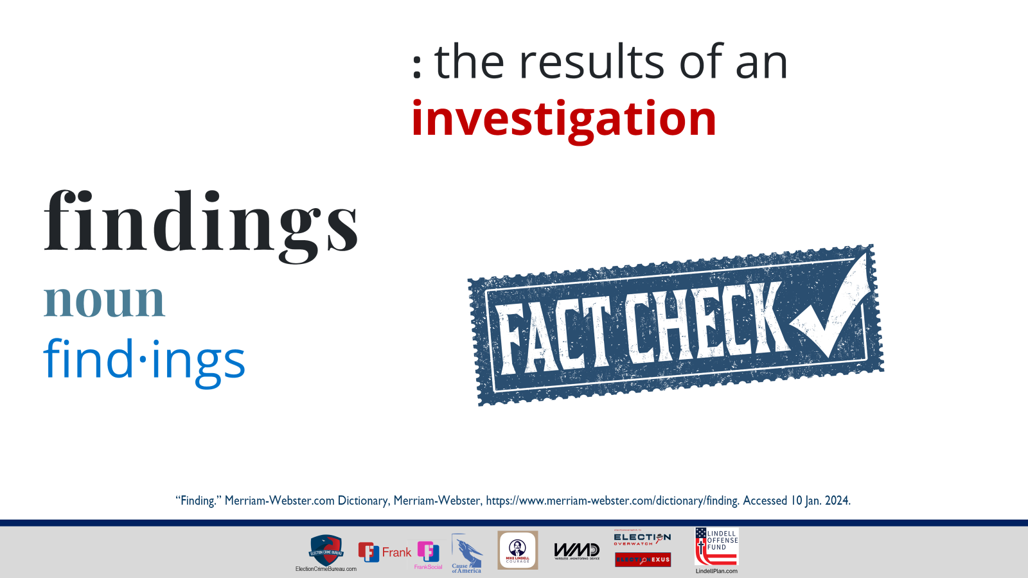
Notes:
“Finding.” Merriam-Webster.com Dictionary, Merriam-Webster, https://www.merriam-webster.com/dictionary/finding. Accessed 10 Jan. 2024.
1
a: the act of one that finds
b: FIND sense 2
2
findings plural : small tools and supplies used by an artisan (such as a dressmaker, jeweler, or shoemaker)
3
a: the result of a judicial examination or inquiry
b: the results of an investigation
—usually used in plural

Slide 7
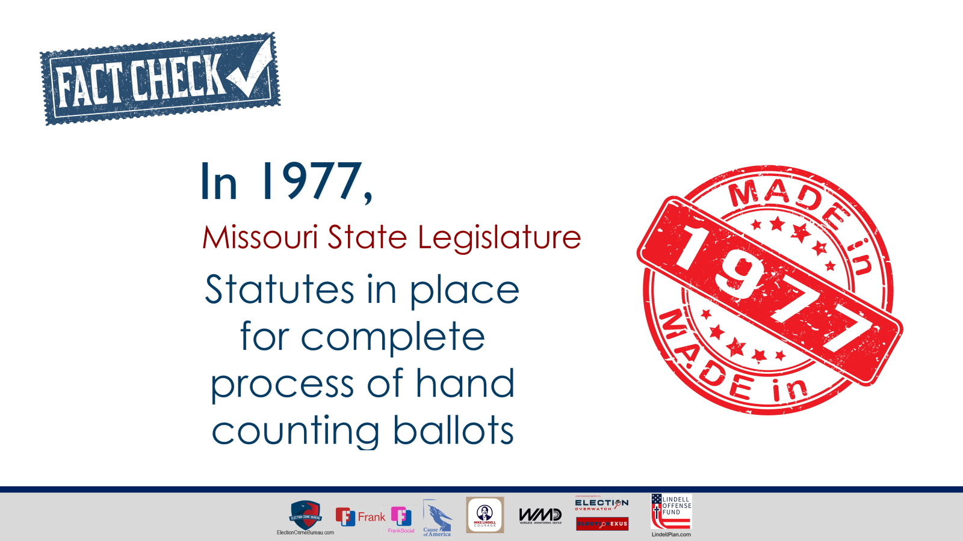

Slide 8
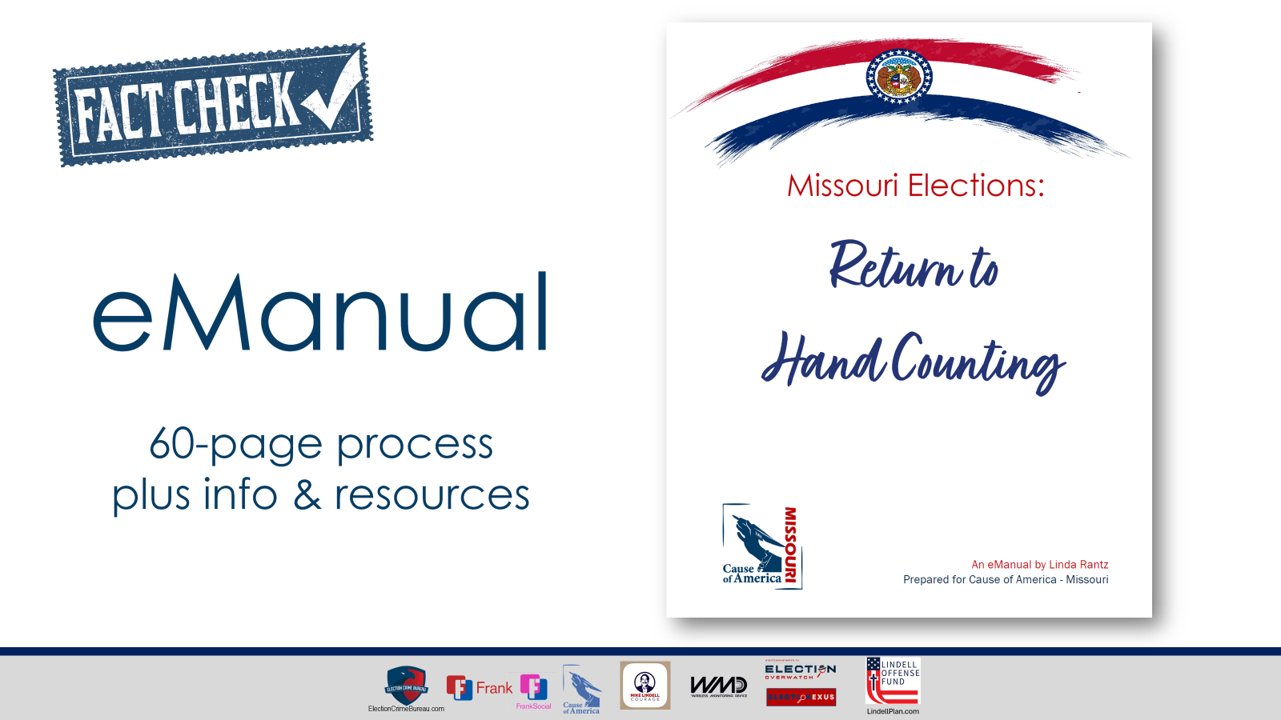

Slide 9


Slide 10
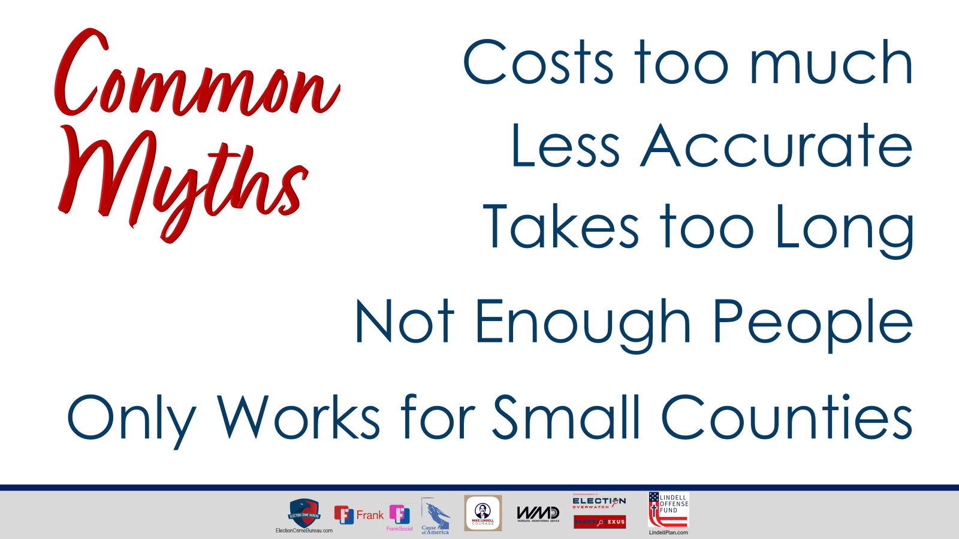

Slide 11
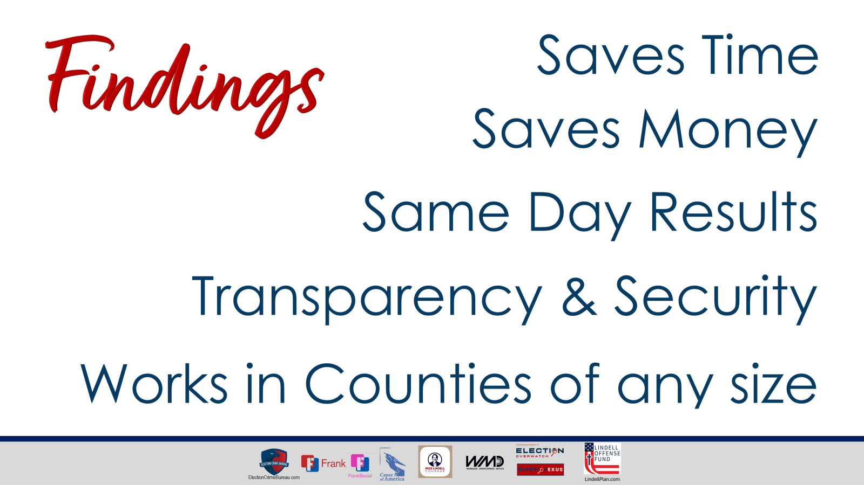
Notes:
Hand counting will:
Save TIME,
Save MONEY,
give ELECTION DAY RESULTS,
and provide TRANSPARENCY and better SECURITY.
In a nutshell, we will present some solid reasons for returning to hand counting. We want to hear what clerks and election officials have to say, but a simple, “machines make my life easier,” is not likely to be a motivation well-received by the people.
(pg 33)

Slide 12


Slide 13
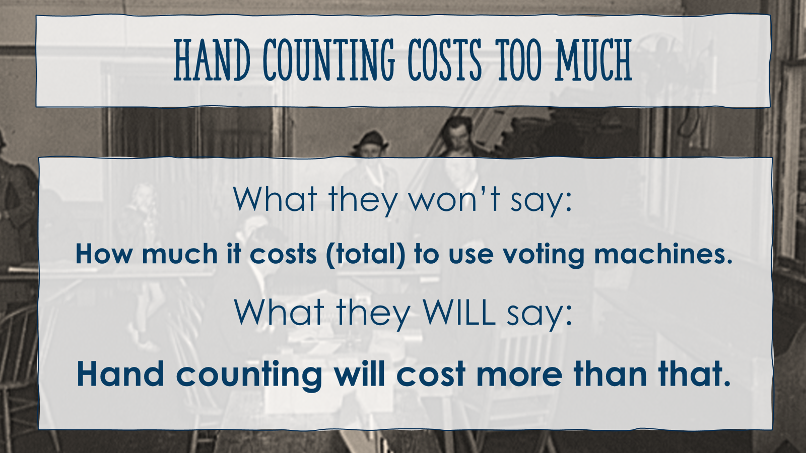

Slide 14
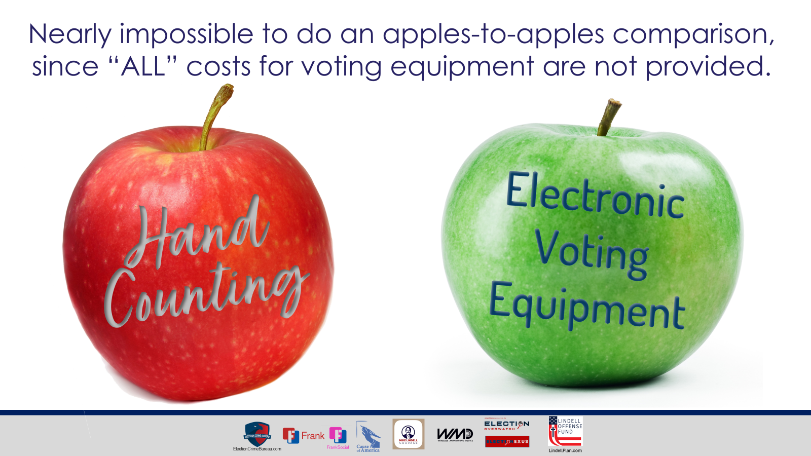

Slide 15
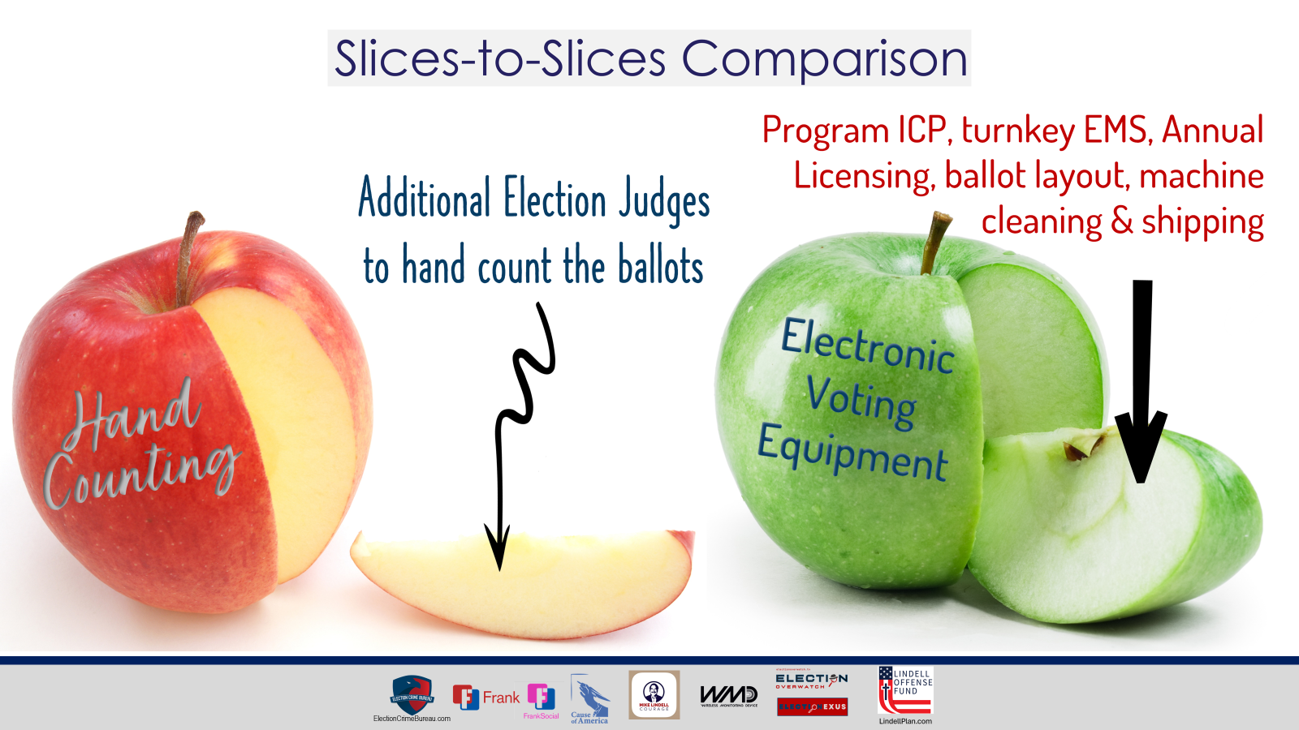

Slide 16
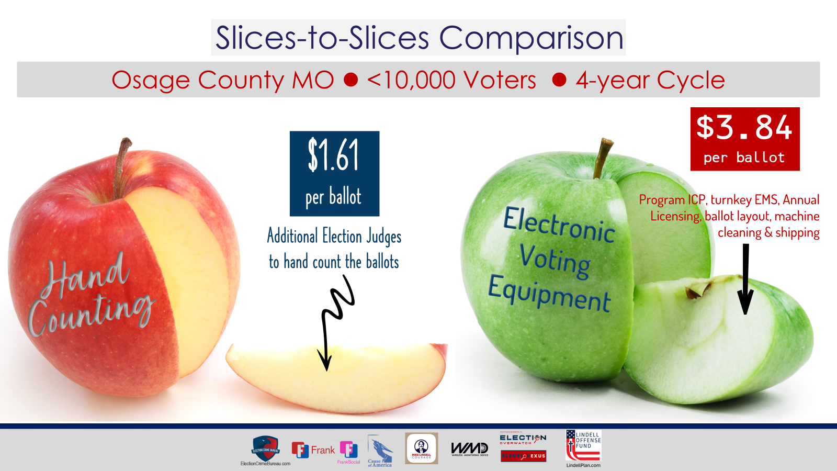

Slide 17
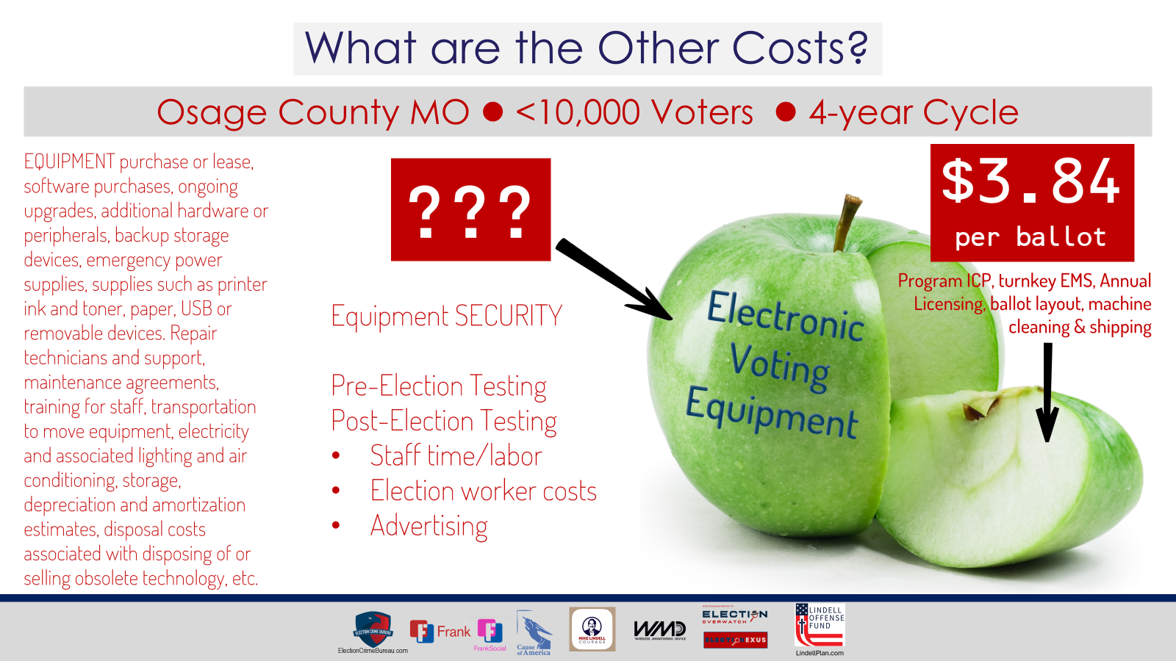

Slide 18
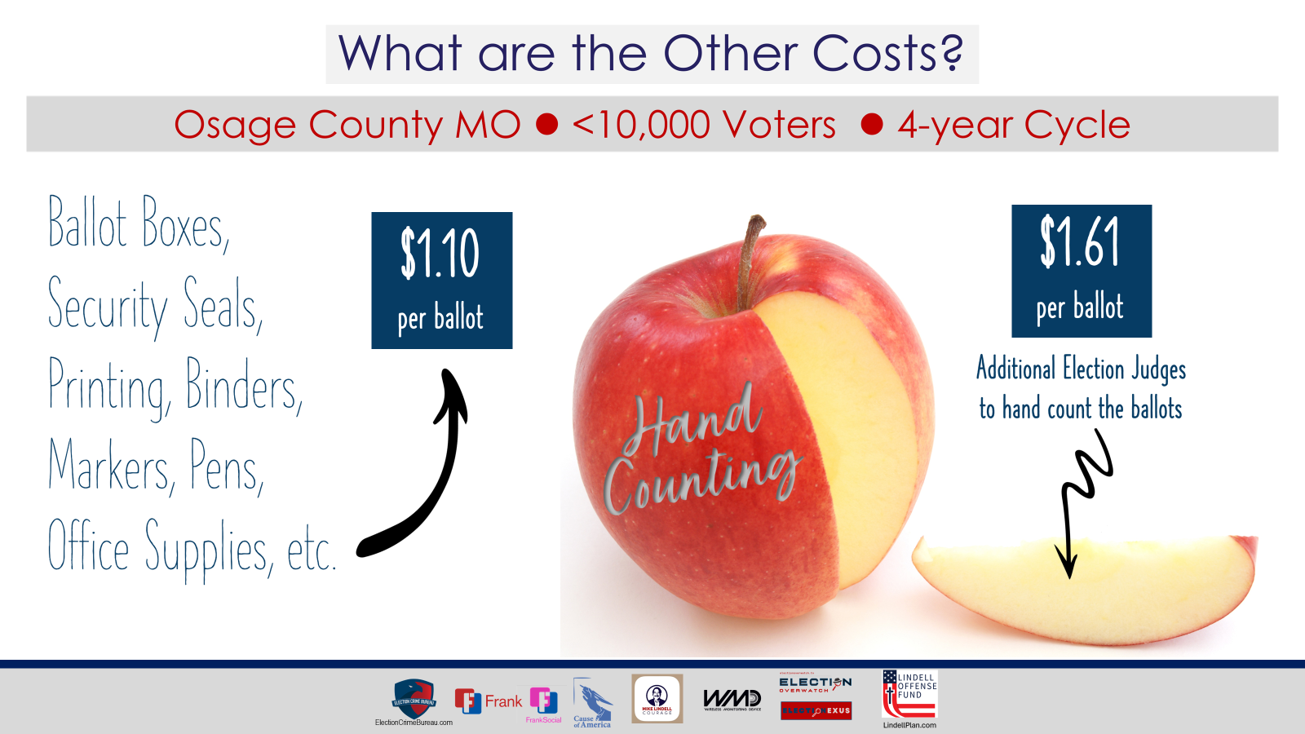

Slide 19
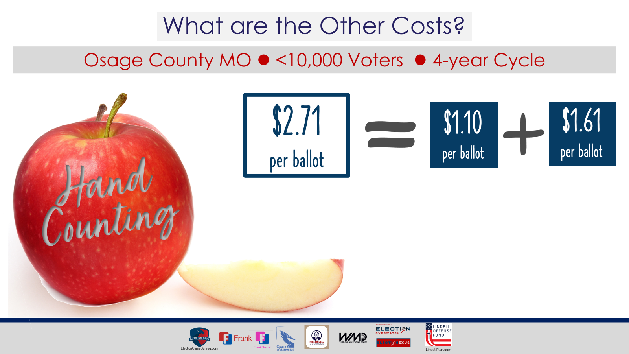

Slide 20
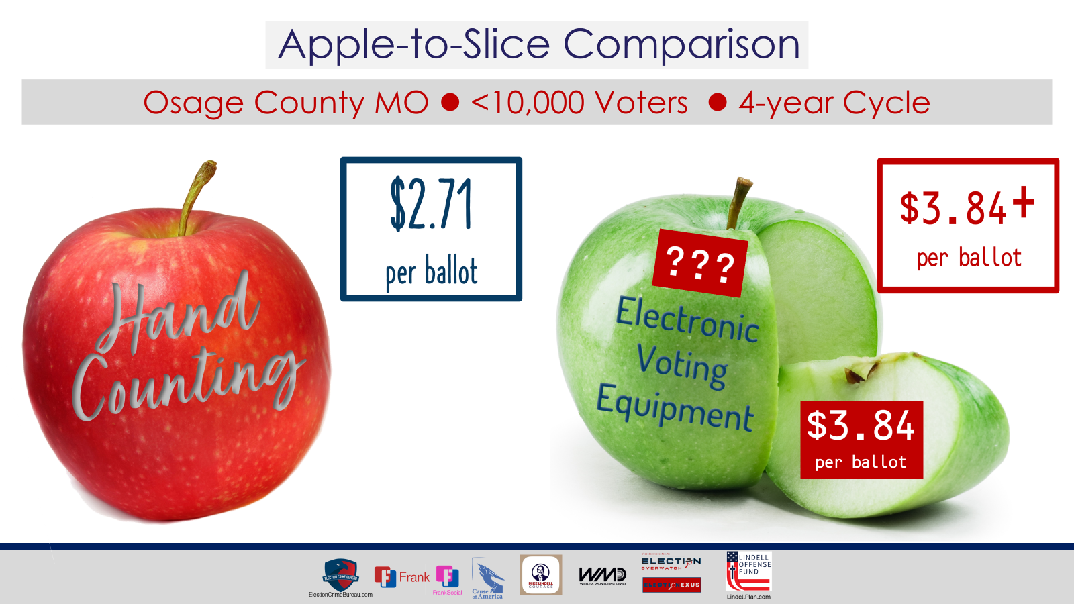

Slide 21
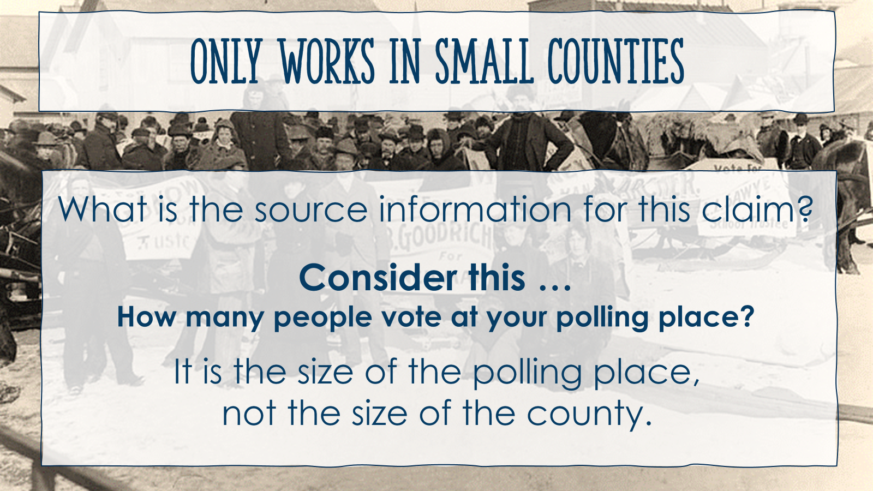

Slide 22
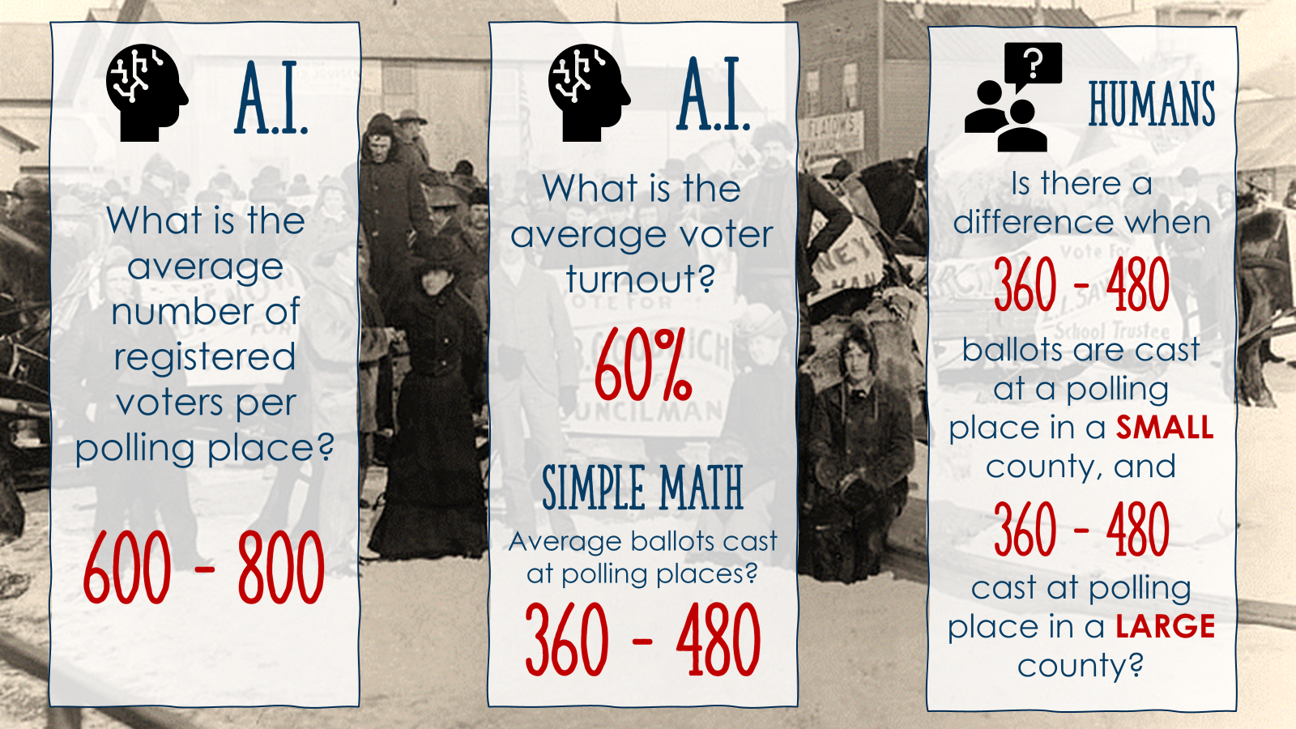
Notes:
AI - Brave
Census Bureau, as of 2020, approximately 27% of the total voting-age population in the United States lives in cities with a population of over 100,000. This percentage is based on the estimated 2020 population of 331,449,281 and the estimated voting-age population of 247,351,354.
What defines a "big city"
New York City
According to the United States Census Bureau, as of 2020, the voting-age population of New York City is approximately 12,352,815. This number includes all individuals who are 18 years of age or older and are eligible to vote.
voting age population of city of los angeles
According to the United States Census Bureau, as of 2020, the voting-age population of the City of Los Angeles is approximately 4,993,876. This number includes all individuals who are 18 years of age or older and are eligible to vote.
voting age population of Atlanta
According to the United States Census Bureau, as of 2020, the voting-age population of Atlanta, Georgia is approximately 2,425,921. This number includes all individuals who are 18 years of age or older and are eligible to vote.
voting age population of Miami
According to the United States Census Bureau, as of 2020, the voting-age population of Miami, Florida is approximately 2,233,354. This number includes all individuals who are 18 years of age or older and are eligible to vote.
According to data from the United States Election Project, the average voter turnout at a polling place in the United States during recent elections has been around 60% of registered voters. However, this number can vary significantly depending on the type of election, the location, and other factors. For example, turnout for presidential elections is typically higher than for midterm elections, and turnout in some states and districts may be higher than others due to factors such as voter enthusiasm, demographics, and the competitiveness of the election. Additionally, voter turnout can be affected by factors such as voter ID laws, voter suppression efforts, and access to polling places
According to data from the United States Election Project, the average number of registered voters per precinct in the United States is around 1,200 to 1,500 voters. However, this number can vary significantly depending on the state, county, and locality. Some precincts may have as few as 500 voters, while others may have over 3,000 voters. Additionally, the number of registered voters per precinct can fluctuate over time due to factors such as population changes, redistricting, and voter registration drives.
900 per precinct
According to data from the United States Election Project, the average number of registered voters per polling place in the United States is around 600 to 800 voters. However, this number can vary significantly depending on the state, county, and locality. Some polling places may have as few as 200 voters, while others may have over 2,000 voters. Additionally, the number of registered voters per polling place can fluctuate over time due to factors such as population changes, redistricting, and voter registration drives.
The United States Election Project, a website run by the non-partisan election data and analysis firm, ElectProject, provides information on the average number of voters per polling place for the United States as a whole, as well as for individual states and counties.
To access this information, you can visit the United States Election Project website at [www.electproject.org](http://www.electproject.org). From there, you can select the "Data" tab at the top of the page, and then select "Voter Turnout" from the drop-down menu. This will take you to a page with a variety of data on voter turnout, including the average number of voters per polling place.
Alternatively, you can also access the data directly through the following URL: [www.electproject.org/home/voter-turnout](http://www.electproject.org/home/voter-turnout). This page provides a map of the United States with interactive charts and tables that allow you to explore voter turnout data for different states and counties. You can also download the data in CSV format for further analysis.
Please note that the data on the United States Election Project website is based on official election results and may not reflect the most up-to-date information. Additionally, the website only provides data for general elections, and may not include information on primary elections or other types of elections.

Slide 23
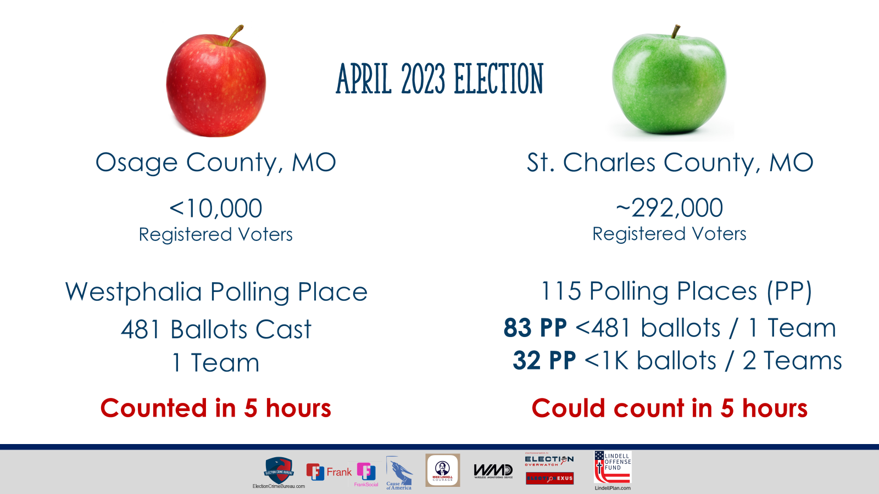

Slide 24
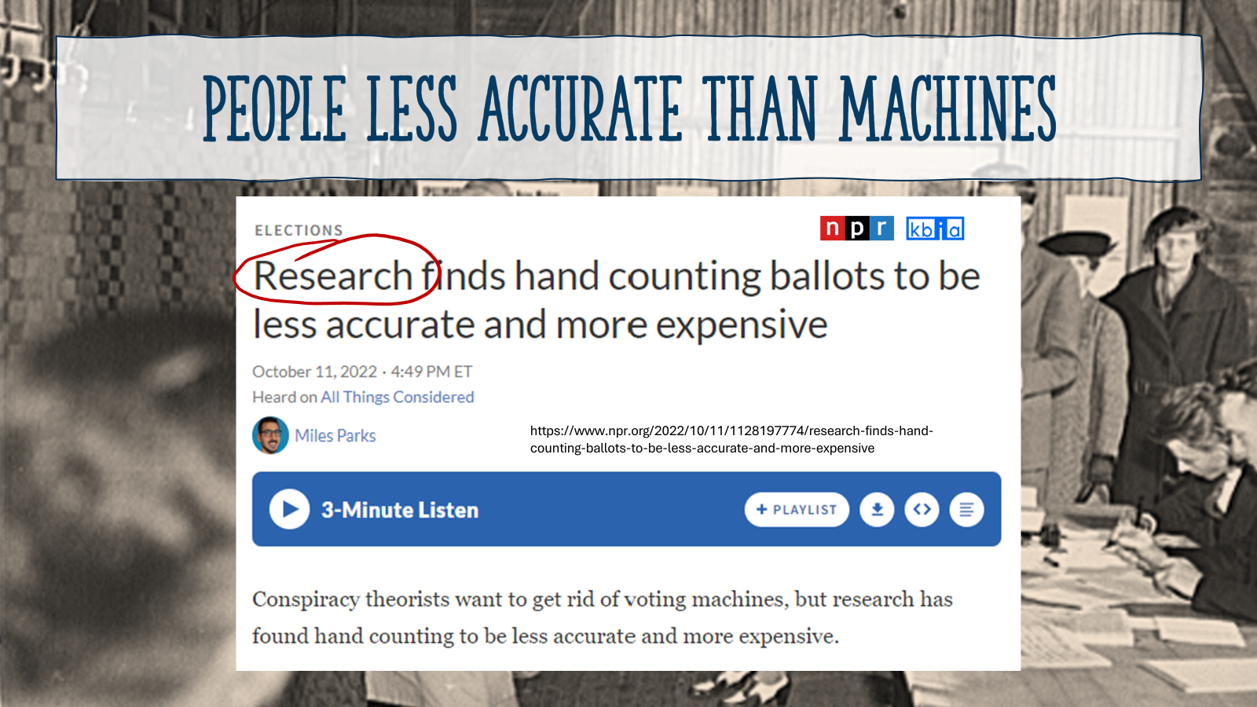

Slide 25
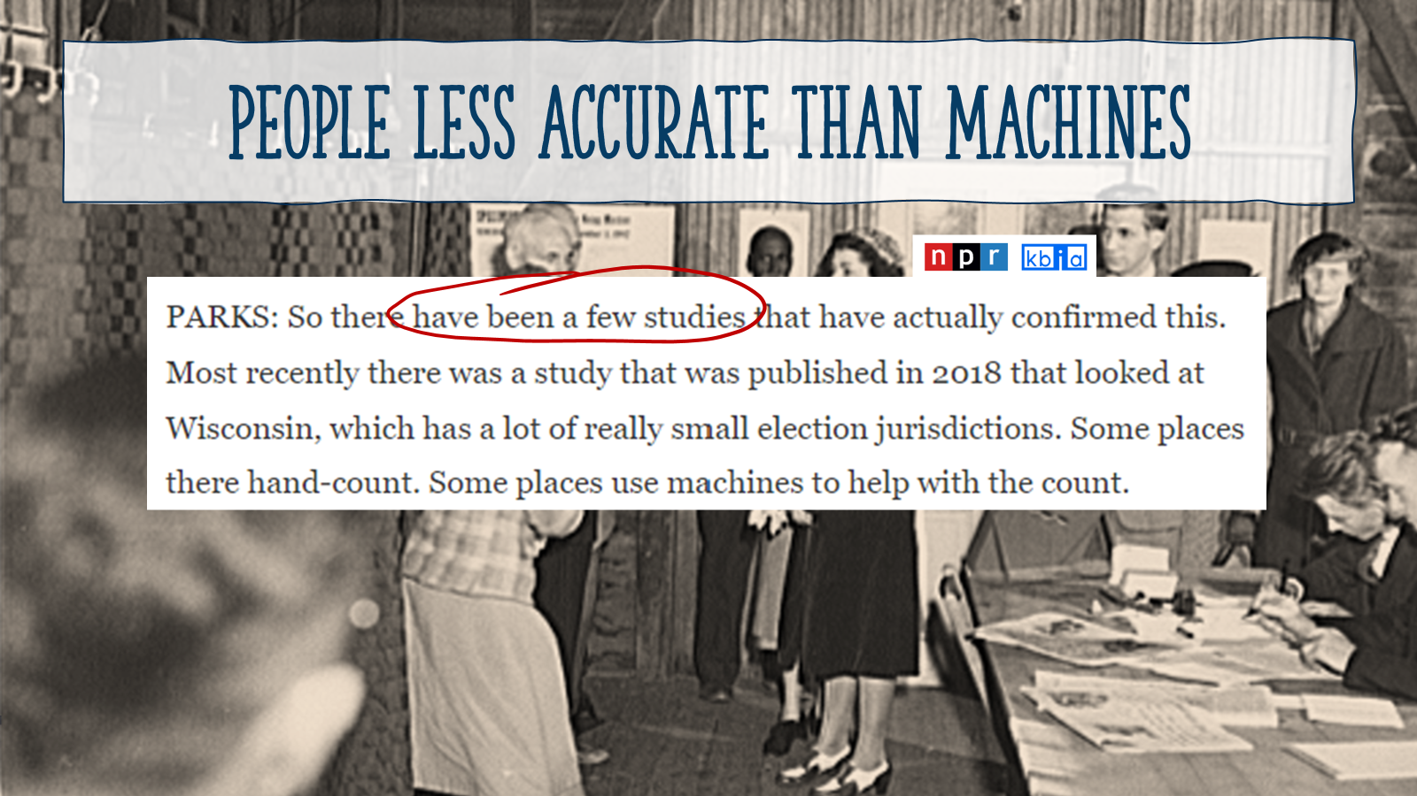

Slide 26
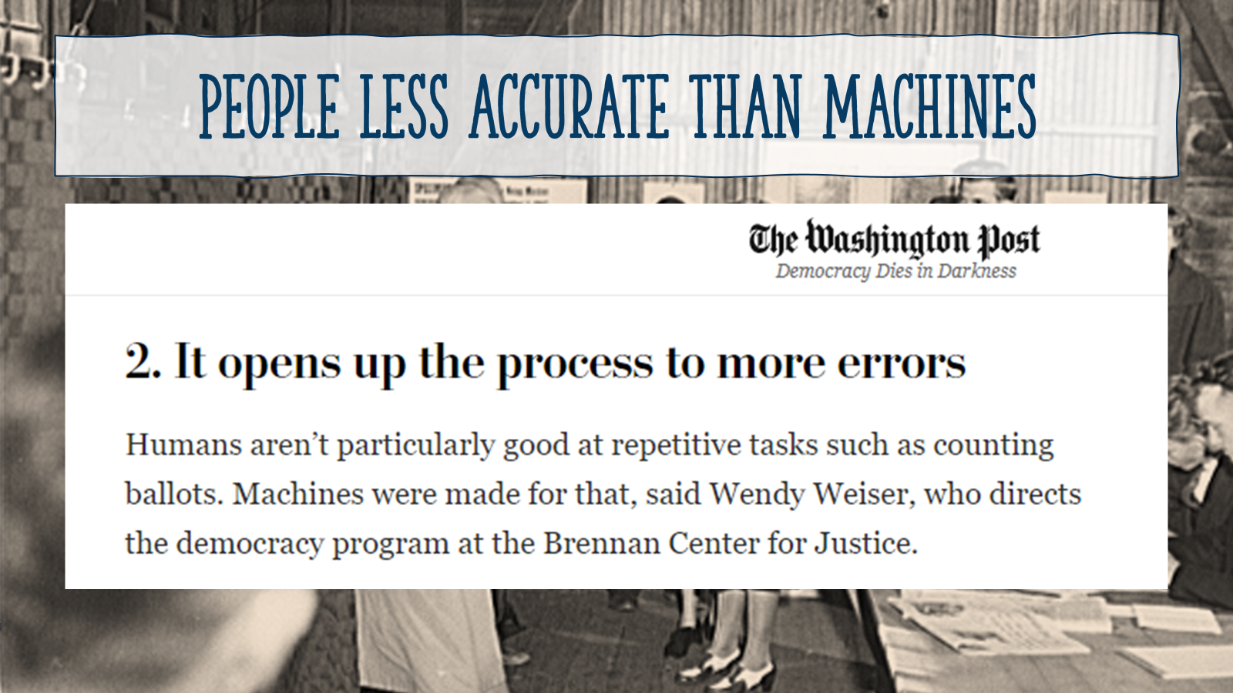

Slide 27
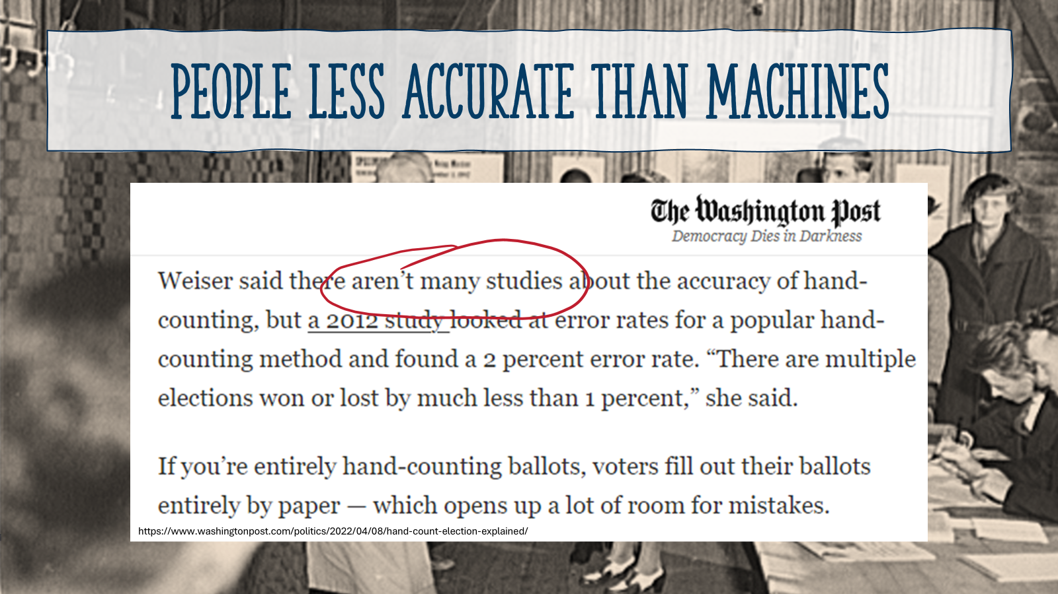

Slide 28
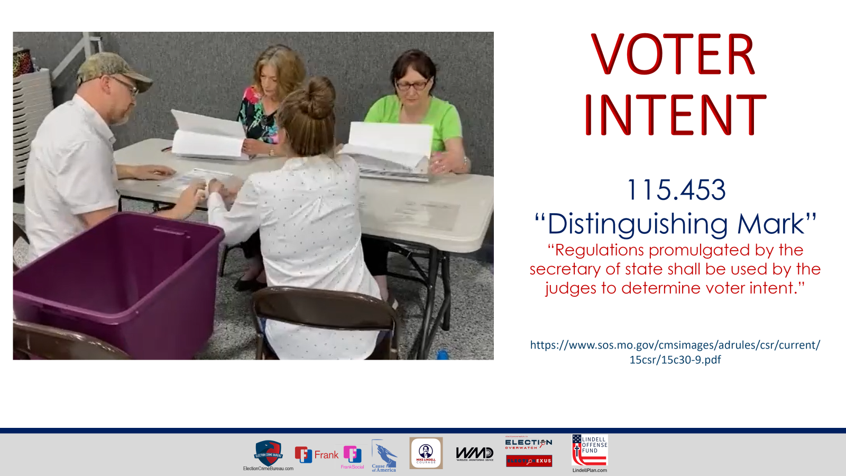
Notes:
https://revisor.mo.gov/main/OneSection.aspx?section=115.453

Slide 29
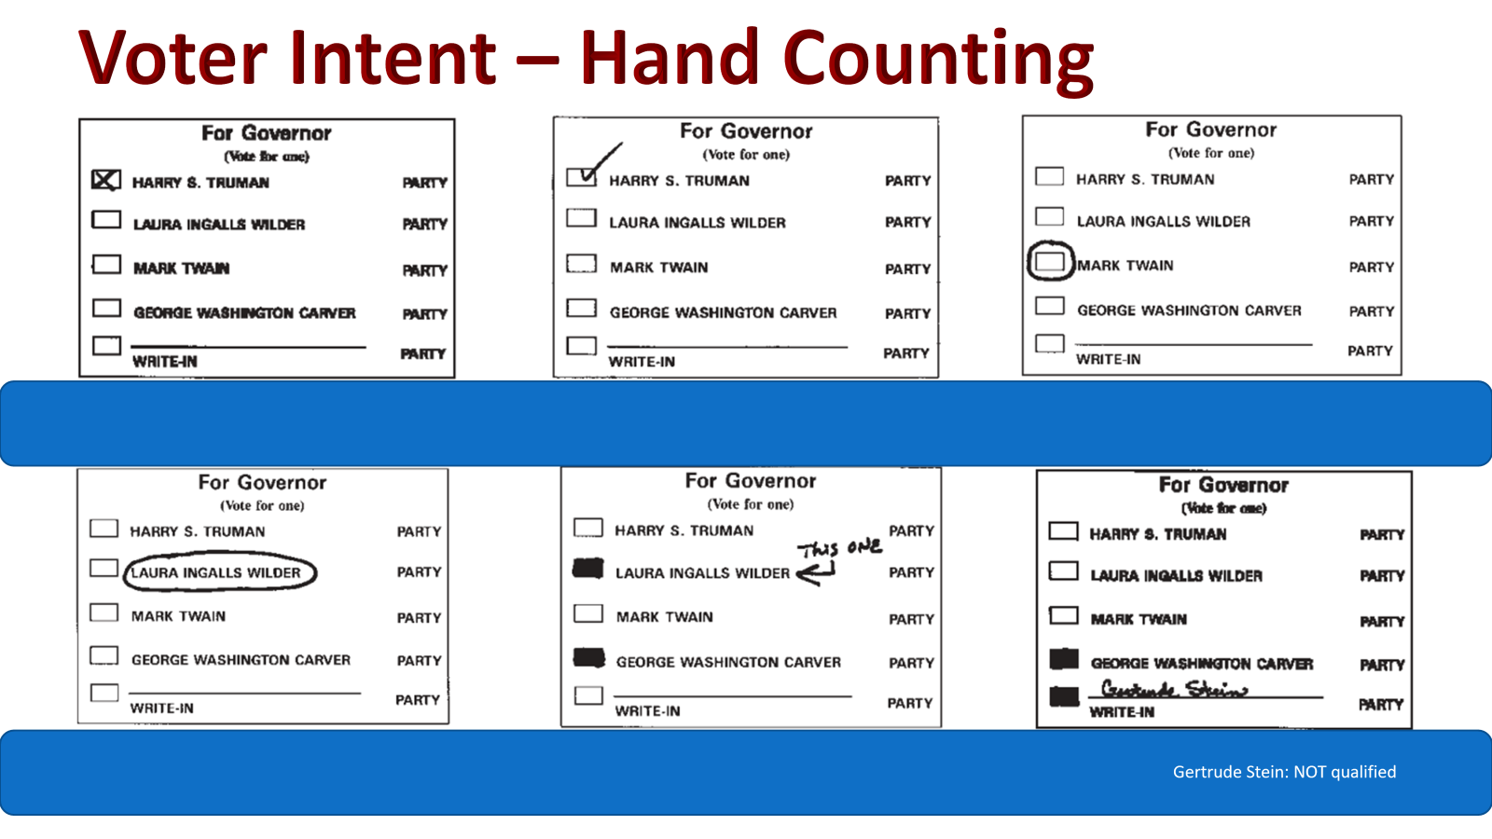
Notes:
https://www.sos.mo.gov/cmsimages/adrules/csr/current/15csr/15c30-9.pdf

Slide 30
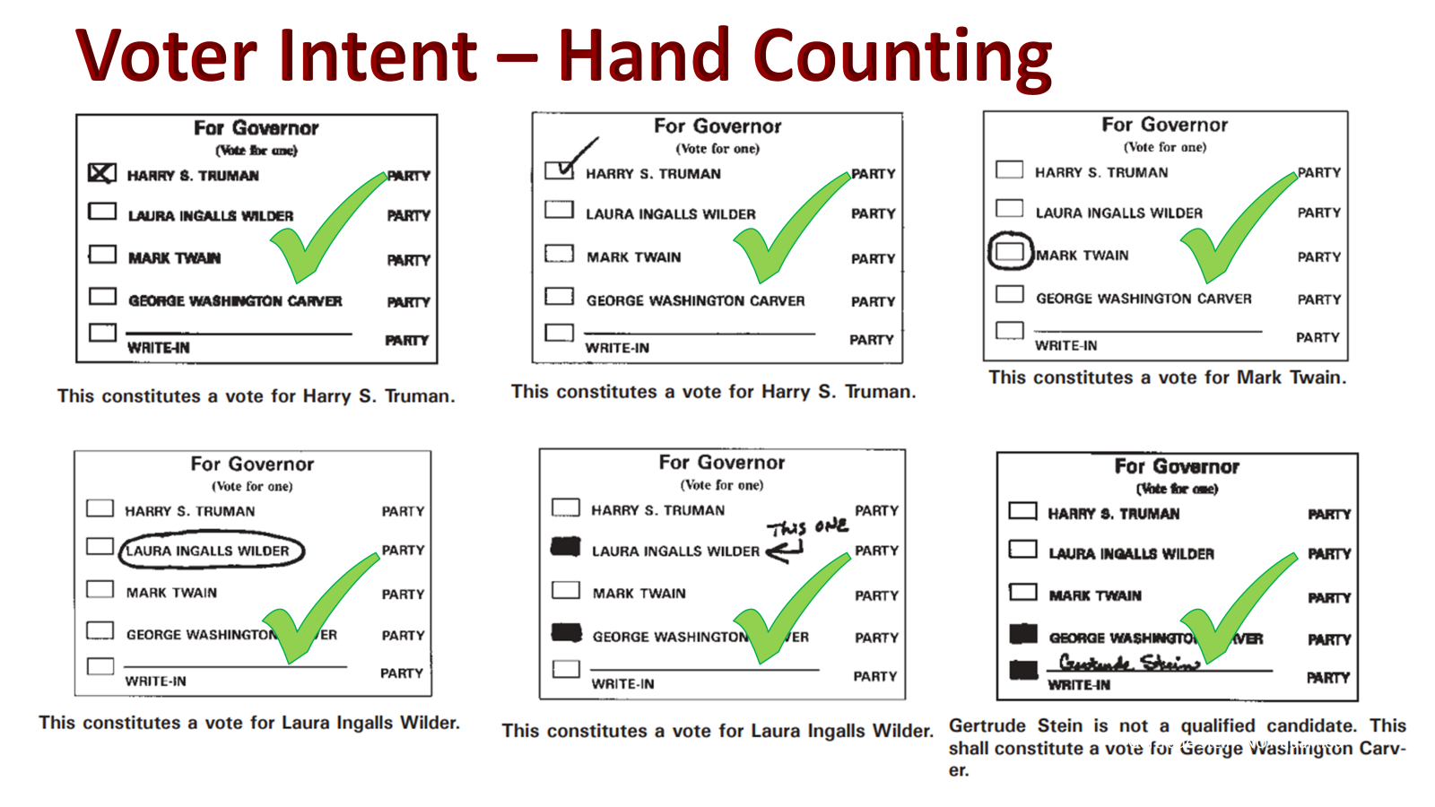

Slide 31
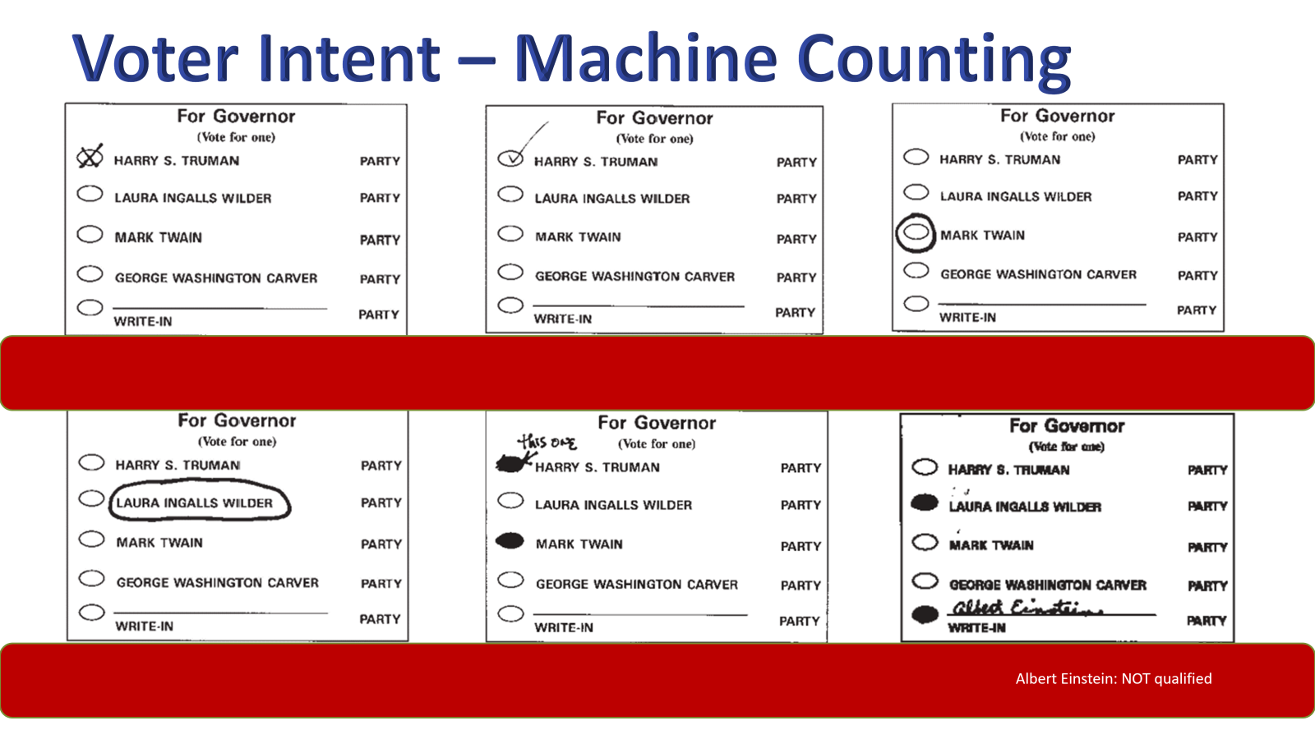
Notes:
https://www.sos.mo.gov/cmsimages/adrules/csr/current/15csr/15c30-9.pdf

Slide 32
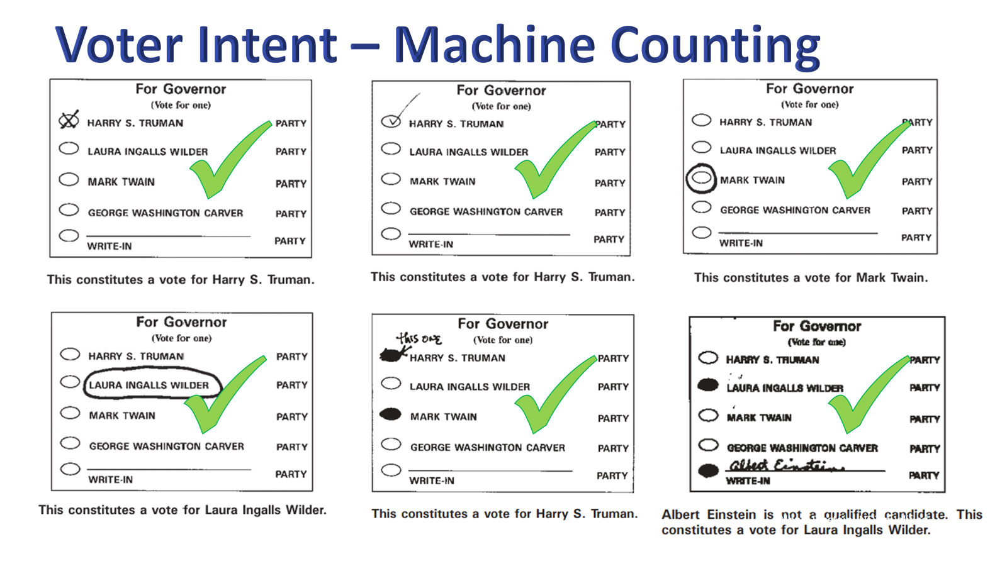

Slide 33
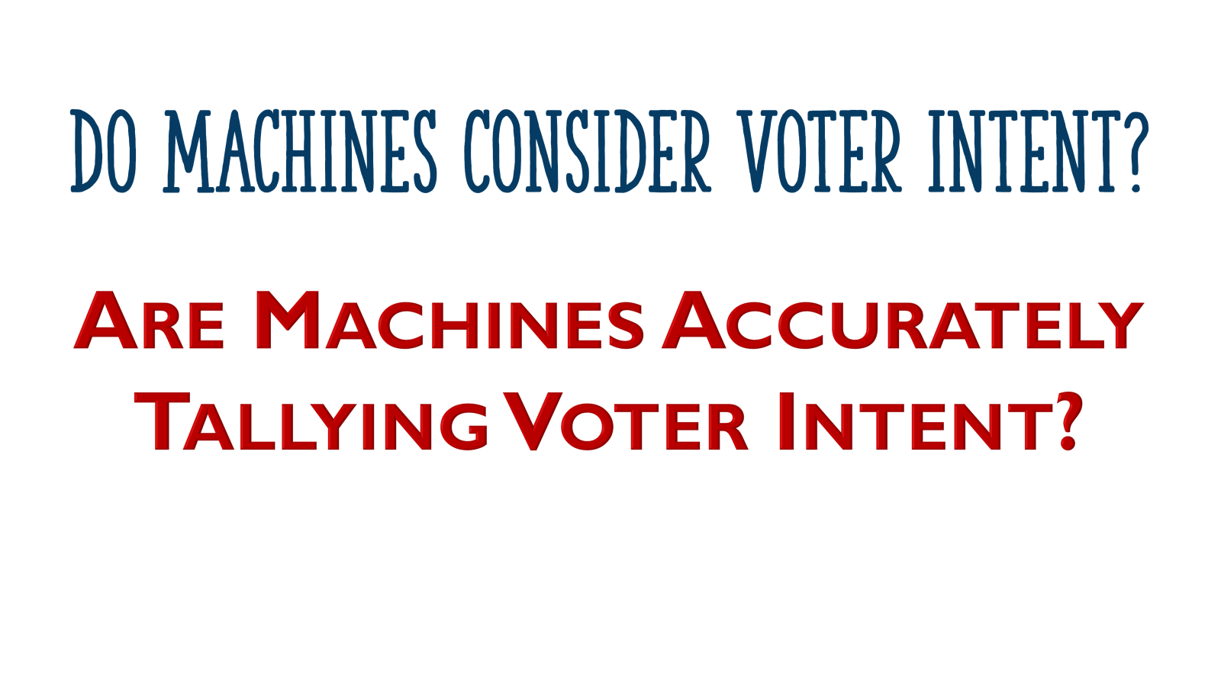

Slide 34
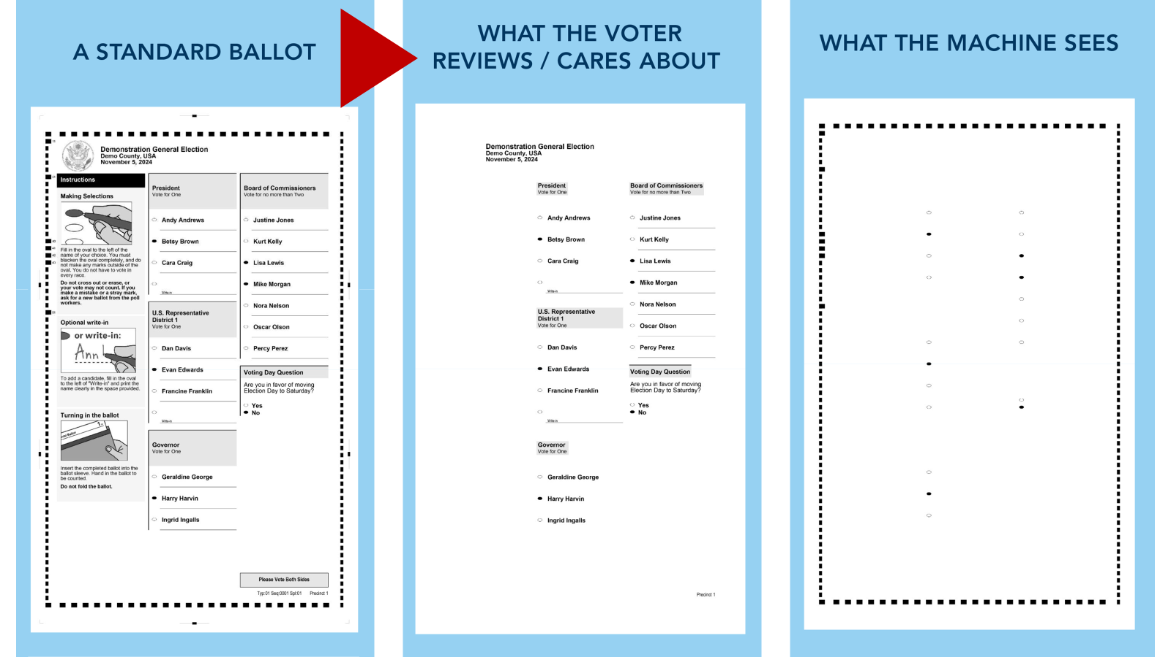

Slide 35
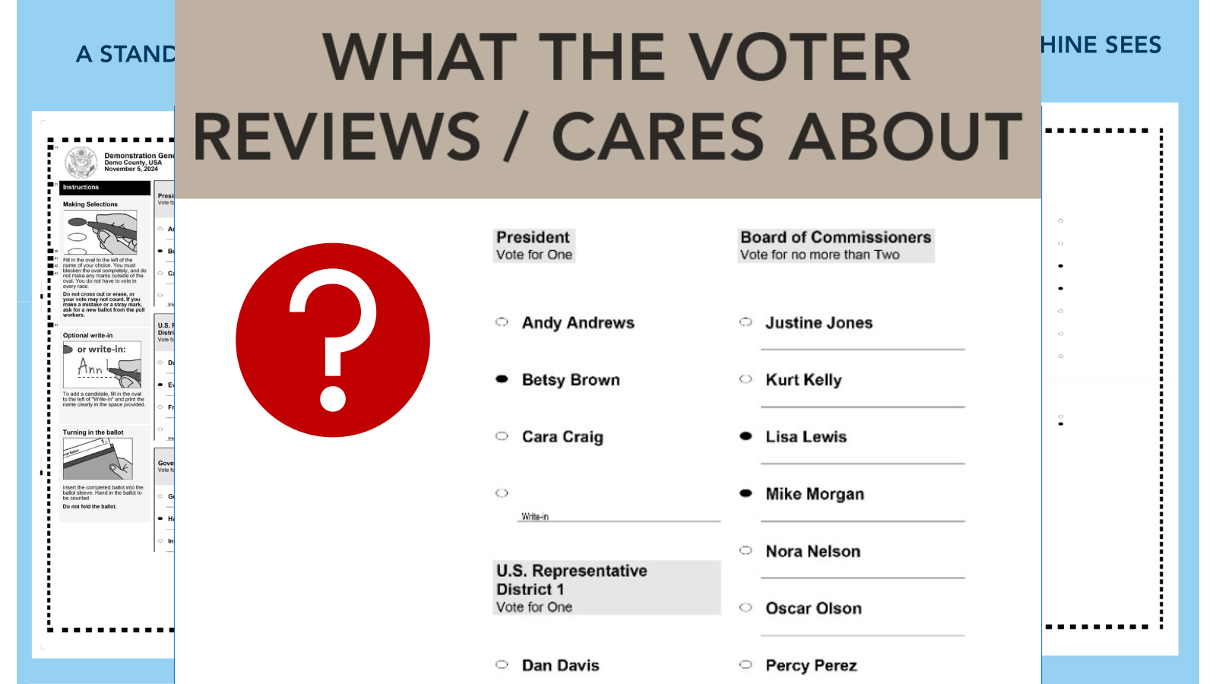

Slide 36
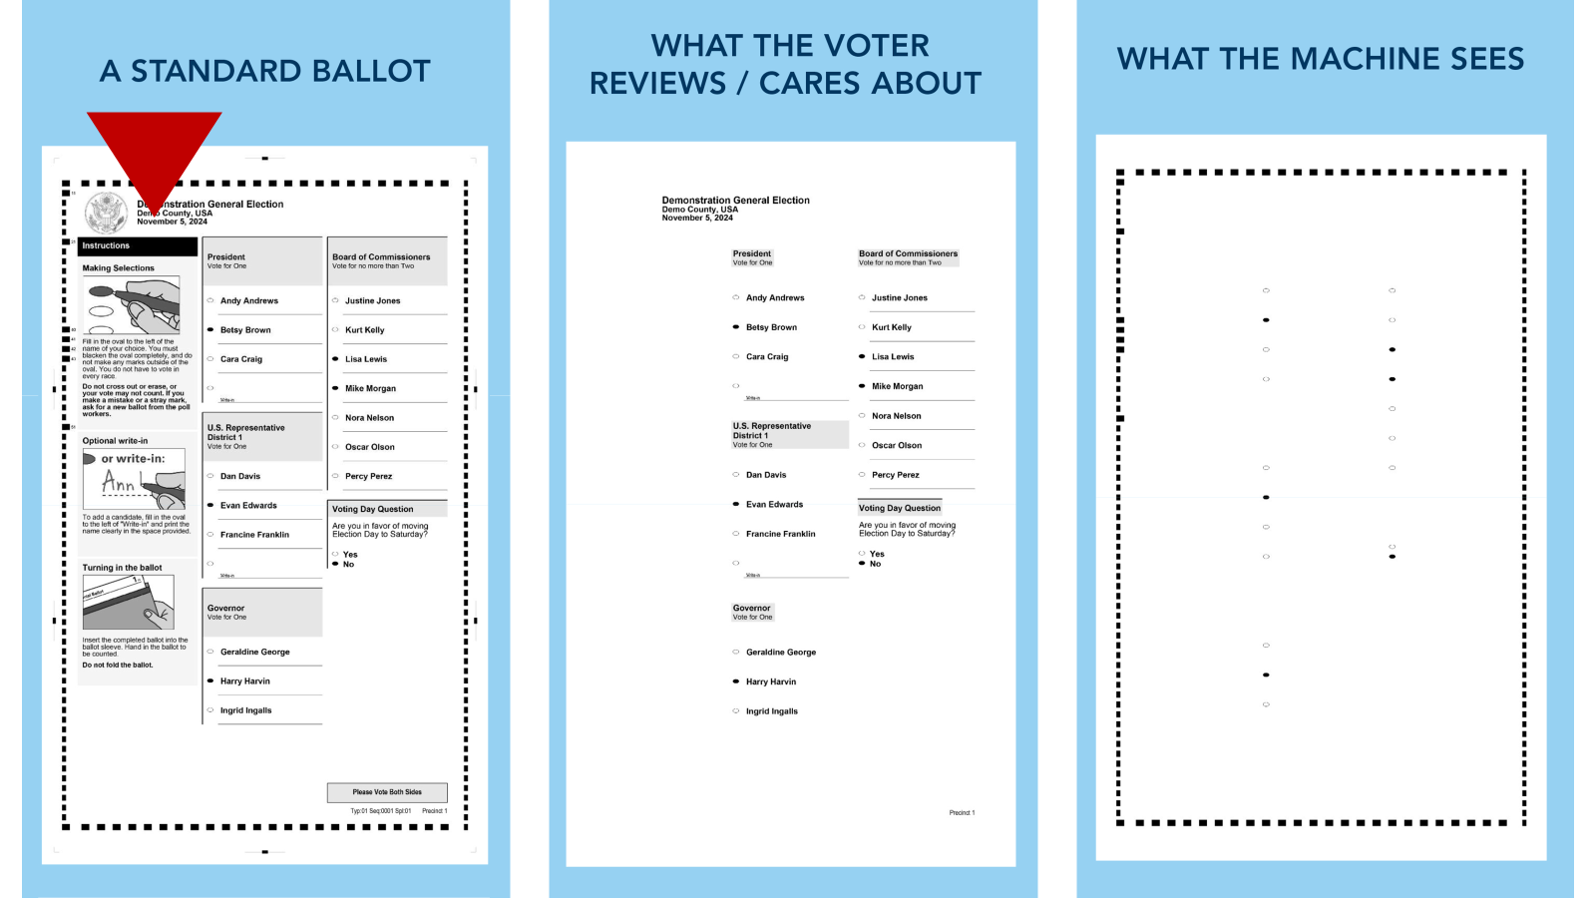

Slide 37
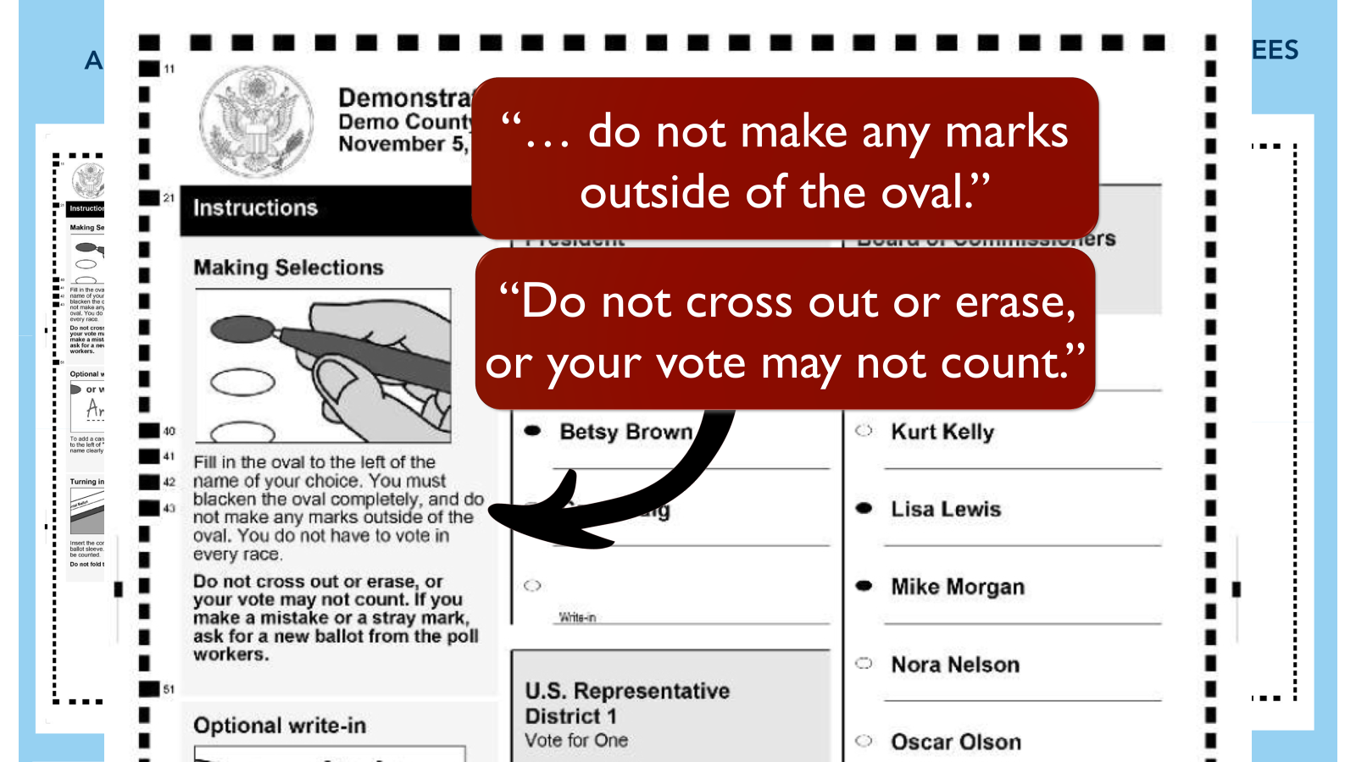

Slide 38
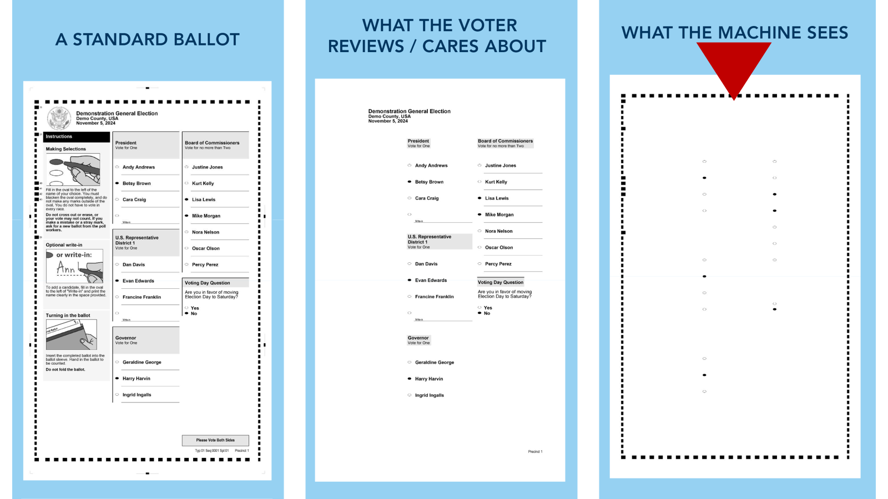

Slide 39
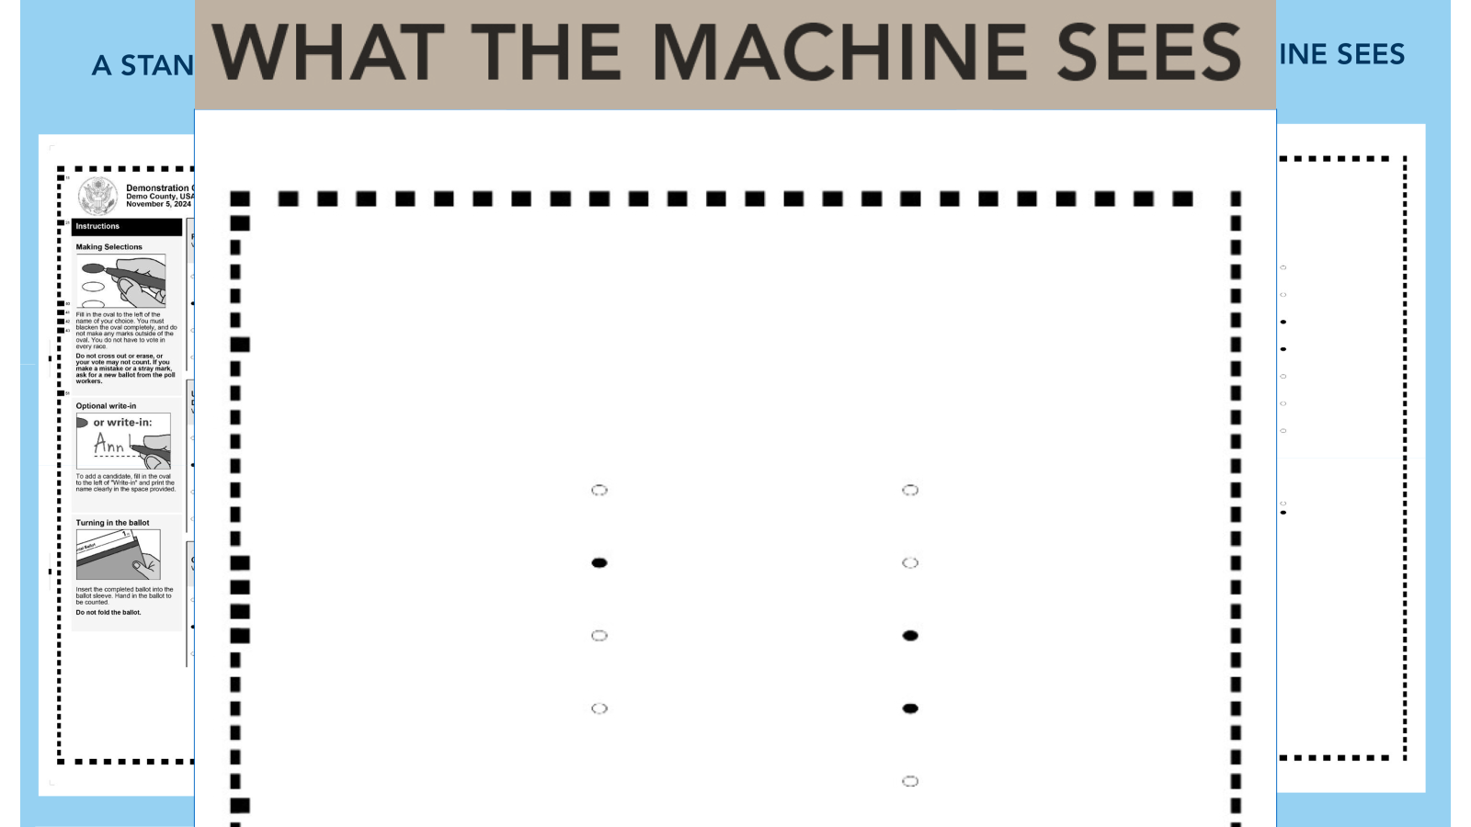

Slide 40
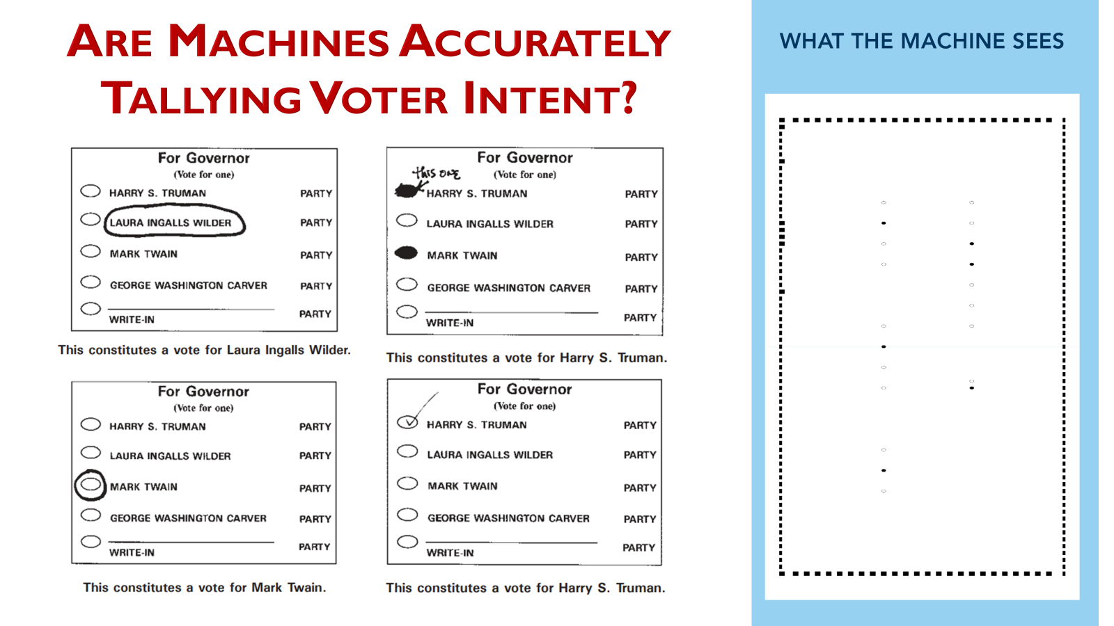

Slide 41
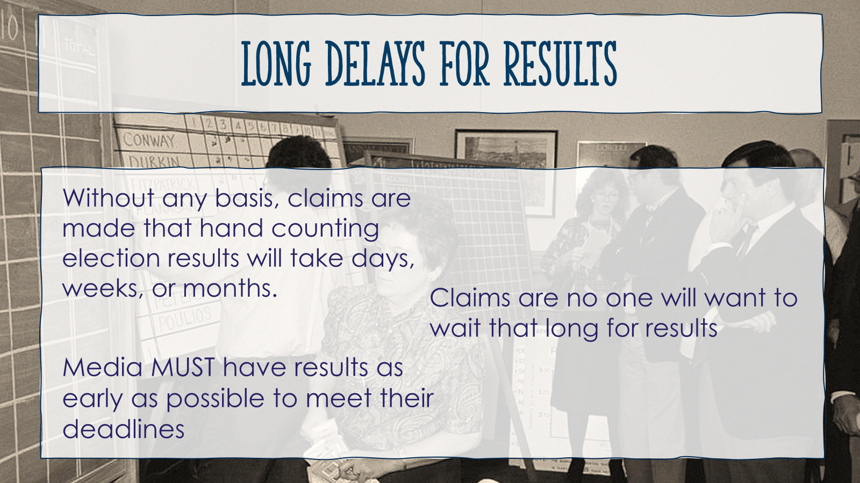

Slide 42
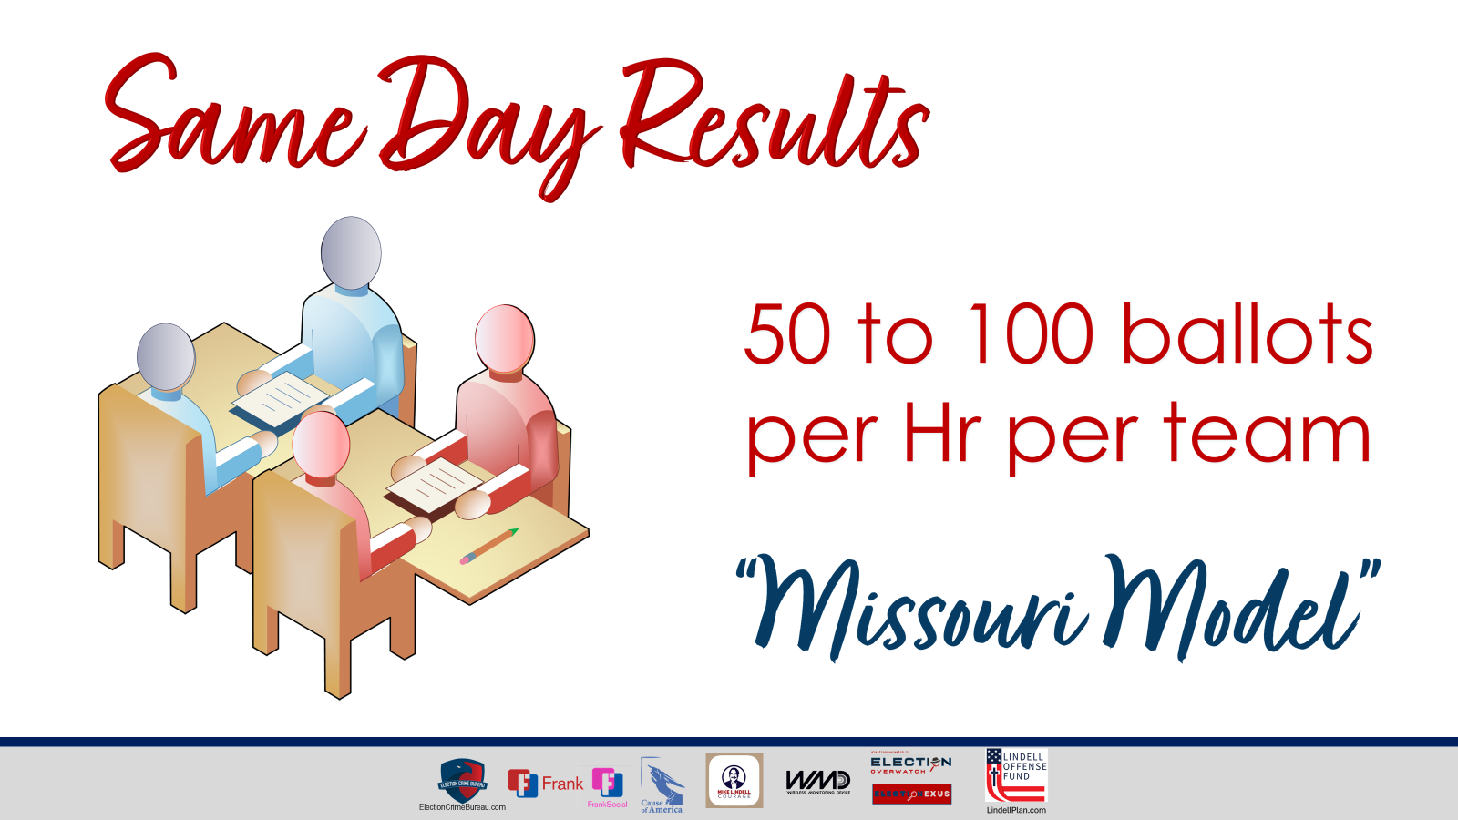

Slide 43
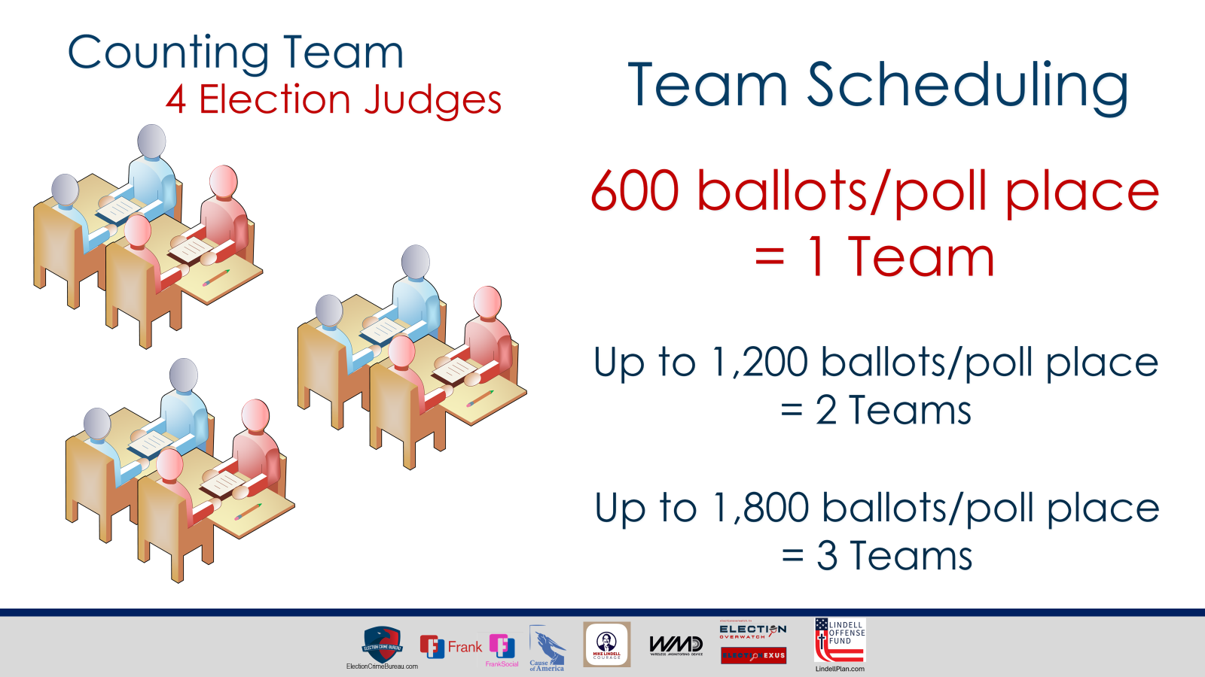

Slide 44
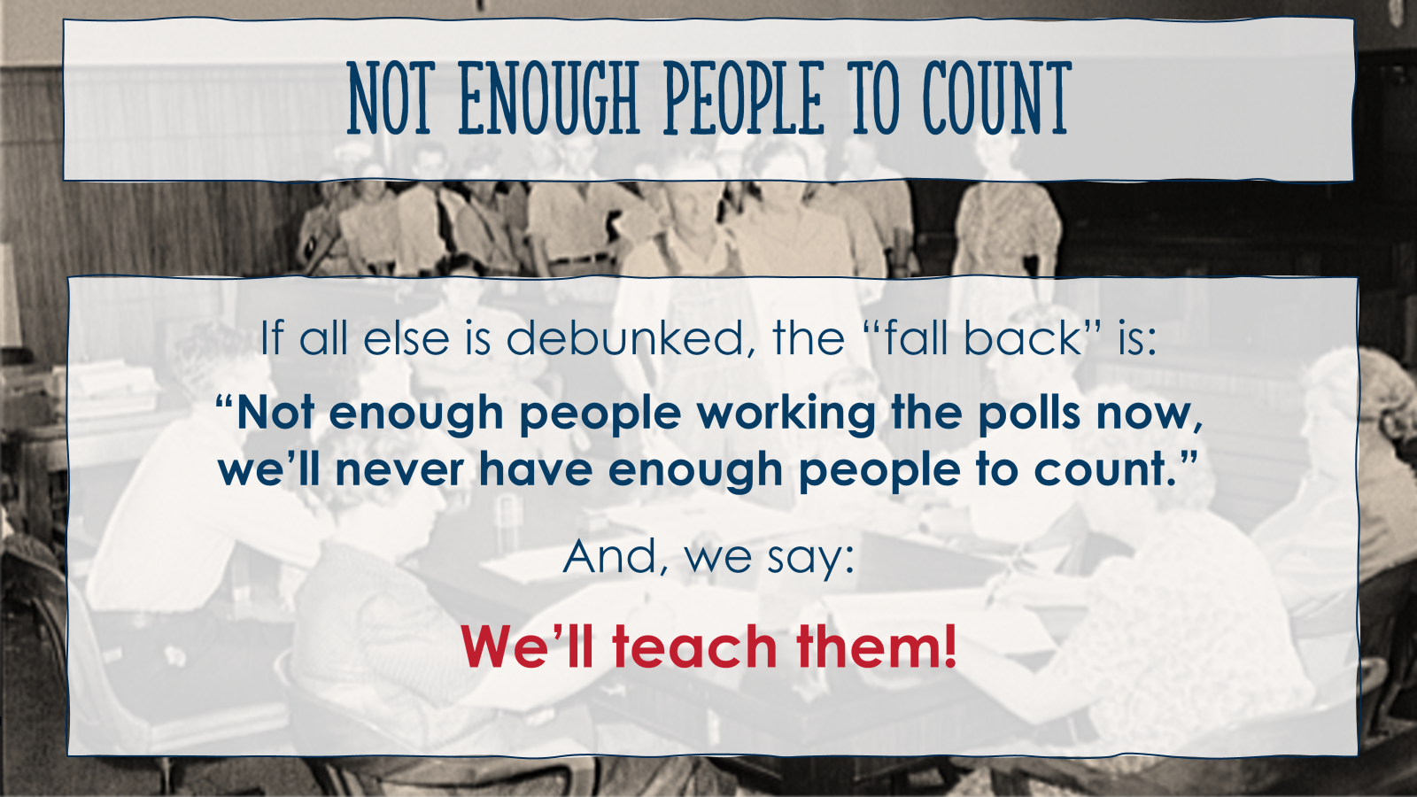

Slide 45


Slide 46


Slide 47


Slide 48
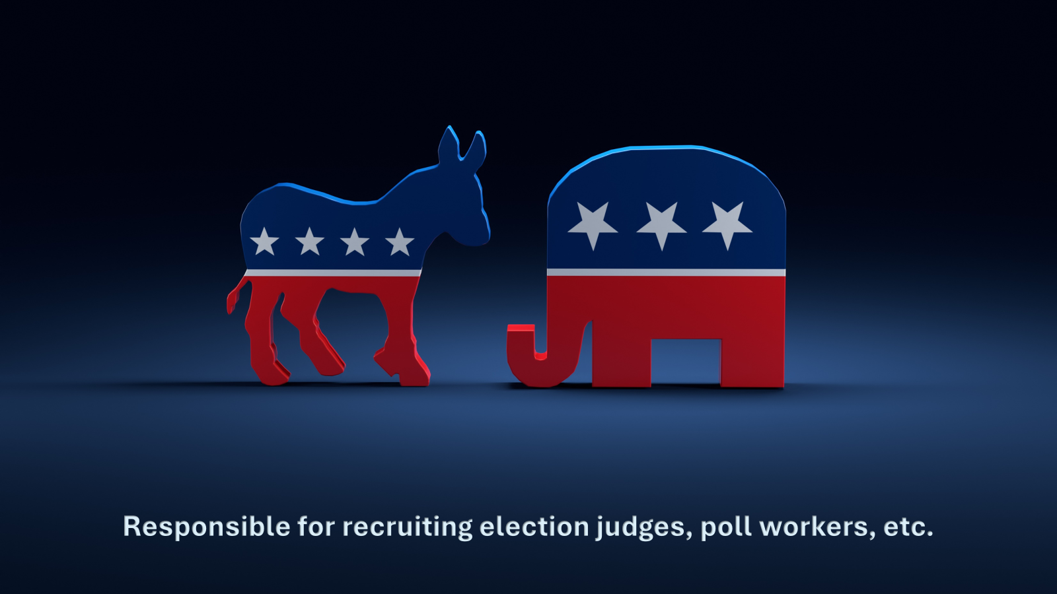

Slide 49
