Slide 1

Notes:
This slide deck was designed for a 4-hour training course with the purpose of training “trainers.” It is not necessarily meant to train someone simply interested in hand counting, although it could be used that way. The information is very in-depth to teach trainers how to answer questions about hand counting and, for that reason, it may be “too much information” for someone only interested in the basics.
The notes provided for this slide deck are NOT intended to be a script. Instead, the purpose of each slide and some prompts are provided for instructors. The “Read #” shown in brackets is a suggestion to read the checklist item text (it’s on the slide). Of course, the text may be paraphrased. There is no requirement to read it verbatim.
The eManual, the 4-hour training program, and this slide deck are authored by Linda Rantz and are copyrighted material. No use of this training program is permitted for any purpose, other than its intended purpose of training trainers. For permission to use the materials for other purposes or for questions, email HandCounting@pm.me.

Slide 2
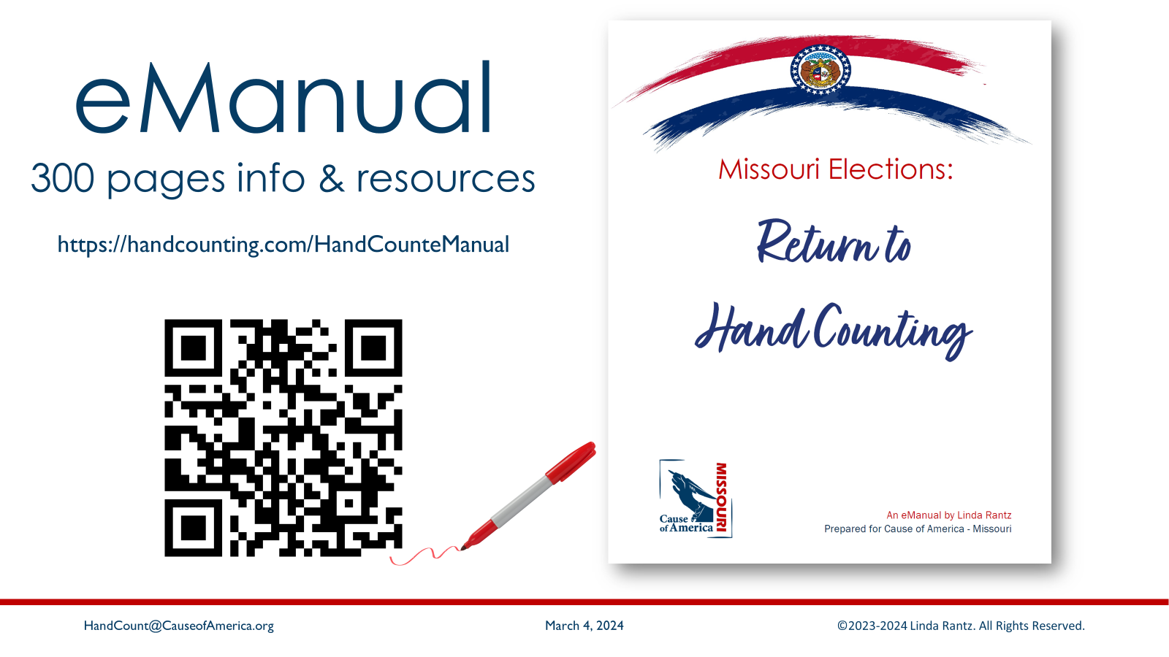
Notes:
This hand count method was written based on Missouri statutes and rules. Nevertheless, it is a very basic system and easily adaptable for other states and jurisdictions. Keep in mind, as training progresses, what is being taught is the Missouri method and may be different for other states.
Hopefully, when they registered for the class, all attendees were encouraged to read Chapter 5 of the eManual in advance. Our experience has been that, while a person might not absorb all the details from reading Chapter 5, it makes it easier to understand what is being presented during training and keep up with the rest of the class.

Slide 3
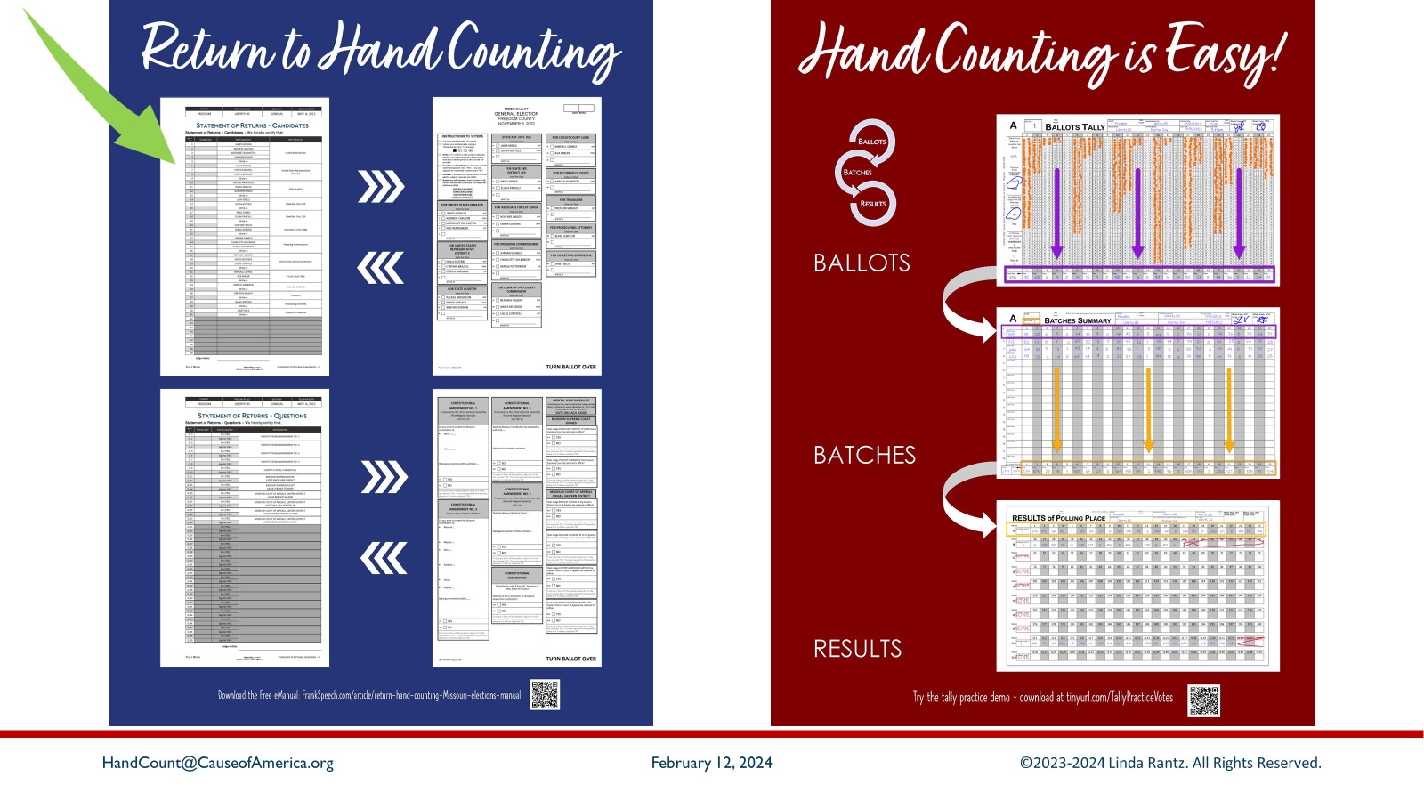
Notes:
It is helpful for trainees to have an overview of the hand count process from start to finish. These 2 panels show the overview. The process begins on the blue panel with the “Statement of Returns” and moves across to the red panel. Then, loops back to the Statement of Returns.

Slide 4
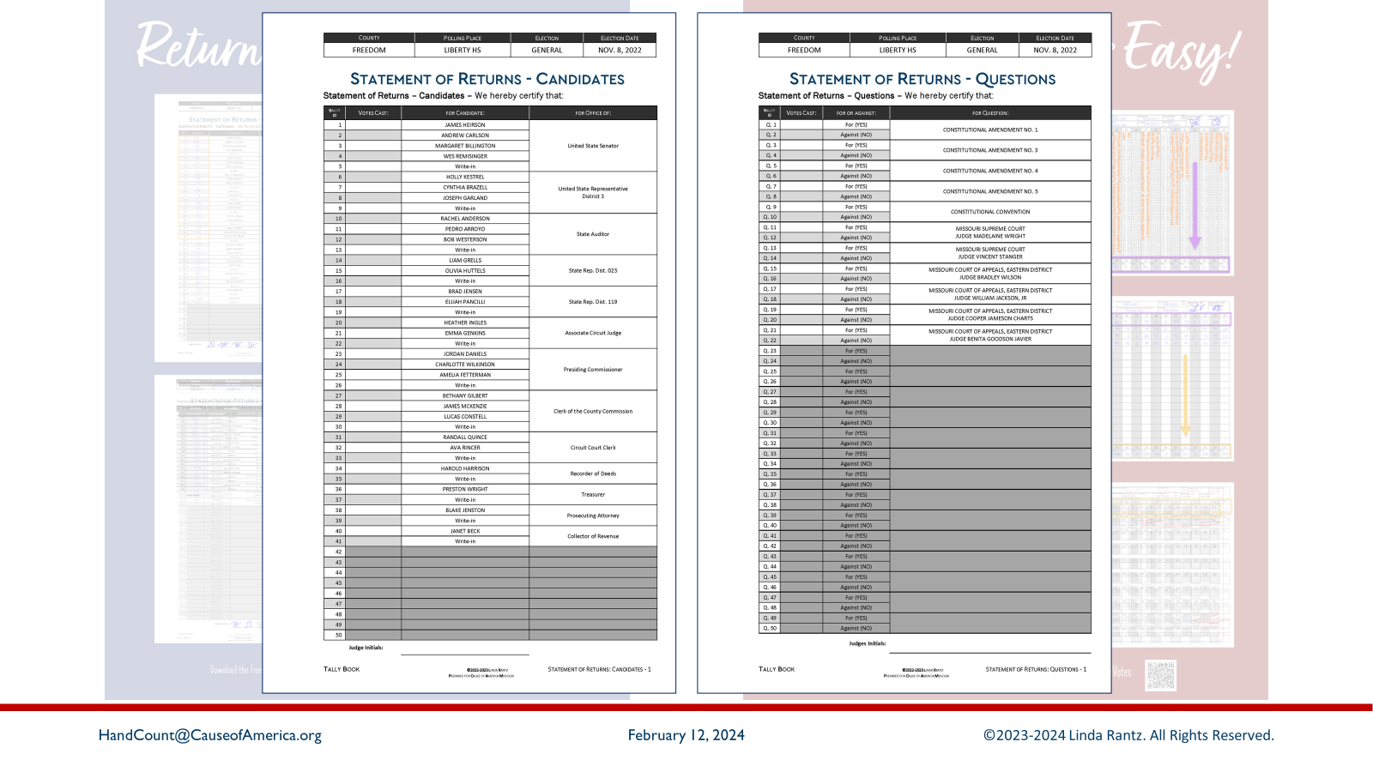
Notes:
The Statement of Returns has a version for Candidates, and a version for Questions. When the candidate filing deadline has passed, the clerk will have the names of every candidate running for office, and every question that will be on the ballot. The clerk creates a list of candidates and questions in order according to rules. (These versions of Statement of Returns are designed by Linda Rantz based on interpretation, but clerks may use a different format. However, the Statement of Returns, in whatever format, is a statutorily required document.)

Slide 5
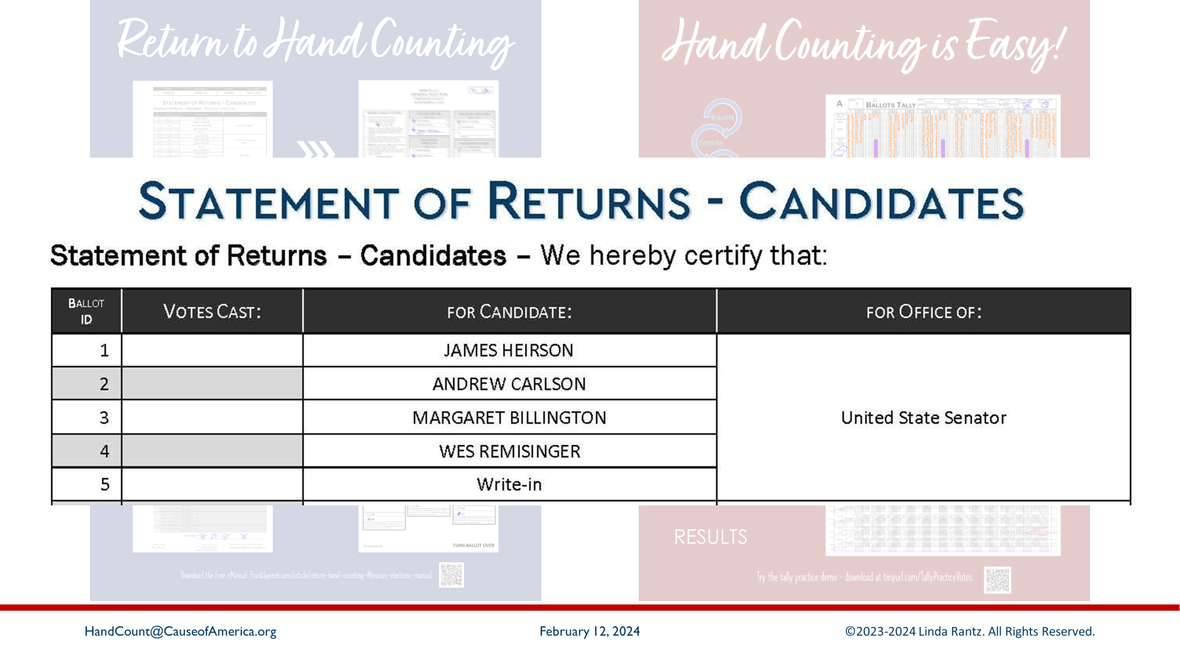
Notes:
The far-left column of the Statement of Returns for Candidates contains unique numbers for each candidate. Even though there may be different versions of a ballot within a county, the candidate must always have their unique number associated with their name on every ballot in the county.

Slide 6
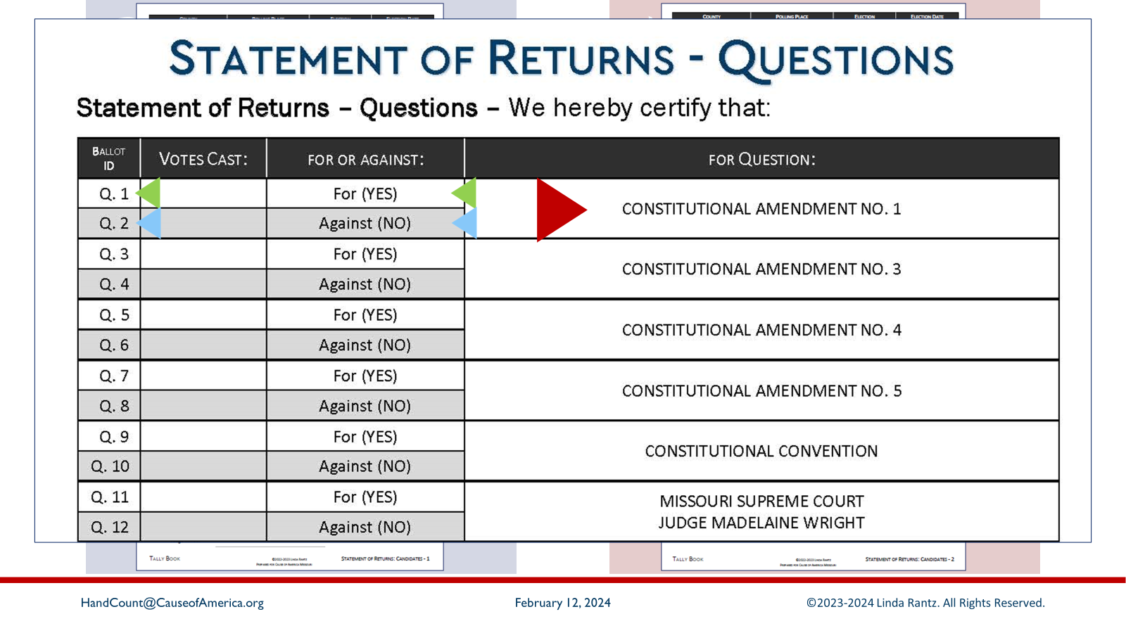
Notes:
On the Statement of Returns for QUESTIONS, each question has the option of YES or NO. So, in the left-columns, there is a unique number for the YES and a unique number for the NO. For questions, the numbers are preceded by “Q”, which must be spoken by the Counting Judge who is calling out the votes.

Slide 7
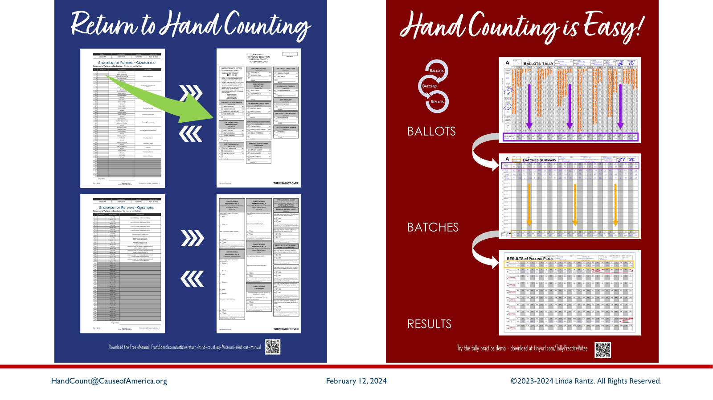
Notes:
From the Statement of Returns, the next step is the creation of the ballots. The numbers from the Statement of Returns should be included on the ballots.

Slide 8
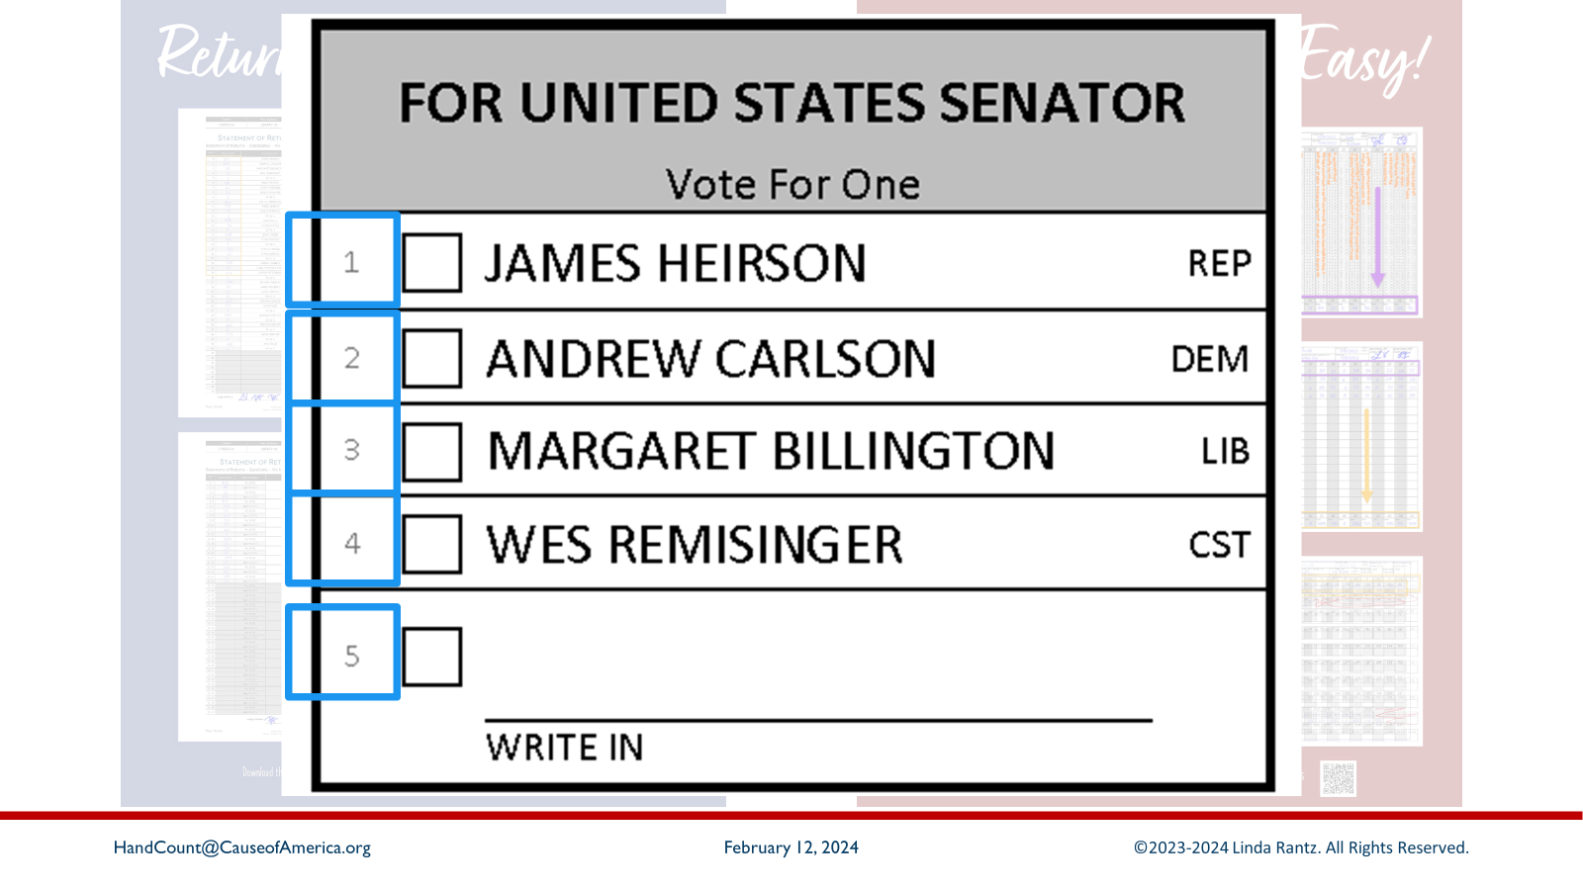
Notes:
While clerks seem satisfied with putting computer timing codes on ballots (dashed marks around the border of the ballot), many object to putting discrete numbers on the ballots to identify candidates or questions. It is NOT a deal breaker if the clerk will not put numbers on the ballots. Contact HandCount@CauseofAmerica.org for other solutions.

Slide 9
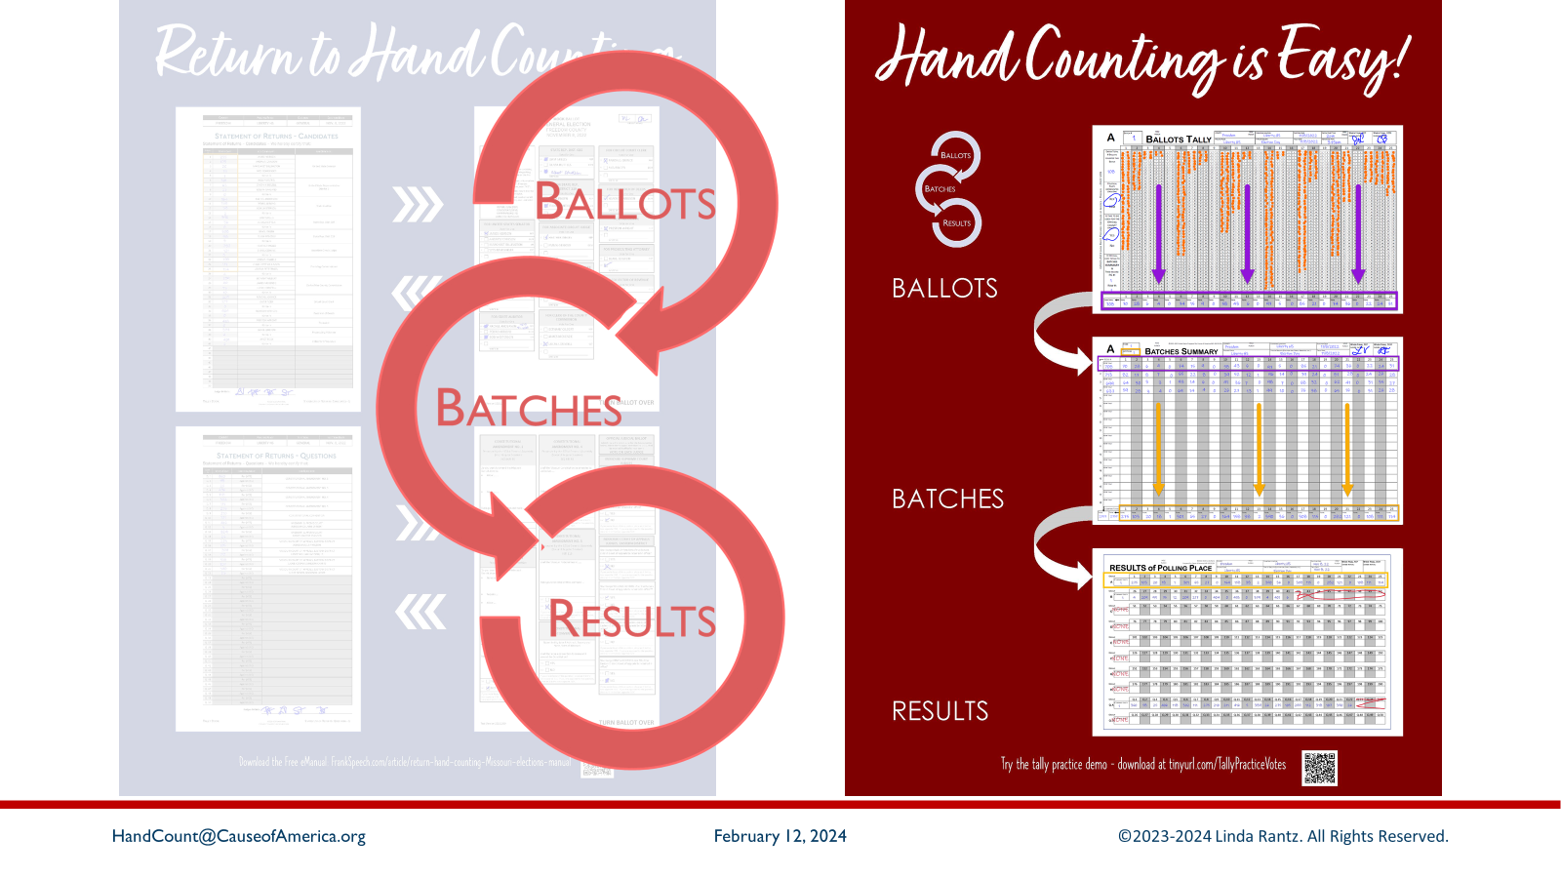
Notes:
Next is the process for tallying and counting the ballots: BBR = Ballots, Batches, Results. Examples of the forms on are the red panel.

Slide 10
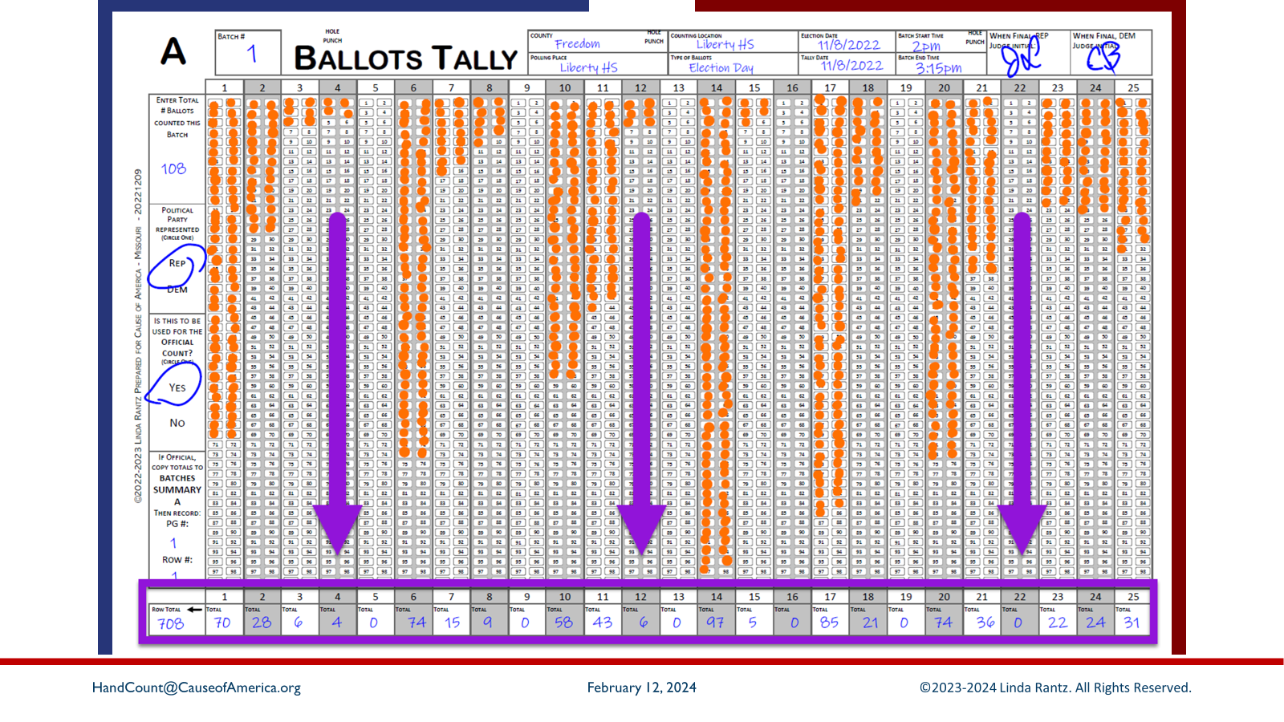
Notes:
First step is BALLOTS. The “Ballots Tally” form is used to tally the votes. When a batch is complete, the votes are totaled at the bottom of the Ballots Tally form. In this example, outlined in purple.

Slide 11

Notes:
The next step is BATCHES. The totals from each Ballots Tally form are recorded on a BATCHES SUMMARY SHEET, which is the middle form on the red panel.

Slide 12
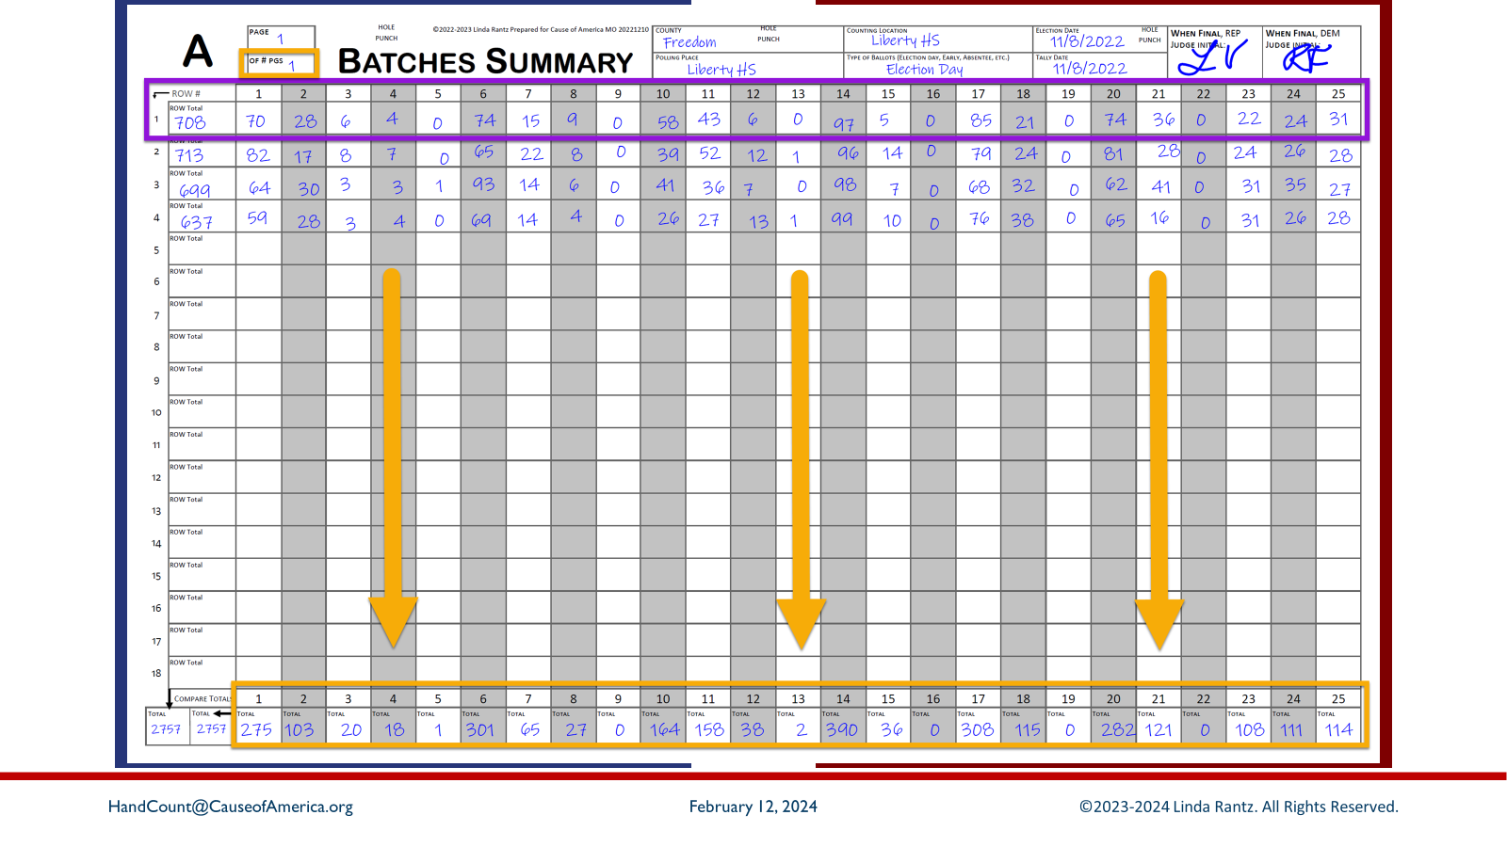
Notes:
Row 1, outlined in purple, shows the totals from the Ballots Tally form on the previous slide, which was copied over to this Batches Summary sheet. In this example, 3 more batches were recorded (see 4 completed rows). When all ballots have been counted and all batches recorded here, the totals are added up and written in the bottom totals row, outlined in gold.

Slide 13

Notes:
Now the third step of BBR = Results, which is the bottom form on the red panel.

Slide 14
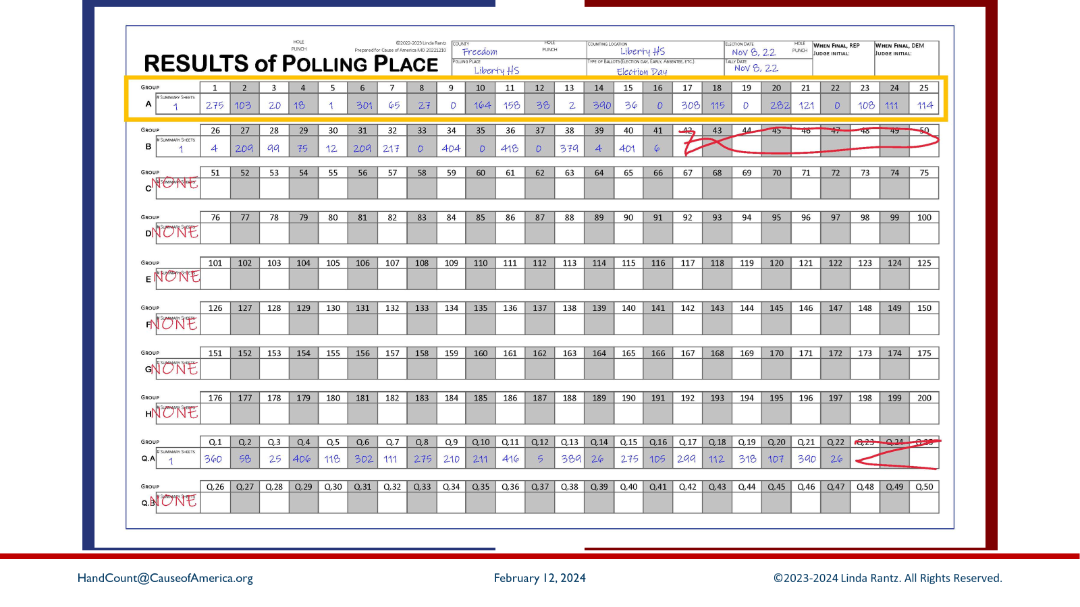
Notes:
The total from the Batches Summary Sheet, the top row outlined in gold, is recorded on the RESULTS OF POLLING PLACE. These are the final numbers for votes cast at this polling place. Next, Missouri statutes require that these numbers be recorded on a Statement of Returns.

Slide 15
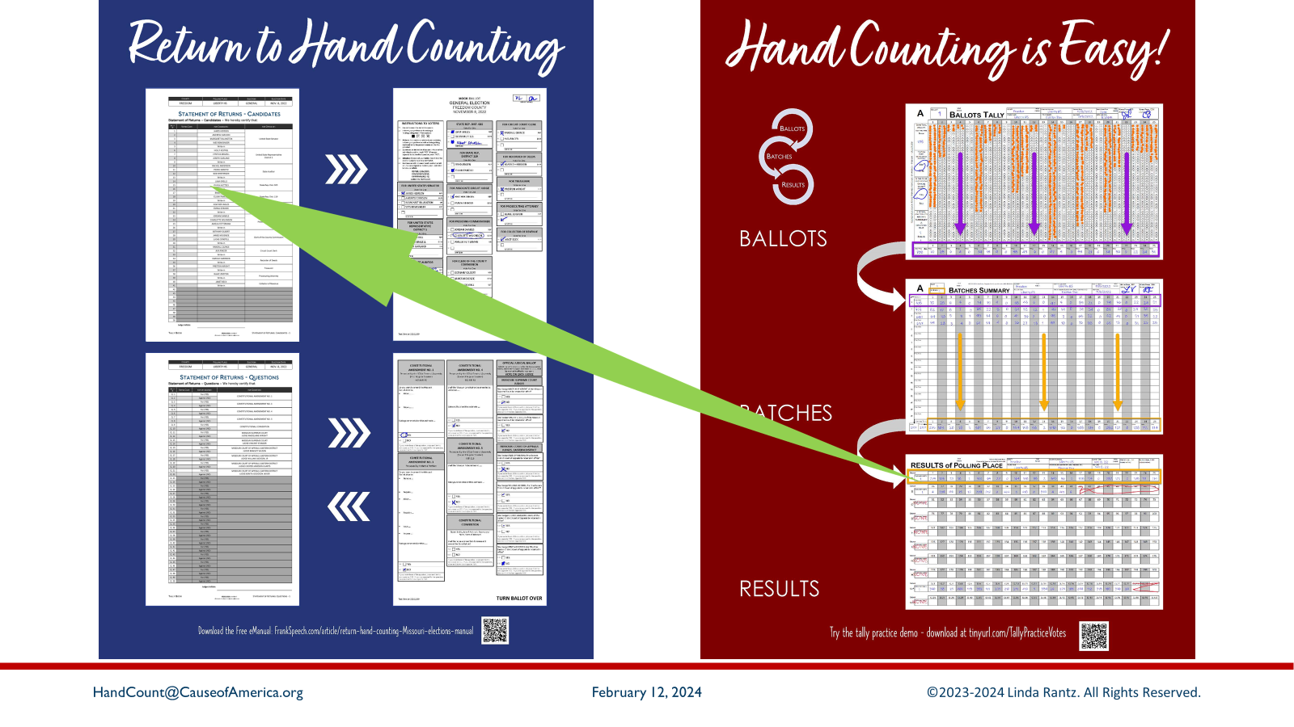
Notes:
Which brings us back to the original documents: Statement of Returns for Candidates and Questions.

Slide 16
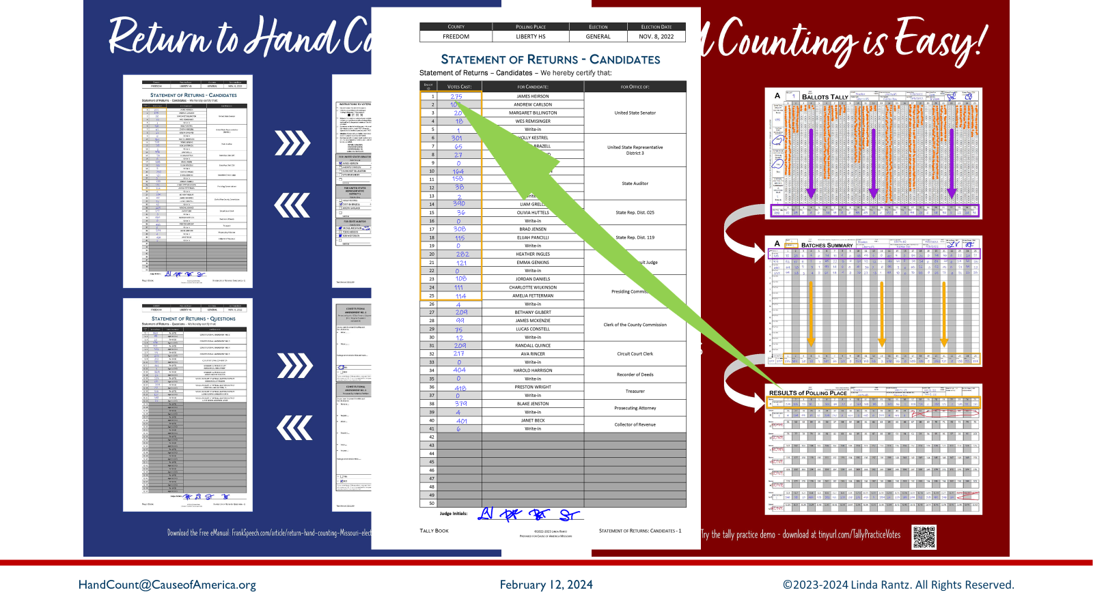
Notes:
Notice on the column header for the first row of the Results of Polling Place, the numbers 1 through 25. These match up to the numbers in the left column of the Statement of Returns. So, if 275 is the total in column 1 of the Results of Polling Place, write “275” in row 1 of the Statement of Returns.

Slide 17
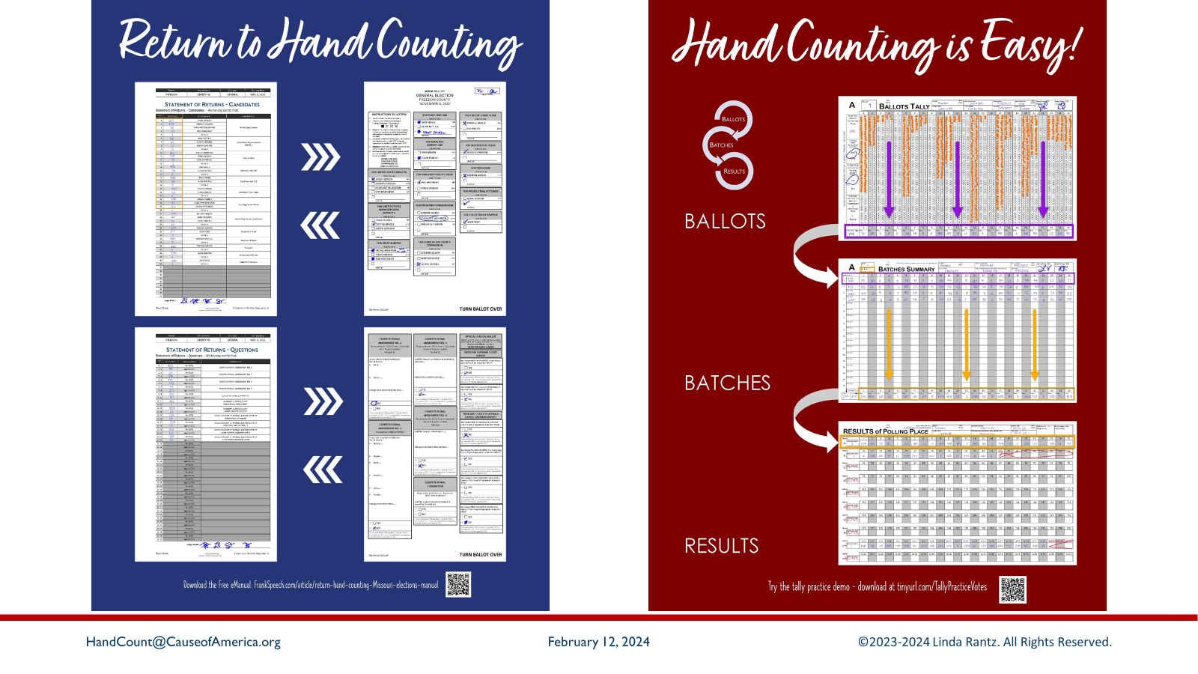
Notes:
This has been a quick overview of how you start with a blank Statement of Returns, tally the votes, total each form, and come back to the Statement of Returns with the total votes cast.

Slide 18
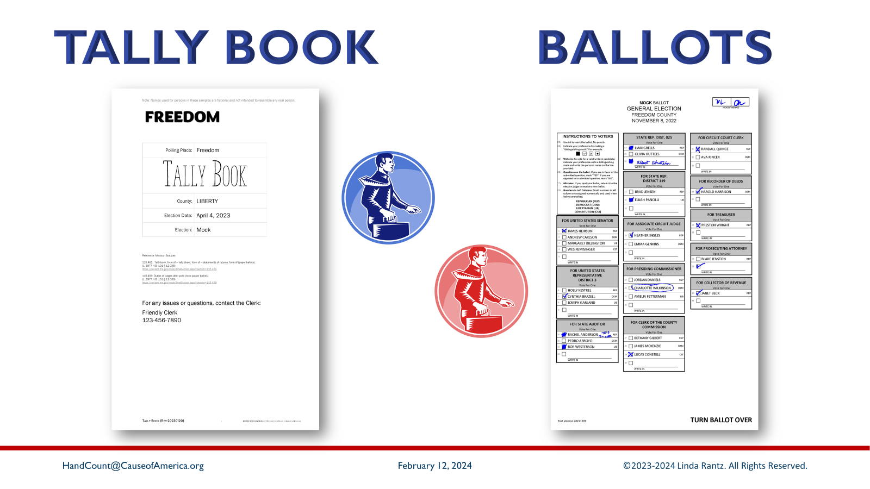
Notes:
At the end of the counting process, there will be 2 sets of paperwork/forms. One set will go in a “Tally Book” and the other will go with the ballots. This means the Tally Book will hold official election results. Throughout election day, and when the book is being returned to the clerk, it should be kept as secure as the ballots.
The ballots and the Tally Book are returned separately to the clerk, one taken by a Republican and the other by a Democrat.

Slide 19
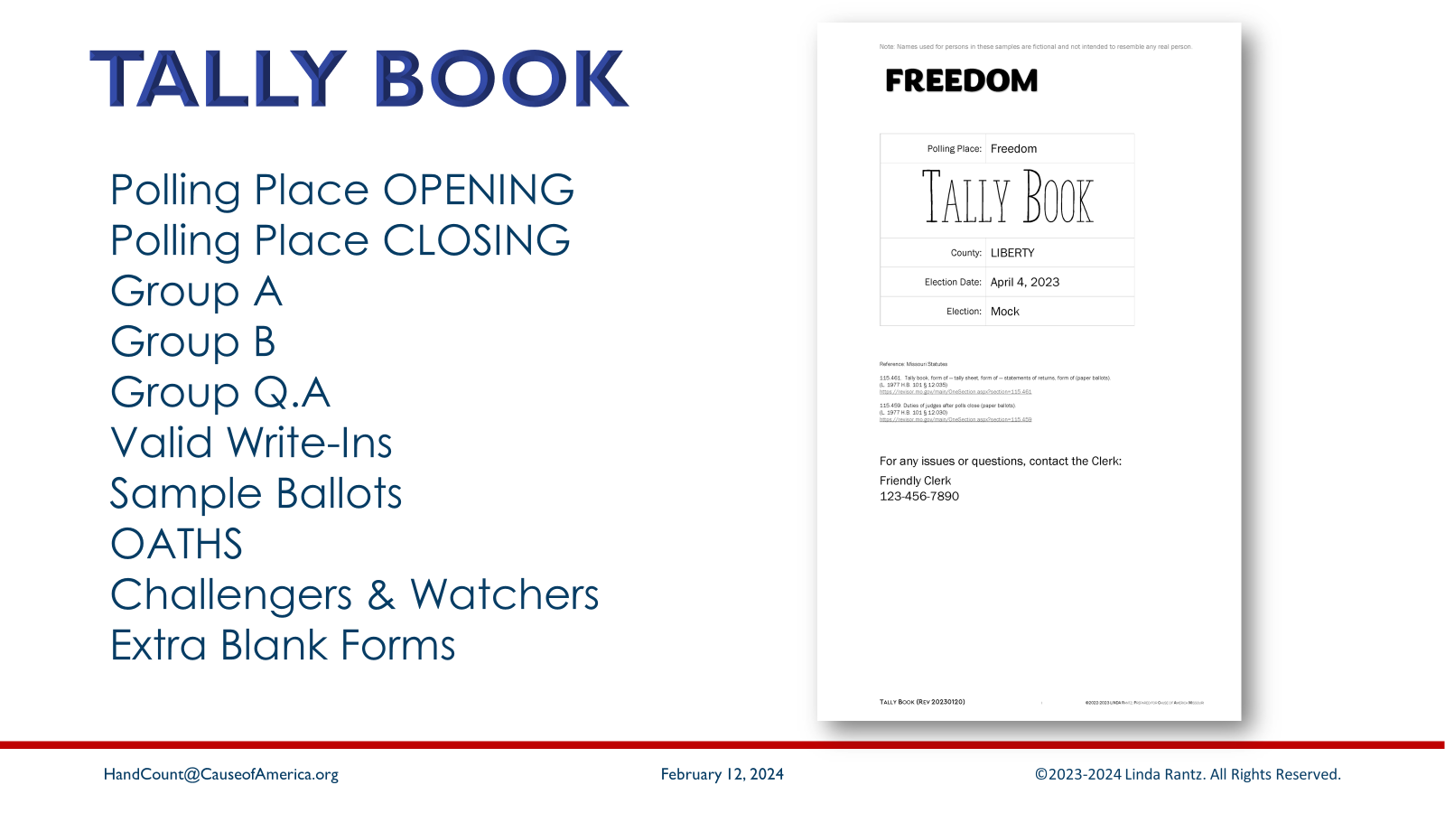
Notes:
There is a Tally Book each table – please open so everyone at the table can see it. During the training today, there will be instructions to go to a section of the Tally Book for a particular reason. The tabs in the Tally Book have these section headings: Polling Place Opening, Polling Place Closing, Group A, Group B, Group Q.A, Valid Write-Ins, Sample Ballots, Oaths, Challengers & Watchers, Extra Blank Forms

Slide 20
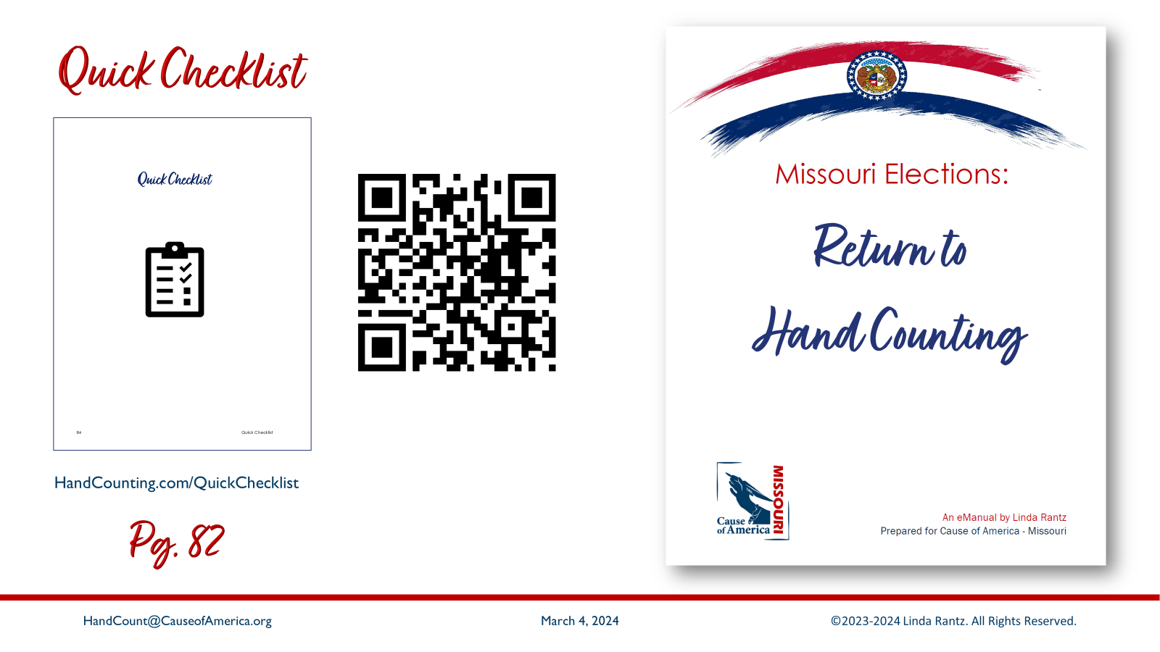
Notes:
All attendees should have a “Quick Checklist” handout. This is a 4-page document from the eManual (beginning at page 82).

Slide 21
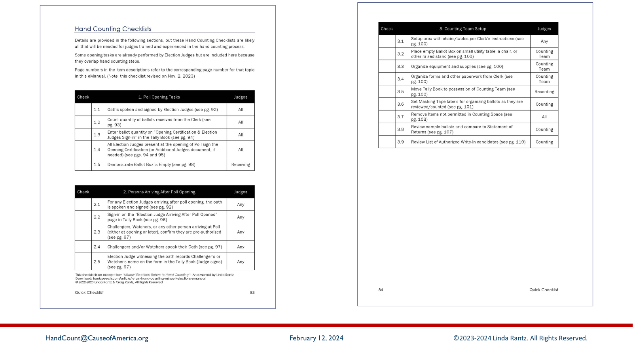
Notes:
This checklist covers every step of the hand count process, from opening the polling place to delivering the election results and ballots to the Clerk. During training, it is a good idea to make notes on this checklist. Some of the election judges who hand counted the Osage County election took these checklists with them on election day. It helped them follow the steps for hand counting.

Slide 22
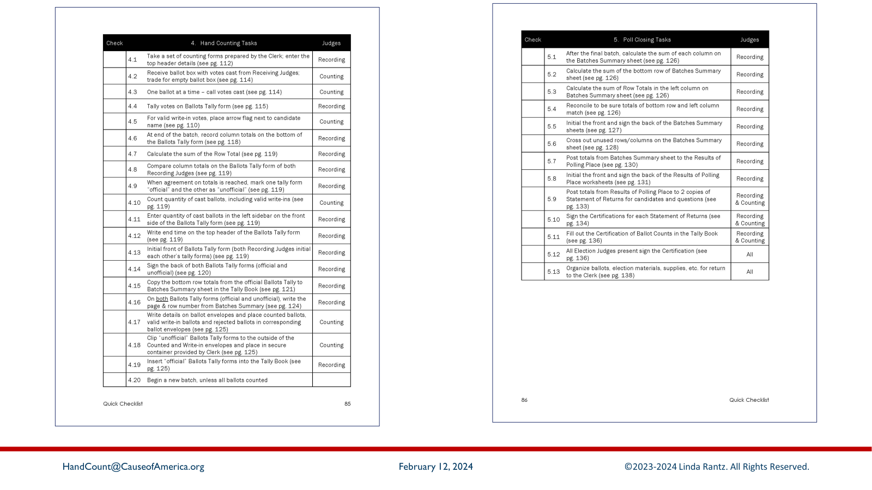
Notes:
Keep in mind, these are tasks required by Missouri laws. The county clerk may have a different order or list of instructions. But, at a minimum, this checklist identifies tasks that should be completed.
For items on the Checklist that say, “see page # …” that corresponds to the page number in the eManual for hand counting.
**** Suggest a 7-minute break at this point.

Slide 23
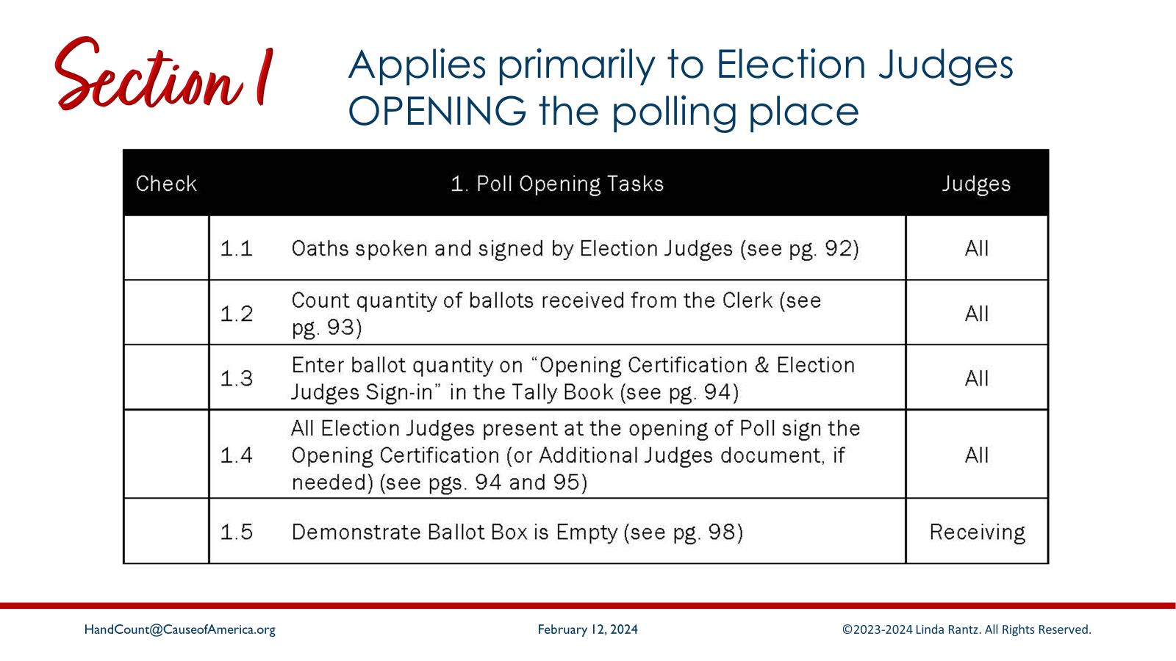
Notes:
Section 1 pertains primarily to the election judges who arrive at 0-dark-early to set up the polling place. In many cases, that will NOT be the counting team. But, since the information recorded by the early morning judges is needed by the counting team, it is good to understand what is done before the counting team arrives.

Slide 24
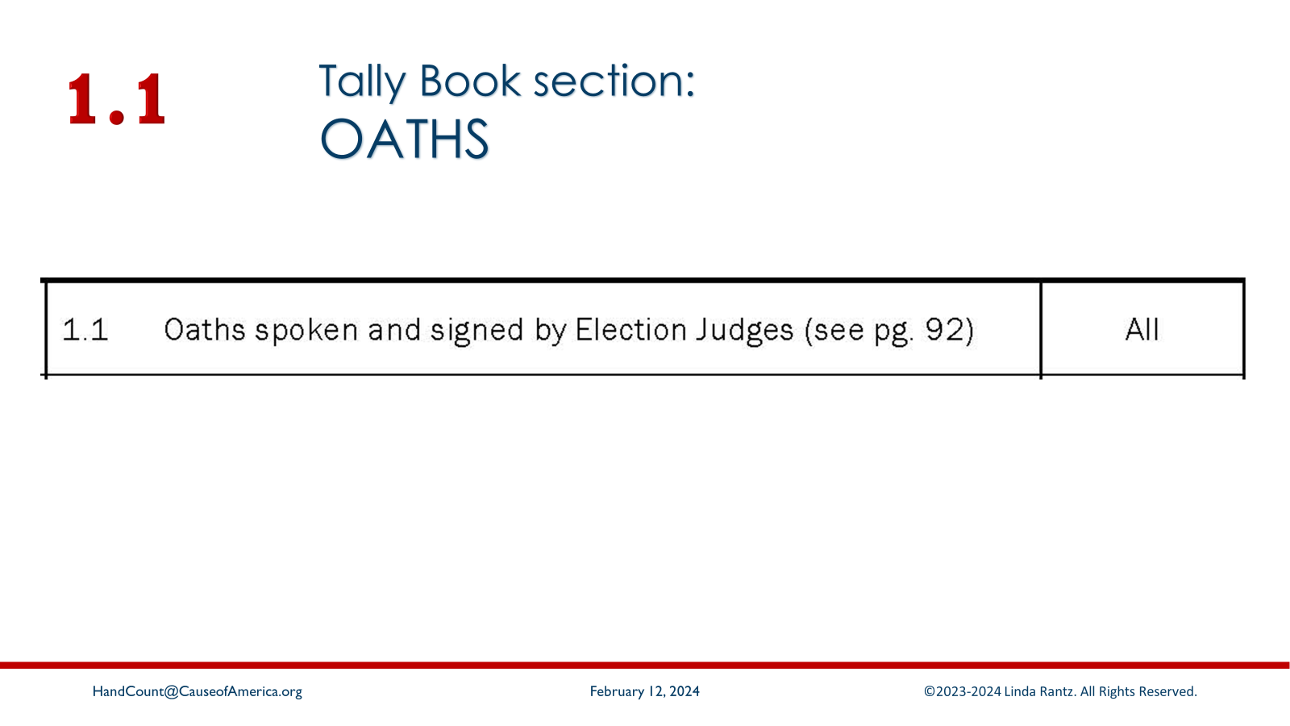
Notes:
[Read 1.1] Oaths can be found in the “Oaths” section of the Tally Book.
The statute says the oaths are spoken – NOT administered. The statutes also imply that election judges are equal – there is no head honcho judge (unless the clerk has assigned someone). But, by statute, the judges are called Recording, Counting, Receiving, Supervising judges. The title pertains to the task they are performing at a given time. If they switch to a different task, their title will change, too. It is simply to identify who is doing what.

Slide 25
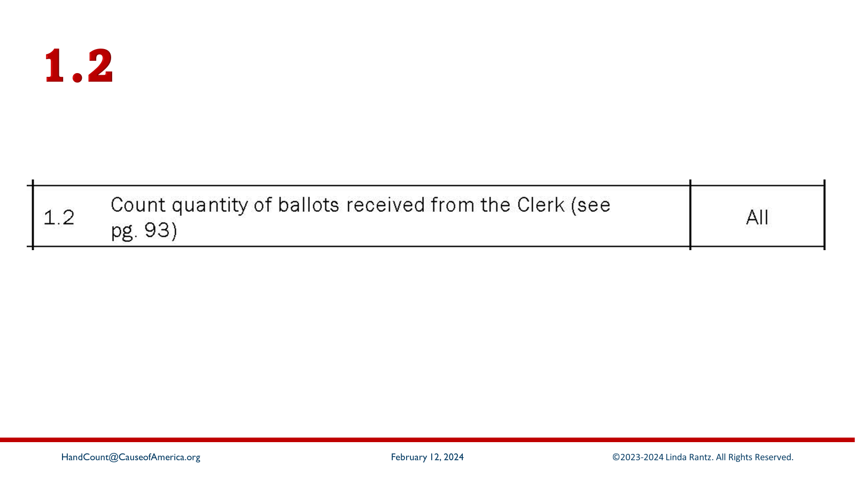
Notes:
[Read 1.2] The election judges who open the polling place are required to count the quantity of all the ballots (which should be blank) sent to the polling place by the clerk.

Slide 26
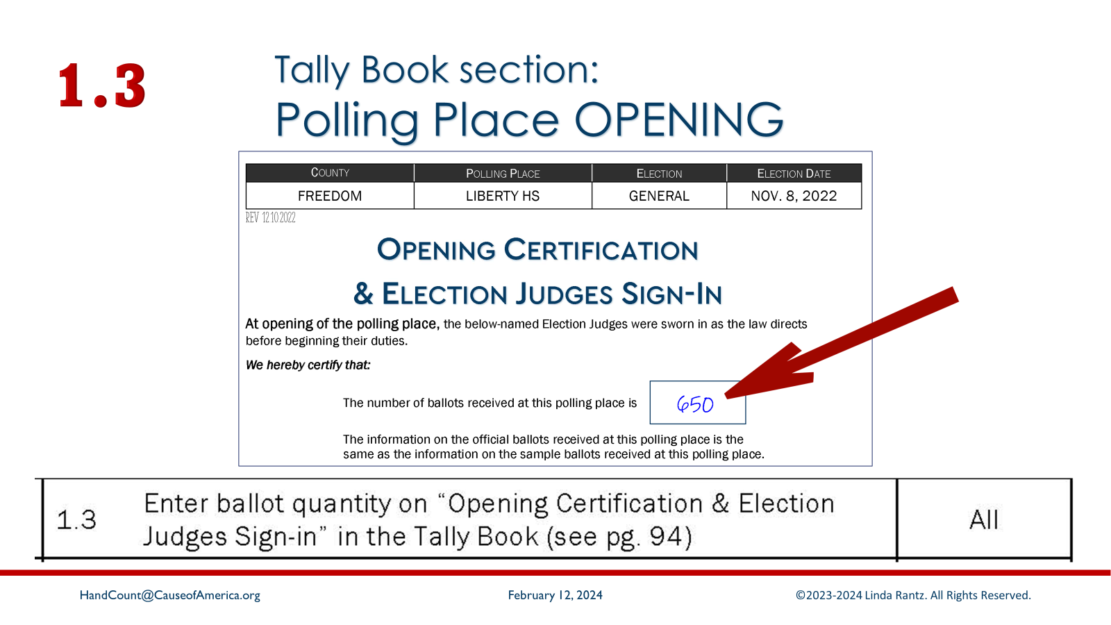
Notes:
[Read 1.3] The quantity of ballots is written on the “Opening Certification & Election Judges Sign-In” form

Slide 27
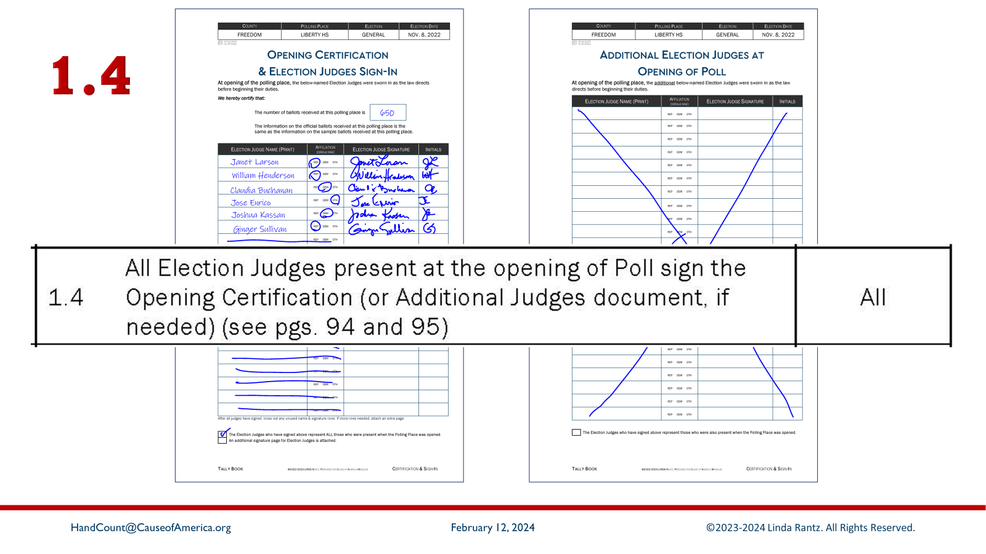
Notes:
[Read 1.4] Right below the quantity of ballot count is the space for election judges **who are present when the poll opened** sign in. Again, this is a suggested form because there were some important items we felt should be included: one is initials of election judges. Throughout the process, signatures are always on the back of a form with the instructions to not photograph or publish signatures (protection against identity theft). Initials are on the front of the form and provide a simple security – someone would need to know which judges are working and how they mark their initials.
Second: Nothing says that there must be a separate sign-in sheet for the judges opening the polling place. However, given that judges can switch roles during the day, it seemed reasonable to know which judges opened the polling place and certified the count of the ballots.
The extra page for “Additional Election Judges at Opening of Poll” was created simply to satisfy clerks of large counties who might object only because they thought the form did not have enough sign-in lines.

Slide 28
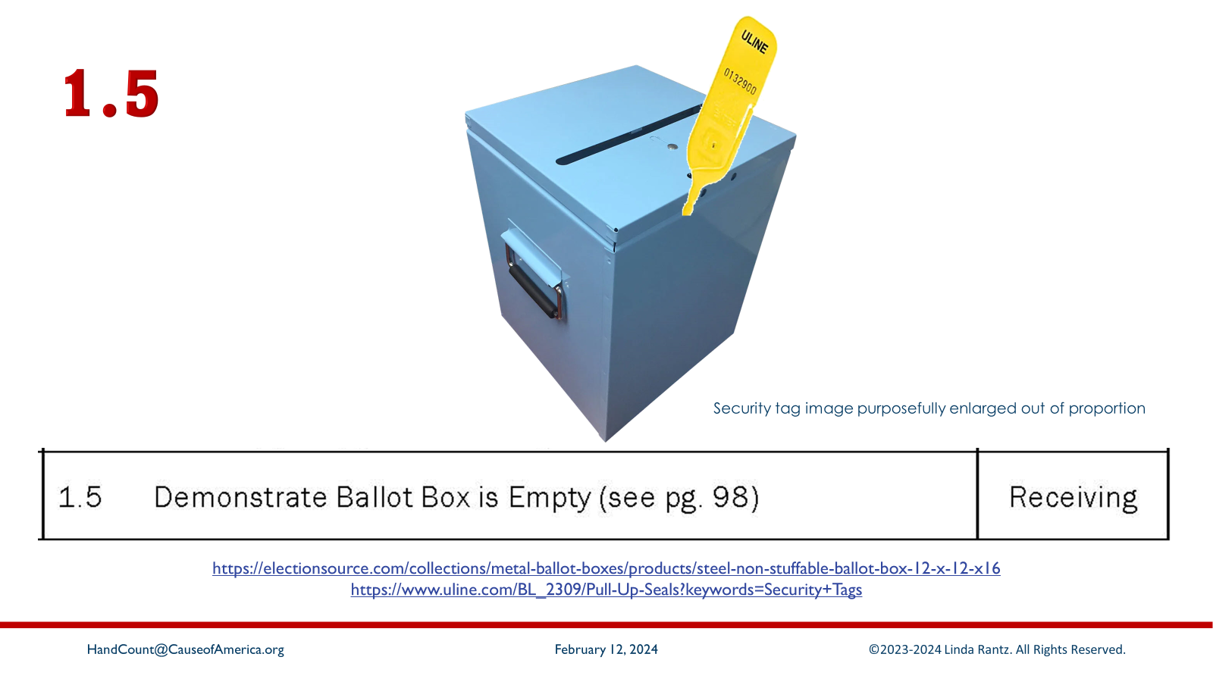
Notes:
[Read 1.5] MO law requires there be a demonstration that the ballot box is empty. (Recommend also showing there is no false bottom.) A security ID tag(s) or other security device should be placed on the ballot box at this point, and the ID number(s) recorded as per the clerk’s instructions. This is the ballot box that will be used for voters to drop their ballots as they cast them.
https://electionsource.com/collections/metal-ballot-boxes/products/steel-non-stuffable-ballot-box-12-x-12-x16
https://www.uline.com/BL_2309/Pull-Up-Seals?keywords=Security+Tags

Slide 29
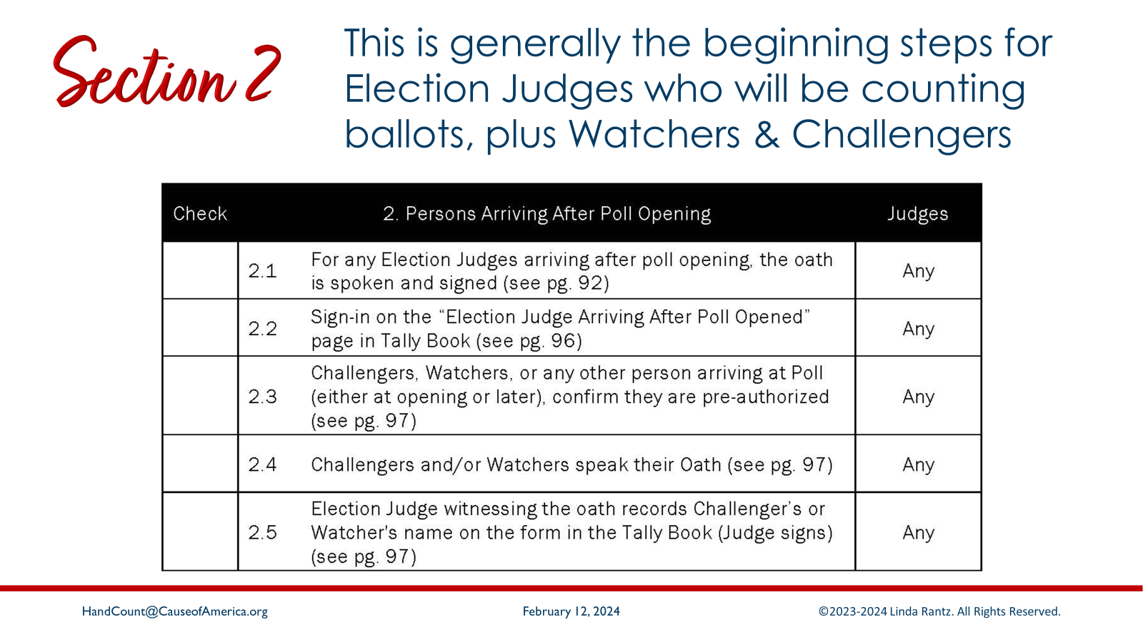
Notes:
Section 2 covers the beginning steps for the counting process. This section will apply to those arriving after the poll has already opened (unless the counting team was required to be present before the poll opened).

Slide 30
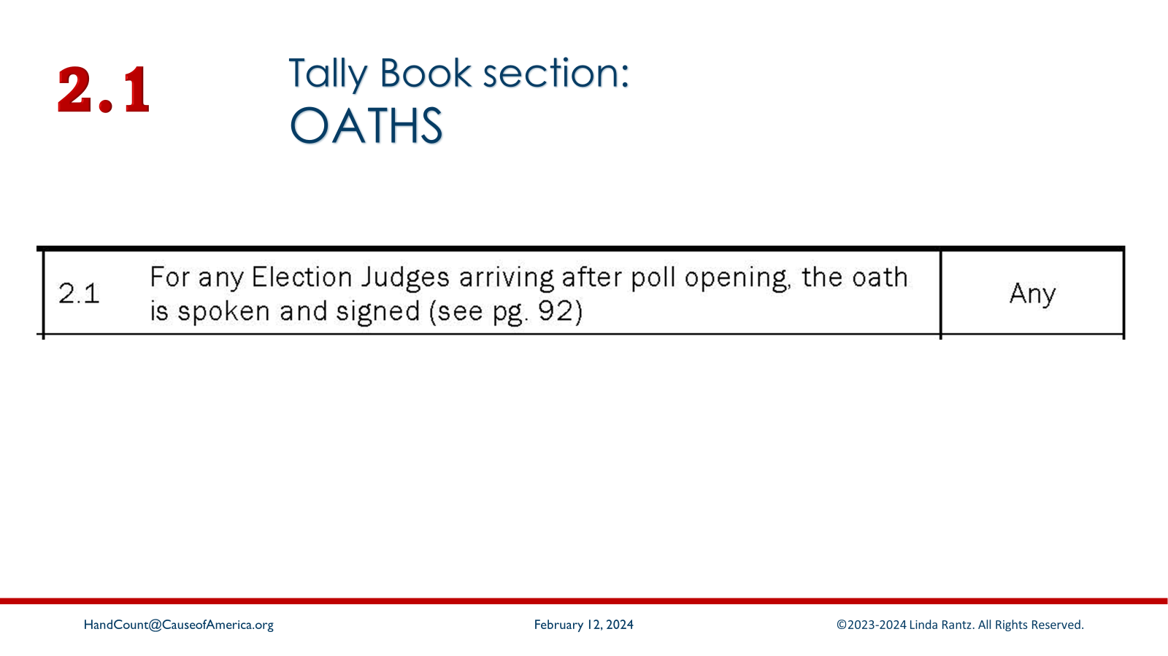
Notes:
[Read 2.1] The same as for judges who arrived before the poll opened, judges arriving later speak their oath. The clerk probably also has an oath form for each judge to sign. Follow your clerk’s instructions on this.

Slide 31
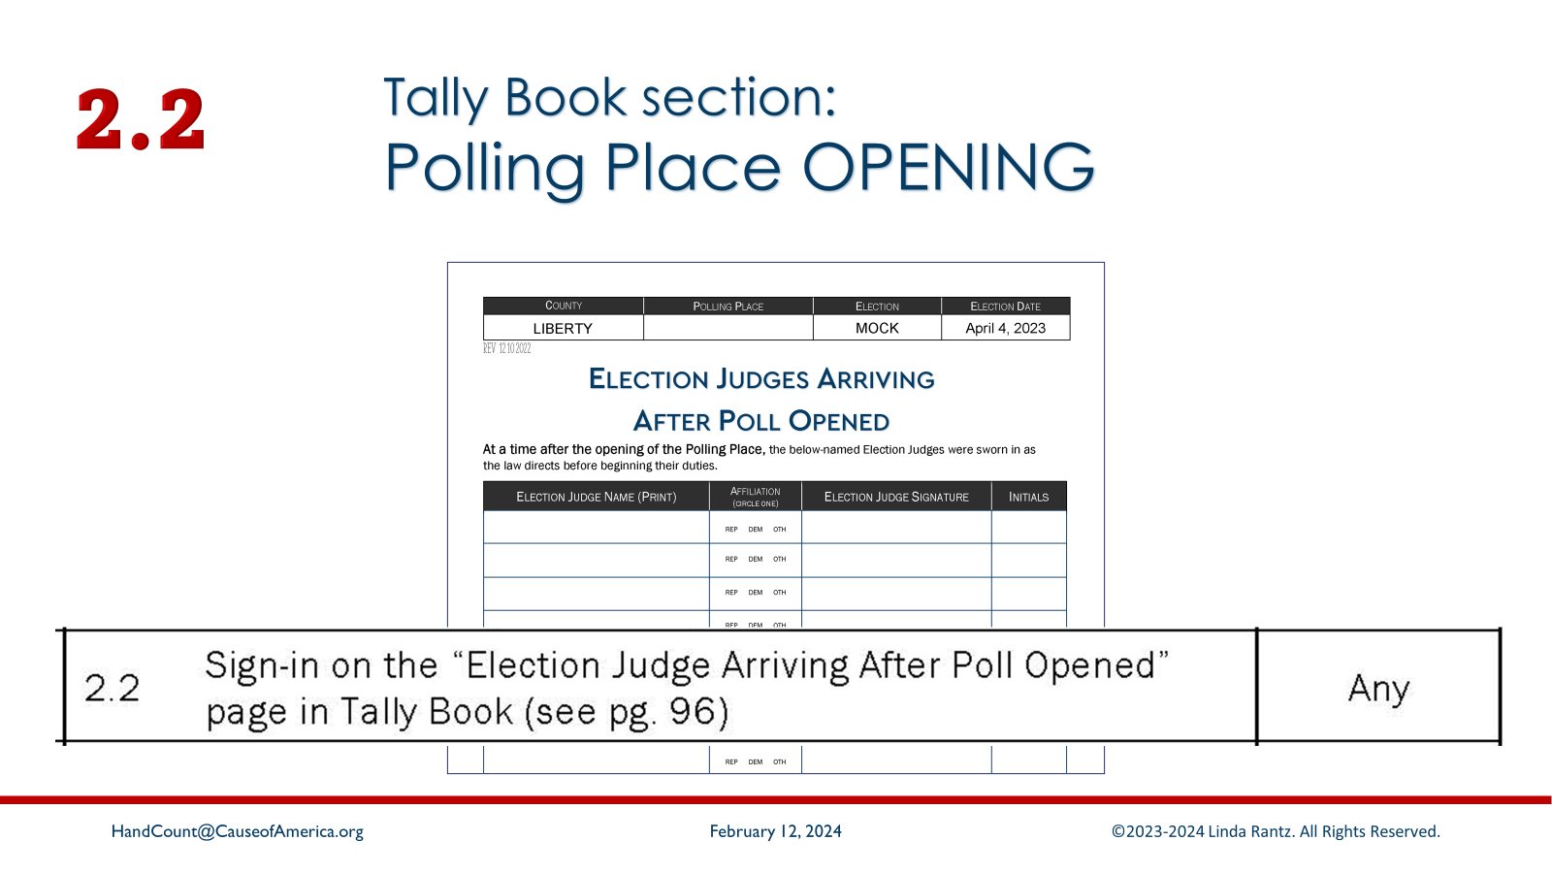
Notes:
[Read 2.2] In the Tally Book (Polling Place Opening section) is a separate sign-in sheet for judges arriving after the poll opened.

Slide 32
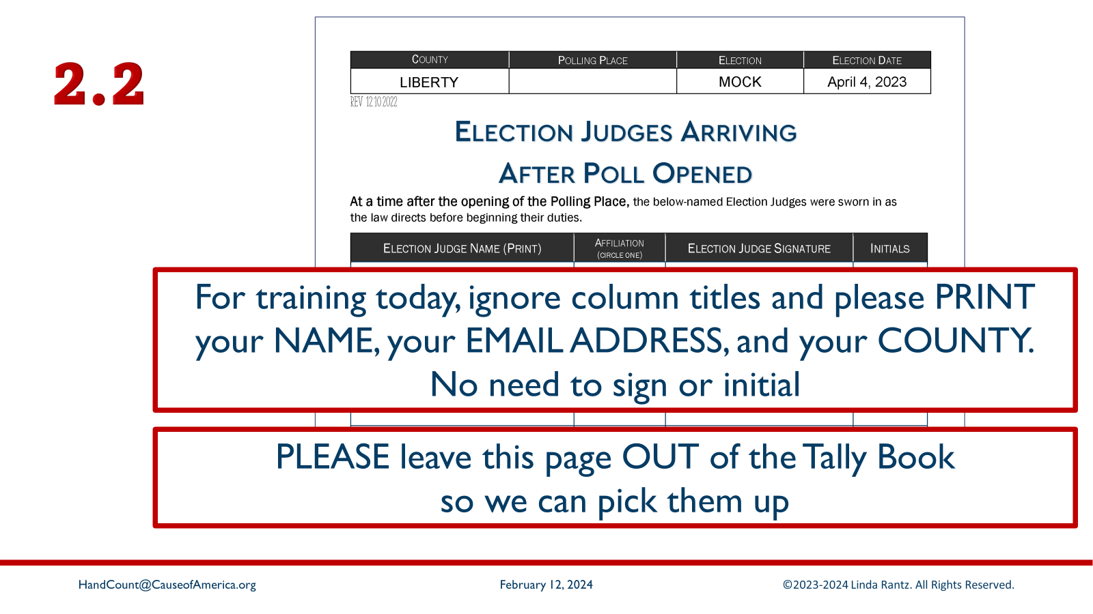
Notes:
Please remove this form from the Tally Book. For today’s training, IGNORE the column headings and just have everyone at your table WRITE their name, email address, and county. We do this so we can add you to the Cause of America database of hand count trainers. We will be sending updates, resources, and tips about hand counting.
Instructor: collect these sheets and send copies to HandCount@CauseofAmerica.org

Slide 33
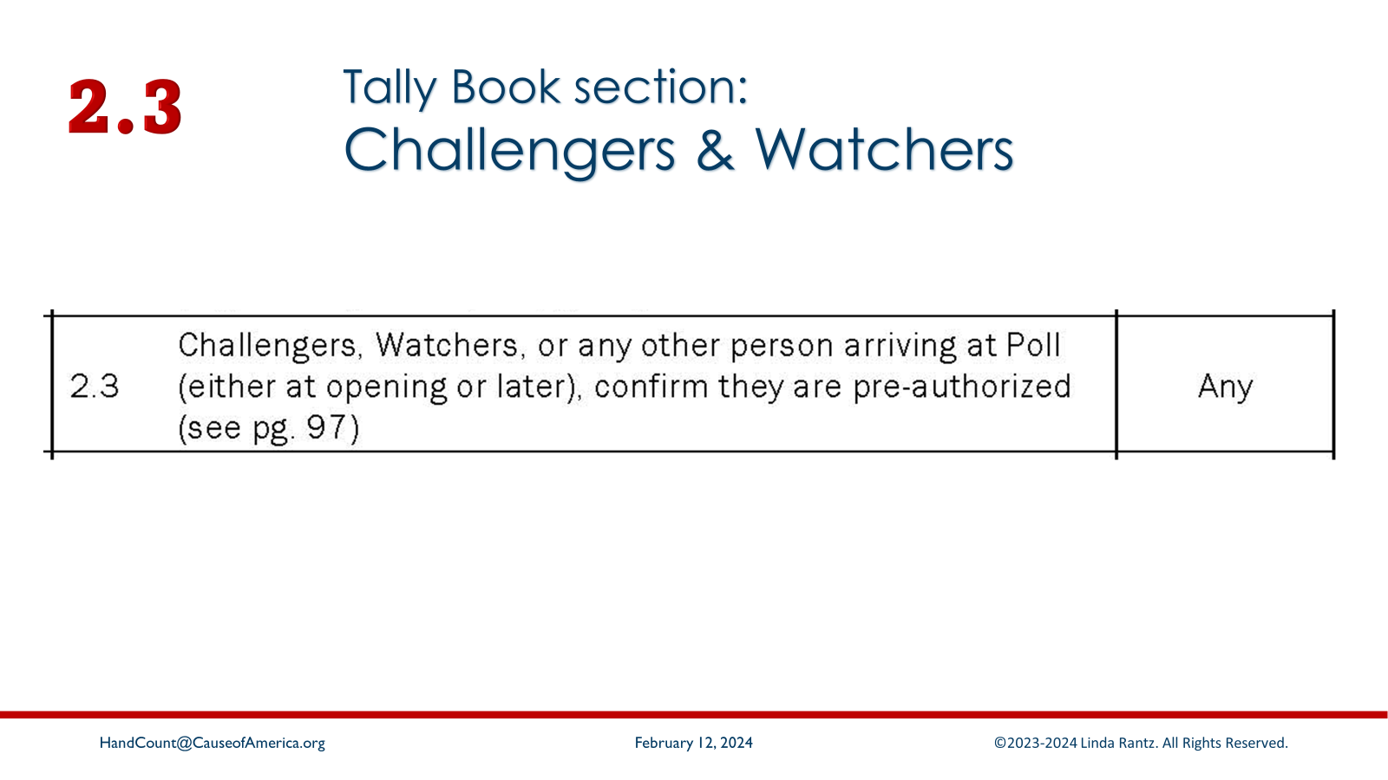
Notes:
[Read 2.3] In Missouri, there is a process for Challengers & Watchers to be appointed and permitted to be in the polling place. The clerk should have a list of authorized persons and, the suggestion is that they be in the Challengers & Watchers section of the Tally Book. In any case, all election judges have the duty of ensuring that those in the polling place are authorized.

Slide 34
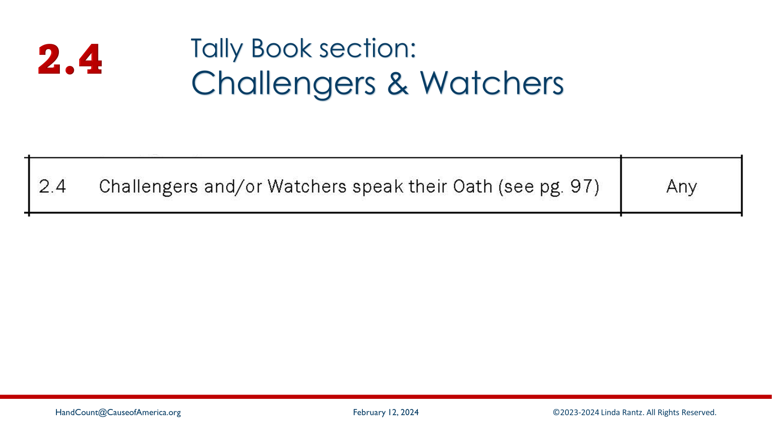
Notes:
[Read 2.4] Just as with election judges, the statutes say that challengers and watchers speak their oath – not that an oath is administered. The difference in this case, though, is that the oath must be witnessed.

Slide 35
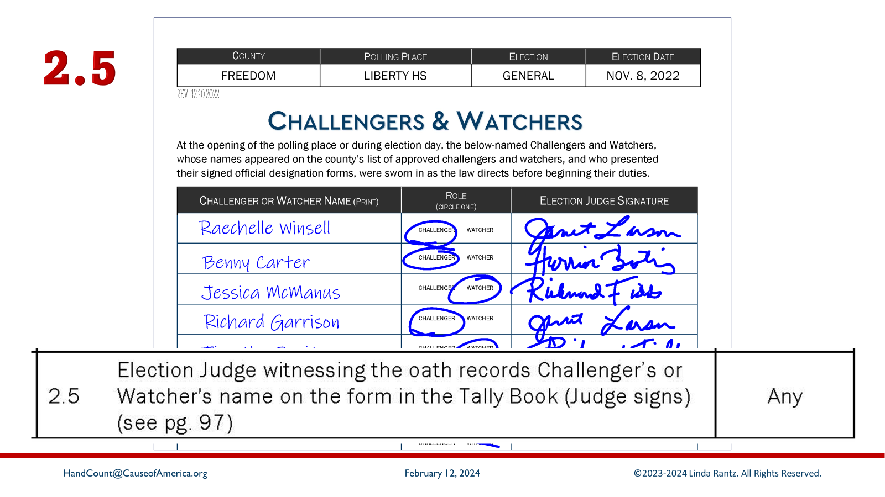
Notes:
[Read 2.5] Important here – the statute says that the election judge who witnessed the oath will record the challenger or watcher’s name in the tally book, and the ELECTION JUDGE signs that they witnessed the oath.
We covered challengers and watchers early because they could arrive before the poll opens, or they might come later in the day. That is true of observers, media, and anyone else authorized to be at the polling place. The steps, of course, are the same even if arrivals are later in the day.

Slide 36
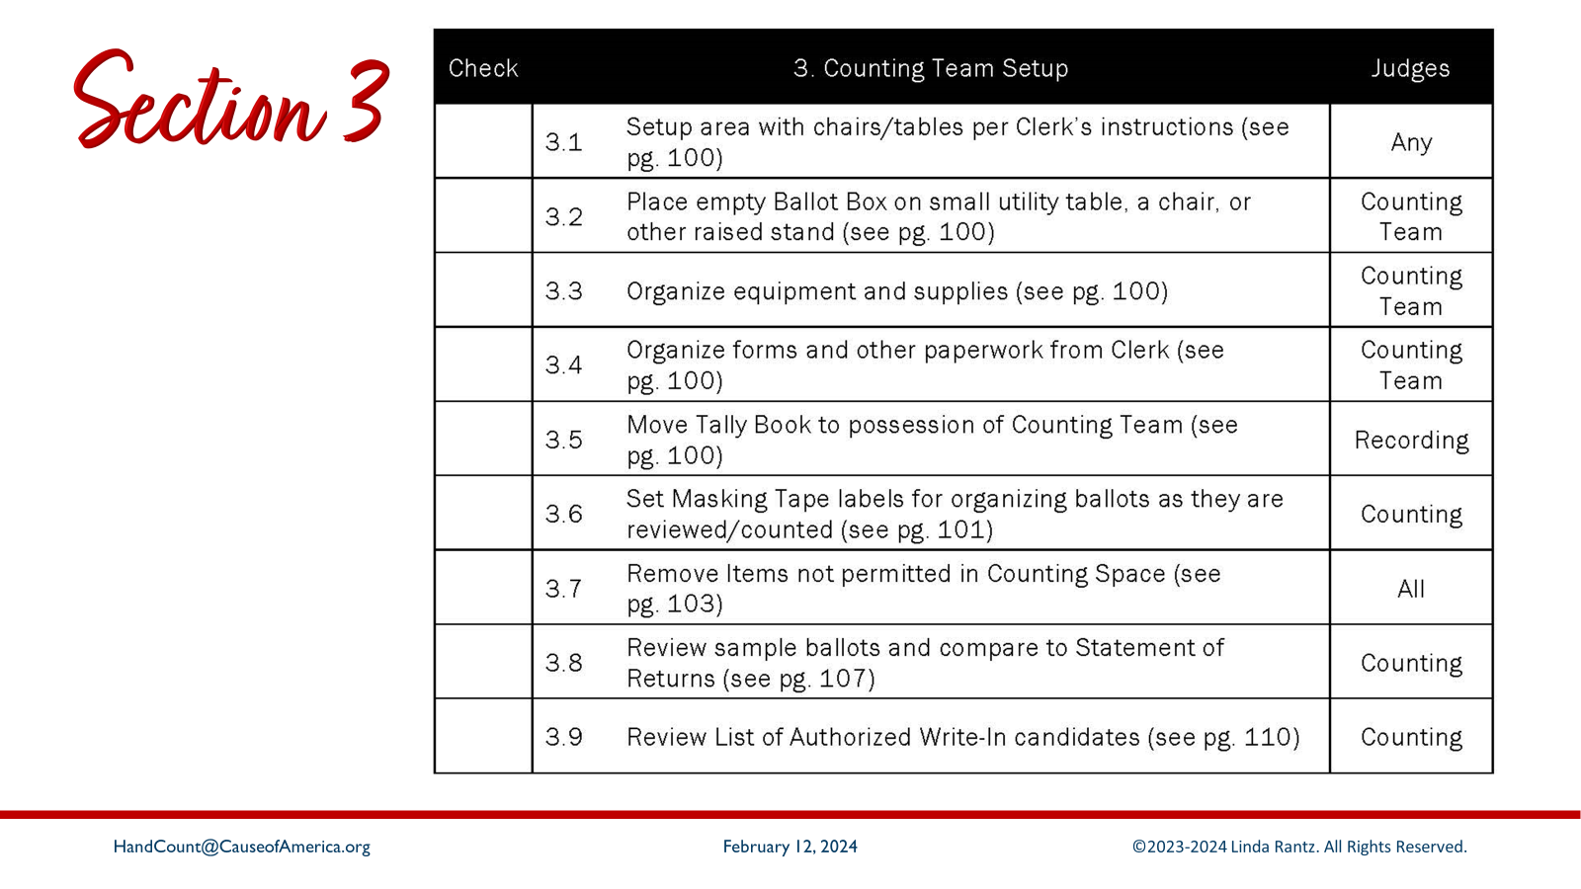
Notes:
Section 3 covers all the task the counting team needs to complete before they begin to tally ballots.

Slide 37
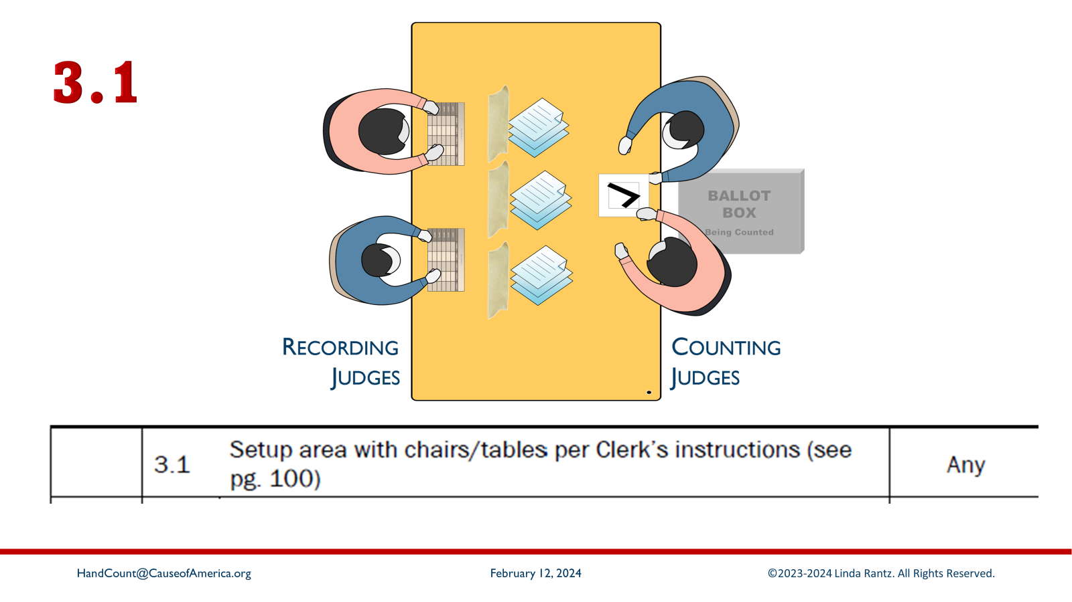
Notes:
[Read 3.1] Hopefully, the clerk provided instructions for the set up of the polling place, including the counting area. This is a good question to ask the clerk a few days before the election. Each counting team needs a table with 4 chairs – 2 on each side. If the tables are narrow, consider putting 2 tables together for more workspace. It is also helpful to have an extra supply table nearby, but not accessible by anyone who is not on the counting team.

Slide 38
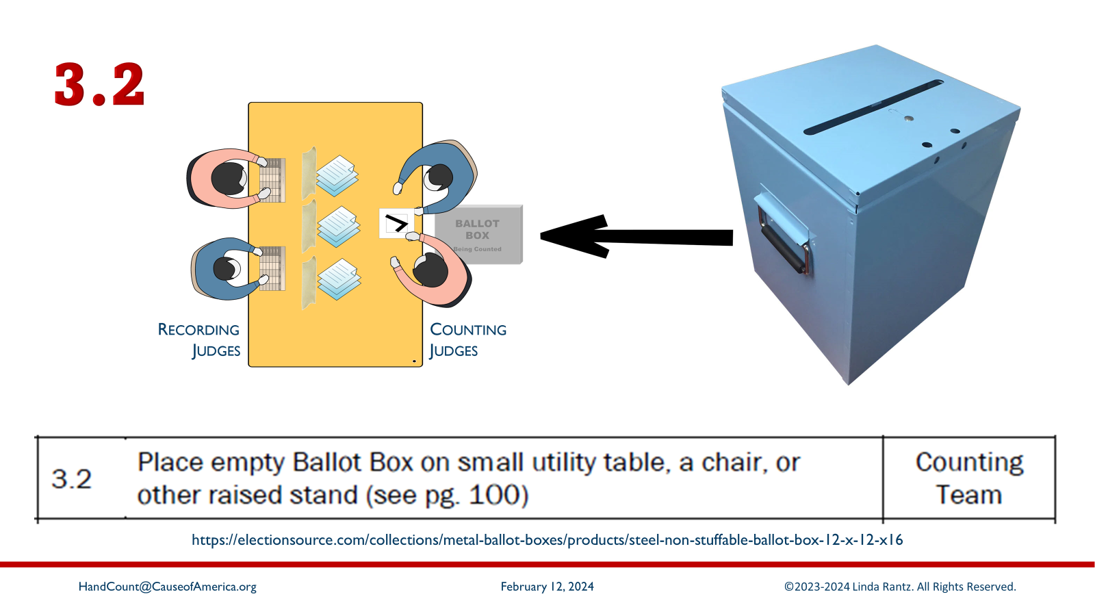
Notes:
[Read 3.2] Each counting team has one empty ballot box. The empty ballot box will be swapped later for a ballot box that ballots in it cast by voters. On one side of the table, add an extra chair or small utility table between the 2 judges to hold the ballot box.
[Ballot box suggestion: https://electionsource.com/collections/metal-ballot-boxes/products/steel-non-stuffable-ballot-box-12-x-12-x16]

Slide 39
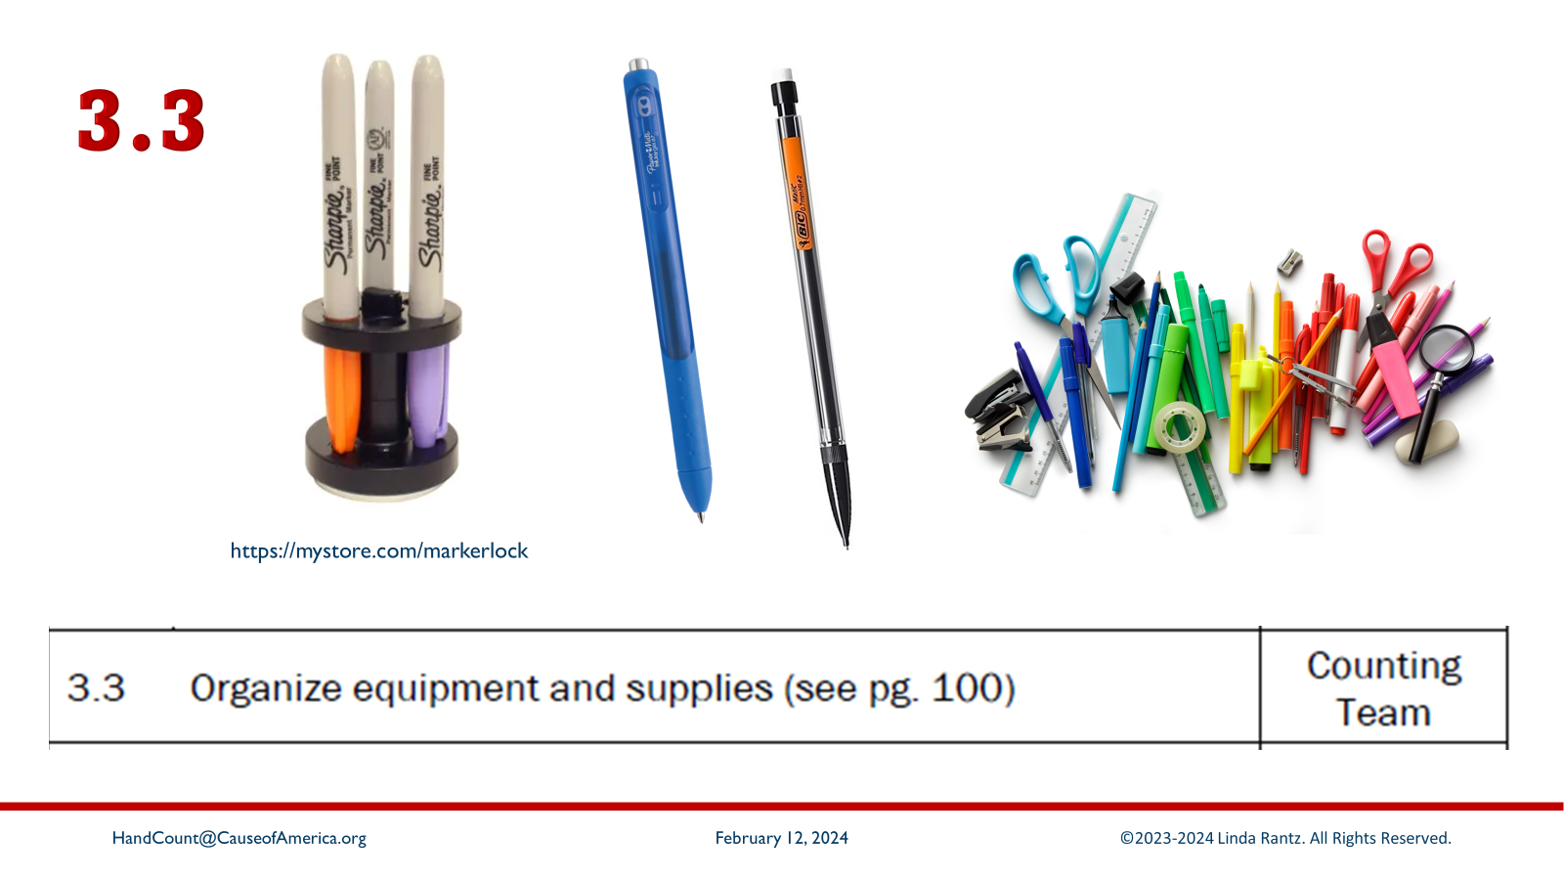
Notes:
[Read 3.3] During training, you will learn about all the supplies needed for hand counting, but a few are highlighted.
** Sharpies: Tallying is done with Sharpie-style markers. It is suggested the clerk supply 4 Sharpies for each team. As added security, do not use regular red, blue, green, or black. Instead, use non-standard colors. Also, the clerk might track which colors are sent to each polling place. If there are questions about the validity of tally sheets turned into the clerk, the first check could be whether that ink color had been provided to the polling place.
** Blue ballpoint pens: Sharpies are only for tallying/dabbing. Everything else should be done in blue ballpoint. Avoid black because it is easy to photocopy and reprint.
** Pencils (suggest mechanical pencils with white erasers) are used for noting tallying errors. They should not be used for any other purpose.
** Other supplies, items such as binder clips, paper clips, tape, etc. may also be provided by the clerk.

Slide 40
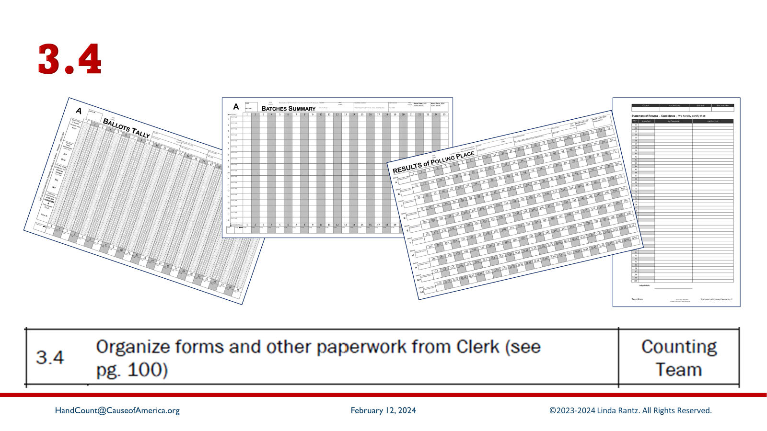
Notes:
[Read 3.4] Based on the anticipated turnout in the polling place, the clerk should provide plenty of forms to complete the hand count process. These forms should be always secured and kept near the counting team. No other person should have access to these blank forms.

Slide 41
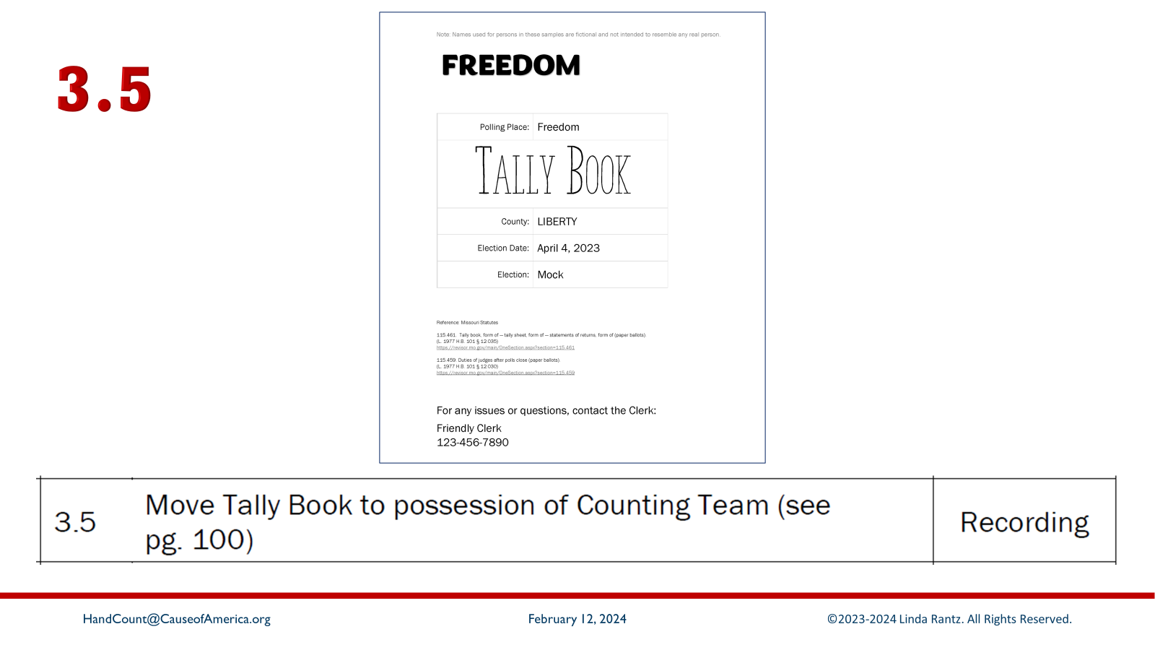
Notes:
[Read 3.5] As taught in Section 1, the Tally Book would be used by the election judges who open the polling place, and they should keep it secure throughout election day. At the point that the counting team has their area set up, the Tally Book should be transferred from the Receiving Judges (those checking voters at the entrance) to the counting team.

Slide 42
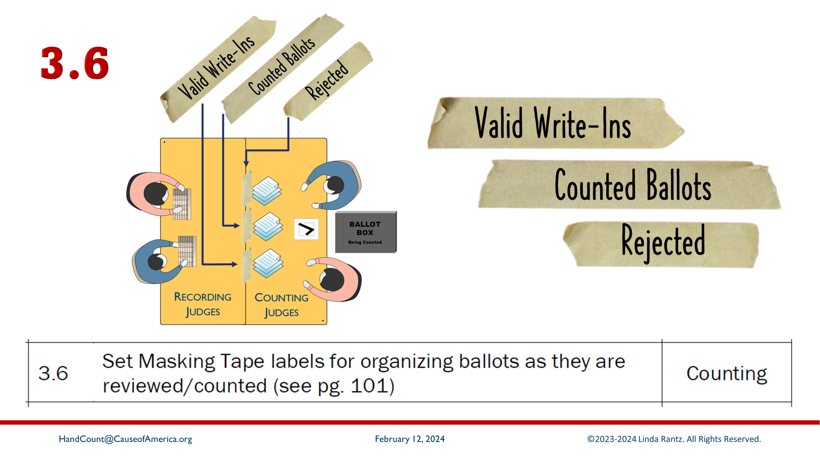
Notes:
[Read 3.6] Three pieces of masking tape should already be placed on each table (depending on space, horizontal as shown in the image, or perpendicular, if space is limited). Instruct the teams to use a dark Sharpie and write as large as possible, “Counted Ballots” on the center piece, “Valid Write-Ins” and “Rejected” on the 2 outside pieces of tape.

Slide 43
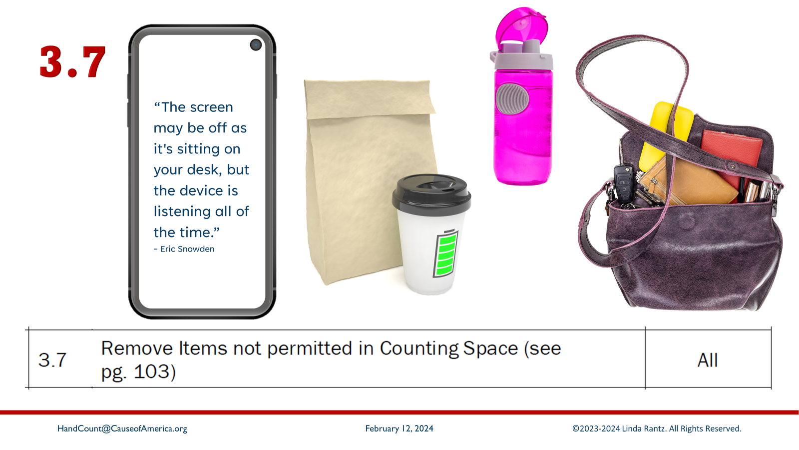
Notes:
[Read 3.7] Items not permitted near the counting area will be the decision of the clerk. These are suggestions:
- cell phones or any digital devices (including smart watches)
- beverages and food
- even water bottles
- personal bags
Where should they be? Nearby, secure, but out of reach.

Slide 44
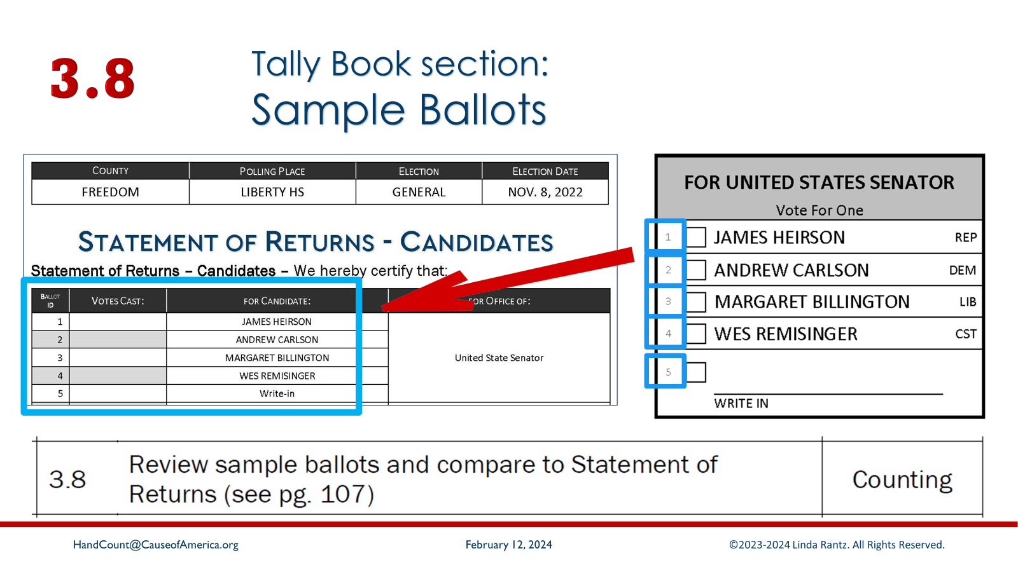
Notes:
[Read 3.8] While not required by statutes or rules, the numbering system for candidates and questions requires due diligence of double-checking the ballots. Imagine the error if the number printed for a candidate on a ballot is not the accurate number and belongs to another candidate. This double-check could be a time-consuming task but is very important.

Slide 45
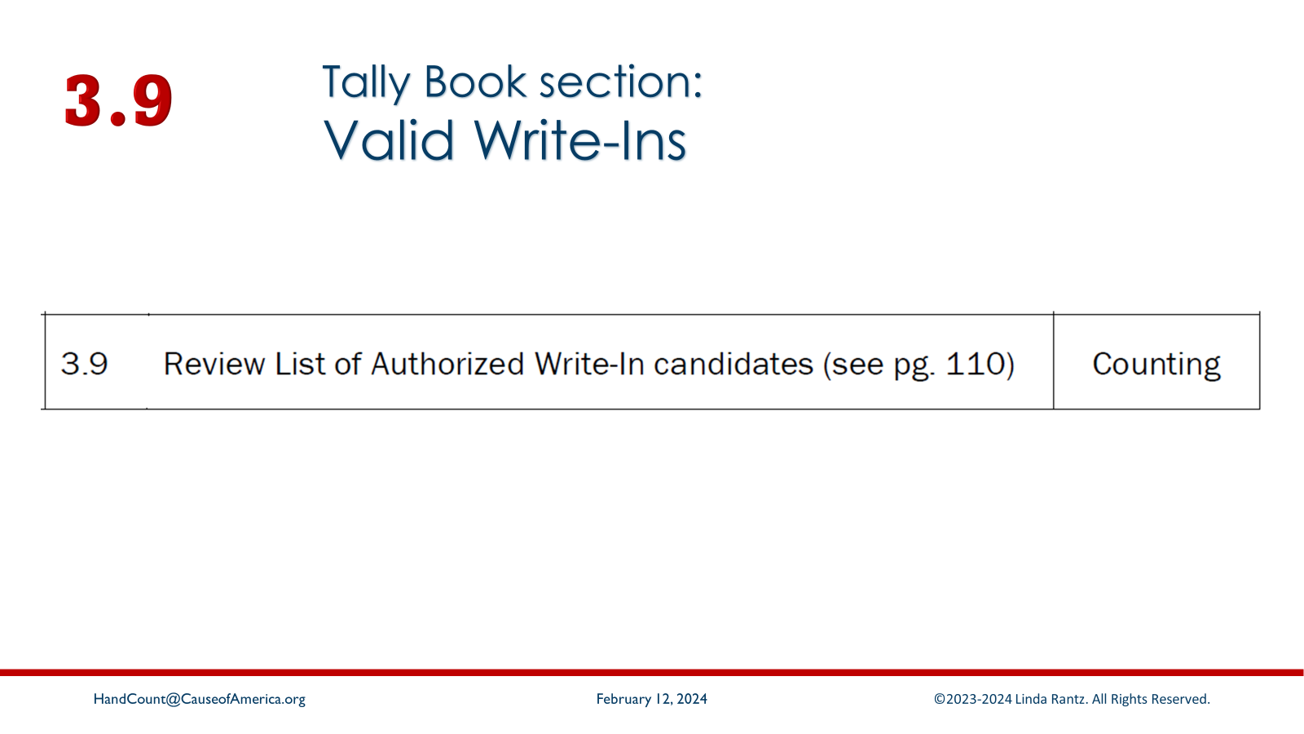
Notes:
[Read 3.9] In Missouri, writing in a candidate is permitted in some elections but it must be someone who registered as a write-in candidate. The clerk should provide a list of the races with valid write-ins, and the names of persons who are valid for those races.
Recommend a 7-minute break before next slide

Slide 46
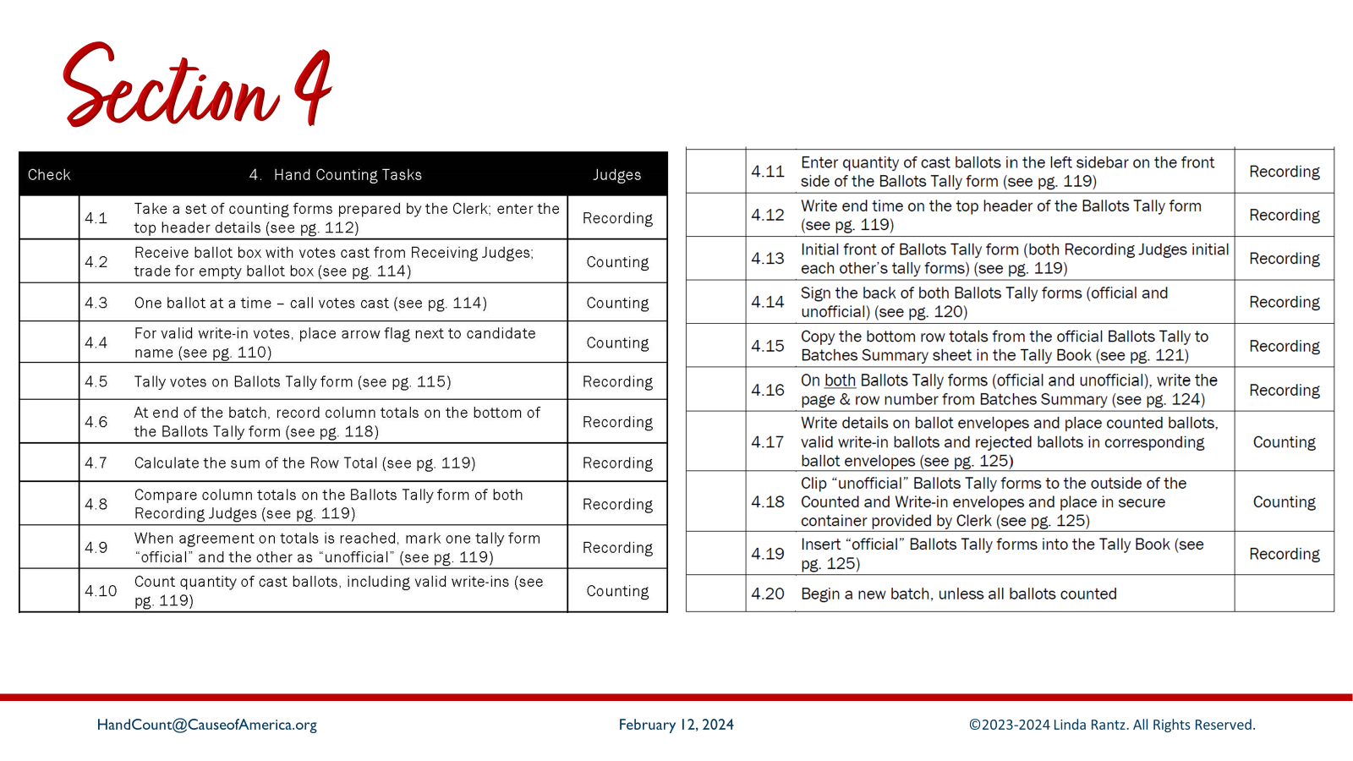
Notes:
Section 4 covers the process of tallying the votes on the ballots.

Slide 47
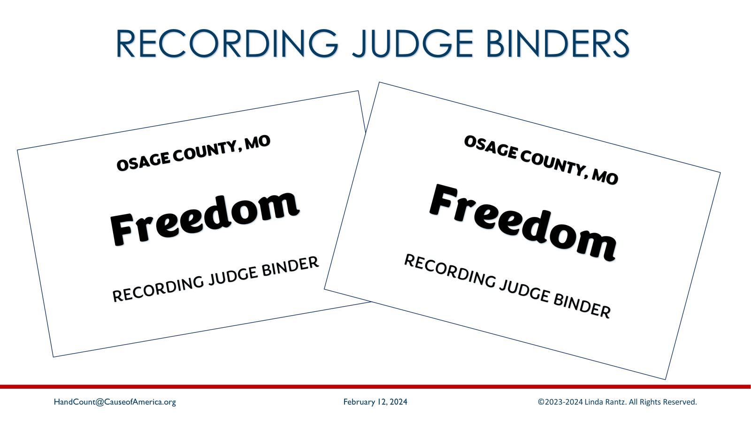
Notes:
Each counting team has 2 Recording Judge Binders. They will be used by the 2 judges on the side of the table WITHOUT the ballot box. It should be 1 Democrat and 1 Republican. For an actual election, the binders would be empty, except for the cardstock used in between the tally sheets. For training purposes, the forms for the 1st batch are already in the binders and a 2nd set of forms is in the inside pocket of the binder.

Slide 48
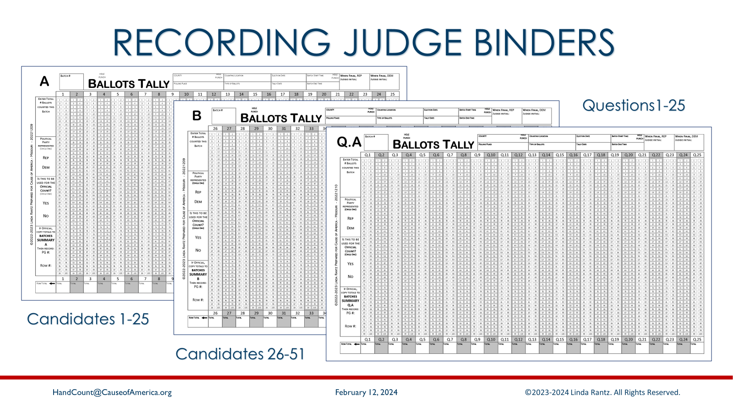
Notes:
Point out to attendees that the tally sheets are identified by “Group” letters, which are visible in the upper left corner.
- Group A has columns 1 thru 25 for the candidates who were assigned those numbers.
- Group B is 26 thru 50
- Group Q.A has columns Q.1 thru Q.25, for questions on the ballots.
If the ballots had more candidates or questions, additional groups would be added (such as Group C for 51 thru 75).

Slide 49
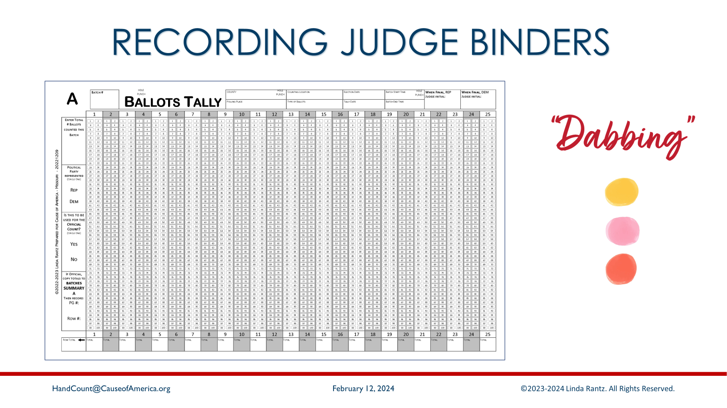
Notes:
These Ballots Tally forms are the only place Sharpies are used. For speed and efficiency, be sure to “dab” – don’t try to fill in the ovals. (That was the psyop).

Slide 50
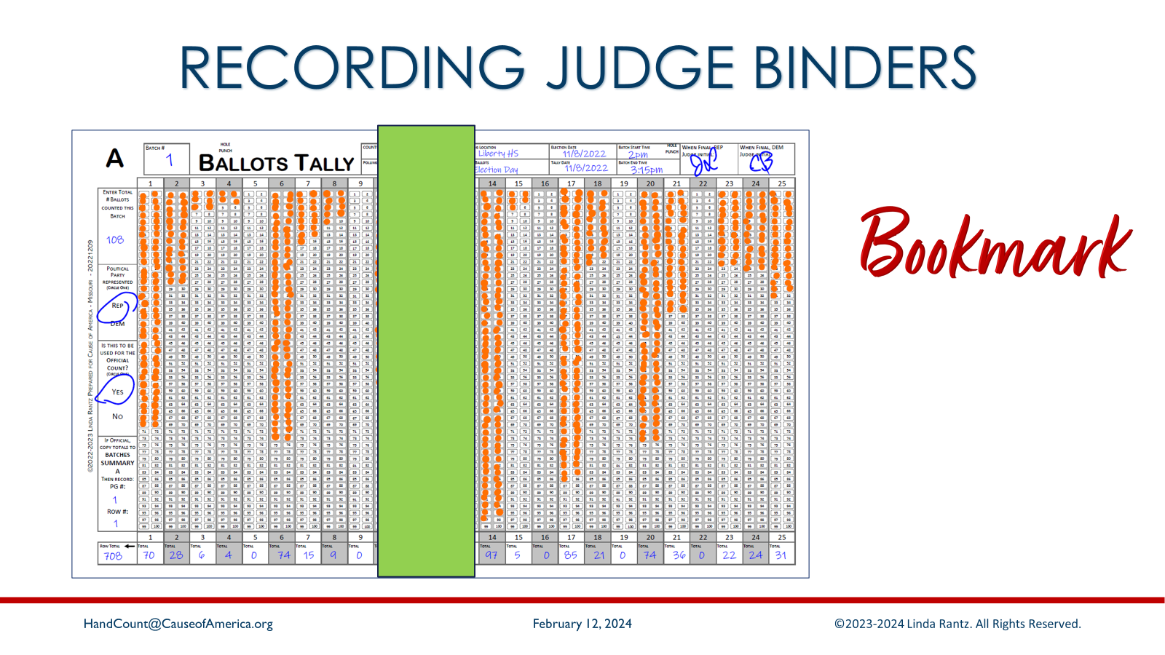
Notes:
Another simple tool is a piece of cardstock to use as a bookmark. If you line the bookmark up alongside the columns, it will help with accuracy in dabbing the correct column. Especially when the dabs are getting further down the page.

Slide 51
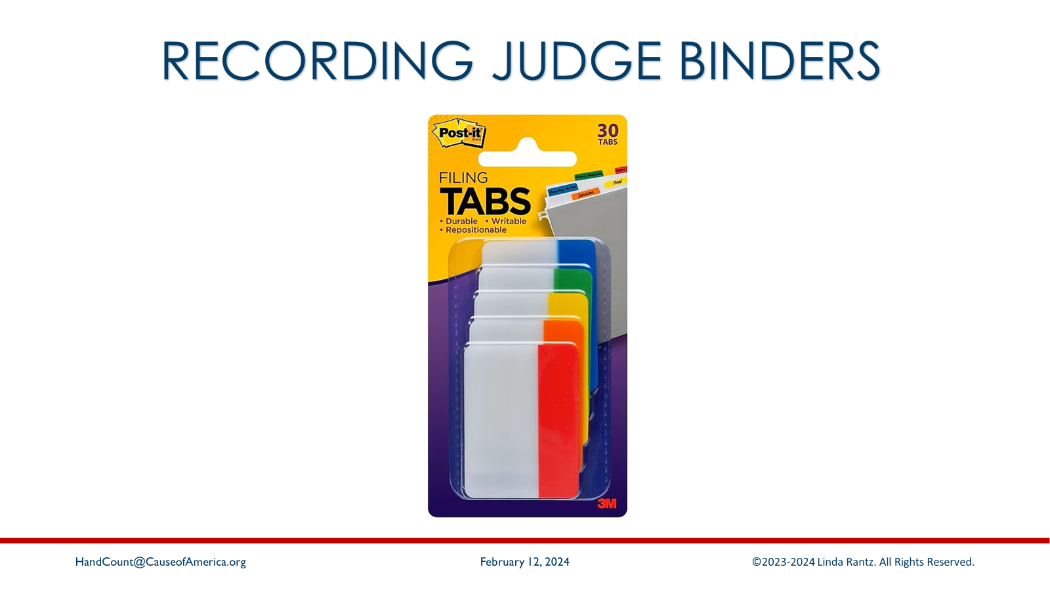
Notes:
As you move from Ballots Tally forms A to B to Q.A, you want to be able to “flip” the page comfortably. For left- or right-handed people, this can mean the tab for flipping needs to be in a different spot. The tabs are movable – so find a comfort spot.

Slide 52
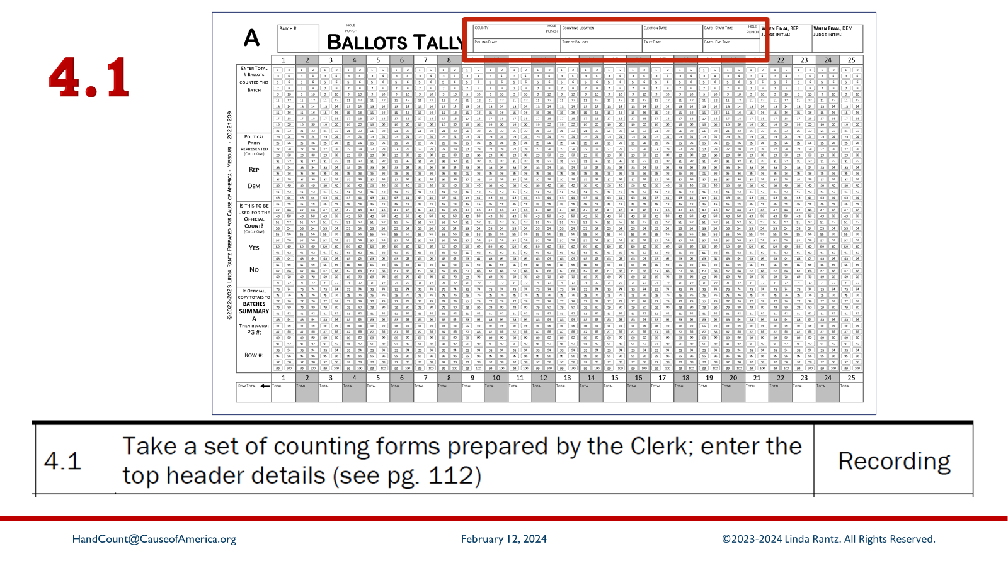
Notes:
[Read 4.1] Recommend that these NOT be completed for training (takes too much time) but point out the information that would be filled in, and that it would be done on all 3 Ballots Tally forms (A, B, Q.A)
SEE NEXT SLIDE FOR CLOSE UP

Slide 53
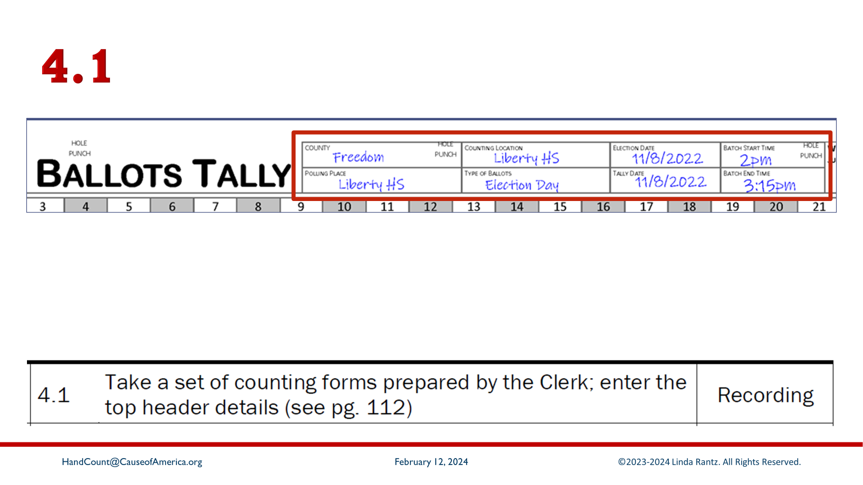
Notes:
Fields to complete: COUNTY; POLLING PLACE; COUNTING LOCATION (this hopefully is the same as the polling place, but might not be for absentee, provisional, or other ballot types); TYPE OF BALLOTS (election day, early, absentee, military, overseas, etc.); ELECTION DATE; TALLY DATE (might be different for ballots counted after election day, such as military); BATCH START TIME (for tracking purposes).

Slide 54

Notes:
[Read 4.2] When the counting team is ready to begin the first (or subsequent batches), they request the ballot box with ballots cast be brought to them by other election judges.
- First, Counting Judges demonstrate that the empty ballot box is truly empty (no false bottom).
- Before breaking the seal on the locked ballot box, the ID is checked against the list of security IDs.
- The ballot box with ballots is swapped with the empty ballot box.
- New security seal(s) are placed on the empty ballot box. The IDs are recorded as per the Clerk’s instructions.
- The sealed, empty ballot box is placed for voters to drop their cast ballots.
- The counting team begins to tally votes from the ballots in the unsealed ballot box.

Slide 55

Notes:
[Read 4.3] MO law specifically requires that only ONE ballot may be removed from the ballot box at a time. All votes on that ballot (front and back) must be called before pulling another ballot.
The first item to look at on Missouri ballots are the judges' initials. Initials of a Democrat and a Republican judge are required. If one or both initials are missing, the ballot must be REJECTED (no votes counted at all). However, there is an exception to this. If there is belief that the missing initials are a mistake of the election judges, the judges may make a decision to accept the ballot.

Slide 56

Notes:
[Read 4.4] If there is a VALID write-in, call the vote (corresponding number) and then put a post-it flag next to the name. This is done so that if there are multiple write-ins on the ballot, the Clerk will know which ones were accepted by the judges as being valid and, therefore, counted. To be a valid write-in, all the following must be true:
- The person is as a valid write-in for that office on the list from the clerk. (MO allows for variations or misspellings of names, such as Robert, Robbie, Robby, Bob, etc.)
- There must be a distinguishing mark in the box/bubble next to the person’s name.
- The person’s name must be written on the line.

Slide 57

Notes:
[Read 4.5] Offer a reminder about using the bookmark and re-emphasize “dabbing.”

Slide 58

Notes:
Handling dabbing mistakes. As an example, say a dab is placed in column 8, instead of column 7. The Recording Judge should ask the team to pause while they mark the mistake. (Good idea to say out load so any watchers or challengers know what is happening.)
1 – Use a pencil and circle the incorrect dab.
2 – Make a dab in the correct column.
3 – The next time a vote is called for a column with a circled dab, the Recording Judge asks the team to pause. They erase the pencil circle. NO other dab is made.
Questions about what to do if there are no more votes for that column and the pencil circle remains are answered in step 4.6

Slide 59

Notes:
When all votes on a ballot have been called and the ballot is complete, place it on the table in the appropriate section (Valid Write-Ins, Counted Ballots, Rejected). If votes were counted on the ballot, place it in the “Counted Ballots” pile. If a counted ballot had a valid write-in, it is INSTEAD placed in the “Valid Write-Ins” pile.
What is a rejected ballot? In Missouri, the reason to reject an entire ballot is if there is 1) judges initials missing on the ballot, or 2) there is not a single valid vote on the ballot – nothing to count.
Training teams are about to receive ballots to count. Before handing out ballots, go to the next slide.

Slide 60

Notes:
The training to tally votes in a Train the Trainers class is done by performing a mock election. The ballots that teams will receive to tally will have some “issues” in them. Please alert the instructor when you come upon a ballot with an “issue.” If the topic has not been covered yet, the instructor will ask the entire class to “PAUSE.” Then, the question will be answered so everyone has the same information.
It is so important that everyone PAUSE when asked to, including stopping all private discussions. Experience has shown that teams that do not pause to hear the information tend to fall behind and start asking the same questions previously answered. It is also disrupting to the rest of the class when some teams continue private discussions.
Please help the instructor and the class by pausing when asked, paying attention, and being patient with the interruptions.
At this point, hand out ballots and allow the teams to begin tallying votes.
Recommend giving teams about 20 minutes to tally as many ballots as they are able, but no more than 30 minutes. As time is running short, give a warning of “last ballot.” Recommend a 10-minute break before beginning next slide.

Slide 61

Notes:
Instruct Recording Judges to remove the 3 Ballots Tally forms from their binders. Using blue ball point pen, go through each Ballots Tally form (A, B, Q.A) and FIND any pencil circled dabs that were not able to be erased. Use blue ballpoint pen to “X” out the pencil-circled dab, and both Recording Judges initial near the “X”.

Slide 62

Notes:
[Read 4.6] Using blue ball point pen, go through each Ballots Tally form (A, B, Q.A) and write each column total in the bottom row.
- If there are any pencil circles with an “X”, subtract that “dab” from the column total.
- Enter Zero in any columns with no tallies.
During training, experience has been that some trainees will try to match up numbers during tallying or check their totals before writing them in the totals row. In an actual election, this may appear suspicious to observers. Encourage trainees to complete their tally forms themselves and wait for step 4.8 to compare totals. That said, to save time, suggest that the other judges on the team assist with totaling these forms.

Slide 63

Notes:
[Read 4.7] Explain the purpose of totaling the totals row across. BUT, for training, tell teams NOT to total the row (takes too much time).

Slide 64

Notes:
[Read 4.8] At this point, the ‘Republican’ and the ‘Democrat’ overlay their ballots tally forms and compare the totals. Explain how to reconcile discrepancies and give some time to correct errors. However, some teams will have more errors or spend significant time trying to reconcile. This step can slow down training and use up valuable time. If some teams are struggling, tell them to just pick a form as the correct one and move on. This is a bad place for a team to fall behind.

Slide 65

Notes:
[Read 4.9] The 2 Recording Judges take the 6 Ballots Tally forms (2 Group A, 2 Group B, and 2 Group Q.A), and mark one from each group “Yes” and the other “No” (in the center box of the left sidebar). The purpose is that the “Yes” will be considered the official form for that group and will eventually go into the Tally Book. The “No” is unofficial and will be clipped to the envelopes containing counted ballots. It does not matter which forms are official, and they can be two from 1 judge and one from the other judge.

Slide 66

Notes:
The next box up on the form is for party affiliation. Explain that even though some steps are being skipped in training, in an actual election every box is intended to be completed. There are no fields on these forms which should be blank at the end of an election.

Slide 67

Notes:
[Read 4.10] The Counting Judges (those who read off the votes) should be counting the quantity of the ballots counted. This includes “counted” and “write-in” ballots. Do NOT count “rejected” ballots. This is also an opportune time to mention that it is suggested that the 2 Counting Judges should be the only ones who handle ballots. During reconciliation of the Ballots Tally forms, the Counting Judges are the only ones who should go back through the ballots to check vote totals. Likewise, the Recording Judges (those who tallied) should be the only ones who handle or write on the tally forms. (Although for training, to expedite things, it is recommended to have all 4 judges help finish up the paperwork.)

Slide 68

Notes:
[Read 4.11] The Counting Judges tell the Recording Judges the quantity of ballots counted. The Recording Judges write it in the top box of the left sidebar on every Ballots Tally form.

Slide 69

Notes:
[Read 4.12] In a real election, the team should enter the time they completed the batch – which is about now, when they are finalizing the paperwork. For training, this is optional.

Slide 70

Notes:
[Read 4.13] This is required for an election – optional for training.

Slide 71

Notes:
[Read 4.14] No need to sign during training. Explain the importance of signing during an actual election.
At this point, instruct the teams to divide their Ballots Tally forms into 2 piles. The unofficial into one pile, and the official into a separate pile.

Slide 72

Notes:
Instruct the Teams to open their Tally Book to the Section for Group A, and remove the sheet titled, “Batches Summary.” They should note the letter “A” in the upper left corner.

Slide 73

Notes:
[Read 4.15] The Group A Ballots Tally form is overlaid at the top of the Group A Batches Summary sheet. (Important to be sure the teams to line these up properly.) The totals from the bottom of the Ballots Tally form are transferred onto the highest blank row of the Batches Summary sheet. Discourage the approach of one person reading the numbers while another person writes them down. There will be observers watching and they should see the 2 forms lined up and the numbers matching.

Slide 74

Notes:
[Read 4.16] Take the page number (top of the Batches Summary) and row number (left-most column of Batches Summary) and write that information in the bottom box of the left sidebar of the Ballots Tally form.
Repeat 4.15 and 4.16 for Groups B and Q.A

Slide 75

Notes:
If not already done, hand out envelopes for Counted and Write-In ballots. The Rejected envelope is not needed until the final batch.
[Read 4.17] For training purposes, some areas have red boxes showing info to be filled in. Other information was pre-filled. Depending on time, completing the information may be skipped. It is suggested that, if information is filled in, ask that it be done with pencil so it can be erased, and the envelope reused.

Slide 76

Notes:
[Read 4.18] ONLY ballots should be placed in the envelopes. In an official election, the envelopes will be sealed with some sort of security tape. The Unofficial Ballot Tally forms would be ‘clipped’ to the OUTSIDE of the envelopes. (Binder clips are the best, but if not given out during training, just have the teams place the Ballots Tally forms on top of the envelopes.) There should be a secure container of some sort provided by the clerk for transporting ballots to and from the polling place. Whatever contain is provided, counted ballots are placed in the container to be held until the poll is closed and all ballots counted.

Slide 77

Notes:
[Read 4.19] Place the “official” Ballots Tally forms and the Batches Summary sheets in the Tally Book in their respective sections.

Slide 78

Notes:
[Read 4.20] Explain that all the paperwork should be completed for Batch 1
Recommend a 10-minute break. Before ‘dismissing,’ explain that when attendees return from break, the team members should switch roles. They should now know what to do to be prepared for another batch of ballots (encourage them to look at the checklist). They can get their Recording Judge binders set up. When they are ready to begin counting, they need to flag an instructor who will deliver another batch of ballots.
During the break, collect the envelopes of counted and write-in ballots, along with any uncounted ballots. Each team will start with a fresh batch of ballots.

Slide 79

Notes:
After all ballots have been counted, the election results are totaled and certified. This is covered in Section 5.
Note to Instructor: Before proceeding, it is important to make sure all teams are at the same point. All that should remain on their table, after completing Batch #2, is the Tally Book and blue ball point pens (of course, their checklist and notepads are fine). All the unofficial Ballots Tally forms with the ballot envelopes, uncounted ballots, Recording Judge Binders, Sharpies, and pencils can all be taken off the table.

Slide 80

Notes:
In the Tally Book, Section for Group A, remove the Batches Summary sheet. Repeat for Group B and Group Q.A. Give one Batches Summary sheet to 3 of the team members.

Slide 81

Notes:
[Read 5.1] For each Batches Summary sheet, add the numbers in each column and write the total in the bottom row. The recommendation for calculators at the polling places are cheap, no-features, no-WiFi enabled calculators. After the polls close, using cell phones or more advanced calculators could be permitted.

Slide 82

Notes:
[Read 5.2] Preface this step by telling teams NOT to do it for training (takes too much time). Explain the purpose of adding the columns totals to produce a total number of votes counted. That number goes in the 2nd box from the left on the totals row.

Slide 83

Notes:
[Read 5.3] As in the previous step, preface this by telling teams NOT to do this for training. The purpose is to add the numbers from the left-hand column of the Batches Summary to produce the total of votes counted. That number goes in the left box of the totals row.

Slide 84

Notes:
[Read 5.4] The total sum of votes counted produced by adding the left-hand column should match the total from the bottom row. If they do not match, there is either a simple addition error or some other error that needs to be reconciled. Since the numbers were not calculated for training, there should be no numbers here to compare. Someone may have run the totals and might have a discrepancy, but there is no time during training to locate it.

Slide 85

Notes:
[Read 5.5] As before, no need to initial and sign during training, but explain the purpose.

Slide 86

Notes:
[Read 5.6] Unused rows or columns may be crossed out on the Batches Summary sheet.

Slide 87

Notes:
In the Tally Book, go to the Polling Place CLOSING section. Leave the title page but remove all other pages in the section. These are the documents that are in this section:
- One copy of the Certification of Ballots Counts form
- One copy of the Results of Polling Place
- Two copies of the Statement of Returns and Certification
For now, put everything aside except the Results of Polling Place

Slide 88

Notes:
[Read 5.7] Starting with the Batches Summary for Group A (circled in red), overlay the Batches Summary form on top of the Results of Polling Place so that the Batches Summary totals are right above the blank row for Group A (circled in red) on the Results of Polling Place. Copy the totals from the Batches Summary to the Results of Polling Place.
Where the Batches Summary shows the total # of pages used (circled in green), copy that number to the “# Summary Sheets” box on the Results of Polling Place (circled in green).
Repeat for Group B and Group Q.A.

Slide 89

Notes:
[Read 5.8] No need to initial and sign for training but explain the step. Only 2 judges needed to initial the front of the Results of Polling Place. It is a recommendation that all 4 judges on the counting team sign on the back of the form.

Slide 90

Notes:
[Read 5.9] From their Polling Place CLOSING documents, have trainees take out the TWO sets of Statement of Returns. There are 2 copies of Statement of Returns for CANDIDATES, two copies for QUESTIONS, and 2 copies of Statement of Returns Certification. Copy the vote totals from the Results of Polling Place to the Statement of Returns. Example, on Results of Polling Place, Group A, Box 1, the total is 275. On the Statement of Returns for Candidates, go to Line 1, enter 275.

Slide 91

Notes:
[Read 5.10] Complete the Statement of Returns Certification by having all 4 election judges on the counting team sign the form (this is a recommendation, not statute).

Slide 92

Notes:
[Read 5.11] From the Polling Place CLOSING documents, only the Certification of Ballot Counts remains. The top section is to reconcile the ballot counts … comparing what the clerk sent to the polling place against what is being returned. This form was prepared for Missouri based on the specifics of the statute but, unfortunately, it means that it would not actually reconcile properly.
For training purposes, the top box (number of ballots received) can be filled in. That number is in the Polling Place OPENING section of the Tally Book, on the Opening Certification & Election Judges Sign-in Form. It is suggested that the rest be ignored (for training).

Slide 93

Notes:
[Read 5.12] It is a recommendation that all election judges still at the polling place sign the Certification of Ballot Counts.

Slide 94

Notes:
In the Tally Book, go to the Polling Place CLOSING section. Leave the title page but remove all other pages in the section. These are the documents that are in this section:
- One copy of the Certification of Ballots Counts form
- One copy of the Results of Polling Place
- Two copies of the Statement of Returns and Certification
For now, put everything aside except the Results of Polling Place

Slide 95

Notes:
[Read 5.13] One Republican and one Democrat, traveling separately, will return the election results to the clerk. One of them takes the Tally Book, which contains the official Ballots Tally Forms, Batches Summary sheets, Results of Polling Place, a copy of the Statements of Returns for Candidates and Questions with a certification, and sign in sheets. The other person takes the locked security container with the ballots (cast and blank), unofficial Ballots Tally Forms, and a copy of the Statements of Returns for Candidates and Questions with a certification.
All the supplies from the polling place are also packed and returned to the Clerk. The polling place will be completely cleared of all election materials at this point.
Instructor: optional – offer attendees to take any of the forms they filled in during training to keep as reference. EMPHASIZE to take only forms they wrote on, and leave everything else, as it is reused in future classes.

Slide 96

Notes:
Col. Shawn Smith (USAF Ret.) of Cause of America remarked that he felt hand counting is the victory gardens of our day. During WWII, with the need to care for troops overseas and the Homefront, citizens stepped up and began planting gardens to grow food.

Slide 97

Notes:
As citizens, we have also always been able to manage our own elections. Only in recent times, with the advent of computerized voting systems, have we been told we are unnecessary or incapable.

Slide 98

Notes:
The truth is that we are fully capable of managing our elections, including hand counting. This method you have learned was used in an official election in Osage County, Missouri, on April 4, 2023, with 100% accuracy.

Slide 99

Notes:
Calls to Action for hand counting: Tally Demo, this changes the narrative and shows people in 2 minutes that HAND COUNTING IS EASY.

Slide 100

Notes:
Everyone who completes a Train the Trainers is qualified to teach “Express Training.” This is a condensed, 60-minute training course. Many people are willing to hand count, but not able to commit to being trainers. Express Training bridges the gap.

Slide 101

Notes:
Materials to review, or use to train other trainers are available, including this slide deck.

Slide 102

Notes:
Stay in touch about hand counting – tips, events, materials, etc. Join FrankSocial.com and join the 2 hand counting groups: How Do We Hand Count (for anyone interested in hand counting), and Hand Count Trainers (specifically for those who are trained and qualified to teach hand counting).

Slide 103

Notes:
Resources for hand counting

