Slide 1
Library Guild
IPRA Guide
Library Guild
Cynthia Canner
January 2023 Revision

Slide 2
This guide is intended to assist with sending IPRA requests for CVR. Going through the process can be an educational experience for all of us.
We will become more fluent with regulations and laws in place related to election integrity.
We also will gain experience with rebuttals in response to denials and document person responsible for actions taken.
We can become an IPRA powerhouse as a coordinated group to collect valuable information we need for our endeavors.
This guide will cover:
What is IPRA | Enforcement
NM IPRA Compliance Guide | Legal References Related to Elections
Examples of Useful Public Records | Look Up NM Statutory Citations
Procedure for Requesting Public Records for Inspection | Request Templates
Procedure for Inspection | Rebuttals
Procedure for Denied Requests | Tips

Slide 3
What iS IPRA?
Information Public Records Act outlines the public’s right to inspect public records intended to provide the greatest possible information regarding the affairs of government and the official acts of public officers and employees.
NMSA 1978, Chapter 14 (Records, Rules, Legal Notices, Oaths), Article 2 (Inspection of Public Records)

Slide 4
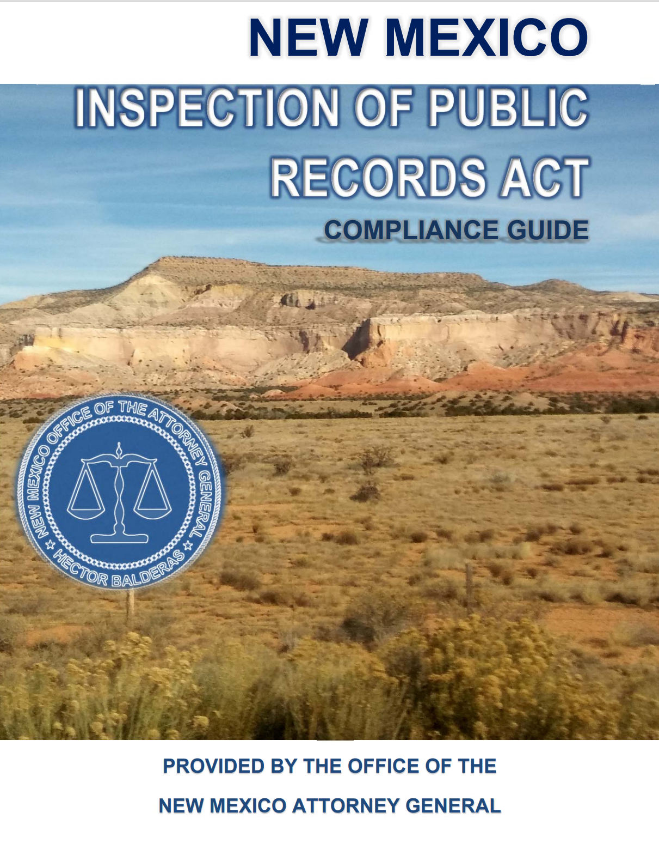
NM IPRA Compliance Guide
Eighth Edition 2015
Available from NM Attorney General Website:
. https://www.nmag.gov/get-help/inspection-of-public-records-act/
. https://www.nmag.gov/wp-content/uploads/2021/11/Inspection-of-Public-Records-Compliance-Guide-2015.pdf
This useful guide assists with resolving recurring questions about the Act’s applicability in particular situations with commentaries.
Appendix contains template forms for records custodian responses, public notice describing procedure and compliance checklist for custodian.
[Office of Attorney General will answer questions from members of the public and government agencies concerning the application of the Act. Otherwise direct questions to an attorney. ]

Slide 5
Public records are useful for
Election integrity research
EXAMPLES:
Cast Vote Records (CVR)
Tabulator purchases
Oaths, Bonds, Surety
Official Communications
3rd party contracts: HAVA, ERIC, Dominion
Programs in use (software, hardware, State Canvass)
Protocols used for choosing counties and precinct during State canvass
Think of a good one to do? Share!

Slide 6
Procedures for Requesting
Public Records for Inspection
Request must be submitted to records custodian. Each county is different: normally the records custodian is the County Clerk but for some counties it may be delegated to someone else such as County Attorney /Manager/Chief Bureau of Election or an employee specifically designated as Records Custodian.
  If custodian is not specified on county website - I usually submit request County Clerk to begin with. S/he will be responsible for forwarding to the appropriate person and submit a wrong custodian letter.
A written request MUST contain the name, address and telephone number of the person making the request. We can provide the templates based on specific request as a team.
  Few counties has their own form, which I will attach and email with the same information in the body of the email. Few other counties may have a link to submit request using an electronic form. Most are accepted via email. Each county is different, search website around for public records information for specific guidance.
If inspection is not permitted within 3 business days, custodian MUST provide written response the reason(s) for denial or advise when the records will be available within 15 calendar days after receipt of the request. Additional time may be needed if request is deemed broad or excessively burdensome.
NMAC 14-2-8 Procedure for Requesting Records.

Slide 7
Procedure for Inspection
Custodian SHALL provide record(s) in electronic format if available and in the file format in which it exists. CVRs are available as json or csv format (both electronic).
A reasonable fee may be charged for the actual costs associated with downloading copies of public records and/or the cost of the storage device.
  $20 was the cost from Roosevelt for flash drive for a json file. Most CVR was submitted via email attachment as csv file.
Most counties do not charge.
NMAC 14-2-9

Slide 8
Exceptions
(FYI – none likely applies to election integrity related requests, can be redacted)
Mental & physical examinations and medical treatment of persons confined to any institution.
Letters of reference concerning employment, licensing or permits.
Letters or memorandums which are matters of opinions in personal files or students’ cumulative files.
Confidential law enforcement records or individuals not charged of a crime.
Trade secrets, attorney-client privileged info & long-ranged or strategic business plans of public hospitals discussed in a properly closed meeting.
Tactical response plans/procedure for state or a political subdivision that reveals vulnerability/risk.
Otherwise provided by other laws.
Protected personal identifier information (ie SS) are redacted before providing.
NMAC 14-2-1.A-B

Slide 9
Procedure for denied requests
If not permitted within 15 days of receipt, it may be deemed denied (unless more time was requested for burdensome or broad request).
If denied, custodian SHALL provide written explanation(s) in the denial notice, which must:
  Describe records sought
  Set for name, title/position of the person responsible for the denial.
  Explain reason for denial that is authorized by citation(s) (ex: Act, law, court rule &/or constitution).
  Be mailed to requestor within 15 days after the request was received.
  NMAC 14-2-11 Procedure for Denied Requests

Slide 10
Procedure for denied requests
(continued)
Records custodian who does not deliver report or explanation of denial within 15 days after receipt of a request is subject an action to enforce the provisions of the IPRA and the requester may be awarded damages.
Damages shall be awarded if failure to provide is determined to be unreasonable.
Damages shall not exceed $100 per day.
Damages shall accrue from the day the public body is in noncompliance until a written denial is issued.
Damages shall be payable from the funds of the public body.
NMAC 14-2-11

Slide 11
enforcement
An action to enforce the IPRA may be brought by:
the attorney general or the district attorney in the county of jurisdiction; or
a person whose written response has been denied.
A district court may issue a writ of mandamus or order an injunction or other appropriate remedy to enforce the provision of the IPRA.
The exhaustion of administrative remedies shall not be required to bringing any action to enforce the procedures of the IPRA.
The court SHALL award damages, costs and reasonable attorneys’ fees to any person whose written request has been denied and is successful in a court action to enforce the IPRA.
NMAC 14-2-12

Slide 12


Legal references related to election
Publishes master database of official NM state laws, available to public.
Official legal research tool of the NM courts and legislature.
EAC.Gov : National clearinghouse of information on election administration.
Mandated by Help America Vote Act (HAVA) to develop and maintain standards for voting systems.
Adopted Voluntary Voting Systems Guidelines (VVSG) - 15 Principles & 53 Guidelines. NM is required to comply with VVSG for voting equipment, useful for rebuttals..
Voluntary Voting System Guidelines Version 2.0 (eac.gov)

Slide 13

Legal references related to election
(continued)
National Institute of Standards and Technology (NIST) – part of US Department of Commerce.
Promote US innovation and industrial competitiveness by advancing measurement science, standards and technology. Innumerable products and services are mandated to comply with NIST standards.
Special Publication 1500-103: Cast Vote Records Common Data Format Specification Version 1.0 (published 11/19/19 with 3/31/2020 updates). This document is a specification for a common data format for cast vote records (CVR) produced by vote-capture devices such as ballot scanners. It supports the interoperable export of CVRs from these devices and the interoperable import and export of CVRs to/from election management systems, adjudication systems, and audit systems. The specification includes examples of XML and JSON usage. NIST_SP_1500_103_Cast_Vote_Records_Common_Datat_Format_Specification.2019.pdf
Useful for supporting rebuttals (pleading in reply to evidence put forth).

Slide 14
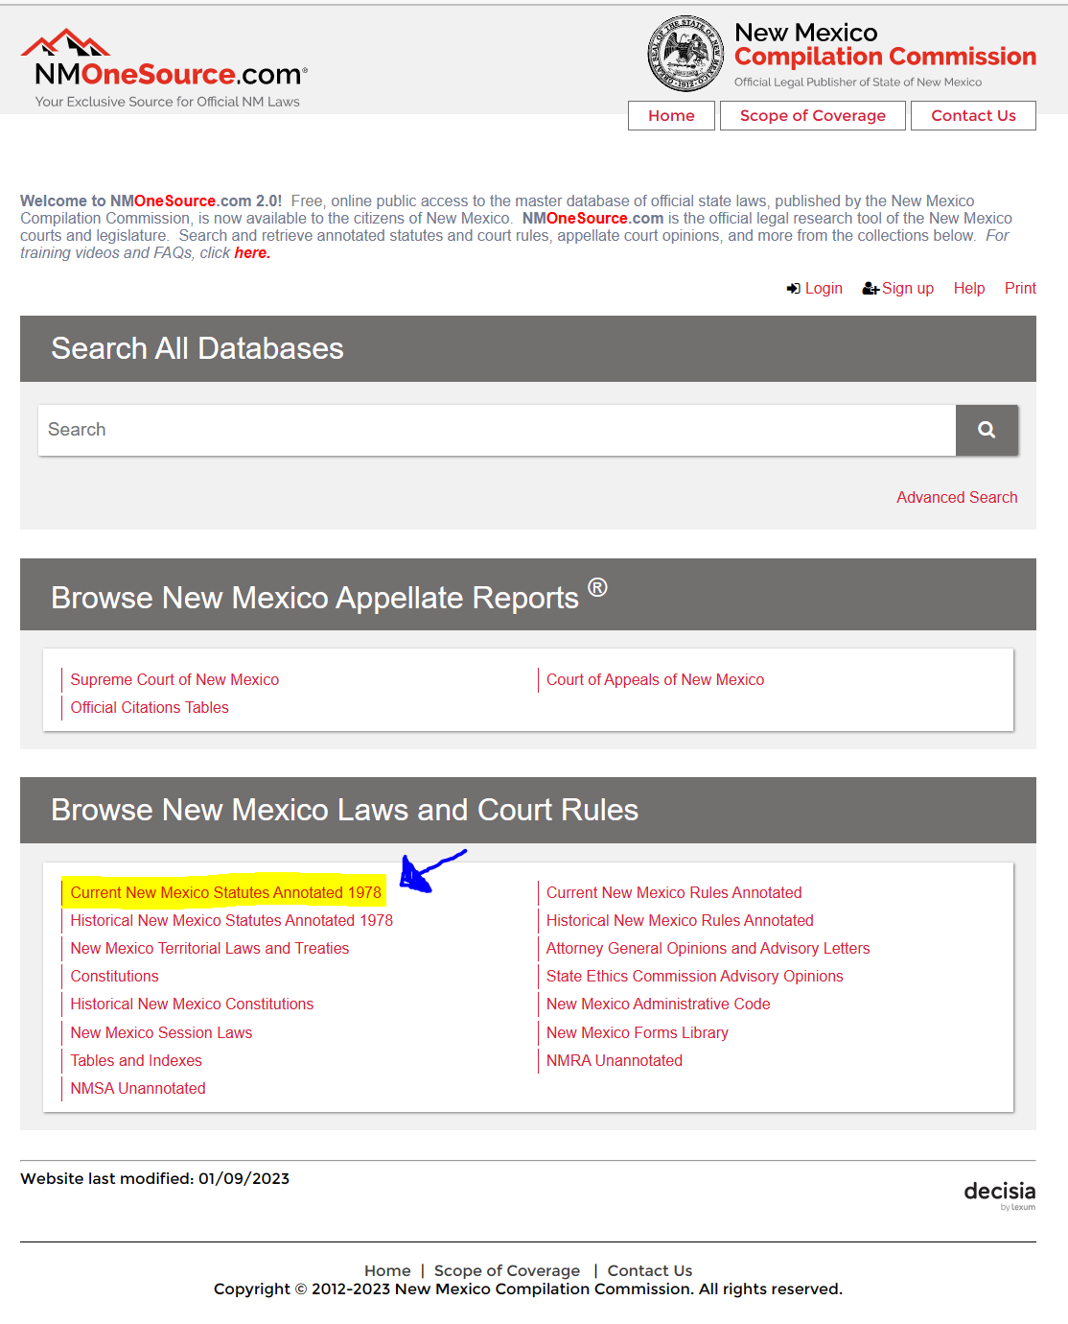
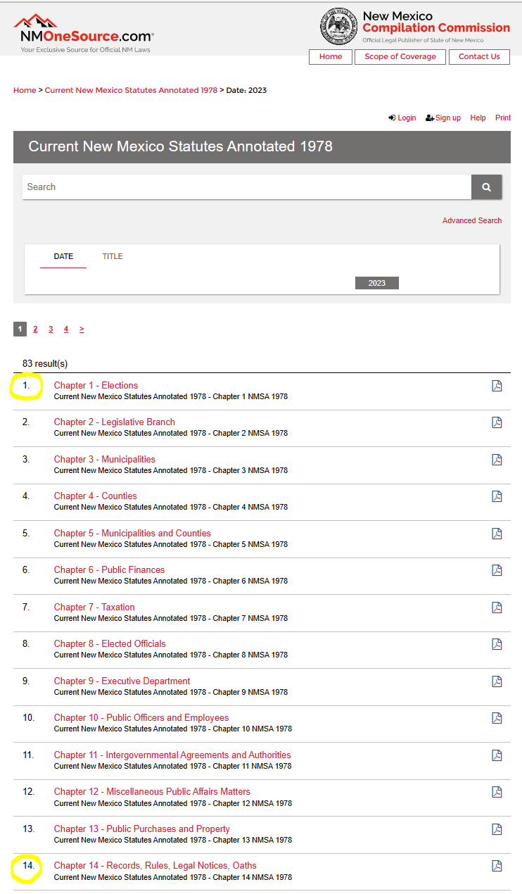
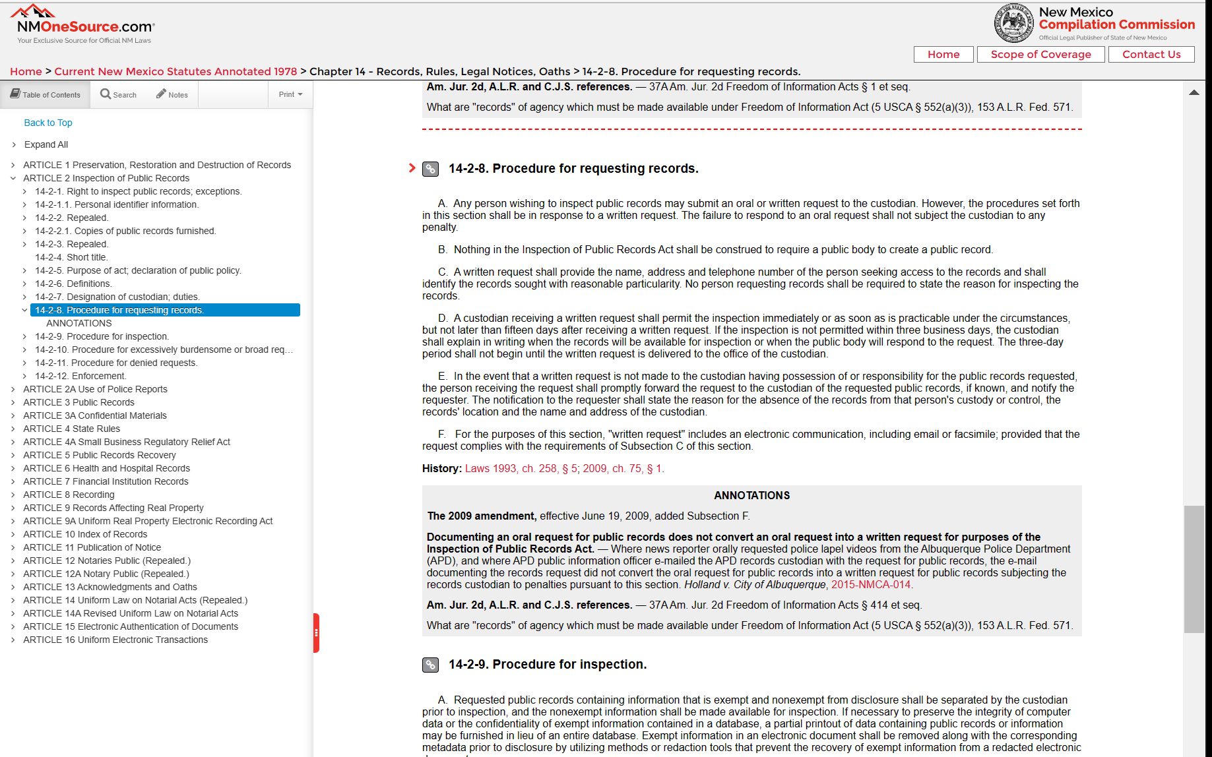
Look Up NM Statutory Citations in NMOneSource.com
Step1
Example: NMSA 14-2-8.B
Chapter 14
Article 2
Section 8.B
Chapter 1 (Election) & 14 (Records, Rules, Legal Notices, Oaths) are commonly cited.
NOTE: It is SLOW, give it time to load
Step 2
Step 3

Slide 15
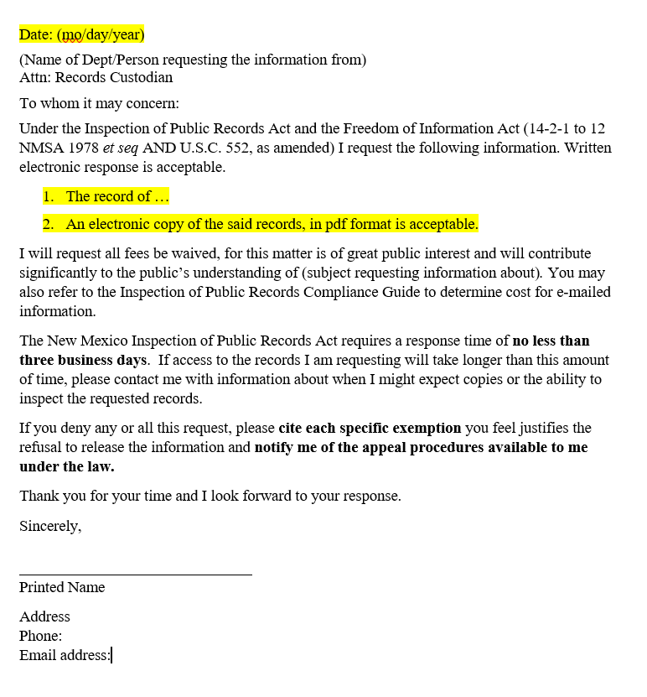
TEMPLATE
Name, address & telephone # of requestor is required.
No person requesting records shall be required to state the reason for request.
IPRA requires the file format in which the records exists to be provided.
Remind and emphasize provisions in the IPRA to the custodian to remind the requirements (ie 3 days, reasons for denial).

Slide 16
Rebuttals
Common citations and rebuttals sheet provided. Mix, match, modified response based on citations.
Look up each citations, interpret the law for context.
Know or research other laws, regulations and standard that are related to our request.
Review rebuttals already covered. If there is a new citation, new angle for a rebuttal or better way to phrase the rebuttal, please share via email to give time to review, think and save time for the next meeting (prevent repetitions).
Document, (date, who, citation), remember to add signature to name.
Next step to be determined. Bonds for Win, Lawsuits ($100/day), Exposure, Legislation.

Slide 17
TIPS
Always add address, phone number under your signature. I do with all of my emails, whether requesting or appealing
Before or after you copy/paste, make sure you don’t forget to fill in the blank, change the county name or date. Proof-read before sending.
Add the County Name to the Subject field, it makes it easier to find & filter your email. Create IPRA folder for your IPRA related emails to keep document on who responded, actions taken & day/time.
Do not get too disappointed if you get a pushback. Some records custodians just follow orders, some need further education, some may be lazy or purposefully avoiding it. Counties are NOT consistent. We are making waves by paying attention. We are collecting valuable information whether useful in our endeavors or not or whether it was provided.
If you need help, please check Cause of America forums (so everyone can learn) on the subject pushback or create a new forum.
If you need access to Cause of America or additional help please email or forward to Cynthia: cindylu65@gmail.com . There may be more unforeseen pushback we are not sure how to respond, we can reach out to Pablo/Erin if needed.

