Slide 1
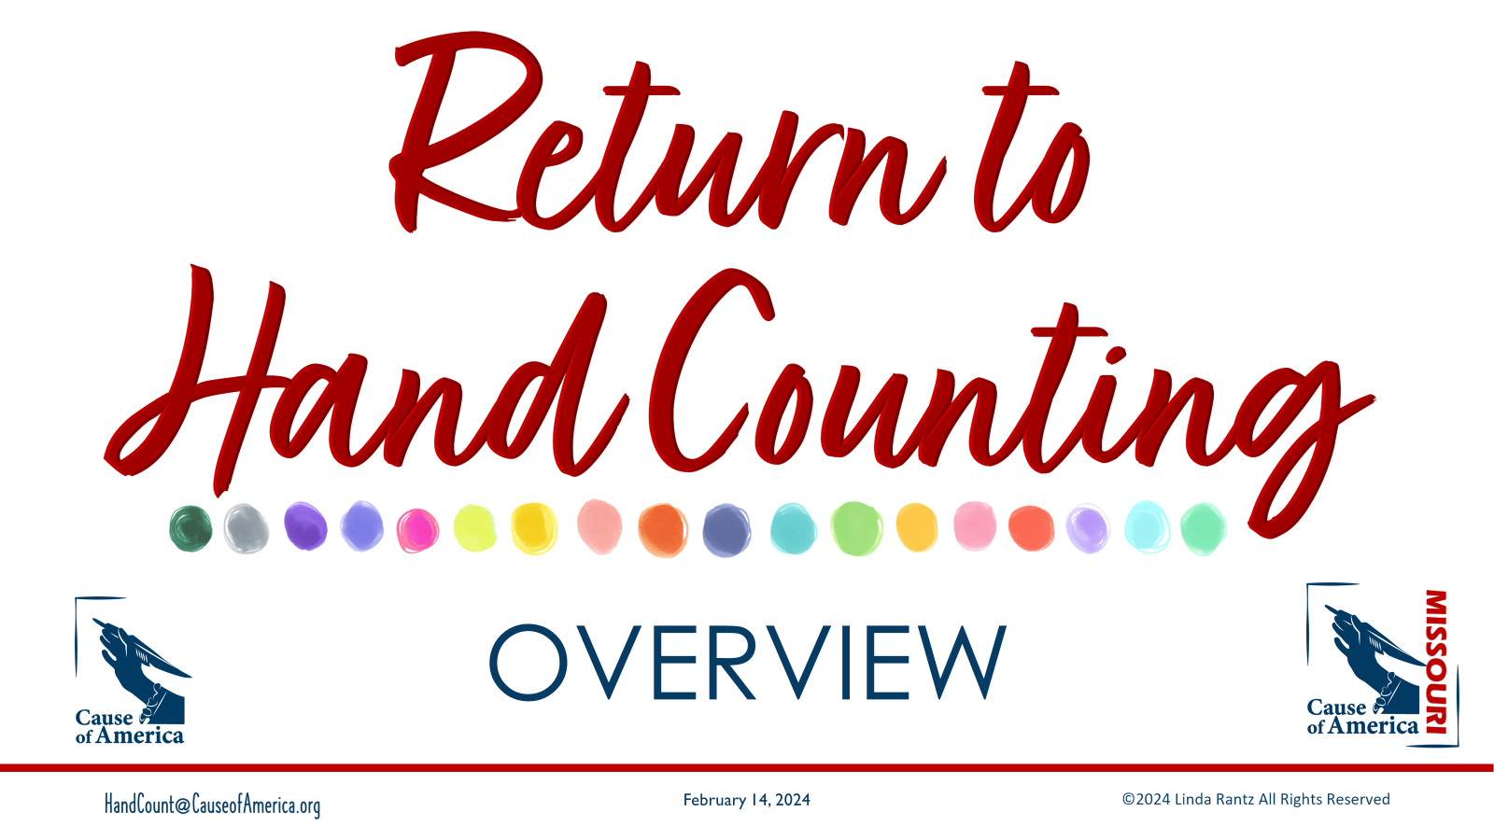
Notes:
This slide deck was designed for a 1-hour overview presentation of hand counting. It is designed to precede the 4-hour “Train the Trainers” event (with a lunch break in-between).
The notes provided for this slide deck are NOT intended to be a script. Instead, the purpose of each slide and some prompts are provided for presenters.
The eManual, this 1-hour overview presentation, and this slide deck are authored by Linda Rantz and are copyrighted material. No use of this program is permitted for any other purpose without prior permission. For permission to use the materials for other purposes or for questions, email Linda Rantz at HandCounting@pm.me.

Slide 2
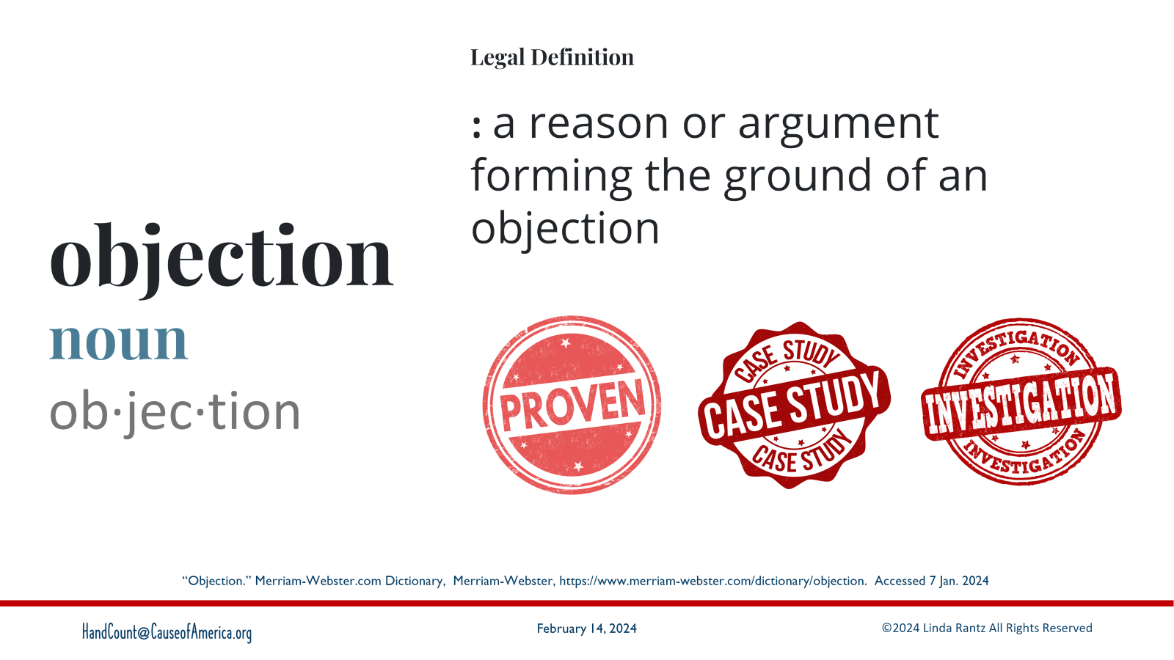
Notes:
Mention “hand counting” and almost always get “objections.” What is an objection?
From dictionary: based on “grounds”. It should be expected that someone making an “objection” knows what they are saying is “proven” or based on a “case study” or “investigation.

Slide 3
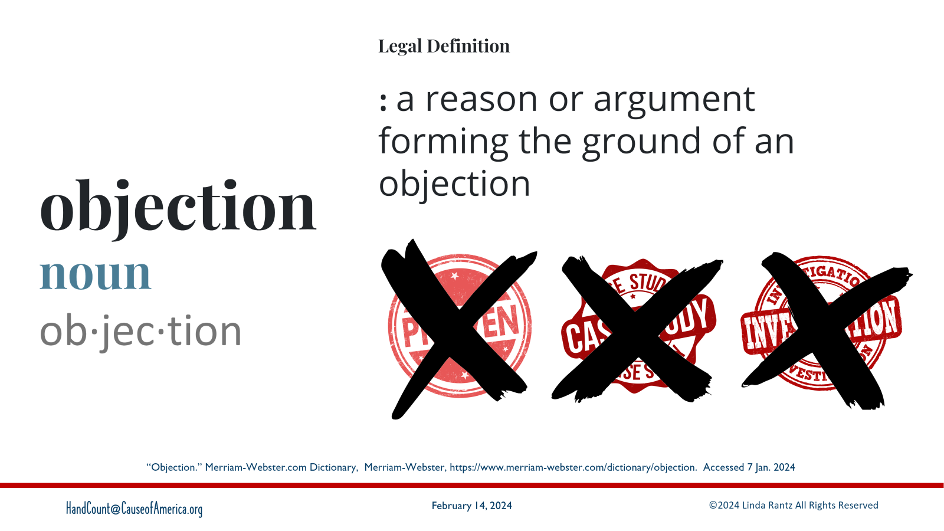
Notes:
When someone pushes an “objection,” ask for a “source” or their “grounds.” Almost always, they have nothing to cite.

Slide 4
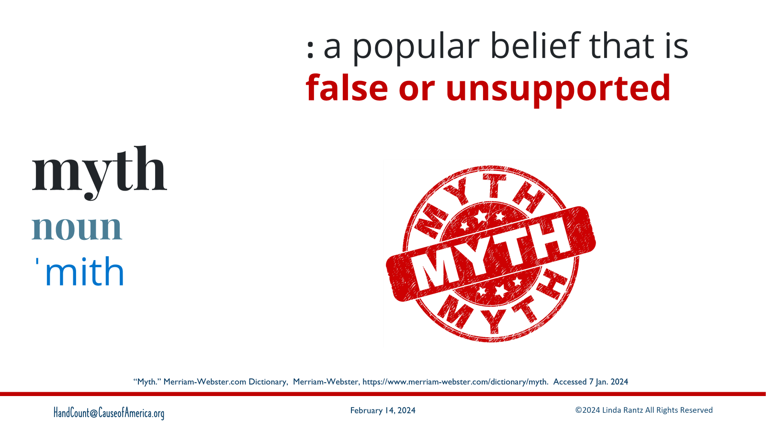
Notes:
Most “objections” about hand counting are “myths” – a popular belief that is FALSE or UNSUPPORTED.

Slide 5
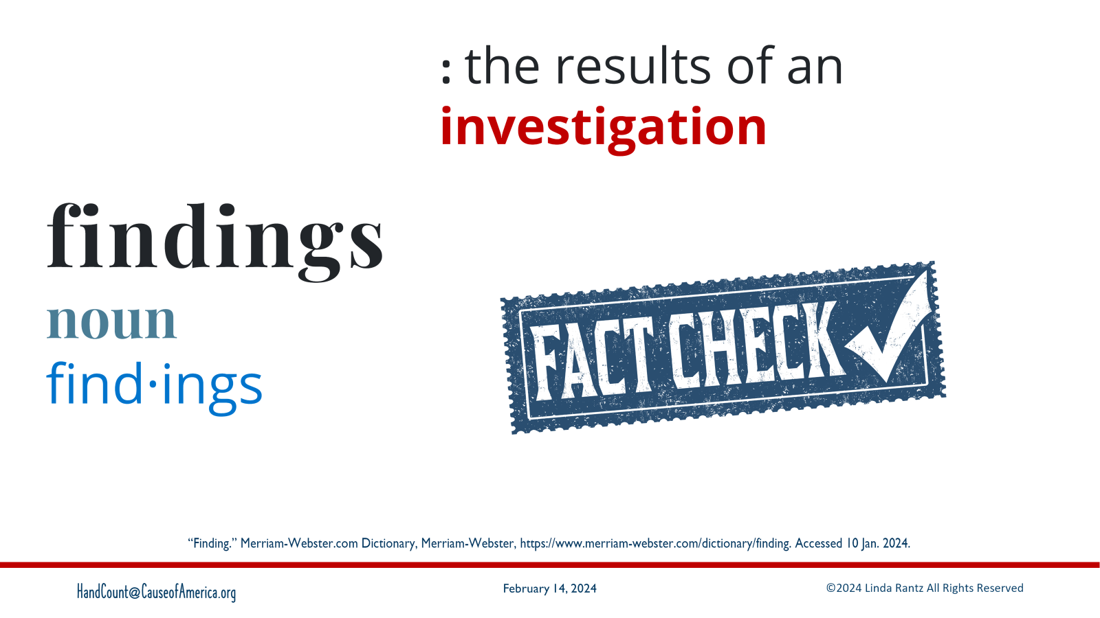
Notes:
What will be presented in this Overview are “Findings.” These are the results of an investigation and research. “Findings” are a true FACT CHECK.

Slide 6
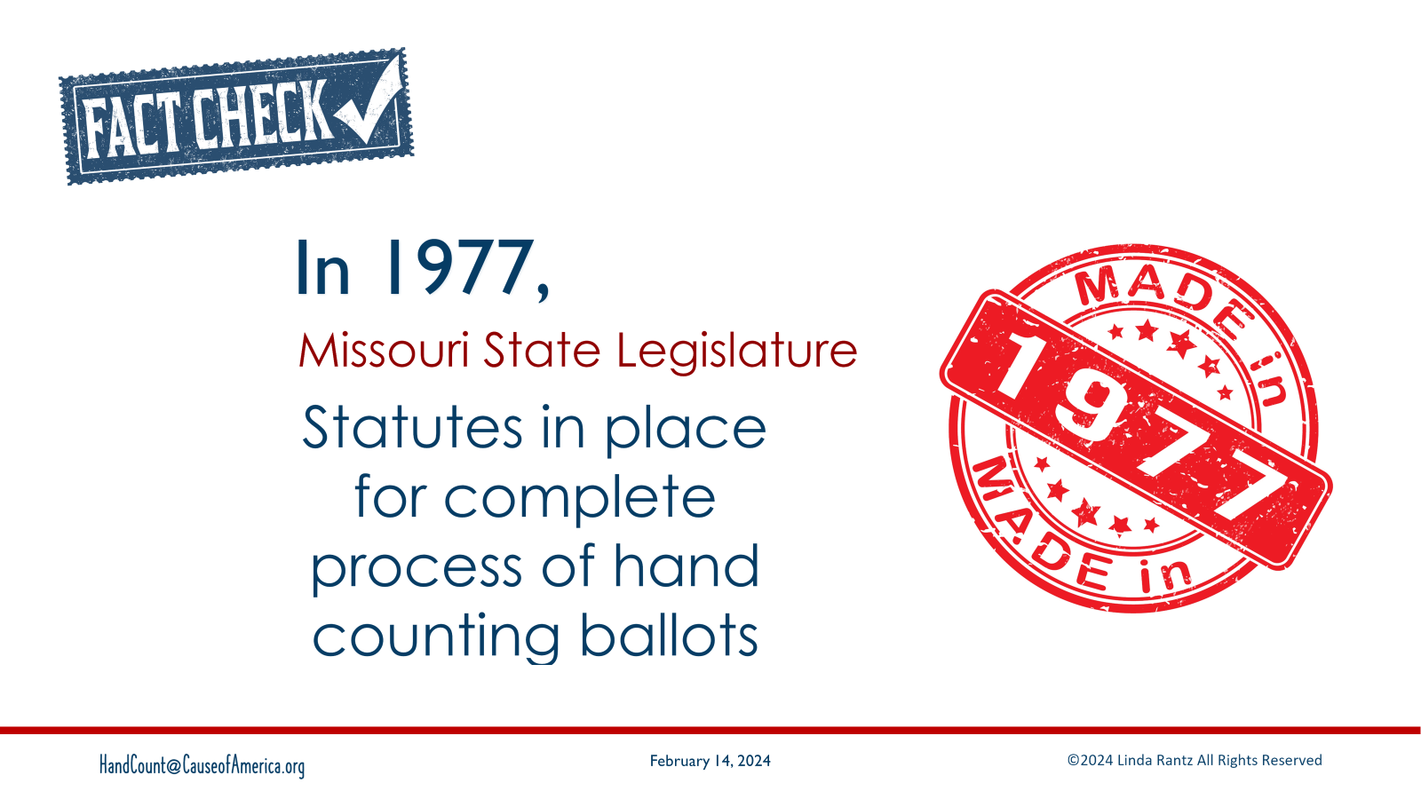
Notes:
The first fact check for the Missouri Method of hand counting comes from statutes. Going back to 1977, Missouri has statutes in place for hand counting election results.

Slide 7
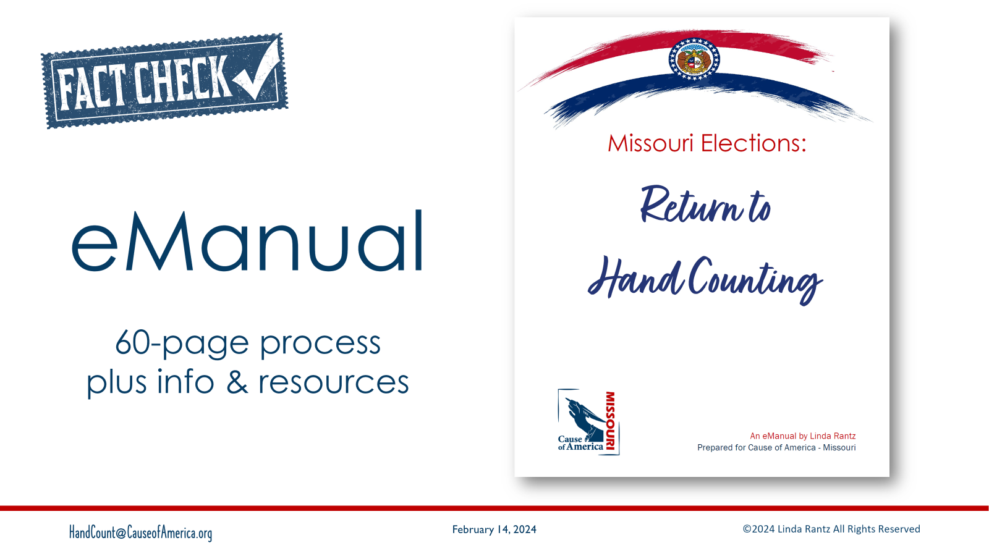
Notes:
From that research work, a start-to-finish hand count method was written. The process part of the eManual is 60 pages … there are another 240 pages of supporting documentation.

Slide 8
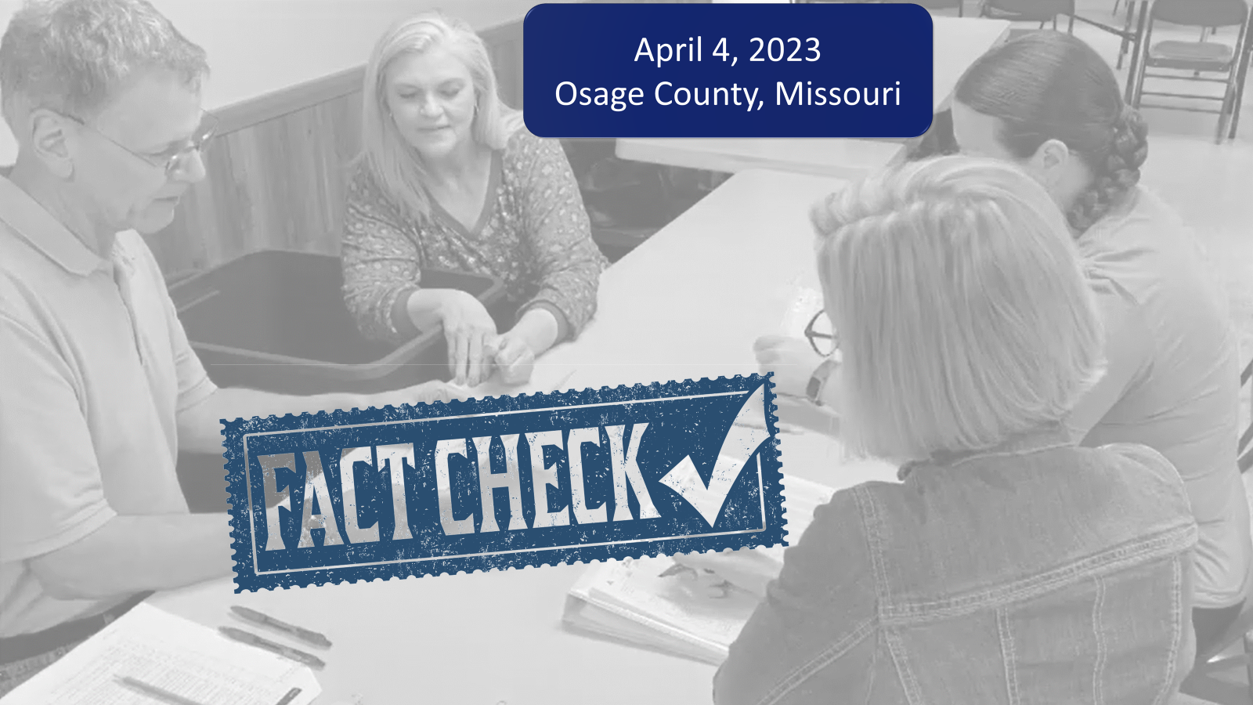
Notes:
The next Fact Check of the Missouri Method is its use in an official election in Osage County Missouri on April 4, 2023. Results back to the clerk on election night with 100% accuracy.

Slide 9
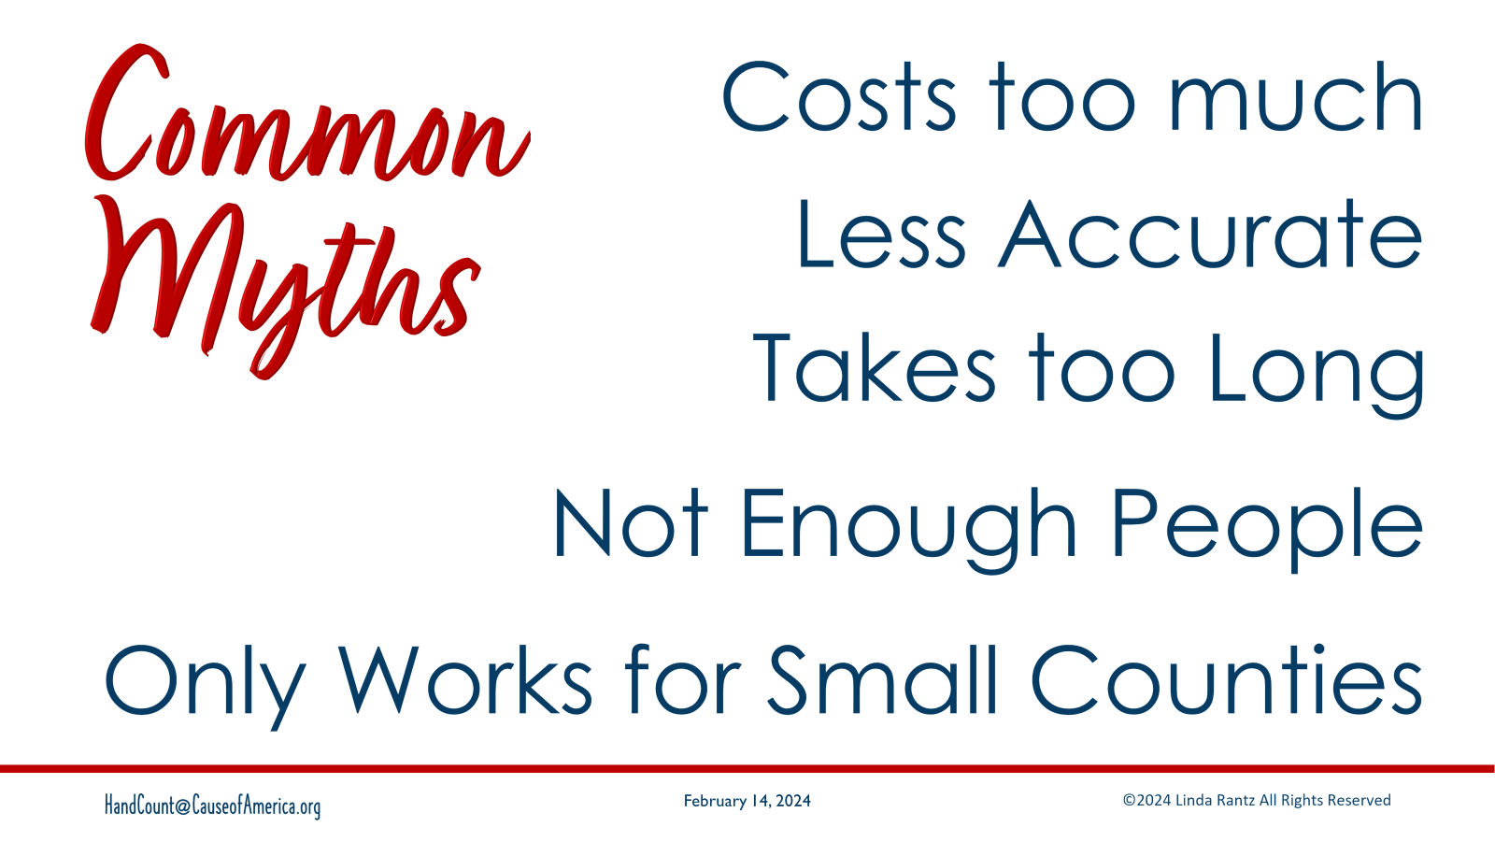
Notes:
What are the most common “myths” about hand counting?
Costs too much
Is less accurate than machines
Takes too long
There are not enough people to hand count
Will only work in small counties

Slide 10
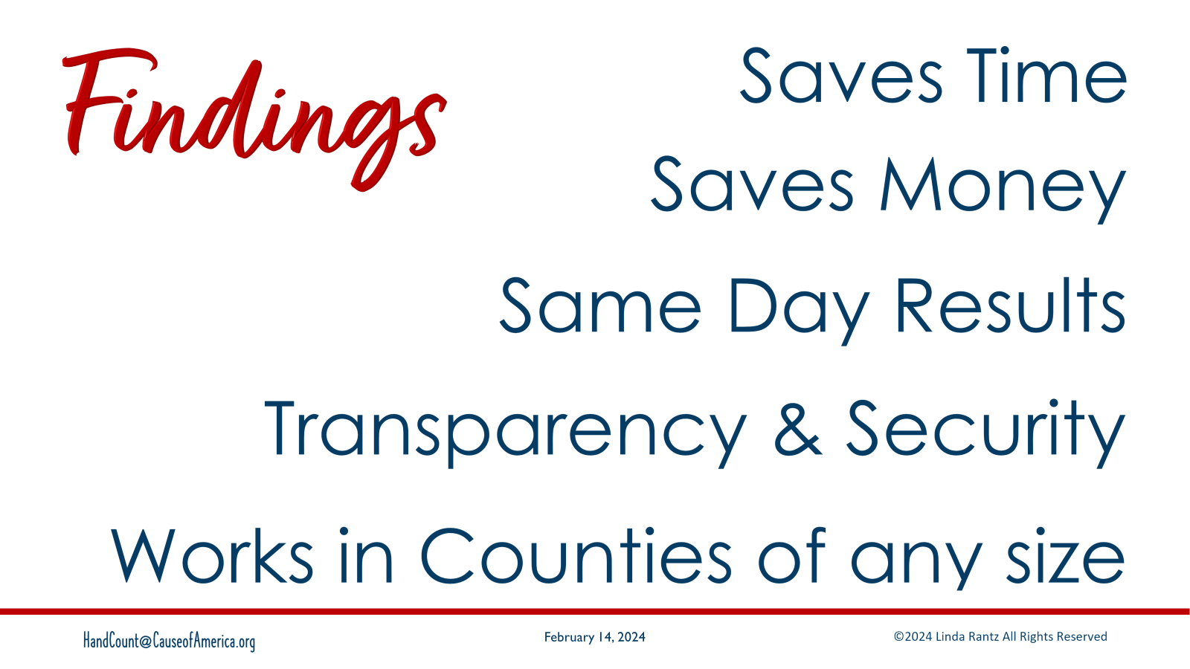
Notes:
Based on our Fact Check, the “findings” about hand counting are:
Hand Counting sames TIME,
It saves MONEY,
You will get same day RESULTS,
Hand counting provides more TRANSPARENCY and better SECURITY.

Slide 11
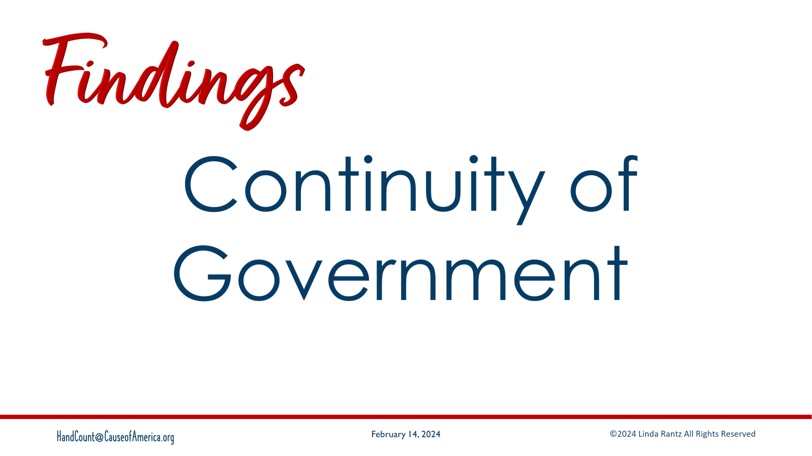
Notes:
AND Continuity of Government. More about this later, but understand that there are federal and state statutes requiring governments to be able to conduct business, including elections, in the of catastrophic events (such as natural disaster, attack, etc.)

Slide 12
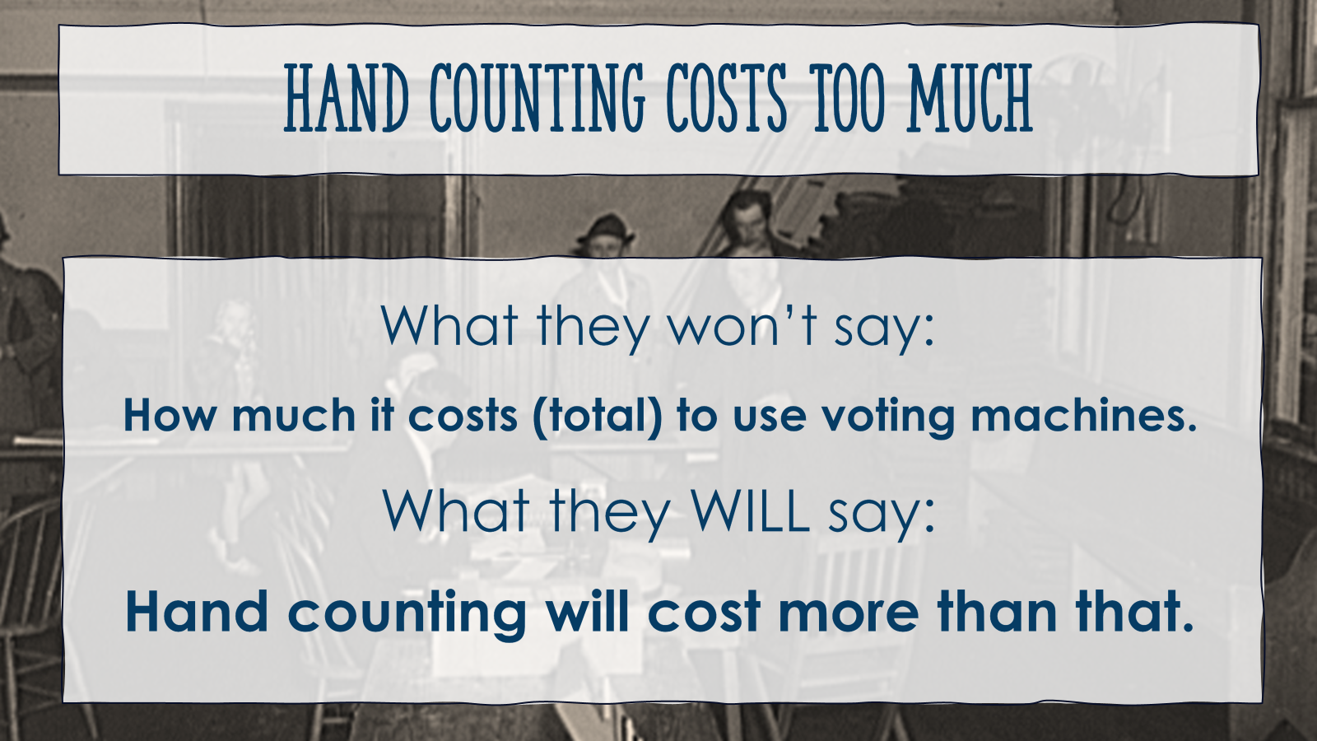
Notes:
Let’s start with one of the most popular myths: Hand Counting costs too much.
What they won’t tell you is how much it costs to use voting machines. Across the country we have been unable to get comprehensive information on the costs of using voting machines. It’s as if the information is siphoned.
What they will tell you is that whatever it costs to use voting machines, hand counting will cost more than that.

Slide 13
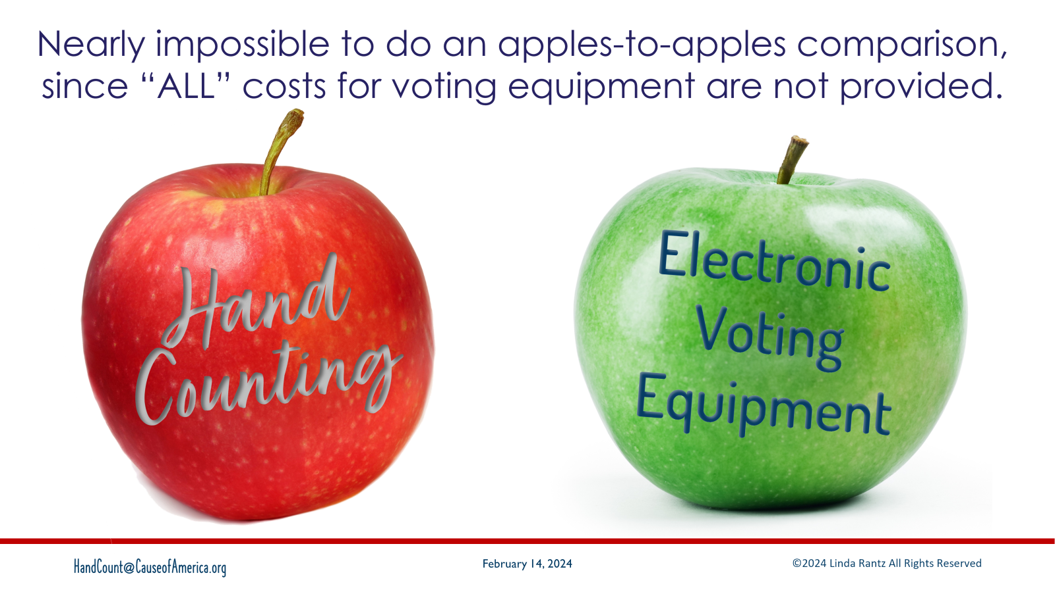
Notes:
There are always requests for “apple to apple” comparison of costs for hand counting versus machine counting. But since it has been impossible to get the voting machine costs, we cannot do “apple to apple.”

Slide 14
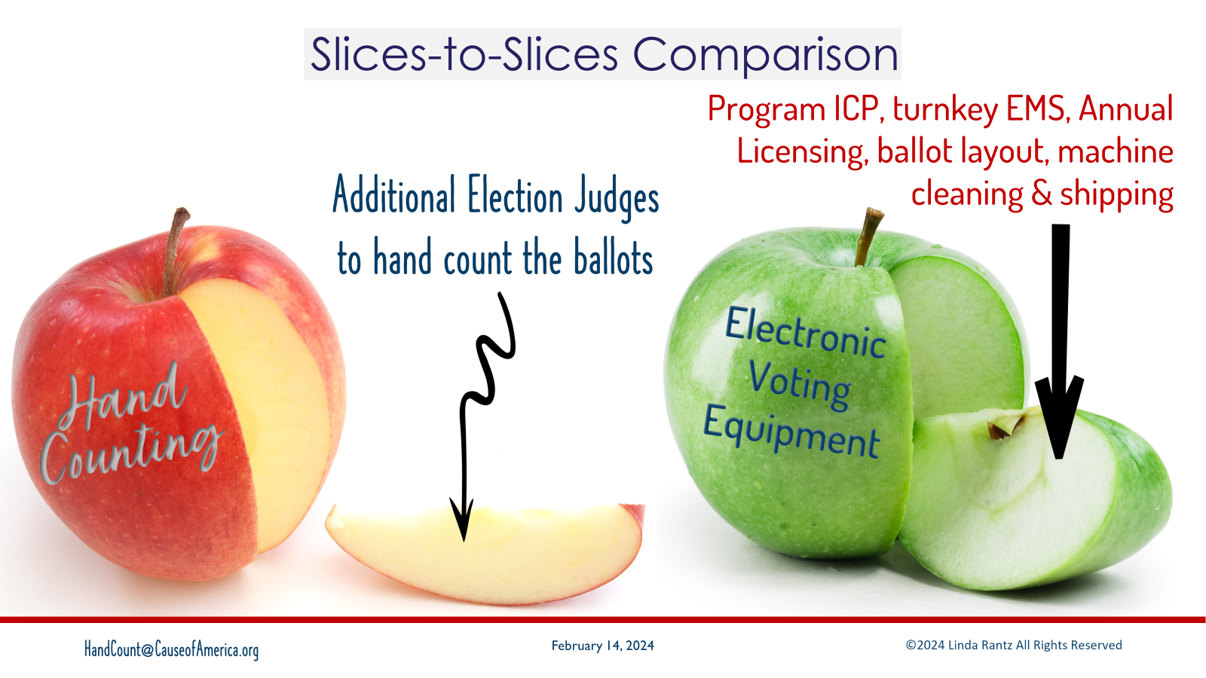
Notes:
What can be done instead, is an “apple-slice to an apple-slice” comparison.
For hand counting, we looked only at the labor costs for the extra people necessary to hand count the ballots. For the voting equipment, we took the vendor invoices we were able to obtain from an open records request and pulled very specific costs for preparing the machines for an election: programming, licensing, additional ballot design costs for machines, updates, and cleaning the machine for each election. It was the closest comparison of putting people in a polling place to count, compared to putting the machine there to count.

Slide 15
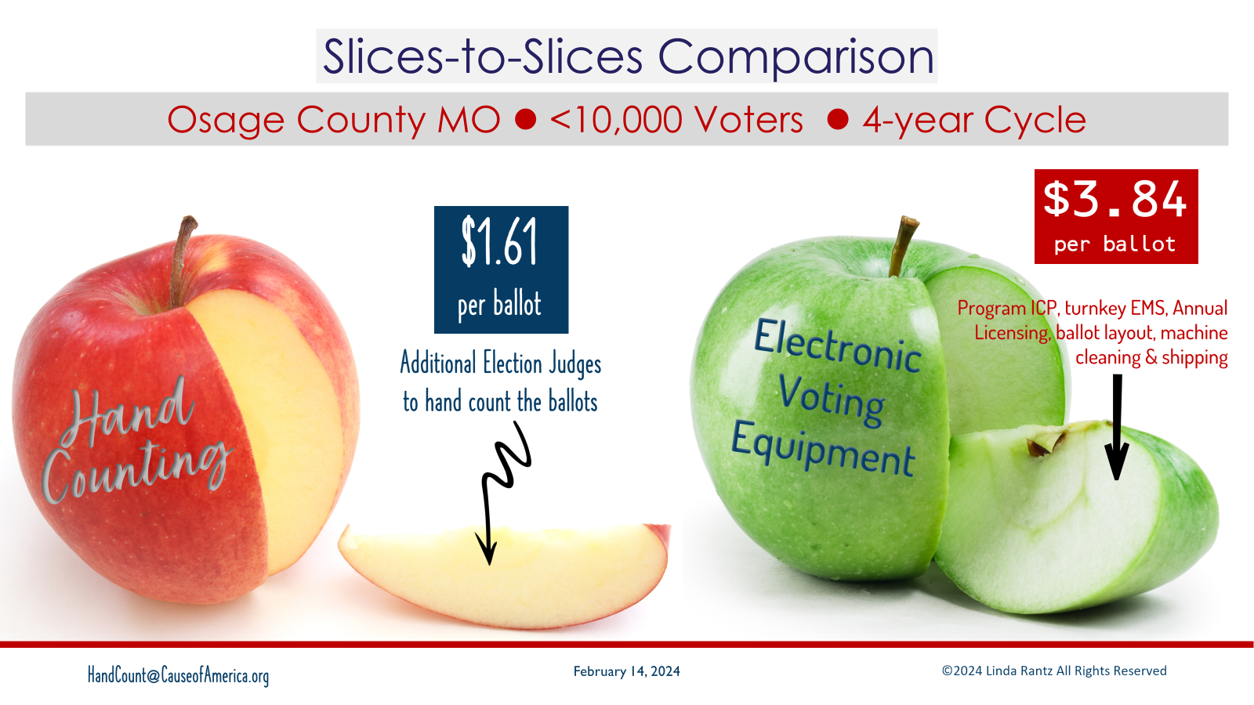
Notes:
The “apple slice” analysis is based on a 4-year election cycle (2020 thru 2023) in Osage County, Missouri – a county of just under 10,000 registered voters. For hand counting, the costs for election judges for all the elections during that cycle would be $1.61 per ballot cast.
The voting machine “apple slice,” for the specific costs we pulled is $3.84 per ballot cast. A difference of $2.23 per ballot cast.

Slide 16
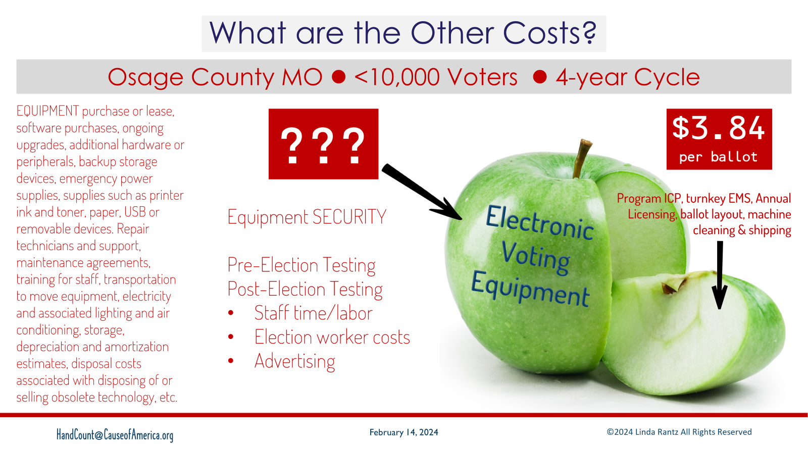
Notes:
What is the cost of the “rest of the apple”? For voting equipment, we don’t know. Some items would be purchase or lease of the machines. How much would that increase the per ballot price? Also think about the staff and time that goes into the pre-election testing of the machines, and the post-election testing. And, by law, these machines require 24/7/365 security and monitoring. How much does that cost?
We can’t tell you how much the per ballot cast cost would go up – all we can say is that, at a minimum, it is $3.84 per ballot cast.

Slide 17
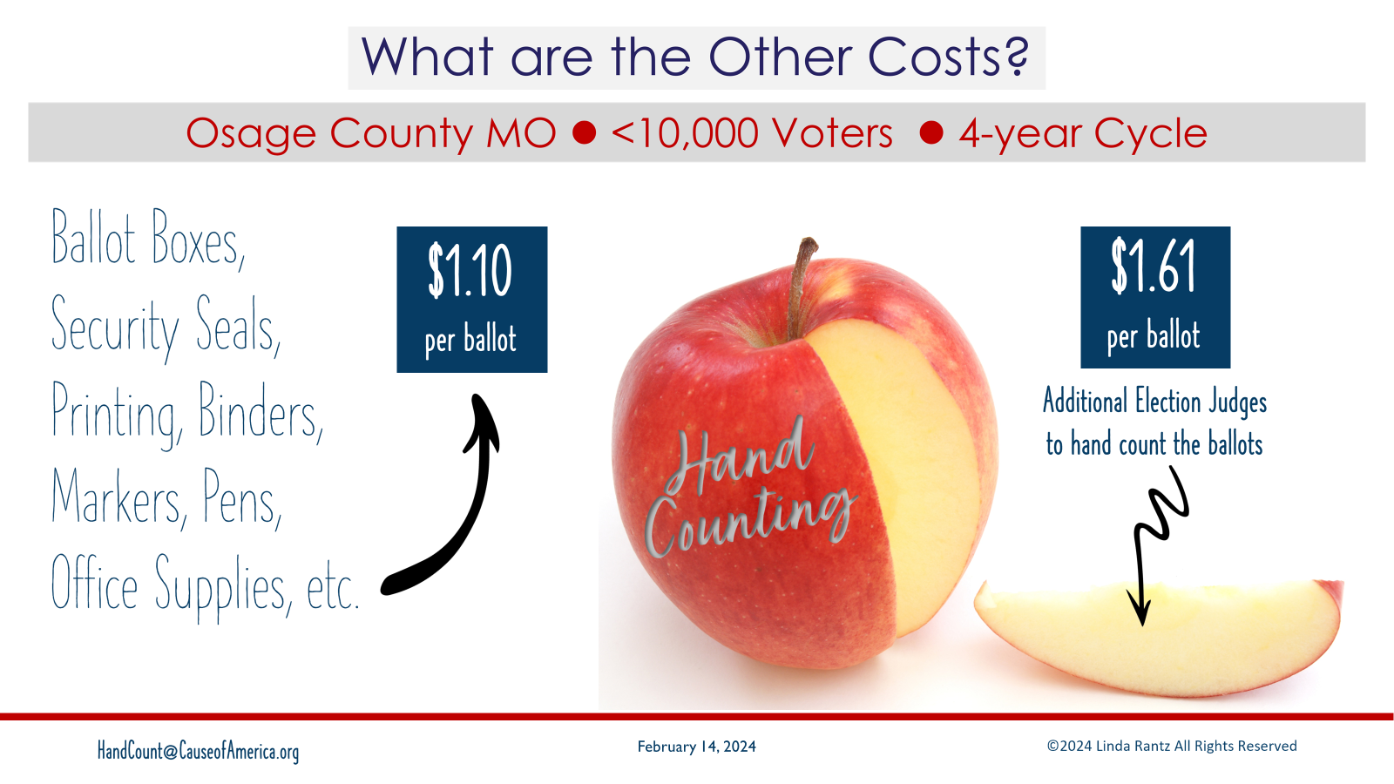
Notes:
What about the “rest of the apple” for hand counting? These costs we know. The secure ballot boxes, security seals, printing, binders, office supplies, etc. Everything that is needed for hand counting adds $1.10 per ballot cast.

Slide 18
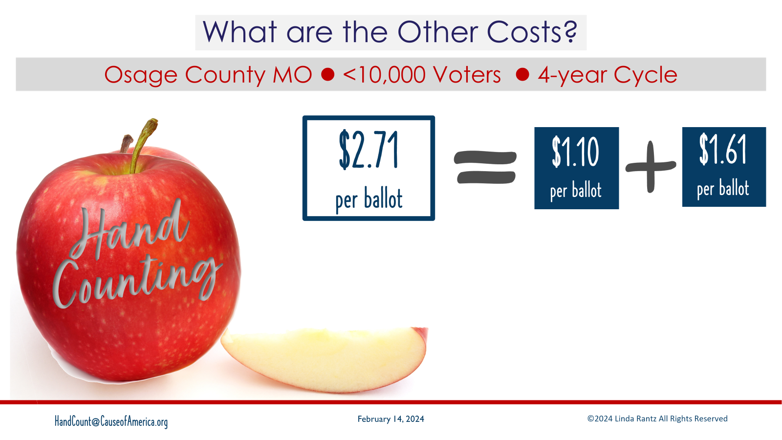
Notes:
Combine the labor cost for hand counting of $1.61 per ballot, plus the additional $1.10 per ballot – the entire “apple cost for handing is $2.71 per ballot cast.

Slide 19
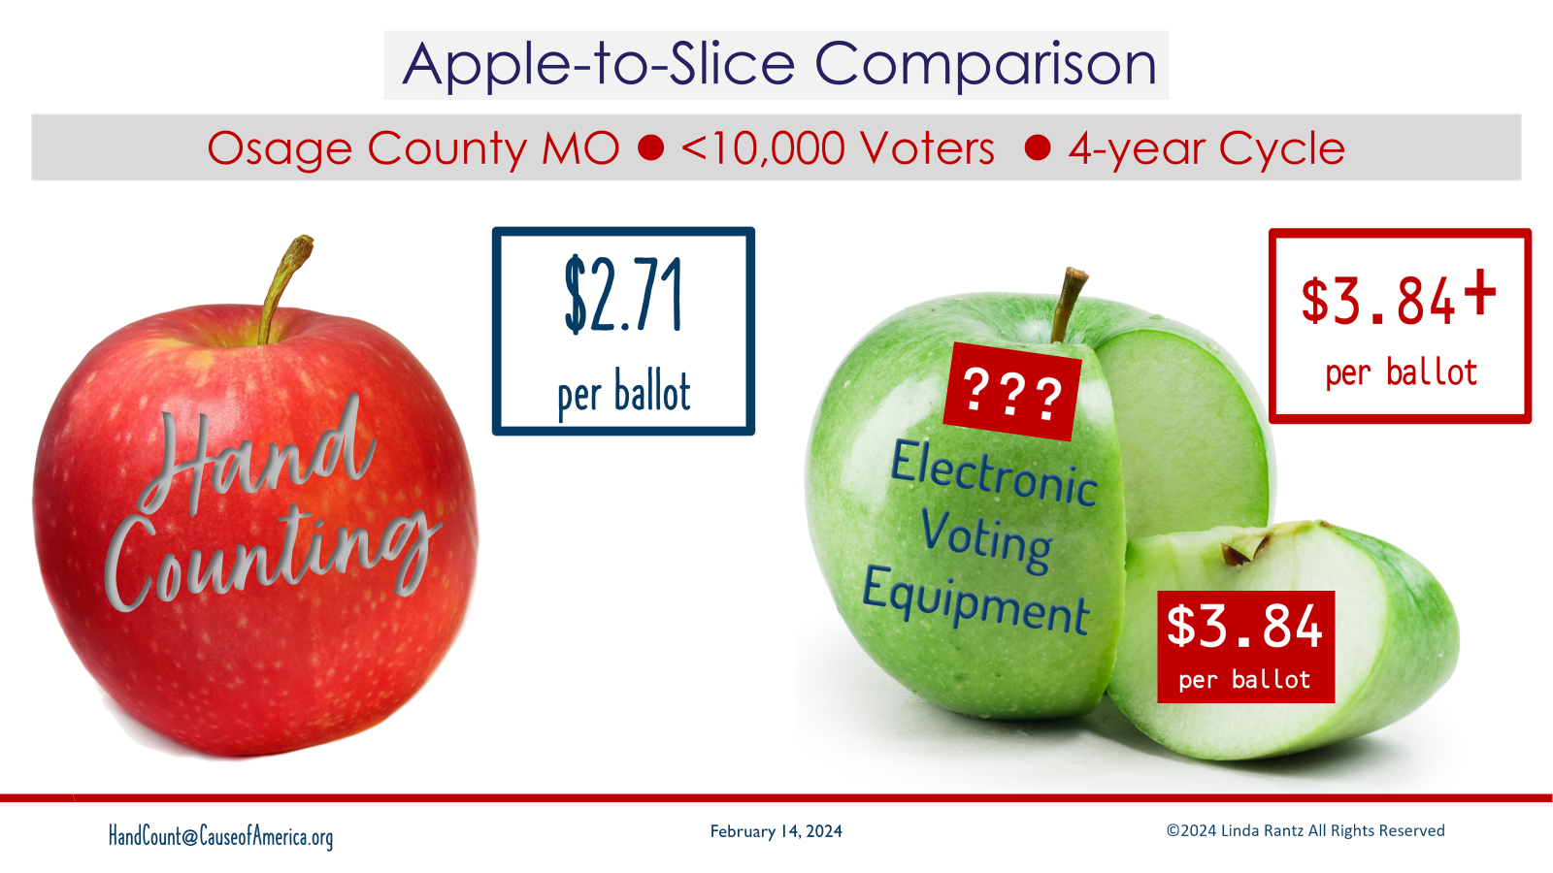
Notes:
The “apple” to “slice” comparison is $2.71 per ballot cast for hand counting compared to AT LEAST $3.84 per ballot cast for voting machine costs. A difference of AT LEAST $1.13 per ballot cast. Imagine if a county had 10,000 ballots cast in an election. They could save AT LEAST $11,300 for ONE election by hand counting instead of using machines.

Slide 20
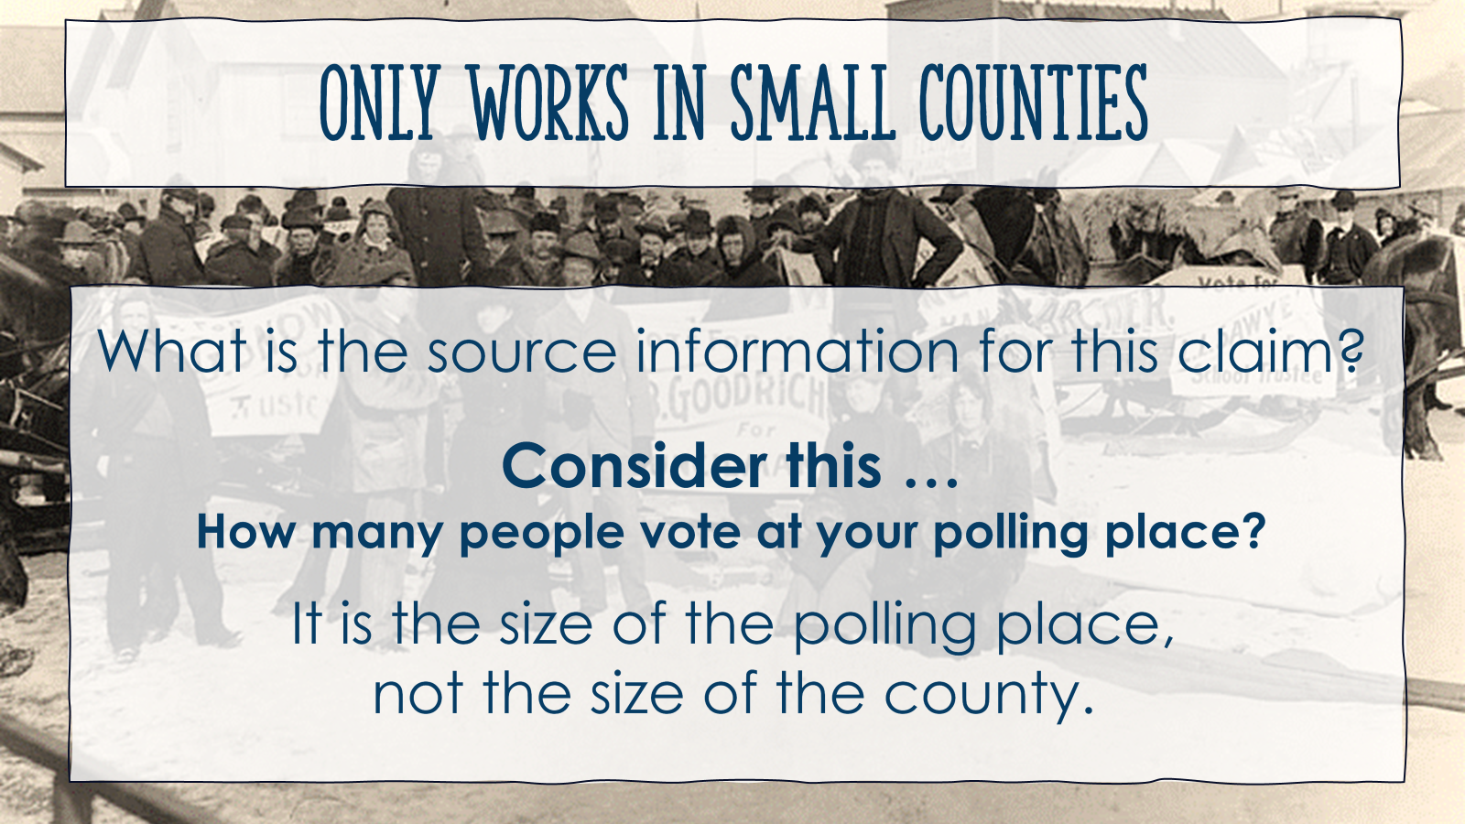
Notes:
The next “myth” to cover is that hand counting will only work in small counties – it can’t be used in big counties. If you hear this “myth,” start first by asking for the source or supporting information. Then, consider your polling place. How many people do you usually see at the polling place? Are there long lines? (Are the lines for the machines or checking in?).

Slide 21
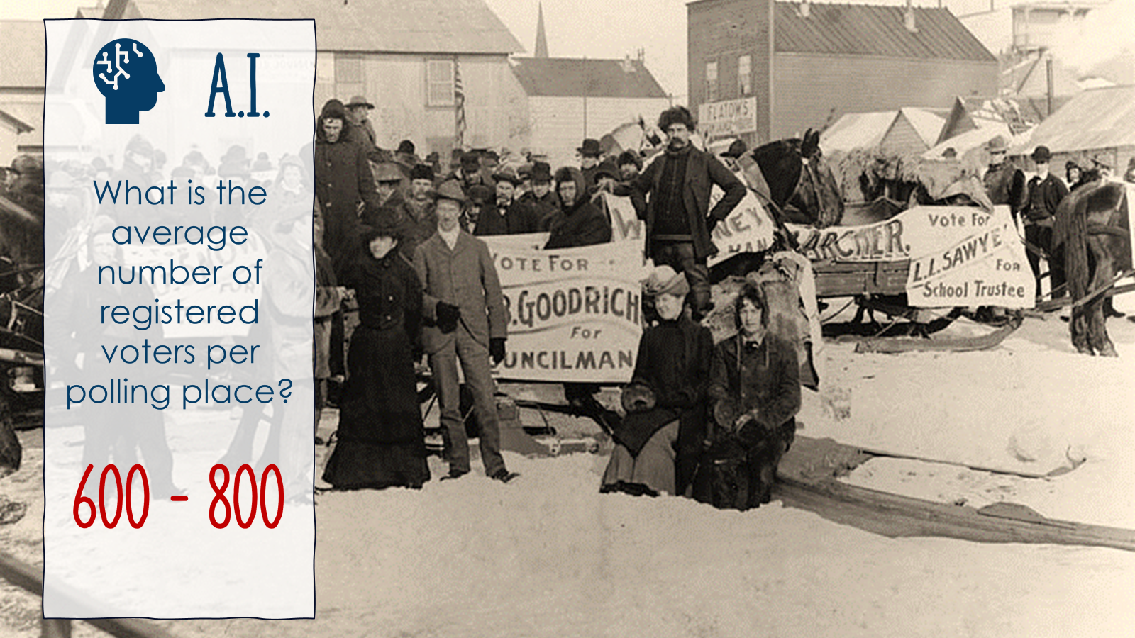
Notes:
To check this, we used A.I. and asked for the average number of registered voters per polling place across the United States. A.I. said 600 to 800.

Slide 22
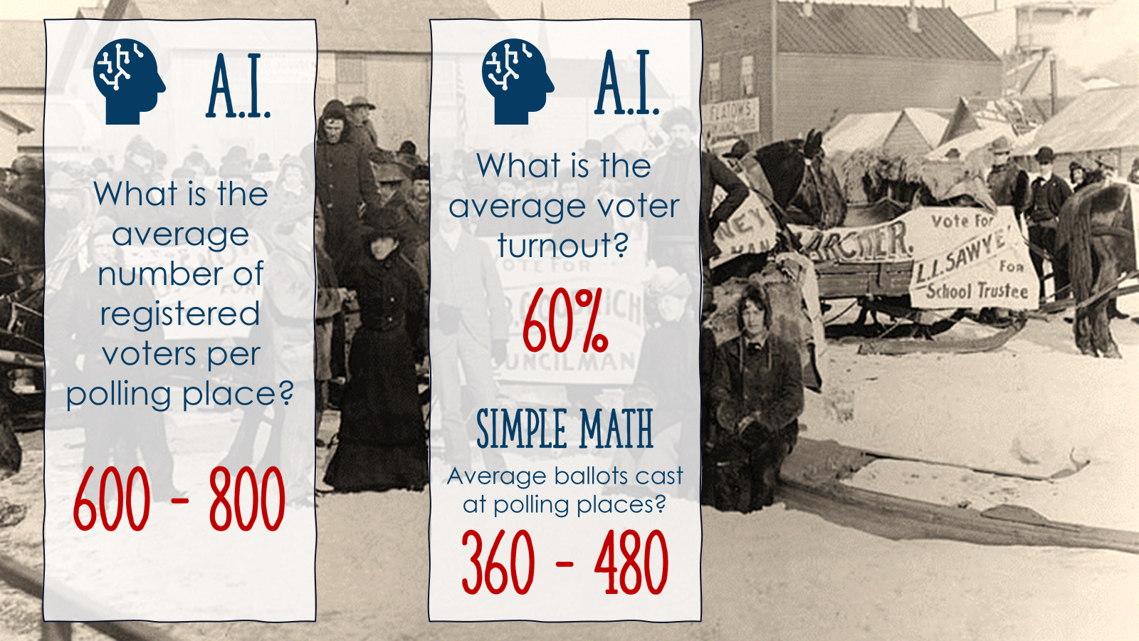
Notes:
Next, we asked for the average voter turnout in the United States. A.I. said 60%.
Simple math tells us that means the average number of ballots cast at a polling place in the United States is 360 to 480.

Slide 23
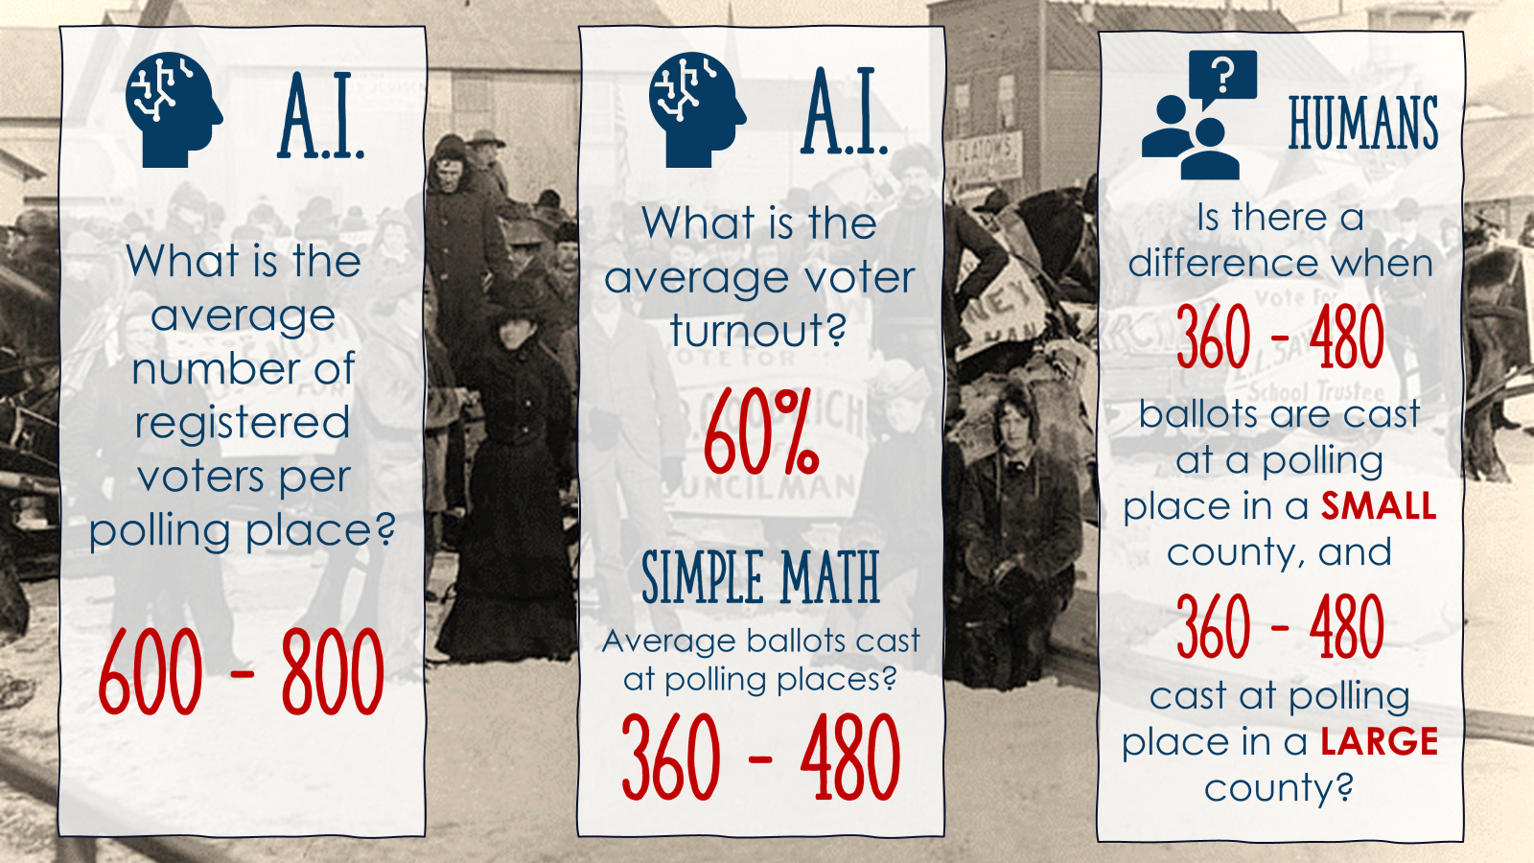
Notes:
That begs the question: Is there a difference of 360-480 ballots cast in a polling place in a SMALL county and the same number of ballots cast in a polling place in a BIG county? It doesn’t matter where the polling place is located – it matters how many ballots are cast.

Slide 24
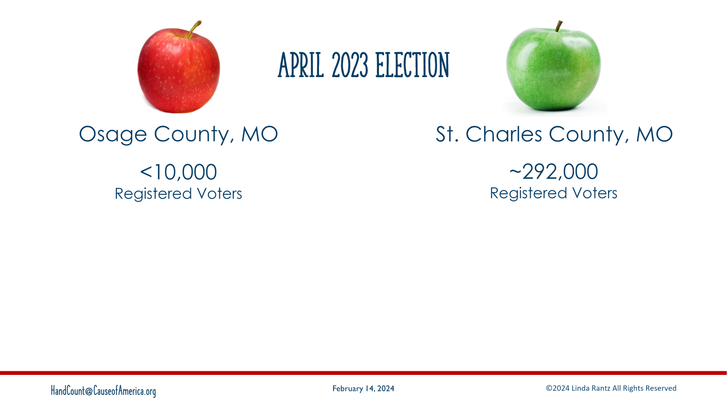
Notes:
To illustrate, compare Osage County Missouri with St. Charles County Missouri. We will look at turnout for the April 2023 election (the one that was hand counted in Osage).
Osage has under 10,000 registered voters. St Charles is about 292,000 registered voters.

Slide 25
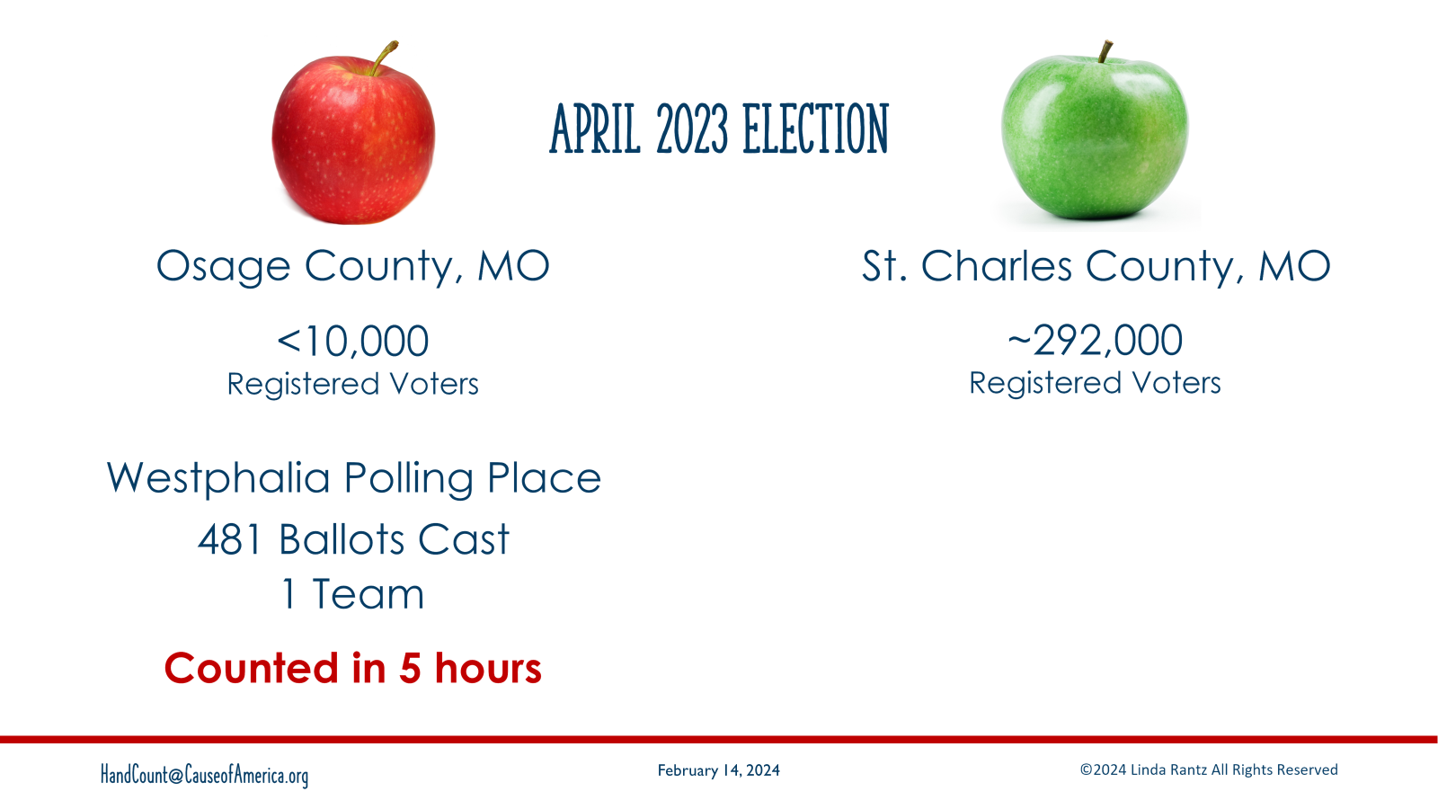
Notes:
At the Westphalia polling place in Osage, 481 ballots were cast. There was 1 counting team (4 people), and it took them about 5 hours to count the ballots.

Slide 26
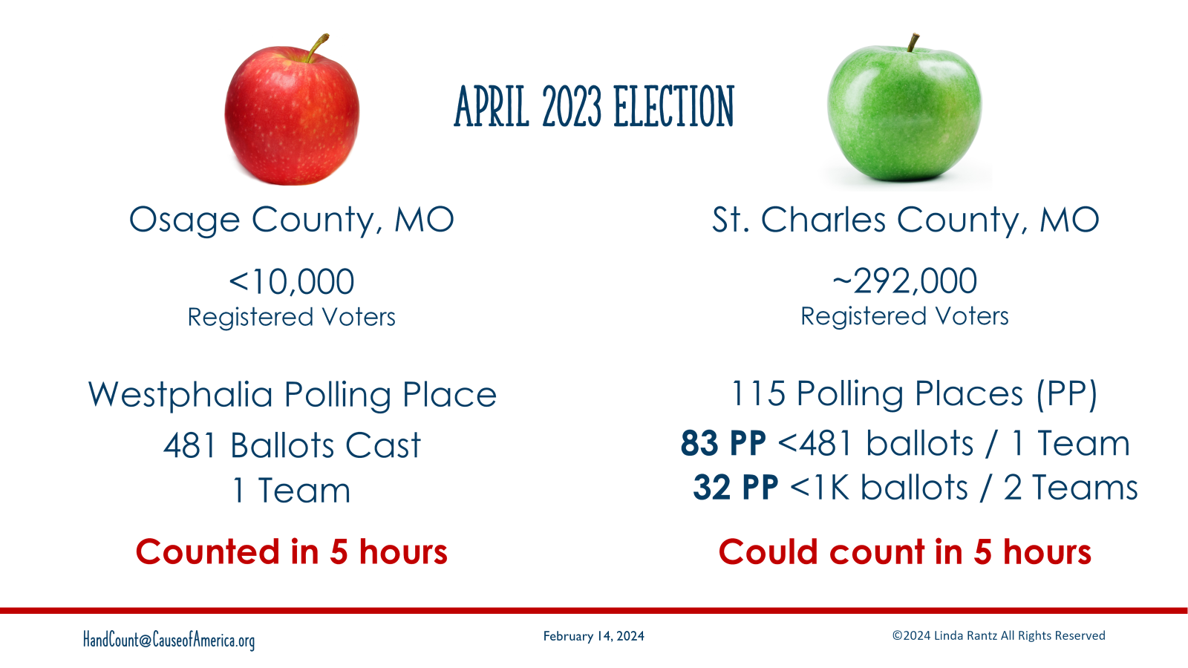
Notes:
St Charles has 115 polling places. Of those, 83 polling places had LESS than 481 ballots cast. LESS than the number of ballots cast in a polling place in a SMALL county. And, of the remaining 32 polling places in St Charles, they were all under 1,000 ballots cast. We would have recommended 2 counting teams at those polling places. St Charles could have hand counted that entire election in 5 hours.

Slide 27
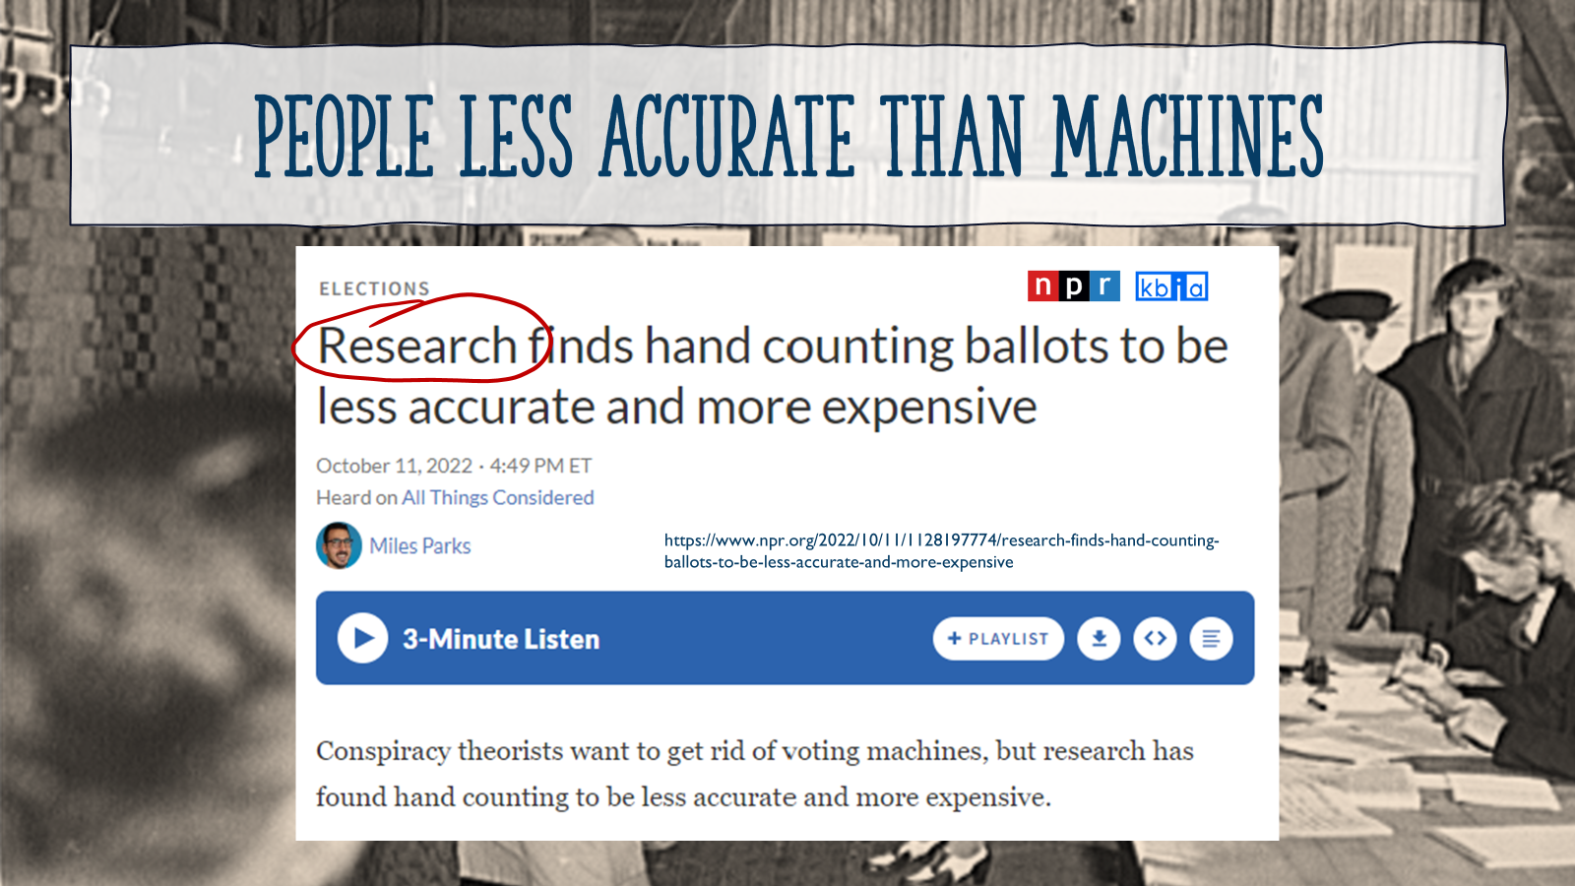
Notes:
The next “myth” is the claim that people are less accurate at counting ballots than machines. The published transcript of an interview done on NPR says, “Research shows” people are less accurate than machines. RESEARCH shows! Keep in mind people tend to only read headlines.
https://www.npr.org/2022/10/11/1128197774/research-finds-hand-counting-ballots-to-be-less-accurate-and-more-expensive

Slide 28
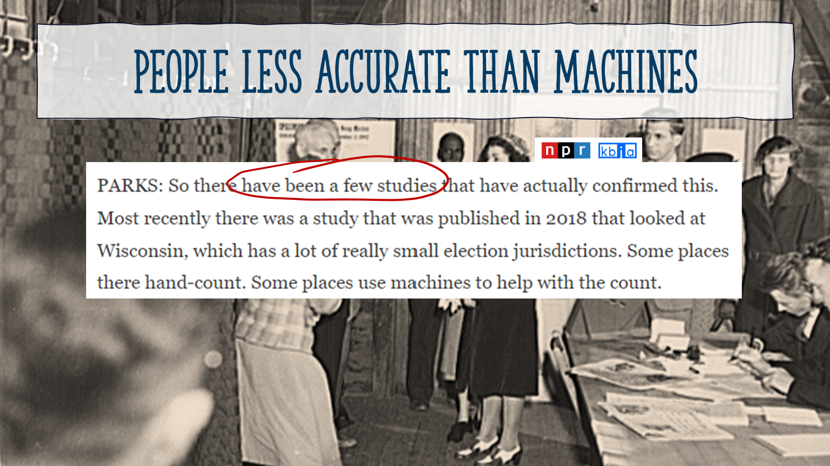
Notes:
If someone scrolled further down in the transcript, they would see the comment that there are very few studies showing this.

Slide 29
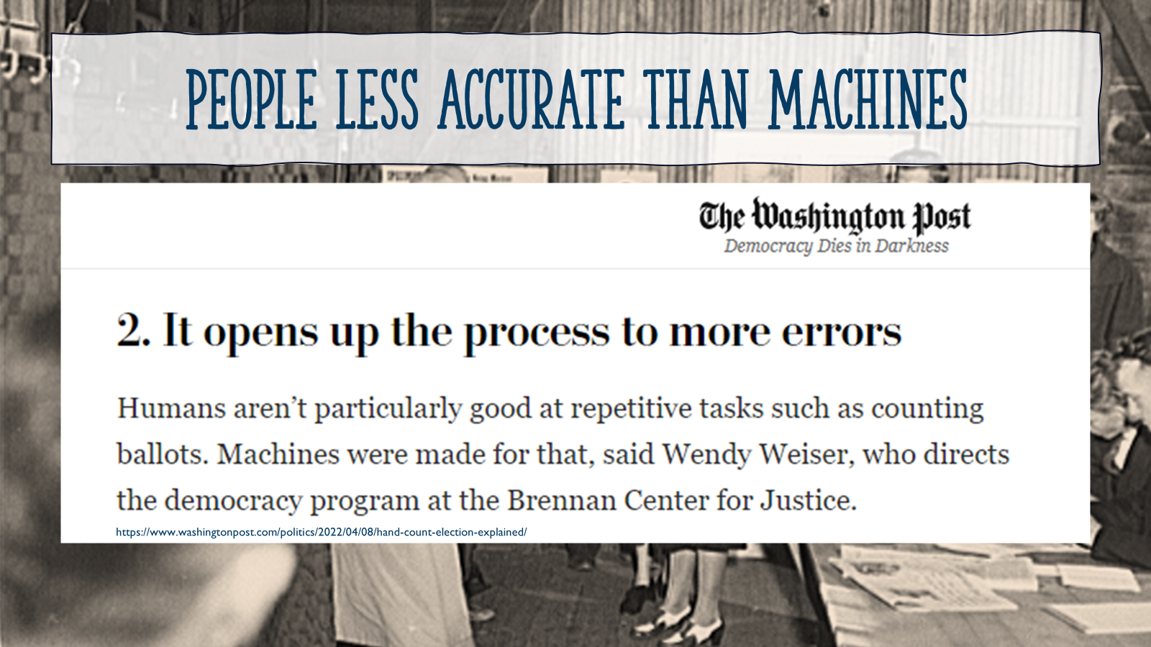
Notes:
Another news source, The Washington Post, had an article called, “Democracy Dies in Darkness.” It said, “Humans aren’t particularly good at repetitive tasks such as counting ballots.”
https://www.washingtonpost.com/politics/2022/04/08/hand-count-election-explained/

Slide 30
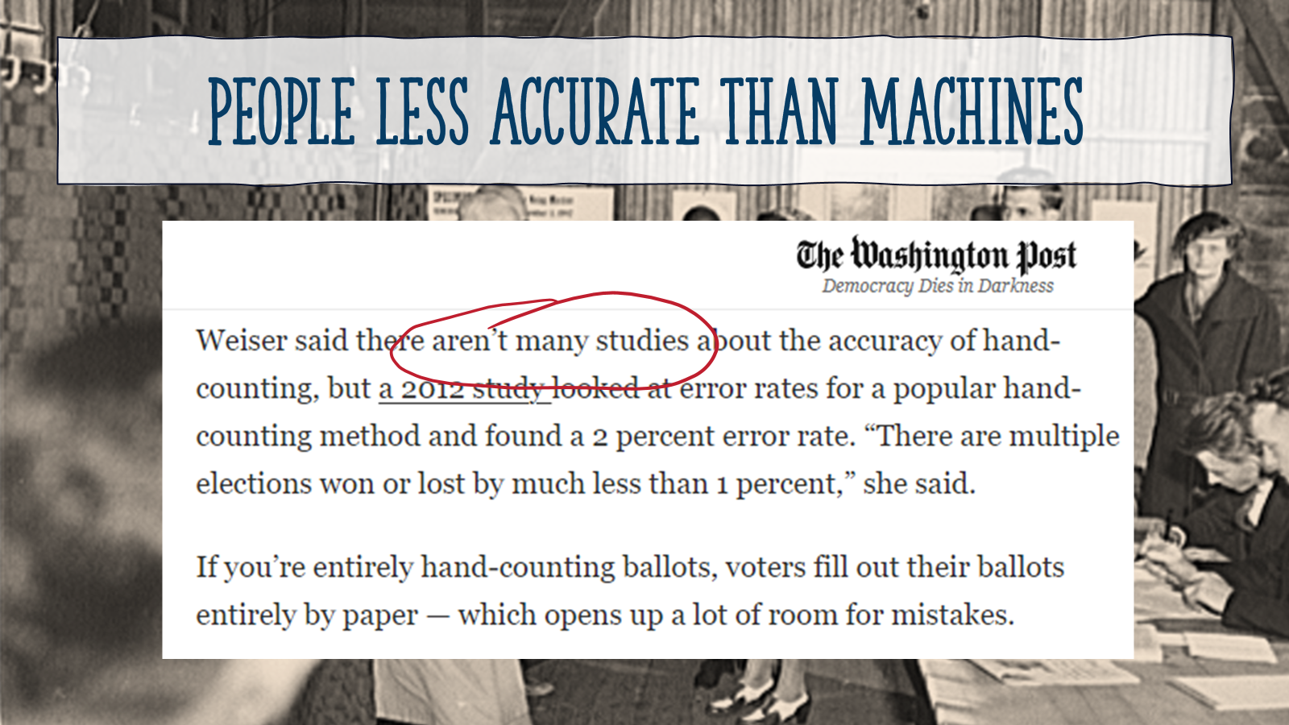
Notes:
But again, if you go further into the article it says, “there aren’t many studies.” As a matter of fact, one of the studies they cited was about repetitive tasks – not specifically hand counting.

Slide 31
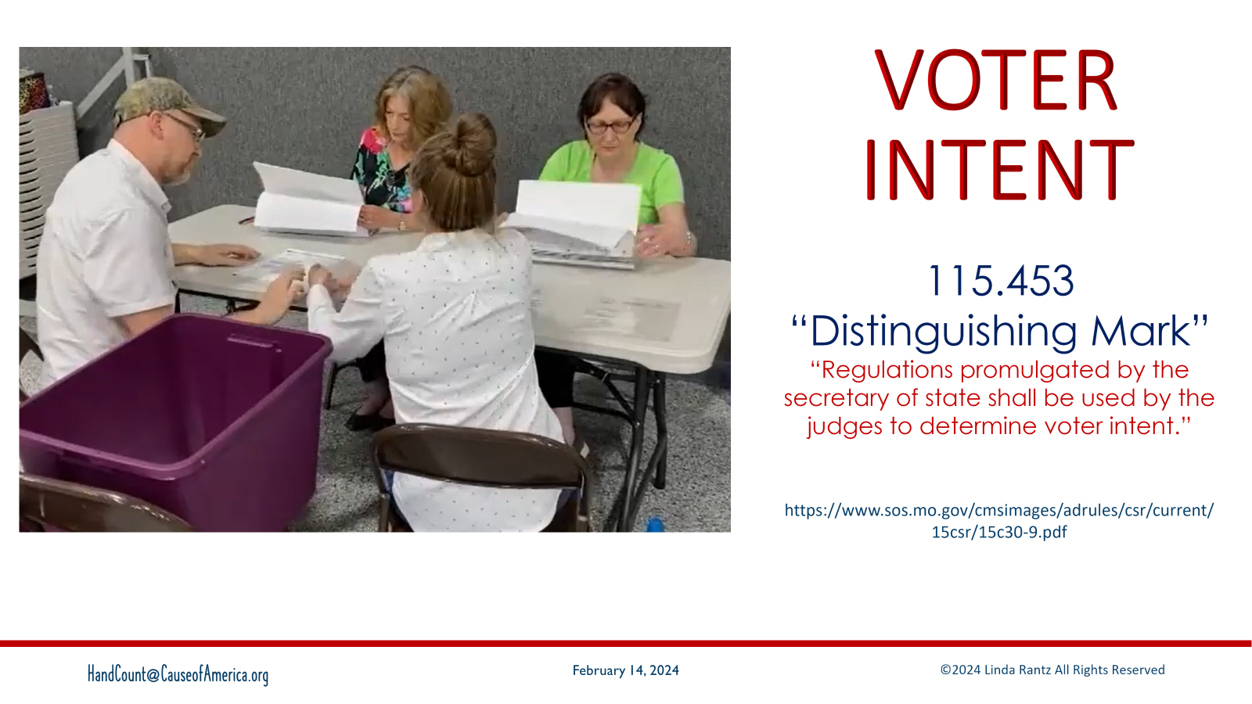
Notes:
To consider the accuracy of machines vs humans, consider what is known as “voter intent.” Missouri and other states have laws and rules about “voter intent.” In Missouri, the law says the voter must make a “distinguishing mark” and the Secretary of State shall promulgate rules for judges to use to determine voter intent.
https://revisor.mo.gov/main/OneSection.aspx?section=115.453

Slide 32
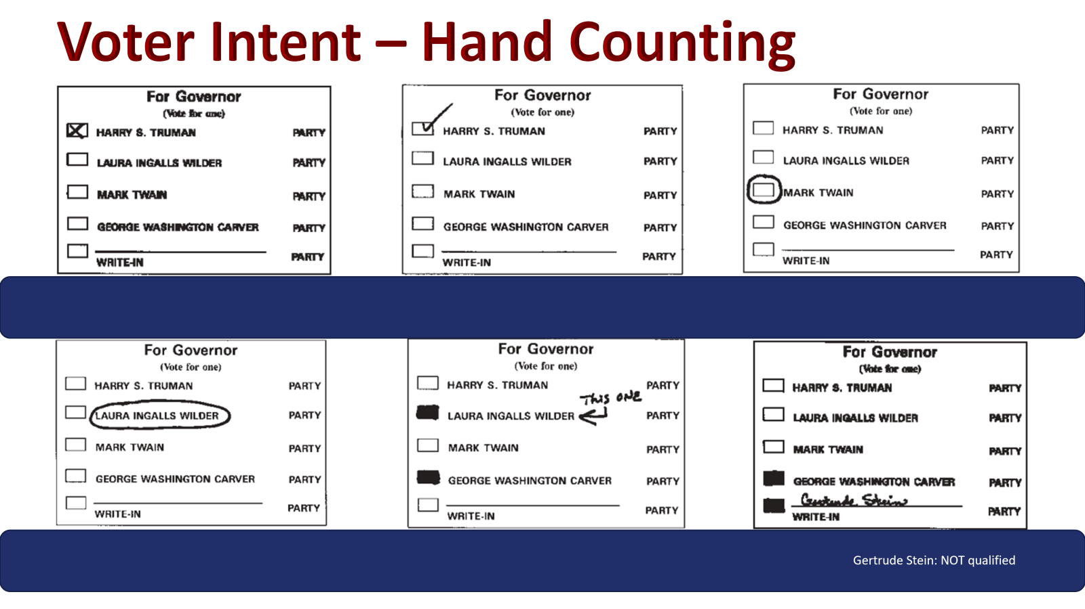
Notes:
On the Missouri SOS website for rules about voter intent, these are actual screenshots of examples of how a voter might mark a ballot. (Notice boxes, rather than ovals.) For the bottom-right, this is Missouri-specific but also true in some other states – a write-in must be “qualified” (they submitted their name prior to a deadline to be considered as a write-in). In this example, Gertrude Stein is the write-in and is NOT a qualified write-in
If humans are hand counting the ballots, which of these examples would be considered valid votes and be counted?
https://www.sos.mo.gov/cmsimages/adrules/csr/current/15csr/15c30-9.pdf

Slide 33
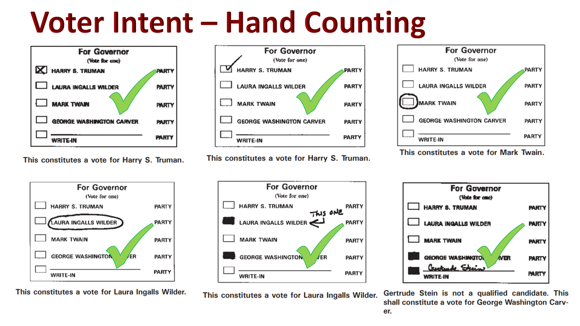
Notes:
Why all of them? Because the law says the voter is to make a distinguishing mark. As a human, looking at these, is it possible to see the voter’s intention? For the bottom right, because Stein was NOT qualified, that entry does not count and so the other vote, for George Washington Carver, is a valid vote.
Keep in mind, these are screenshots taken directly from the SOS website.
https://www.sos.mo.gov/cmsimages/adrules/csr/current/15csr/15c30-9.pdf

Slide 34
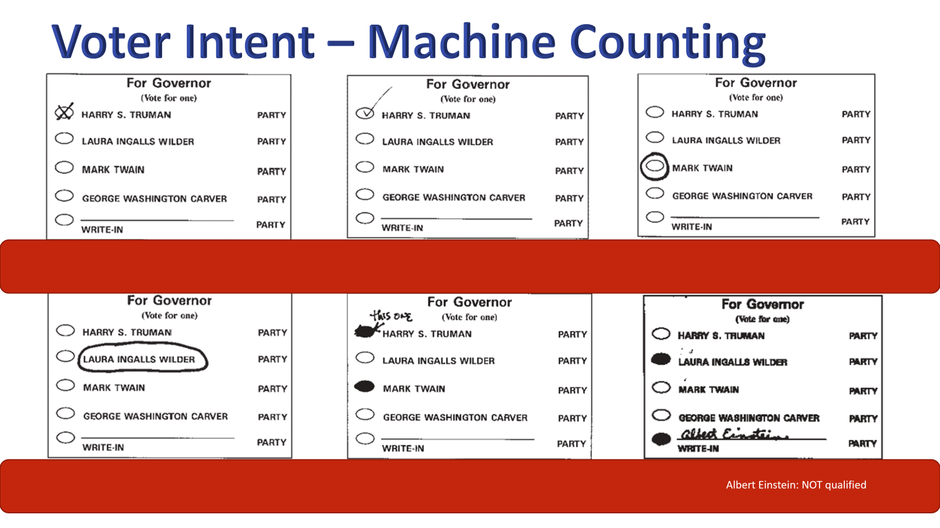
Notes:
Look at similar examples in the section for Machine Counting – notice the ovals, instead of boxes. In the bottom-right, again, Albert Einstein is written in, but he is not a qualified write-in.
When machines are counting the ballots, which of these examples are valid votes? Worth repeating, if the machine is counting the votes on the ballot, which of these are valid?
https://www.sos.mo.gov/cmsimages/adrules/csr/current/15csr/15c30-9.pdf

Slide 35
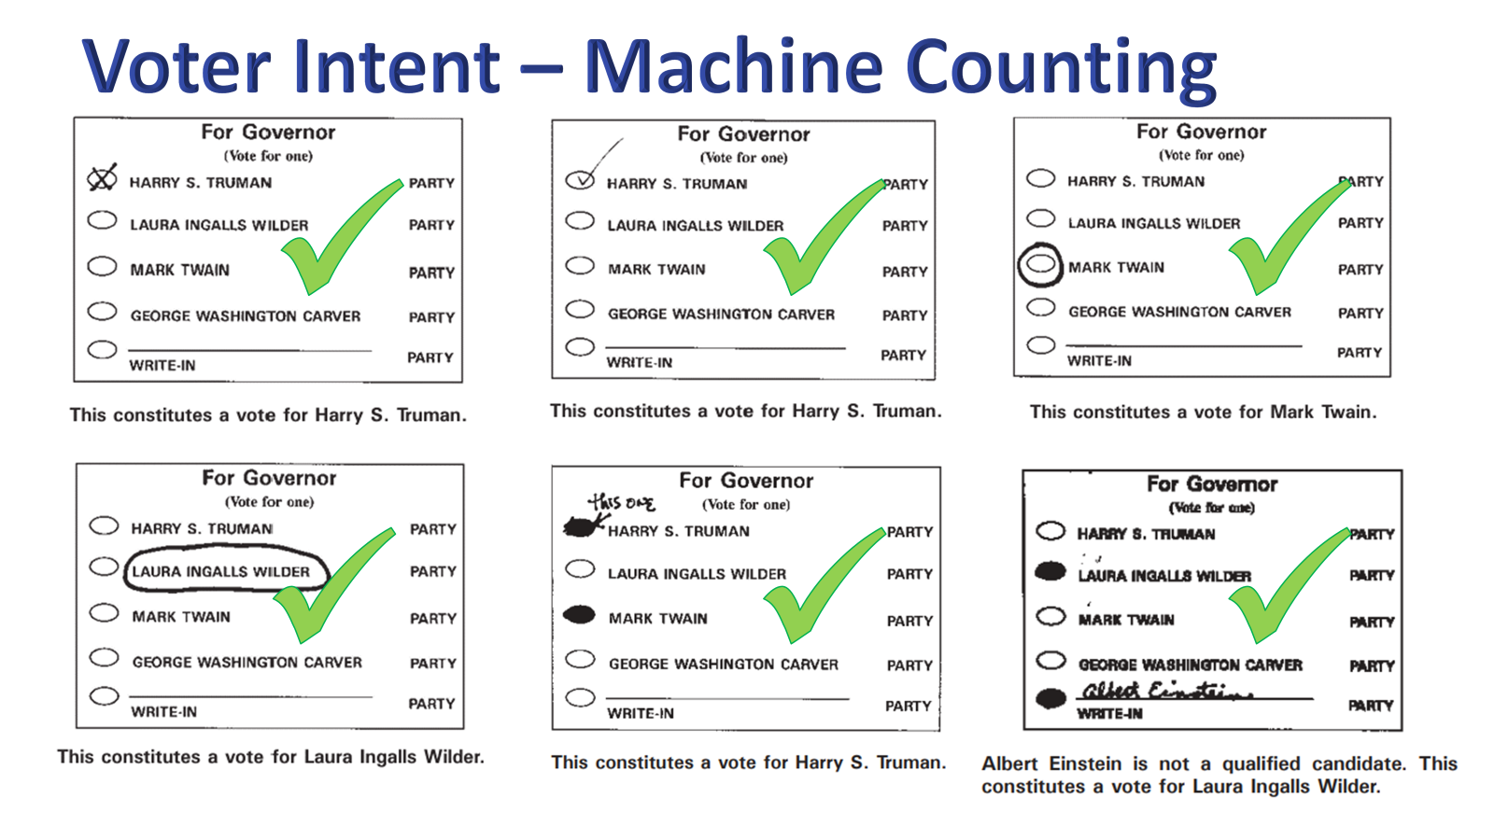
Notes:
Why all? Because the law says the voter must make a distinguishing mark. We have been trained to fill in bubbles. We have been trained to comply – not understand our own laws.
https://www.sos.mo.gov/cmsimages/adrules/csr/current/15csr/15c30-9.pdf

Slide 36
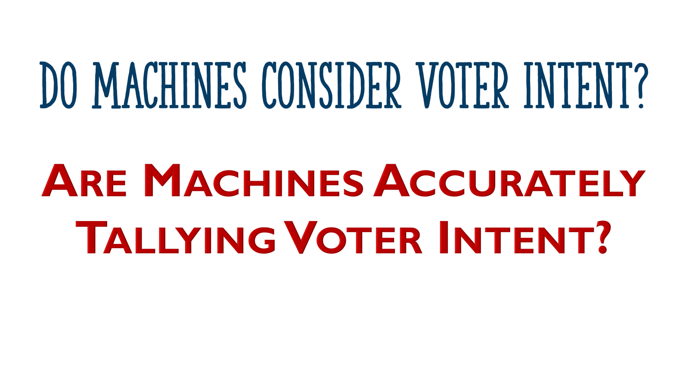
Notes:
Which raises the questions: Do machines consider voter intent? Are machines accurately tallying voter intent?

Slide 37
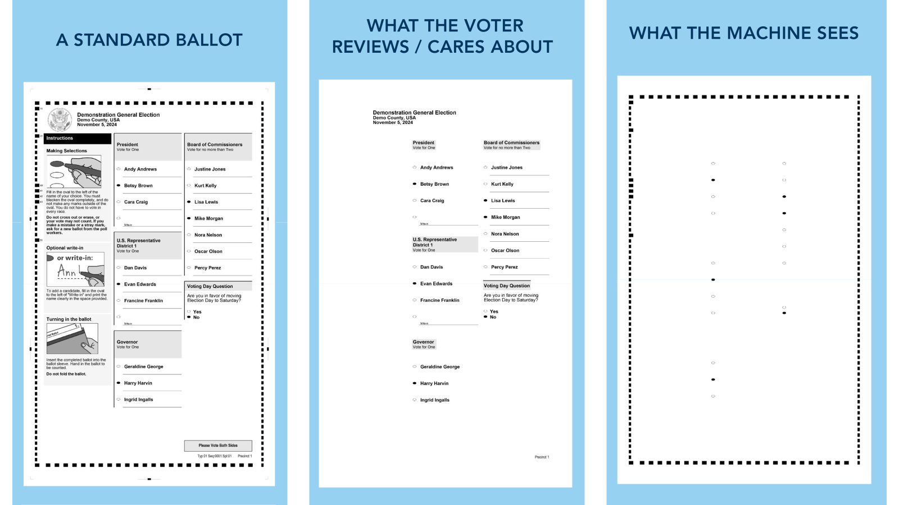
Notes:
In an open records request, we obtained a slide deck from one of the major voting machine companies. It was a presentation to our SOS about the amazing features of their equipment. We found this slide to be very telling.
The center panel is, “what the voter reviews or cares about.”

Slide 38
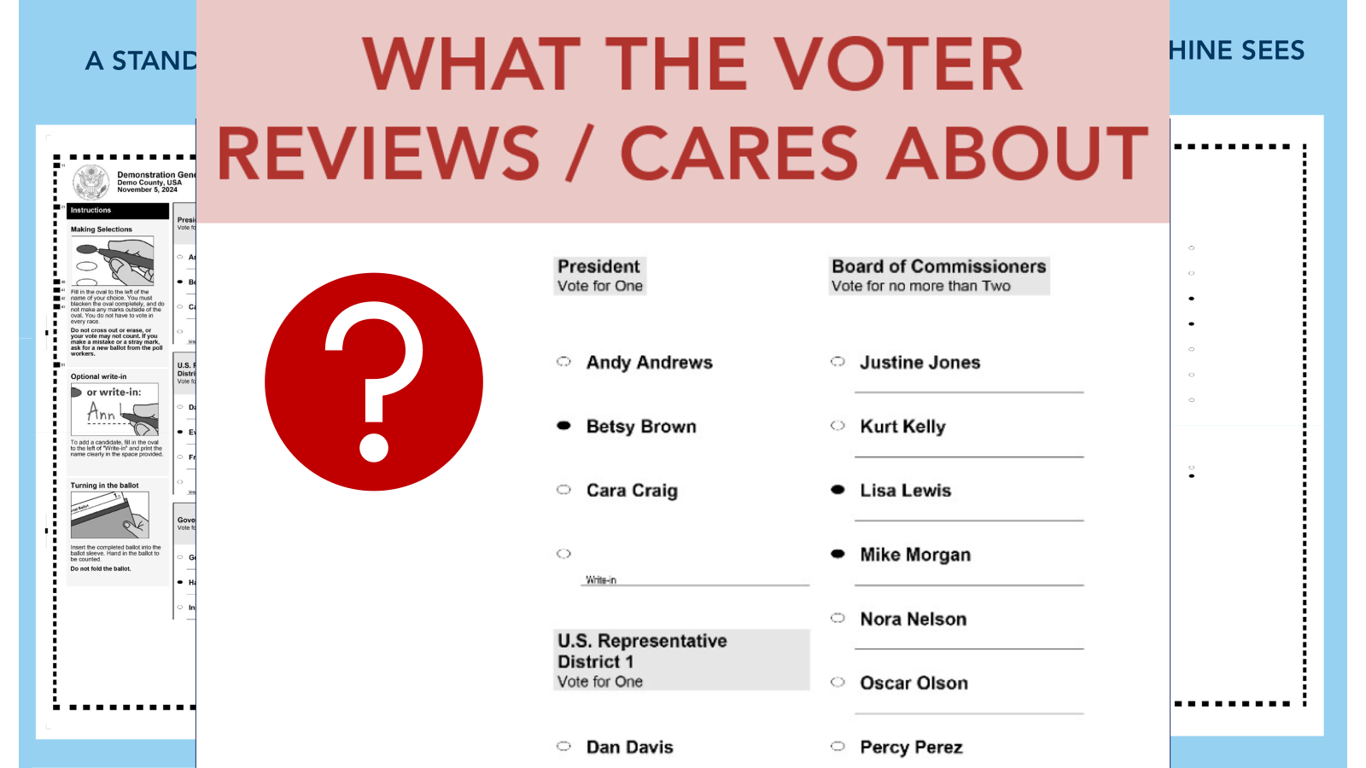
Notes:
Notice it simply shows names and bubbles. Something important missing are the instructions. Apparently, voters do not care about the instructions for filling out the ballot – or the consequences.

Slide 39
Notes:
The left panel shows everything on the ballot, including the instructions.

Slide 40
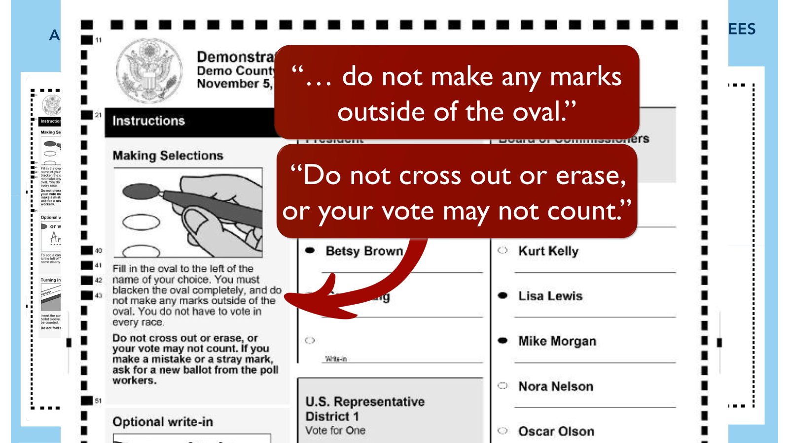
Notes:
What do the instructions say? “do not make any marks outside the oval” and “Do not cross out or erase, or your vote MAY NOT COUNT.”
That does not seem to coincide with what we found on the SOS website.

Slide 41
Notes:
The right panel shows what the machine sees.

Slide 42
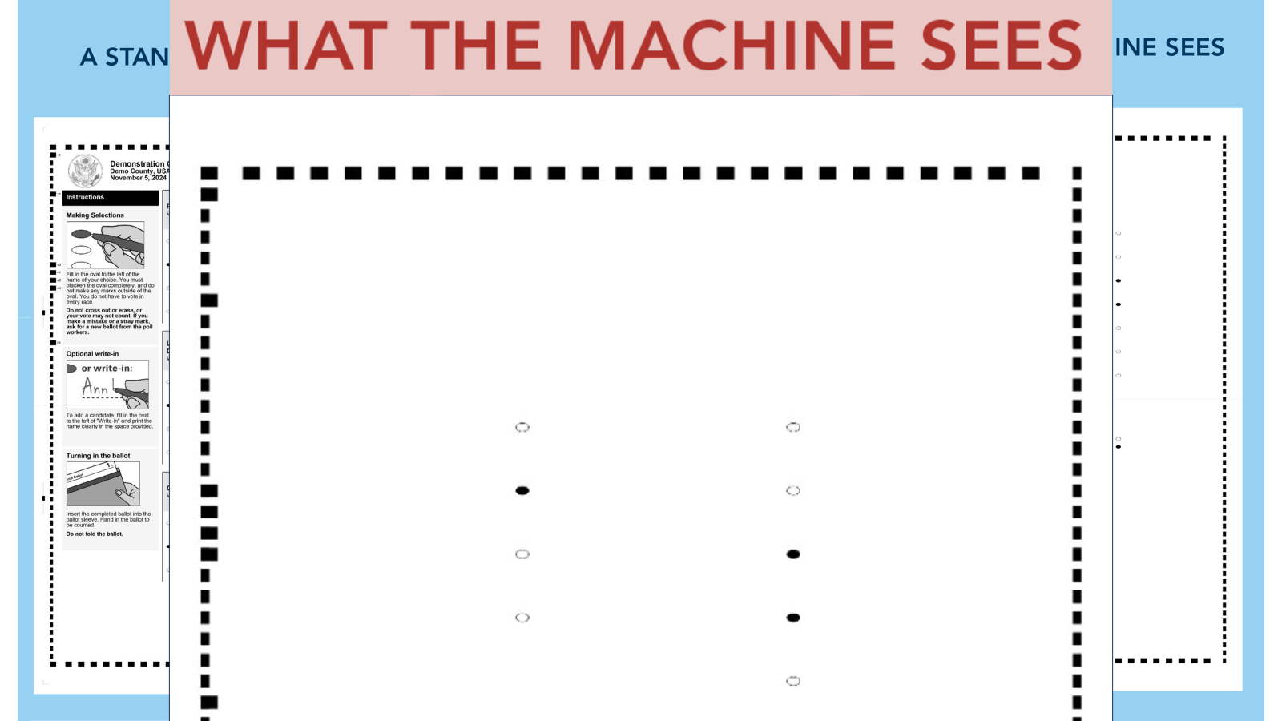
Notes:
Notice there is nothing except the dashes around the border (this is called the timing code) and the ovals.

Slide 43
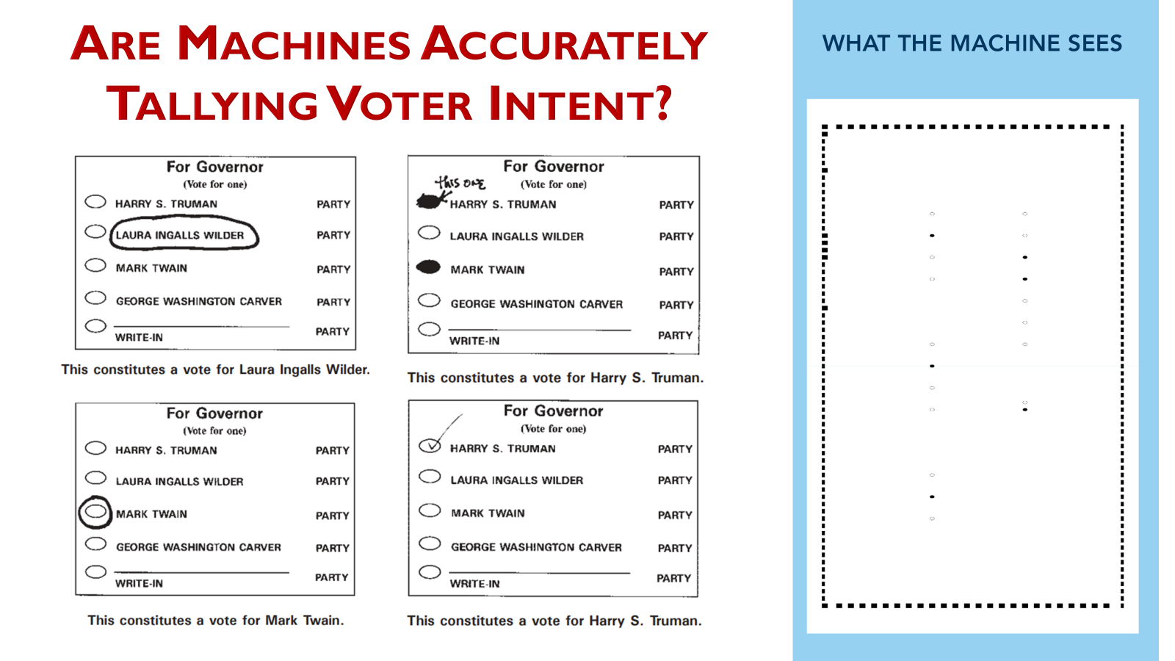
Notes:
If a voter marked their ballot like any of these examples from the SOS website, would the machine count it?
If your county is bringing in machines to mark your ballot for you – BEWARE! They will say it’s to give you a clean ballot that will be printed for you. Question: have you ever messed up your ballot, but decided not to get a new one because it’s too much work to go back fill the ballot out again? If a machine prints a ballot for you, what is the chance you are going to sit down and review it, front and back, to make sure it printed it correctly?
If you must spend so much time double-checking what the machine “marks” for you, why not save the money and time by just marking the ballot yourself?

Slide 44
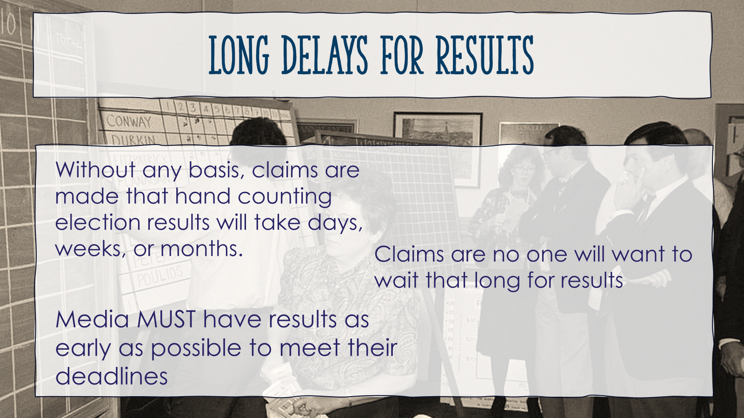
Notes:
Another myth: hand counting takes too long. They say people won’t want to wait for results, and the media needs to be able to call the winners before it gets too late. Again, push for their source on this one. Especially if they say they that the post-election hand count audits take days to complete. Ask what method is being used.

Slide 45
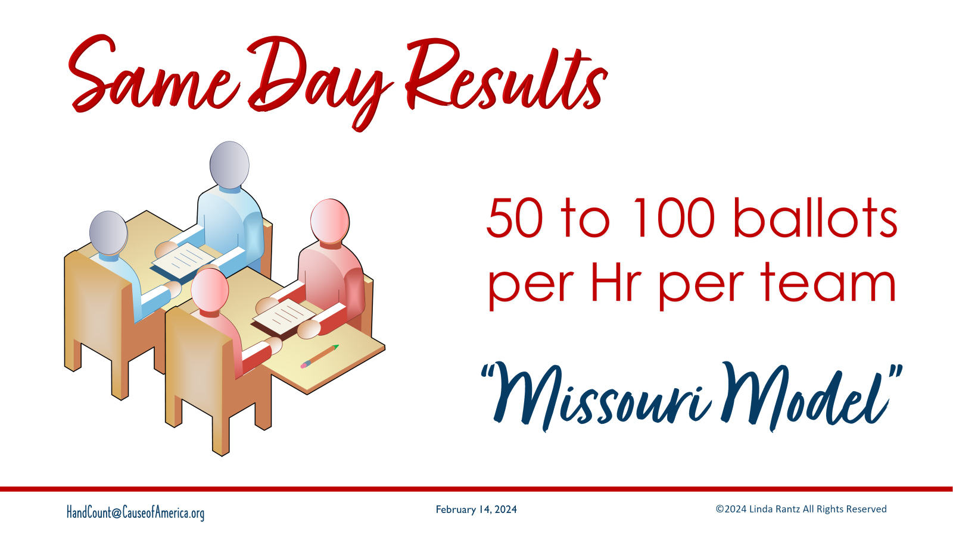
Notes:
For the Missouri Method, the estimate is 50 to 100 ballots per hour per counting team with 50 being the conservative estimate.

Slide 46
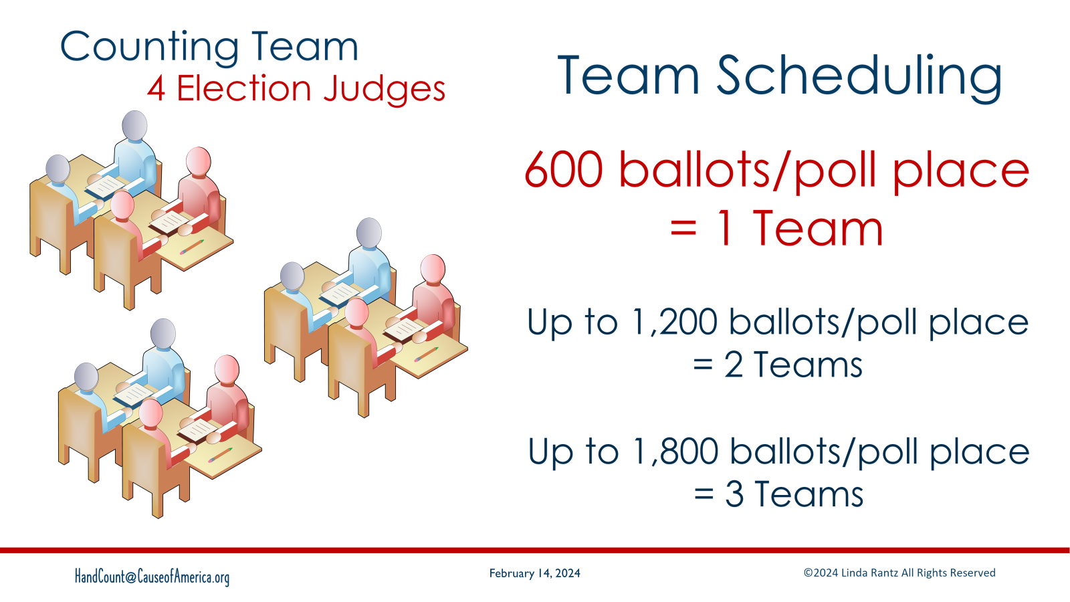
Notes:
To calculate how many teams are needed, the Clerk must anticipate the expected number of ballots to be cast at the polling place.
For 600 or less ballots cast at the polling place, we estimate 1 Counting Team needed (at that polling place).
More than 600, up to about 1,200 ballots cast, increase to 2 Teams
Add a 3rd team if there will be closer to 1,800 ballots cast.
These teams could be there working at the same time or split the day.

Slide 47
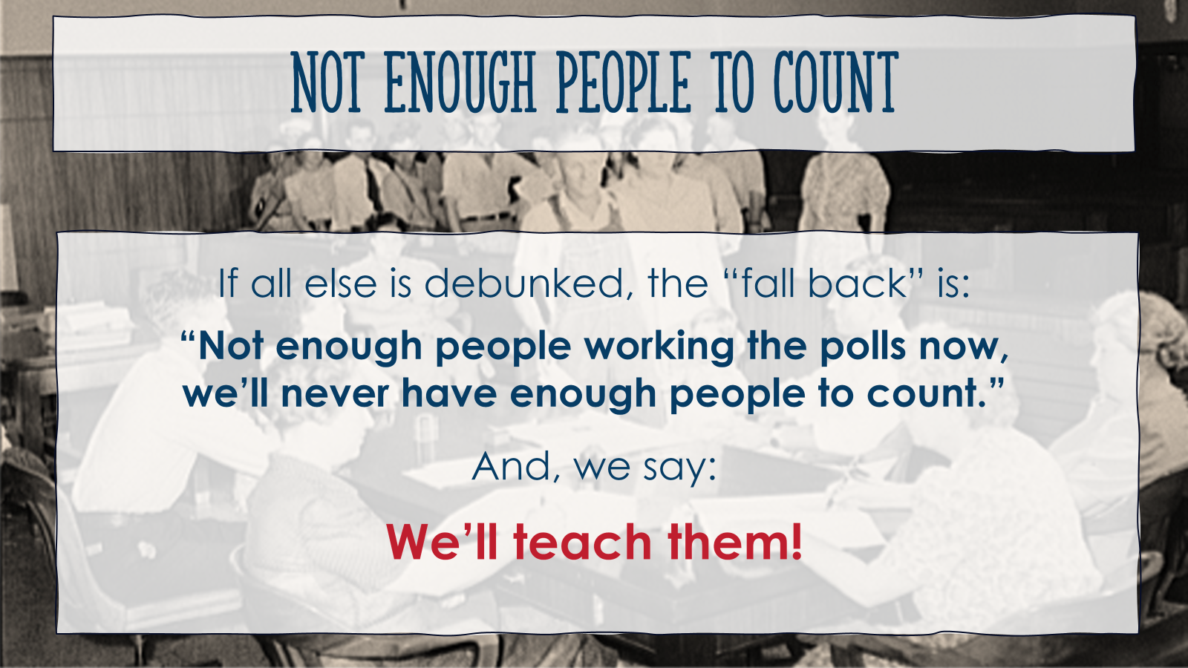
Notes:
This leads to the “myth” that there are not enough people to count. We say, “we’ll teach them!”

Slide 48

Notes:
Which is what we are doing through Cause of America. These are photos from “Train the Trainers” sessions around the country. These people are committed to learning and then going out to train others.

Slide 49

Notes:
Which brings us back to the continuity of government. Col. Shawn Smith with Cause of America said that he feels hand counting is the Victory Gardens of our day. You may have heard of the victory gardens during World War 2. We have troops overseas and people to feed back at home.

Slide 50

Notes:
People stepped up and learned to grow food, even in the big cities. It was then, and is now, the people who will step in to secure our country.

Slide 51
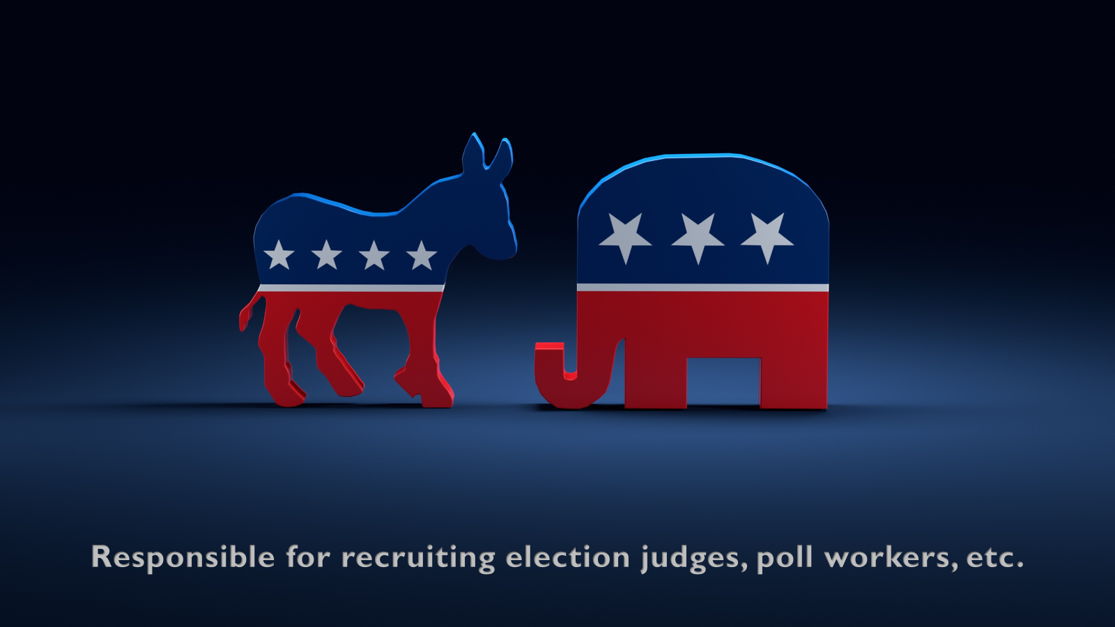
Notes:
Who is responsible for finding the additional people to hand count an election? In Missouri, and appears to be true in other states, it is the political parties. Missouri law states that by Dec 10 of even numbered years, the county central committees must submit the names of double the number of judges requested by the clerk for elections during the next 2 years. That means, the parties recruit and vet members of the party who will serve as elections judges. If the clerk needed 100 names from the party, the party submits 200. For elections during the next 2 years, the clerk must select people from the submitted lists. If someone is serving as a Republican Election judge, but is known locally to not be a Republican, it is the fault of the political party. UNLESS the party fails to submit a list of names by the deadline. In that case the clerk is required to fill positions and nothing in statute says that the clerk has to vet or prove that someone filling a particular party position is affiliated with that party.
This applies in Missouri to 109 of the 114 counties. Counties or other jurisdictions with boards of election have different laws and requirements.

Slide 52
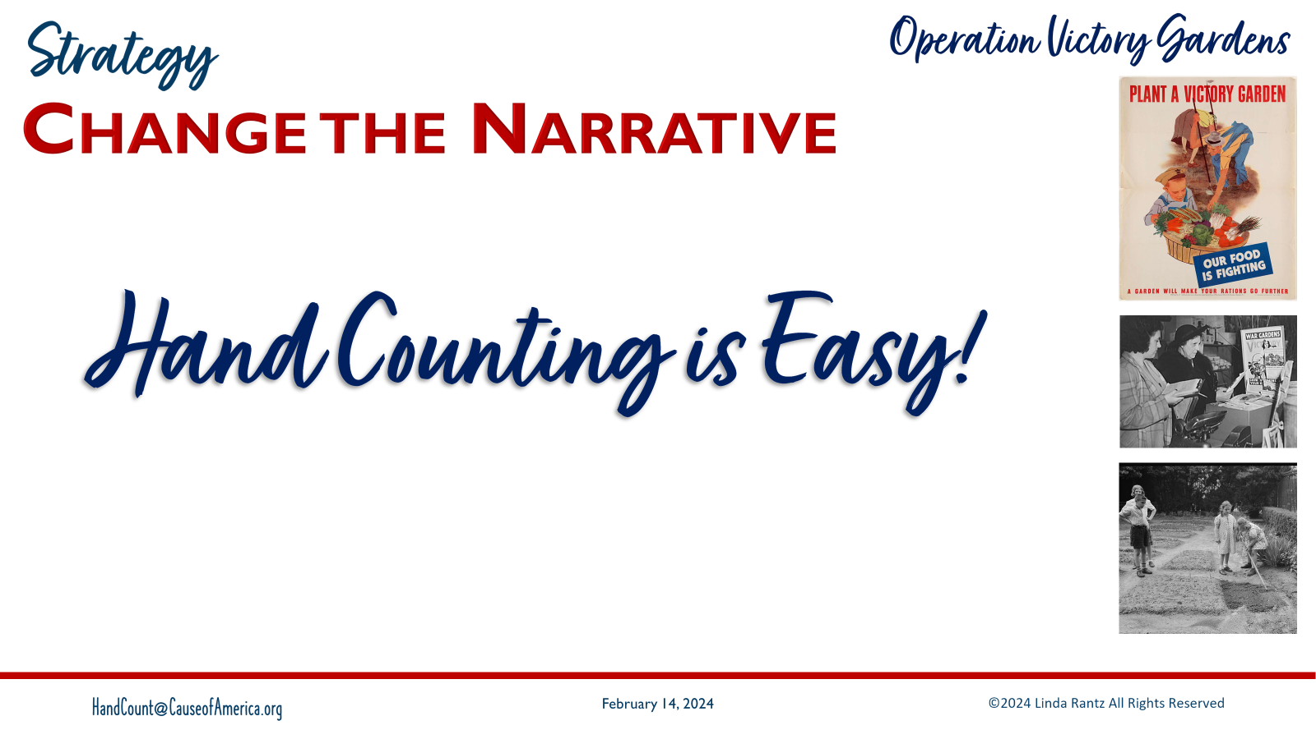
Notes:
The “Operation Victory Gardens” strategy has 3 parts to it. “Change the Narrative” is the first part and is focused on getting out the message that “Hand Counting is Easy.” A tool designed to help with this is a 2-minute tally demo.

Slide 53
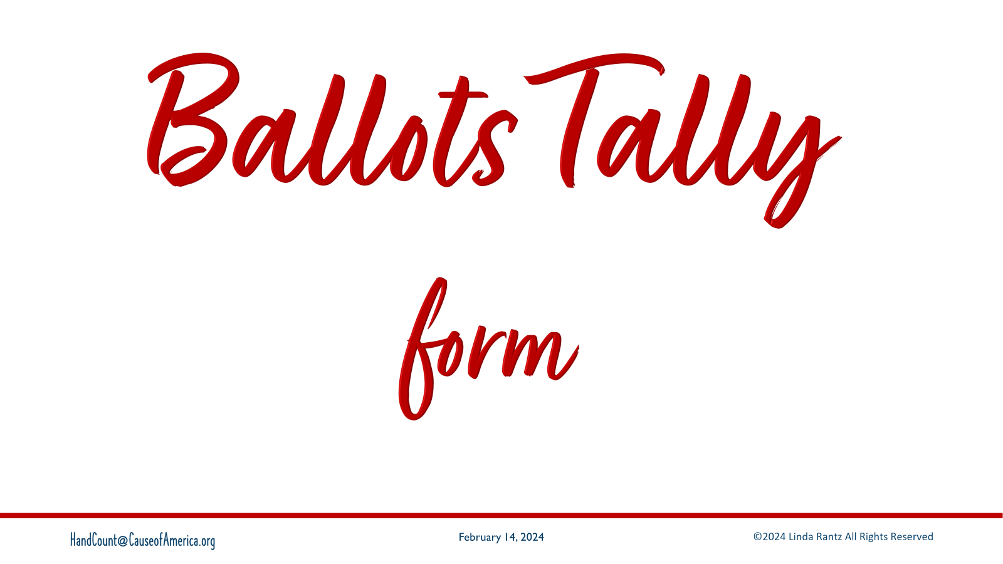
Notes:
The Missouri hand count method is built around form used to tally votes, called “Ballots Tally form.”

Slide 54
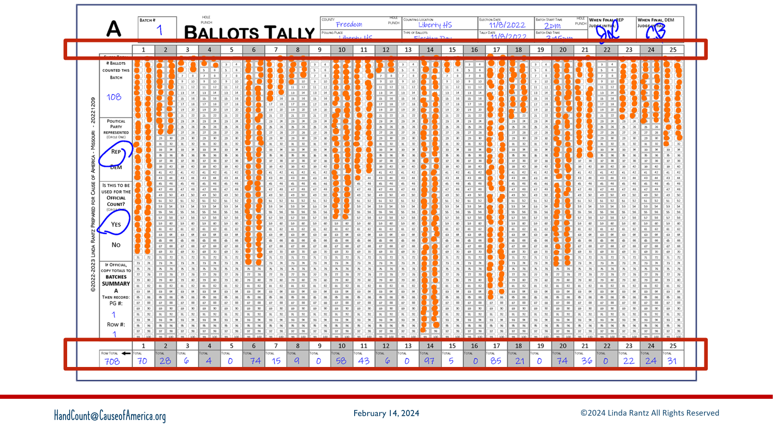
Notes:
On a full-sized Ballots Tally form, there are 25 columns that have ovals in them. The row above the column has a unique number for each column. Each column represents a candidate.
As votes are called, a “dab” is placed in the column for the candidate. When the batch is completed, the counting team will fill in the bottom row with the total votes for each column.

Slide 55
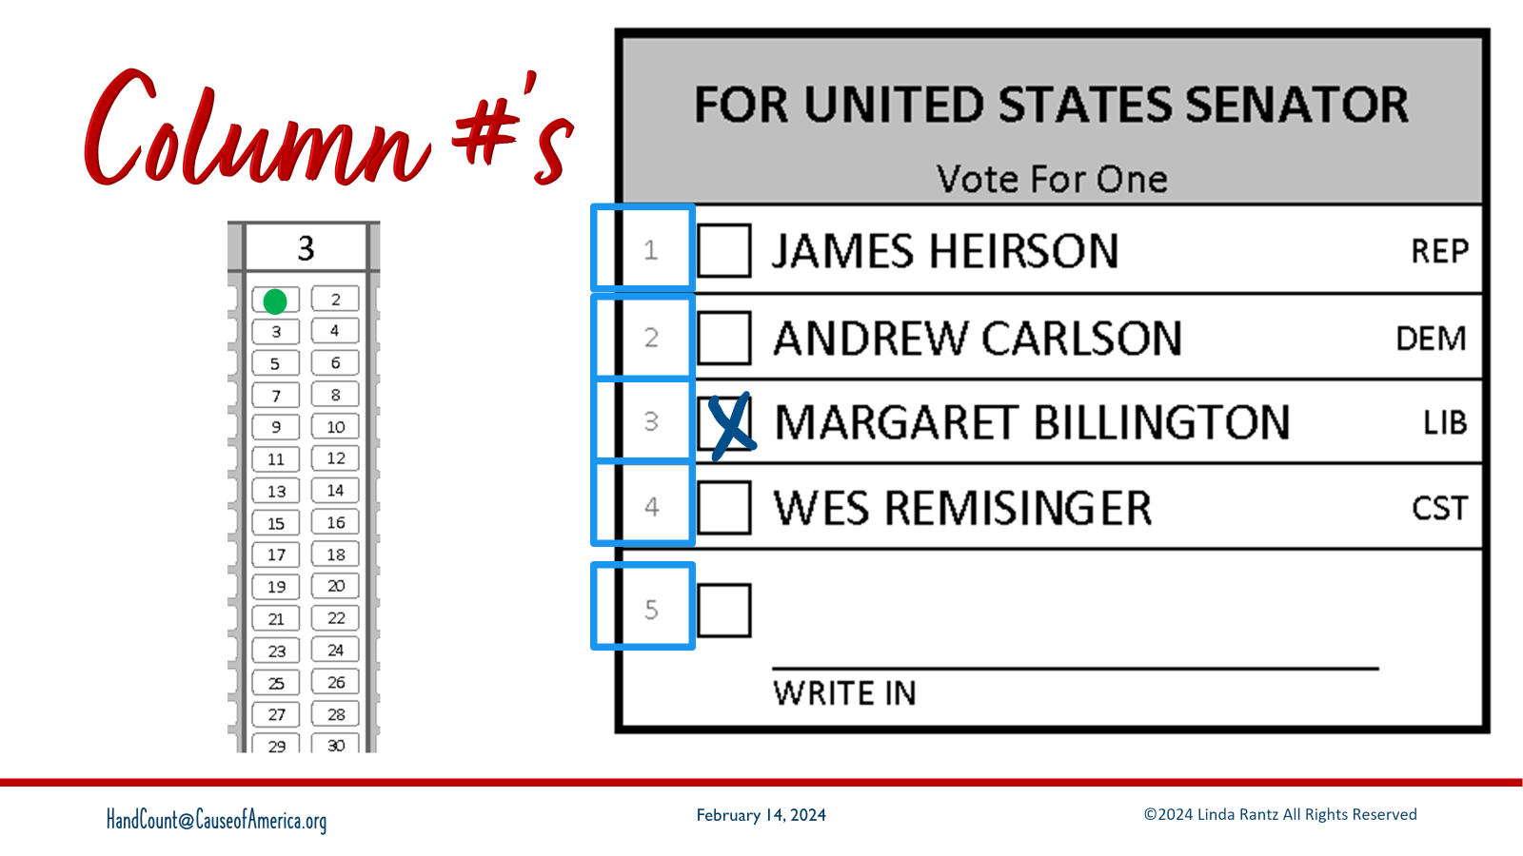
Notes:
What do the column numbers mean?
This is a sample of a race for senator on a Mock ballot.
There is a small number to the left of the checkbox? These numbers are unique to the candidate across all ballots in the county.
As an example, if a vote is marked for Margaret Billington, the Counting Judge is going to call: 3 – Margaret Billington – Senator.
In response, the Recording Judges are going to take their Sharpie, find column 3, and dab the first empty oval in the column. In this case, it’s the first oval. So, this signifies that the candidate who is #3 now has 1 vote.

Slide 56

Notes:
The votes are tallied going left to right and working your way down the column.
Each time a vote is called for #3, Margaret Billington, you dab the next number.
the 2nd time Margaret gets a vote, dab to oval on the right;
next vote gets dabbed on the left, keep going (left right, left right)

Slide 57

Notes:
Time to do a demo of how to tally.
Instructor Note: while tally forms and Sharpies are being distributed, use the next slide to describe Laser Printed vs Hand Tallied

Slide 58

Notes:
Display 2 copies of a Ballots Tally Form – one completed by hand, the other scanned and laser printed.
Purpose is to show that while it is hard to discern between actual hand tallied form and a laser printed copy, flipping it over shows the bleed-through of the Sharpies. Sharpies bleed through. Another level of security.
Also means that the tally form you are about to mark will have bleed throughs, so make sure it has extra paper or something underneath it, or you may end up with Sharpie dots.

Slide 59

Notes:
Call the votes
1 – James Heirson – senator
2 – Andrew Carlson – senator
1 – James Heirson – senator
4 – Wes Remisinger – senator
3 – Margaret Billington – senator
1 – James Heirson – senator
2 – Andrew Carlson – senator
1 – James Heirson – senator
3 – Margaret Billington – senator
3 – Margaret Billington – senator
1 – James Heirson – senator
4 – Wes Remisinger – senator
1 – James Heirson – senator
2 – Andrew Carlson – senator
5 – Write in – senator

Slide 60

Notes:
Total the columns.

Slide 61

Notes:
The Tally Demo shows how easy it is to hand count. Anyone can do this at meetings, events, or family gatherings. There is an instructional video on Cause of America website and the forms and instructions can be downloaded.

Slide 62

Notes:
Stay in touch about hand counting – tips, events, materials, etc. Join FrankSocial.com and join the 2 hand counting groups: How Do We Hand Count (for anyone interested in hand counting), and Hand Count Trainers (specifically for those who are trained and qualified to teach hand counting).

