Slide 1


Slide 2



This section will help you get acquainted with the process and the equipment.
There is no training that will get you 100% trained, but it will put your comfort
Level up a bit.
Do a couple of poll watching sessions and you will be come an expert observer.
This training will help you get there.
Contact us at:
ILL_CAVF@ATT.NET
devin@threeheadedeaglealliance.com

Slide 3
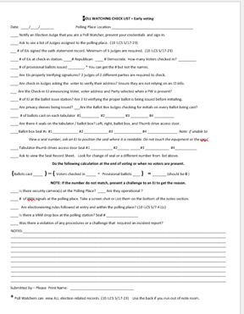

POLL WATCHER
CHECK LIST
GUIDE
FOR
EARLY VOTING
ELECTION DAY
CHECK LIST
IS ONLY DIFFERENT
IN A COUPLE OF
AREAS.

Slide 4
POLL WATCHING CHECK LIST – Early voting
Date: ____/____/_______ Polling Place Location _________________________________________
­­­____ Notify an Election Judge that you are a Poll Watcher, present your credentials and sign in.
____ Ask to see a list of Judges assigned to the polling place. (10 ILCS 5/17-23)
___ # of EJs signed the oath statement record. Minimum of 5 judges are required. (10 ILCS 5/17-23)
WHEN YOU SIGN IN ASK THE
ELECTION JUDGE TO SHOW
YOU the FORMS IN THE BINDER.
CHECK THE JUDGES OATH SHEET.
CHECK AND RECORD THE SEALS
ON THE SEAL DOCUMENT.

Slide 5
____ # of EJs at check-in station. ____# Republican ____ # Democratic How many Voters checked in? _________
____ # of provisional ballots issued ________. * You can get the # but not the names.
____ Are EJs properly Verifying signatures? 2 judges of 2 different parties are required to check.
____ Are check-in Judges asking the voter to verify their address? Ensure they are not relying on an ID info.
___ Are the Check-in EJ announcing Voter, voter address and Party selected when a PW is present?
____ # of EJ at the ballot issue station? Are 2 EJ verifying the proper ballot is being issued before initialing.
____ Are privacy sleeves being issued? __­_Are the Ballot Box Judges checking for initials on every Ballot being cast?
ASK ALL THE JUDGES WHAT ARE
THEY AFFILIATED WITH.
THEY ARE REQUIRED TO TELL YOU.
CHECK-IN JUDGES – BOTH PARTIES?
ARE THEY LEADING THE VOTER?
ARE THEY USING A LICENSE TO TO CHECK IN A VOTER?

Slide 6
____ # of ballots cast on each tabulator #1___­­______ #2__________ #3 _________ #4 ___­_______
____ Are there 4 seals on the tabulator / ballot box? Left, right, ballot box, and Thumb drive access door.
____Ballot box Seal #s #1_____________ #2 ____________ #3 ______________ #4 _______________ Note: if unable to
View a seal number, ask an EJ to position the seal where it is readable. Do not touch the equipment or the seal.
____ Tabulator thumb drives access door Seal #1 ___________­­­­ #2______ _____#3 ____________ #4___________
____ Ask to view the Seal Record Sheet. Look for change of seal or a different number from list above.
Do the following calculation at the end of voting or when no voters are present.
(Ballots cast _____ ) – ( Voters checked in ___­__ - Provisional ballots ____ ) = _______ (should be 0 )
NOTE: If the number do not match, present a challenge to an EJ to get the reason.

Slide 7
____ Is there security camera(s) at the Polling Place? ____ Are they operational ?
____ # of WiFi signals at the polling place. Take a screen shot or List them on the bottom of the notes section.
____ Are electioneering rules followed at entry and within the polling place? (10 ILCS 5/7-41(c)
____ Is there a VBM drop box at the polling station? Seal # ________________
____ Was there a violation of any procedures or a challenge that required an incident report?
NOTES:______________________________________________________________________________________________________________________________________________________________________________________________________________________________________________________________________________________________________________________________________________________________________________________________________________________________________________________________________________________________________________________________________________________________________________________________
Submitted by – Please Print Name: ________________________________
* Poll Watchers can view ALL election related records (10 ILCS 5/17-23) Use the back if you run out of note room.

Slide 8
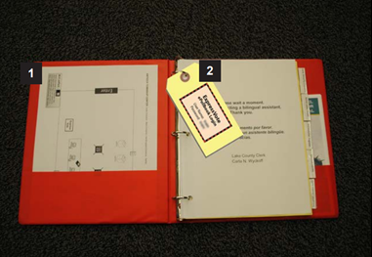
This is what the judges binder looks like.
You are allowed to see all records pertaining to an election - (10 ILCS 5/17-23)

Slide 9
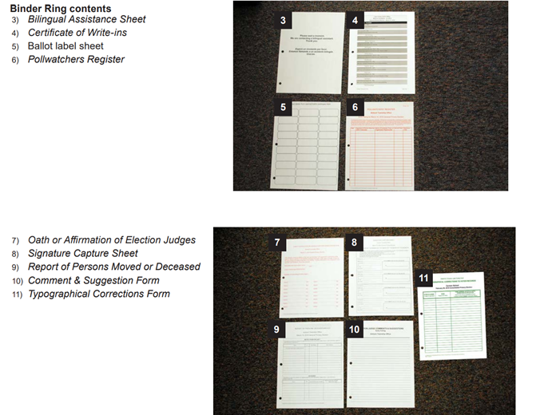
You are allowed to see all records pertaining to an election ….
(10 ILCS 5/17-23)

Slide 10
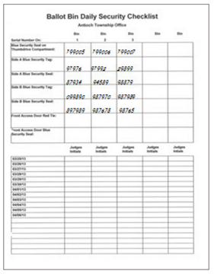
SEAL LOG
RECORD THE
SEAL NUMBERS
TO CHECK
AGAINST THE
SEALS ON THE
TABULATORS.

Slide 11
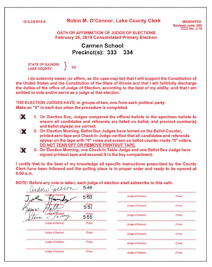
MAKE SURE THAT ALL ELECTION JUDGES HAVE SIGNED THE OATH LOG.

Slide 12
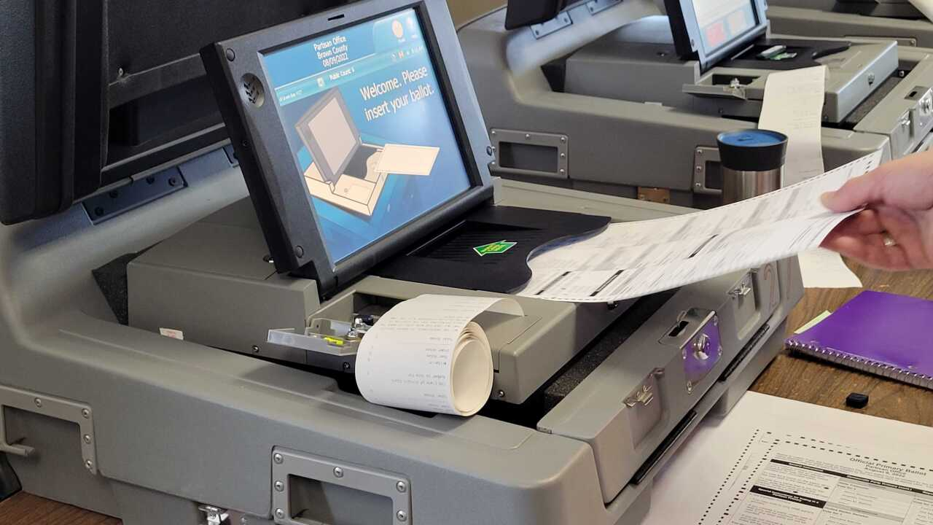
AT THE TABULATOR
CHECK THE SEALS, CHECK THE ZERO TAPE
CHECK THE BALLOT CAST COUNT.

Slide 13
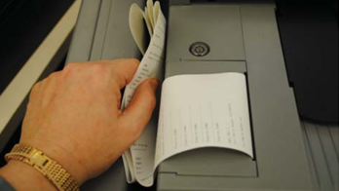
THE ZERO TAPE MUST BE HERE AND NOT DETACHED FROM THE TABULATOR.
THE END OF THE SHOULD SHOW “0”.
IF YOU CANNOT READ IT, DO NOT TOUCH
THE TAPE, ASK THE JUDGE TO HELP YOU.

Slide 14
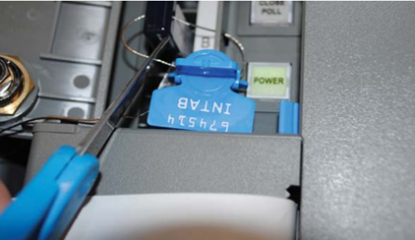
THIS IS THE THUMB DRIVE AND YOU CANNOT SEE IT UNTIL THE END OF THE DAY.
THE DOOR SHOULD BE CLOSED AND LOCKED.
DURING EARLY VOTING THE DOOR SHOULD BE SEALED.

Slide 15
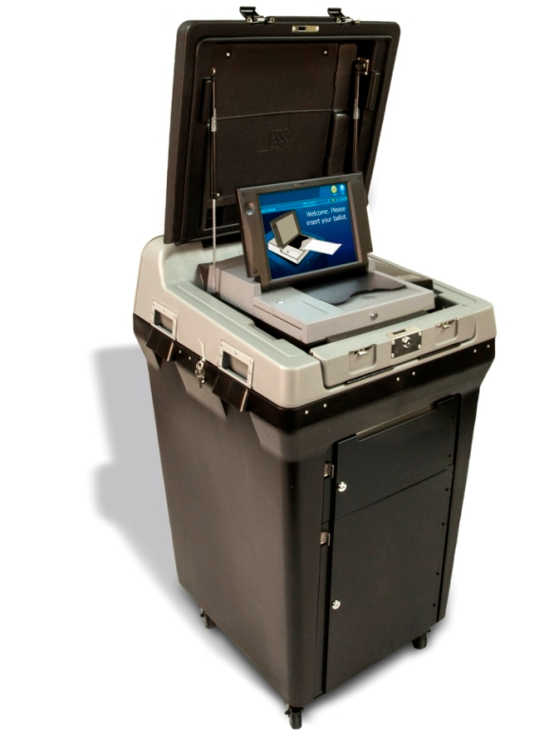
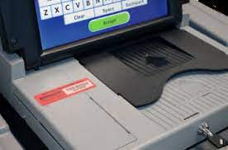

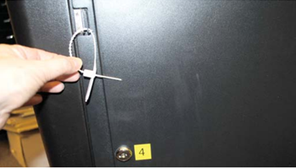
TABULATOR BALLOT BOX DOOR SEAL.
MUST BE SEALED WHILE POLLS ARE OPEN.
TABULATOR DOOR SEAL USED DURING EARLY VOTING BUT MAY NOT BE USED ON ELECTION DAY.
TABULATOR SIDE SEALS LOCATED HERE ON BOTH SIDES

Slide 16
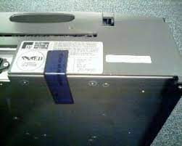
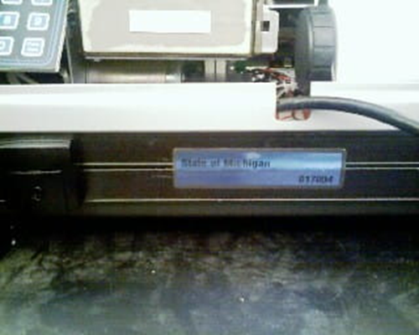
DIFFERENT TABULATORS
HAVE SEALS IN DIFFERENT
PLACES.
YOU MAY HAVE TO SEARCH
THEM OUT.

Slide 17
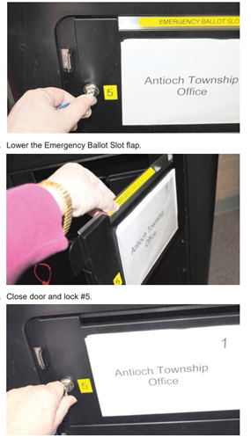
BALLOT BOXES
HAVE AN EMERGENCY
BALLOT SLOT.
THIS MUST BE CLOSED AT ALL TIMES EXCEPT WHEN A TABULATOR
IS NOT WORKING.
NOTE:
IF THE NUMBER OF BALLOTS DO NOT ADD UP…. ASK THE ELECTION JUDGE IF THERE IS ANY BALLOTS IN THE EMERGENCY BALLOT SECTION.
THESE BALLOTS WILL NOT BE COUNTED BY THE TABULATOR.
THESE BALLOTS WILL BE REMOVED AND PUT THRU THE TABULATOR AT THE END OF THE DAY.

Slide 18
DURING THE CLOSING OF THE POLLS THE TABULATOR WILL PRINT OUT THE RESULTS. 2 SETS ARE PRINTED. ONE FOR THE RECORD AND ONE TO POST ON THE DOOR. POLL WATCHERS
CAN ASK FOR A COPY IF THEY WANT IT. IF YOU ARE THERE AT THE END OF VOTING, ASK FOR A COPY.

Slide 19
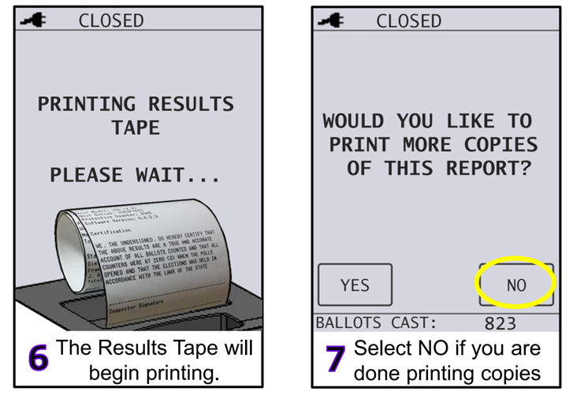
EXTRA COPIES ARE EASY TO RUN.
THEY JUST TAKE TIME……

Slide 20
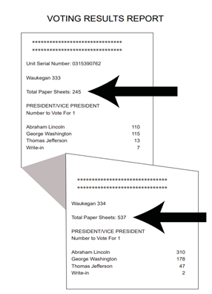
PRECINCT 333’S TAPE
IF THERE IS MORE THAN 1 PRECINCT AT THE POLLING PLACE THERE WILL BE A SECTION ON THE TAPE FOR EACH PRECINCT.
PRECINCT 334’S TAPE

Slide 21


QUESTIONS?
THANK YOU FOR
STEPPING UP
TO HELP INSURE
A SECURE ELECTION.
Contact us at:
ILL_CAVF@ATT.NET
devin@threeheadedeaglealliance.com

